Slide 1
Navigating the Rossman Store Kaggle Competition
Jamie Yachera
DAT-DC-9

Slide 2
The Kaggle Competition
Sales Across 3000 Drug Stores in 7 European Countries
Influenced by:
Future Sales Predicted by Individual Store Managers
Promotions
Holidays (School, State)
Nearest Competition
Inventory
Seasonality
Varied Sales Predictions
GOAL: Predict 6 weeks of daily sales for 1,115 stores located across Germany.

Slide 3
The Kaggle Competition
Files provided by Kaggle; data dictionary included
Store, location data anonymized
All stores in Germany
Historical data including sales
(Train set)
Historical data excluding sales
(Test Set)
Supplemental information about the stores
Daily sales data from 1/1/13 – 7/31/15 (1,017,210 rows)
Store ID
Day of Week
Date
Sales ($)
Customers (#)
Store open flag (0,1)
Store promo flag (0,1)
State holiday flag (category)
School holiday flag
Detail about the stores
(1115 rows)
Store ID
Store Type (categorical)
Assortment (categorical)
Competition distance
Competition open since month
Competition open since year
Flag as to whether the store participates in “Promotion 2”
Week since Promotion 2 started
Year since Promotion 2 started
Consecutive intervals in which the promotion starts new
Used for Kaggle submission purposes only
35k price
5 submissions per day

Slide 4
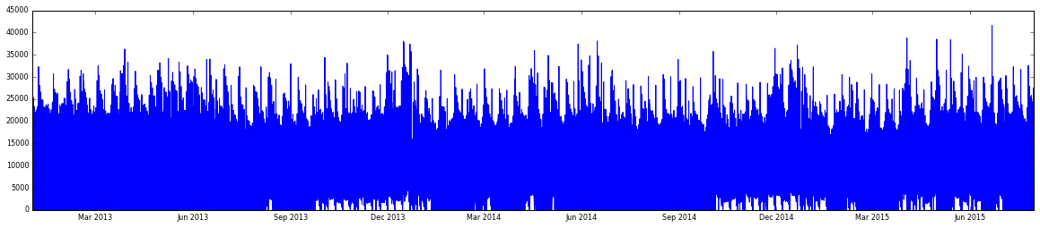
Kaggle or No Kaggle
Not interested in the 35k prize
Train data set is large enough to build a relevant prediction model
Accuracy score is based on “RMSPE”
Emphasis on Classification models in class (KNN, Naïve, Logistic Regression, Decision Trees, Random Forests)

Slide 5
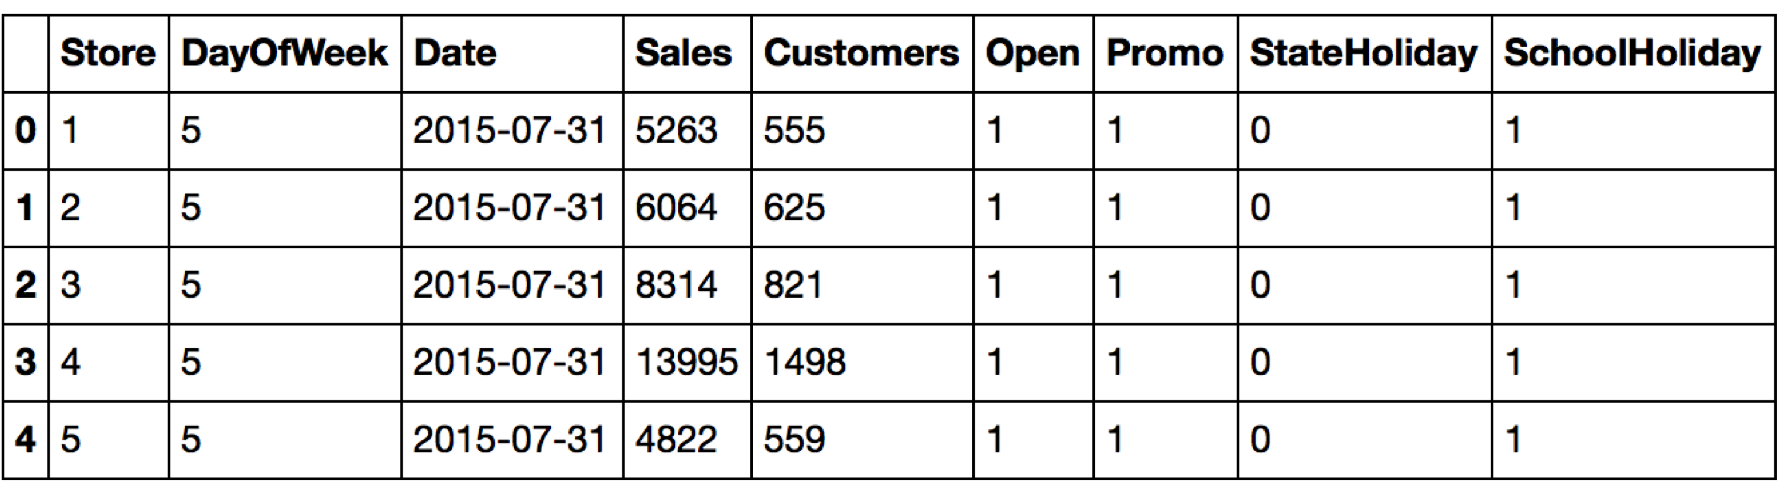
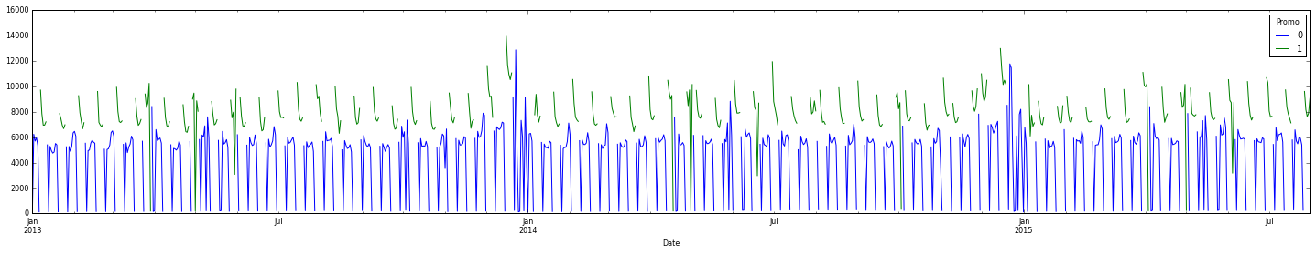
Evaluate - Sales data
Not Linear
No Sales/Customers data on the weekends for stores with Promotions
Higher sales with Promo
Minimal sales on Sundays
180 stores have missing sales for June 2014 – end of year

Slide 6
‘Improve’ - Sales data
Convert Date to a date:
train['Date']=pd.to_datetime(train.Date)
Create new date variables
train['Sale_Month'] = train['Date'].dt.month
train['Sale_Week'] = train['Date'].dt.weekofyear
Create [Cumulative Sales]and [Cumulative Customers] by Store
Create Avg Sales per Customer (Cum Sales/Cum Cust)
train = pd.read_csv(csvf2, sep=',', low_memory=False)

Slide 7
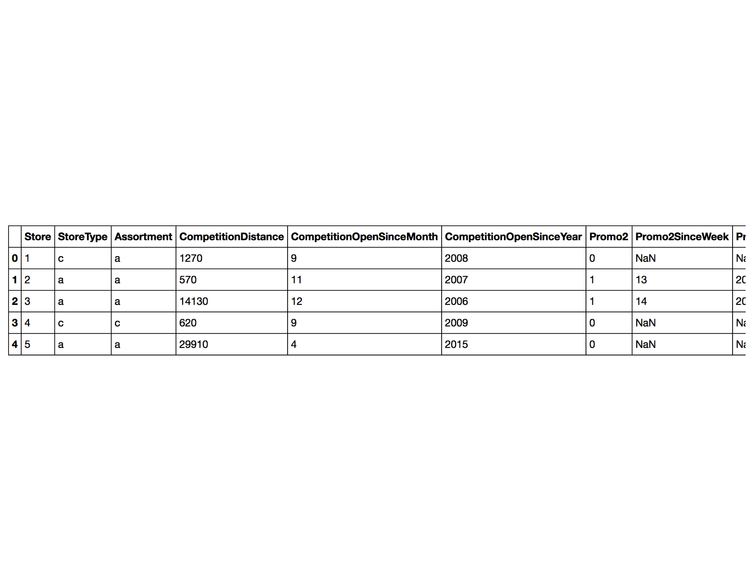
Evaluate - Store data
Missing Data: 3 Competition Distance, 354 Competition Open Since Month/Year, 544 Promo2SinceWeek/Year/Interval

Slide 8
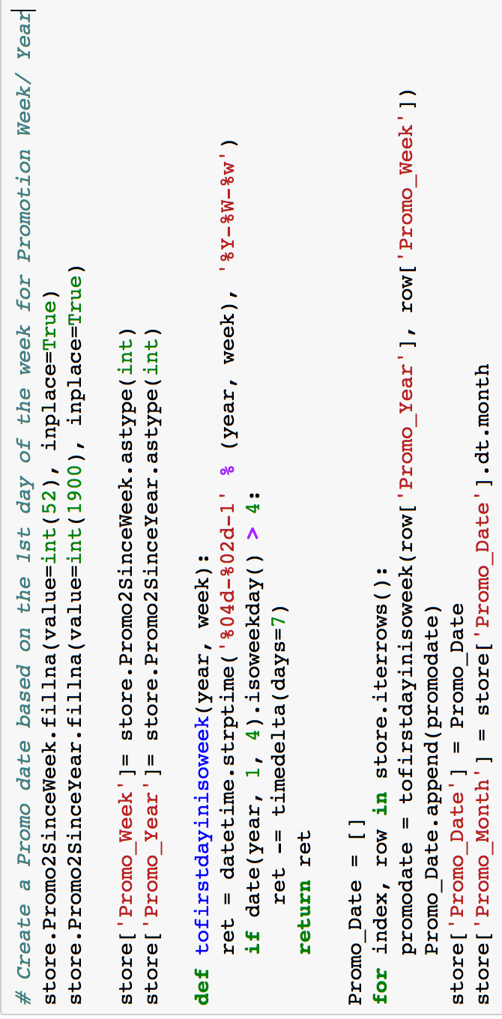
‘Improve’ - Store data
MISS: Removed stores with missing CompetitionDistance (3)
MISS: Removed stores with missing Competition Open Since Month/Year (354)
Set Missing Promo Week = 1, Missing Promo Year = 1990
Create [Promo Date] based on the 1st day of the week for Promotion Week/ Year
Create new dataframe of the number of Competitors [Comp_Count] opened in same year and merged with data set

Slide 9
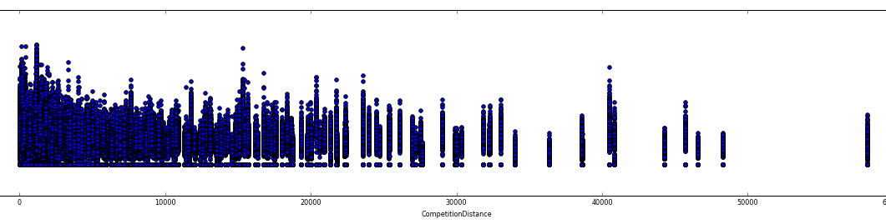
Evaluate - Merged data
Stores with Competition in Close Proximity still have relatively high sales
Store “B” has highest sales, predominantly of “Assortment B”

Slide 10
‘Improve’ - Merged data
[Sale_Since_Comp_Opened] by taking Date difference from Sale Date and Competition Opened Date → SSCO to make # of days into int
[Sale_Since_Promo_Started] by taking Date difference from Sale Date and Promo2 Start Date→ SSPS to make # of days into int
Account for School_Holiday when State Holiday = ‘a’
[Weekend]flag
Dummy variables for StoreType, Assortment, StateHoliday, PromoIntervals
[Comp_Opened_In_Year]flag where np.where((df['SSCO']>0) & (df['SSCO']<=365), 1, 0)
Date Competition Opened
Current Sale Date
SSCO
Date Promo Started
Current Sale Date
SSPS

Slide 11
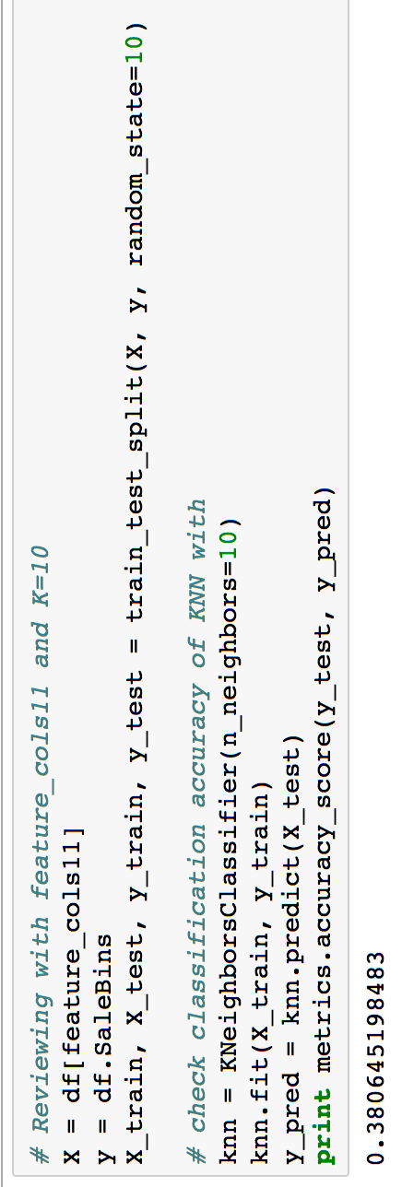
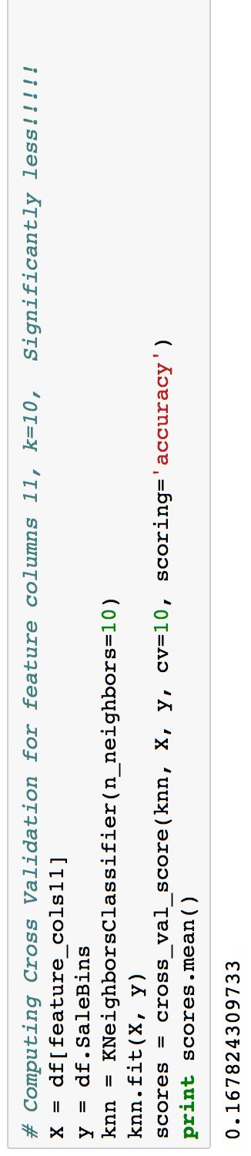
The Classification Model - Failure
Binned Sales in 500k increments (If Sales = 4567 would be in the 4500 bin)
Features (12 combinations) and K {10,12,15,20,30,60} Evaluation/Selection took HOURS to run
Computed “Accuracy Score”
Train-Test-Split did better than random (.3806)
Cross-Val did worse (.167)
Random pick (.17)
In general, less features, better score

Slide 12

Linear Reg & Random Forests - Failure
Approximately 1 hr to run one iteration
Ln of Sales
Calculated using ‘Mean Squared Error’ . Not sure if good or bad
Gave Up on SKLearn
Linear Reg ‘RMSE’s for 13 features: 1208 – 3043
Linear Reg (LN) ‘RMSE’s for 13 features: .19 - .42
Linear Reg (LN) Cross-Val ‘RMSE’: .20 - .41
Linear Reg (LN) Train-Test- Split ‘RMSPE’: ~9.4e-06
RandomForests RMSE: 507-1305 (forgot to use Bins)

Slide 13
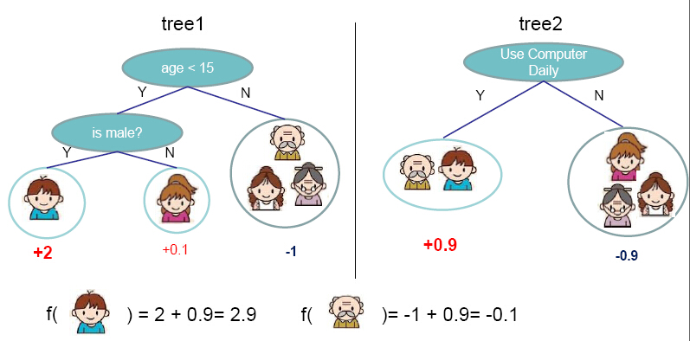
Finding the Kaggle Favorite - XGBoost
XGBoost – Extreme Gradient Boosting
Supports linear models as base learners
Highly used in Kaggle competitions
Faster than SKLearn
Gradient boosting is a machine learning technique for regression problems, which produces a prediction model in the form of an ensemble of weak prediction models. Gradient Boosting Decision Trees use decision tree as the weak prediction model in gradient boosting, and it is one of the most widely used learning algorithms in machine learning today. Its high accuracy makes that almost half of the machine learning contests are won by GBDT models: http://zhanpengfang.github.io/418home.html

Slide 14
XGBoost in Application
class xgboost.DMatrix(data, label=None, missing=0.0, weight=None, silent=False, feature_names=None, feature_types=None)
params = {"objective": "reg:linear",
"booster" : "gbtree",
"eta": 0.3,
"max_depth": 10,
"subsample": 1,
"colsample_bytree": 1,
"silent": 1,
"seed": 1
}
num_boost_round = 300
import xgboost as xgb
X_train, X_valid = train_test_split(train, test_size=0.012, random_state=10)
y_train = np.log1p(X_train.Sales)
y_valid = np.log1p(X_valid.Sales)
dtrain = xgb.DMatrix(X_train[feature_full], y_train)
dvalid = xgb.DMatrix(X_valid[feature_full], y_valid)
http://xgboost.readthedocs.org/en/latest/parameter.html
Notes:
Objective: reg-linear (can also do logistic, rankings)
Booster: gbtree or linear
eta [default=0.3]:step size shrinkage used in update to prevents overfitting
Subsample: subsample ratio of the training instance
Colsample bytree: subsample ratio of columns when constructing each tree.

Slide 15
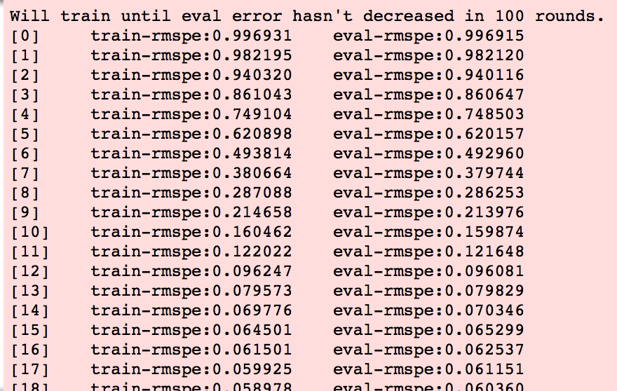
XGBoost in Application
class xgboost.DMatrix(data, label=None, missing=0.0, weight=None, silent=False, feature_names=None, feature_types=None)
watchlist = [(dtrain, 'train'), (dvalid, 'eval')]
gbm = xgb.train(params, dtrain, num_boost_round, evals=watchlist, \
early_stopping_rounds=100, feval=rmspe_xg, verbose_eval=True)

Slide 16
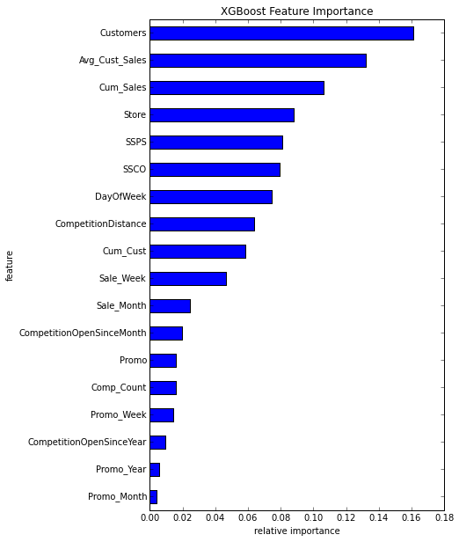
XGBoost in Application
yhat = gbm.predict(xgb.DMatrix(X_valid[features]))
error = rmspe(X_valid.Sales.values, np.expm1(yhat))
print('RMSPE: {:.6f}'.format(error))
RMSPE: .059175

Slide 17
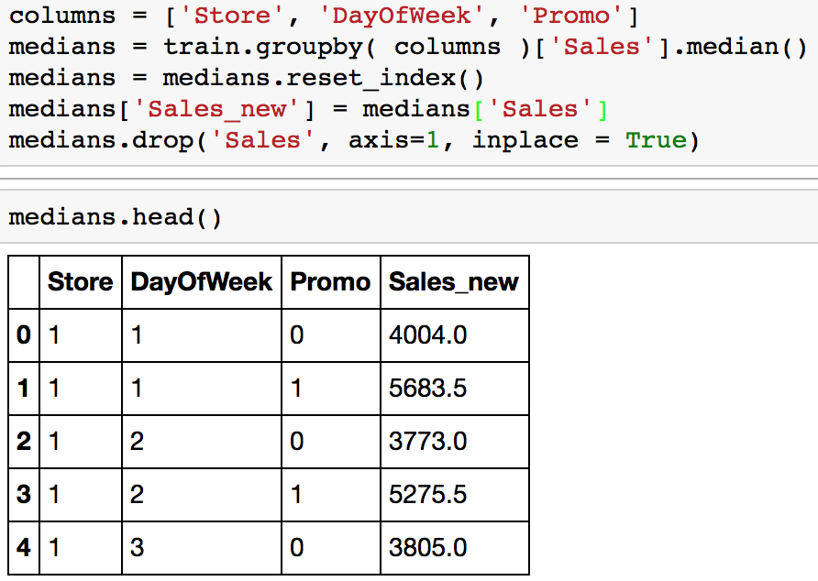
Kaggle Realization
Can only use features that exist in the test set. Test set does not include Sales or # of Customers
Sales_New (median)
Cum_Sales New (max)
Customers_New (median)
Avg_Cust_Sale_New (median)
All stores need to be included in the analysis because all stores exist in the Test set. Needed to refine how to handle missing data
Prior Miss: Avg distances for stores with missing CompetitionDistance (3)
Prior Miss: Replaced Competition Open Since Month/Year with 1/1900 (354)

Slide 18
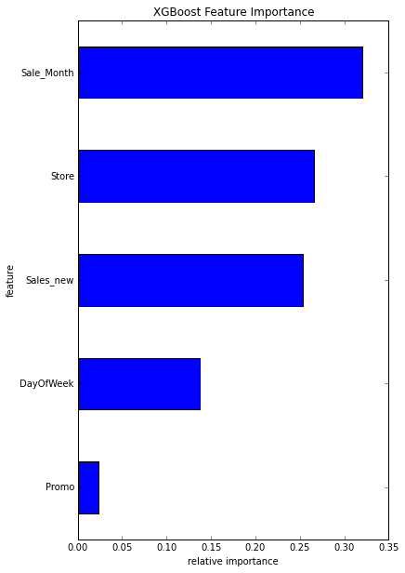
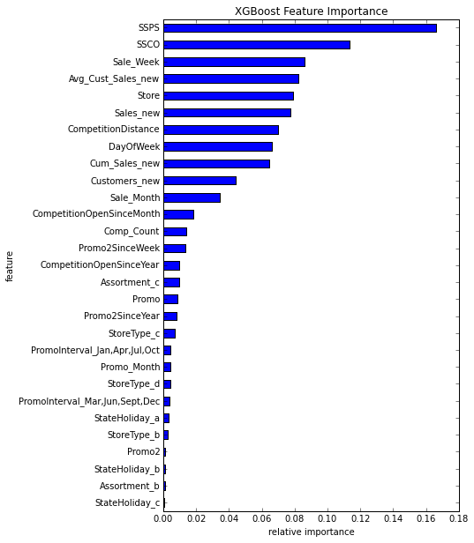
Attempts & ?Successes?
Parameters | Eta = .03, Num Boosters = 100 Stopping round = 50 (Ended up stopping at 62, best iteration 12) | Modified early stopping to be 100 vs. 50
RMSPE – Train, Eval, Calc | 0.203276, 0.231554, 0.24268 | 0.093468, 0.198595, 0.198595

Slide 19
Attempts & ?Successes?
RMSPE – Train, Eval, Calc | 0.097273, 0.201777, 0.201777 | 0.132051, 0.235762, .235762 | Num Boost = 300 0.073730, 0.189150, 0.189150
SSPS
SSCO
Sale_Week
Avg_Cust_Sales_new
Store
Sales_new
CompetitionDistance
DayOfWeek
Cum_Sales_new
Store
CompetitionDistance
Promo
Promo2
Sale_Month
Sale_Week
DayOfWeek
DayOfWeek
Cum_Sales_new
StoreType_b
StoreType_c
StoreType_d
Assortment_b
Assortment_c
CompetitionOpen
Store
CompetitionDistance
CompetitionOpenSinceMonth
CompetitionOpenSinceYear
Promo2
Promo2SinceWeek
Promo2SinceYear
Promo_Week
Promo_Year
Promo_Month
Comp_Count
DayOfWeek
Open
Promo
Sale_Month, Sale_Week
Weekend
StoreType_b, StoreType_c, StoreType_d
PromoInterval_Jan,Apr,Jul,Oct
PromoInterval_Mar,Jun,Sept,Dec
SSPS, SSCO,
CompOpenedInYear
Sales_new
Avg_Cust_Sales_new
Cum_Sales_new
Customers_new

Slide 20
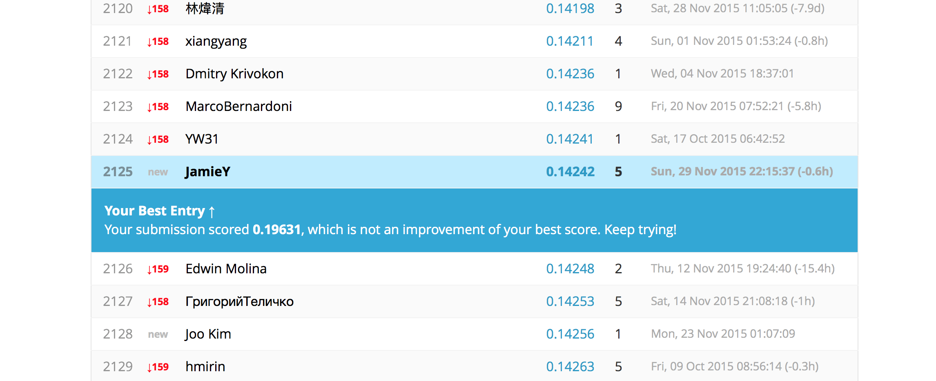
The Leaderboard

