Slide 1

LAB 2: ROS
ABE 424/ ECE 498
Principles of Mobile Robotics
Girish Chowdhary
Andres E Baquero Velasquez

Slide 2
Topics to be covered
ROS definition
ROS Installation
Workspace
ROS Package
ROS Node
Subscriber and Publisher

Slide 3
ROS - Definition
ROS (Robotic Operating System) is an open-source, meta-operating system for your robot. It provides the services you would expect from an operating system, including hardware abstraction, low-level device control, implementation of commonly-used functionality, message-passing between processes, and package management. It also provides tools and libraries for obtaining, building, writing, and running code across multiple computers
The Robot Operating System (ROS) is a flexible framework for writing robot software. It is a collection of tools, libraries, and conventions that aim to simplify the task of creating complex and robust robot behavior across a wide variety of robotic platforms.
http://wiki.ros.org/ROS/Introduction
https://www.ros.org/about-ros/

Slide 4
ROS - Installation
1. Setup your sources.list:
sudo sh -c 'echo "deb http://packages.ros.org/ros/ubuntu $(lsb_release -sc) main" > /etc/apt/sources.list.d/ros-latest.list'
2. Set up your keys:
sudo apt-key adv --keyserver 'hkp://keyserver.ubuntu.com:80' --recv-key C1CF6E31E6BADE8868B172B4F42ED6FBAB17C654
3. Installation
3.1. Updating Debian package index:
sudo apt update
3.2. Desktop-Full Install:
sudo apt install ros-melodic-desktop-full
4. Environment Setup:
echo "source /opt/ros/melodic/setup.bash" >> ~/.bashrc
source ~/.bashrc
http://wiki.ros.org/melodic/Installation/Ubuntu

Slide 5
ROS - Workspace
1. Create the workspace folder:
mkdir -p ~/catkin_ws/src
2. Go to the workspace folder:
cd ~/catkin_ws/
3. Compile your workspace using catkin_make
catkin_make
4. Sourcing your workspace
source devel/setup.bash
5. Verify if your workspace is properly overlayed by the setup script
echo $ROS_PACKAGE_PATH
If your workspace is ok then you should see this message in your screen: /home/youruser/catkin_ws/src:/opt/ros/kinetic/share
http://wiki.ros.org/ROS/Tutorials/InstallingandConfiguringROSEnvironment

Slide 6
ROS - Package
ROS packages are the individual units of ROS software which contains all source code, data files, build files and dependencies. The structure of a ROS package is:
1. Launch Folder: Contains the launch files
2. Include Folder: Contains the additional libraries or .h files that the cpp files need
3. Src Folder: Contains all source files (cpp files and python scripts)
4. CmakeLists.txt: List of cmakerules for compilation
5. package.xml: Package information and dependencies
http://wiki.ros.org/ROS/Concepts

Slide 7
ROS - Package
1. Create the ROS package
cd ~/catkin_ws/src
catkin_create_pkg “name of the package” std_msgs rospy roscpp
2. Compile the ROS package
cd ~/catkin_ws
catkin_make
http://wiki.ros.org/ROS/Tutorials/InstallingandConfiguringROSEnvironment

Slide 8
ROS - Node
Master: An intermediate program that connects ROS nodes. To run the master node you need to use “Roscore”.
Nodes: They are processes that perform computation. They are written with the use of a ROS client library, such as roscpp or rospy.
Topics: Named buses in which ROS nodes can send a message. A node can publish or subscribe any number of topics.
ROS Master
Node 1
Node 2
Node 3
Publisher
Topic
Subscriber
http://wiki.ros.org/ROS/Concepts

Slide 9
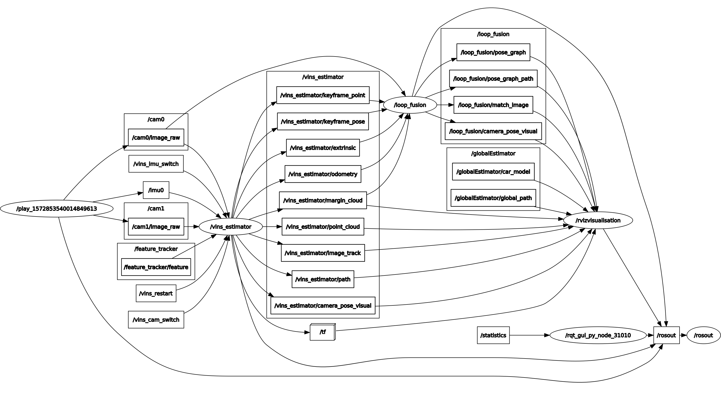
ROS - Node

Slide 10
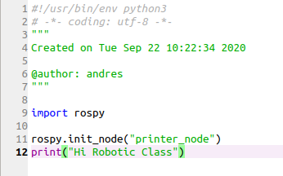
ROS - Node
To run the rospy node, you can use the follow command line:
python2.7 “path of the folder where you have your script”
rosrun “package_name” “python_scrypt_name”.py
http://wiki.ros.org/ROS/Concepts

Slide 11
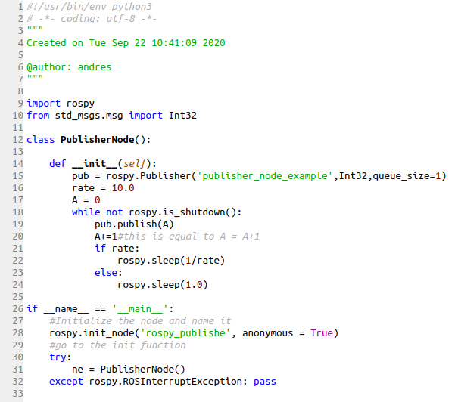
ROS - Publisher
To run the rospy node, you can use the follow command line:
Python2.7 “path of the folder where you have your script”
rosrun “package_name” “python_scrypt_name”.py

Slide 12
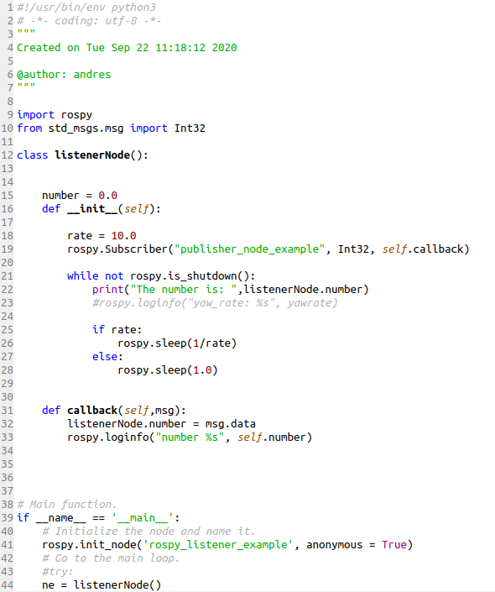
ROS - Subscriber
To run the rospy node, you can use the follow command line:
Python2.7 “path of the folder where you have your script”
rosrun “package_name” “python_scrypt_name”.py

Slide 13
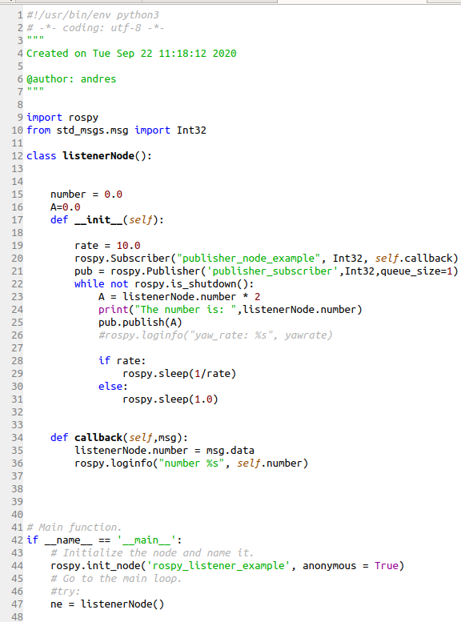
ROS - Subscriber+Publisher
To run the rospy node, you can use the follow command line:
Python2.7 “path of the folder where you have your script”
rosrun “package_name” “python_scrypt_name”.py

Slide 14
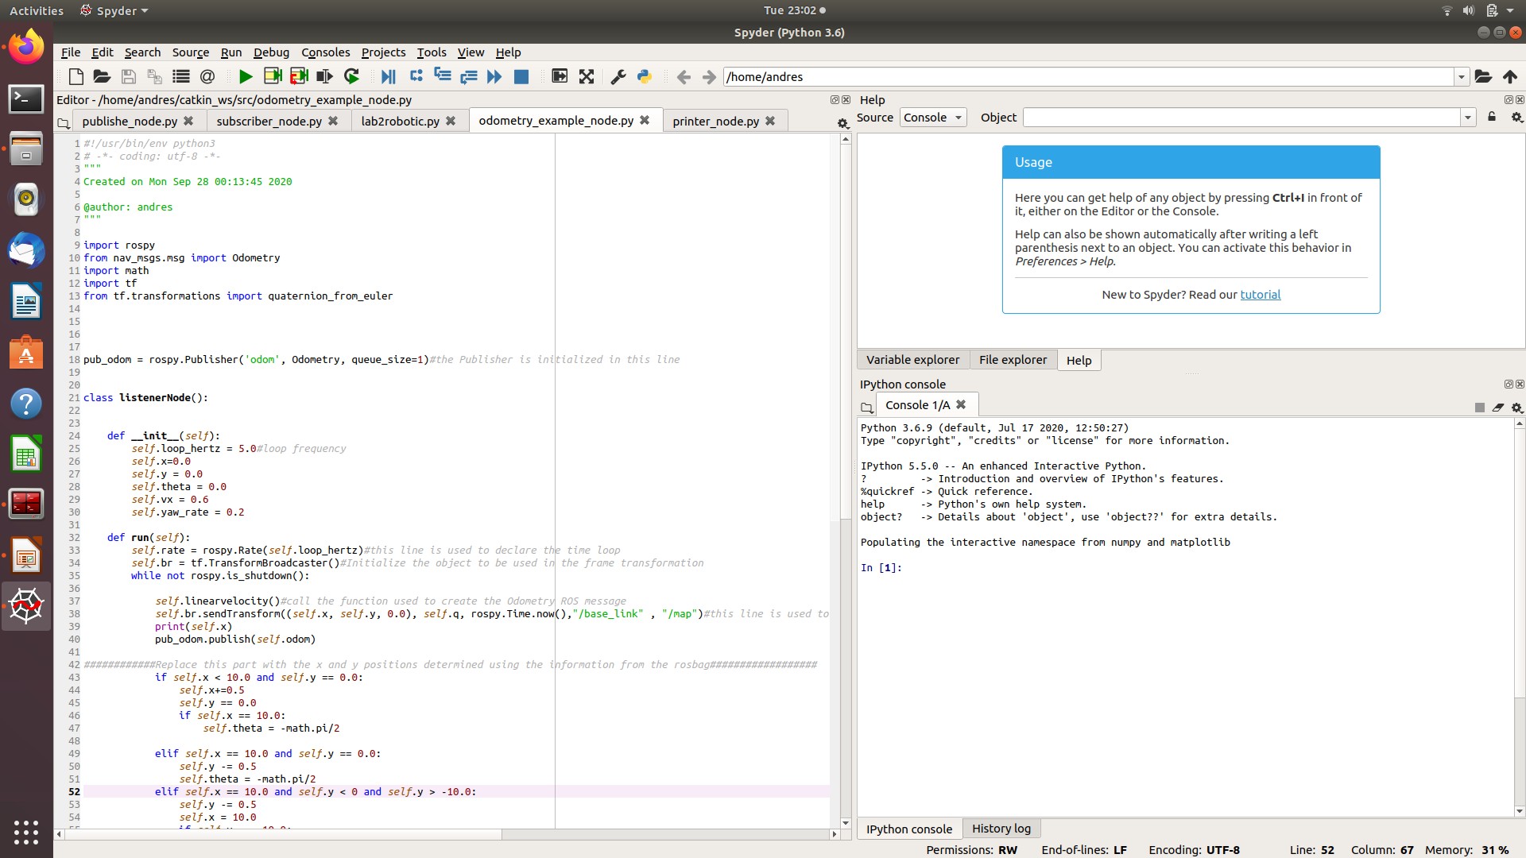
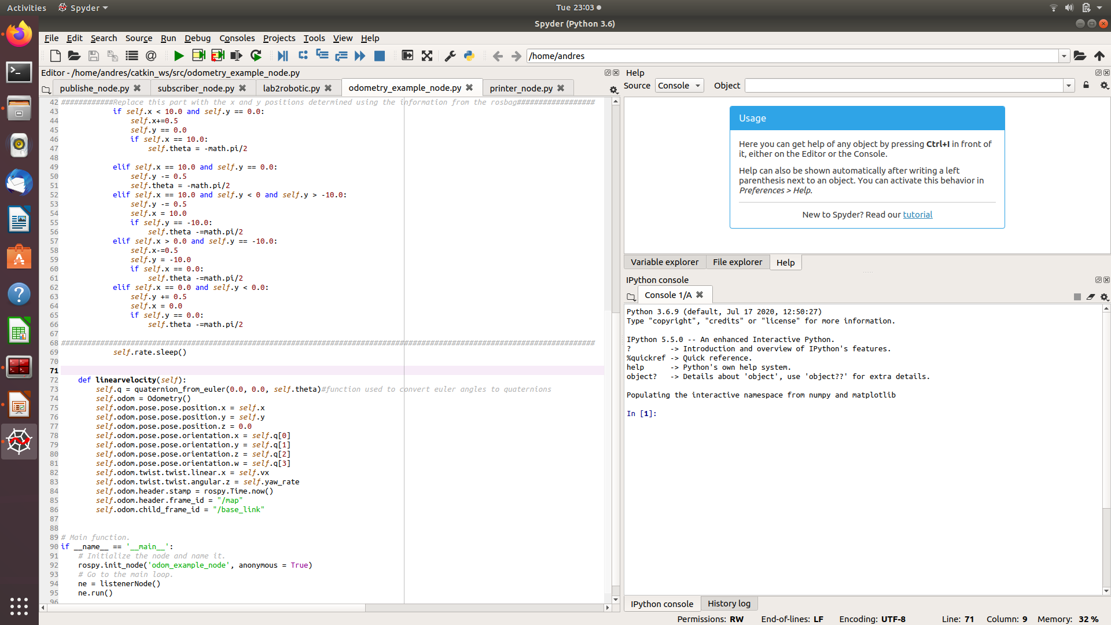
ROS – Odometry Example

Slide 15
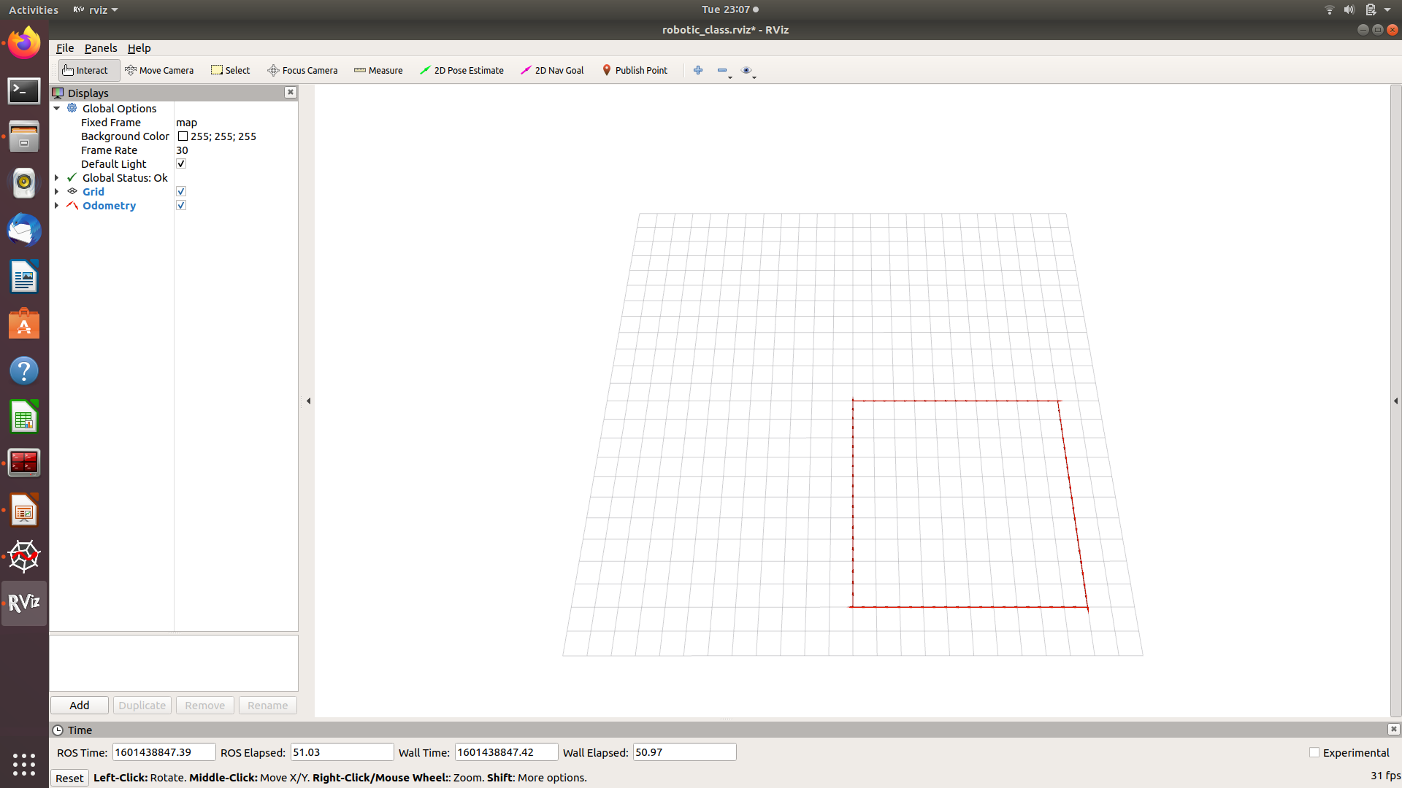
ROS – Odometry Example
You can install RVIZ using:
sudo apt-get install rviz
To install and use tf library, you need to use:
sudo apt-get install ros-melodic-tf
sudo apt-get install ros-melodic-tf-conversions

Slide 16
References
http://wiki.ros.org/melodic/Installation/Ubuntu
http://wiki.ros.org/catkin/Tutorials/create_a_workspace
http://wiki.ros.org/ROS/Tutorials/CreatingPackage
http://wiki.ros.org/ROS/Tutorials/WritingPublisherSubscriber%28python%29
http://www2.ece.ohio-state.edu/~zhang/RoboticsClass/docs/ECE5463_ROSTutorialLecture1.pdf
Joseph, L. Robot Operating System (ROS) for Absolute Beginners, 2018
https://www.youtube.com/watch?v=N6K2LWG2kRI&t=83s
http://wiki.ros.org/rviz
http://wiki.ros.org/tf

