Slide 1
Excel Final Assessment
G Naga Mahesh

Slide 2
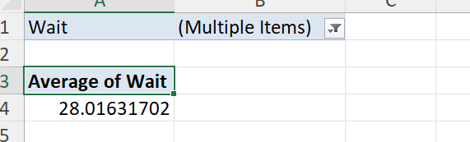
Question-1
Assuming the difference between Reqdate and wokdate is in days and the wait column gives us the number of days it takes to complete the work order. Now assuming that the rows having blank wokdate and wait values being still in work and excluding them when calculating the average lead time between request date and completion date for all work orders we will get the answer as 28 days.

Slide 3
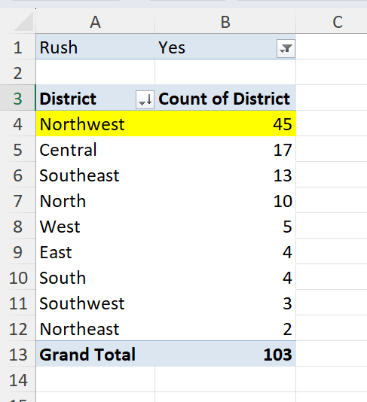
Question-2
Insight: Northwest district has the highest number of rush jobs

Slide 4
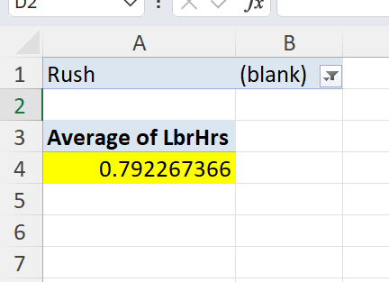
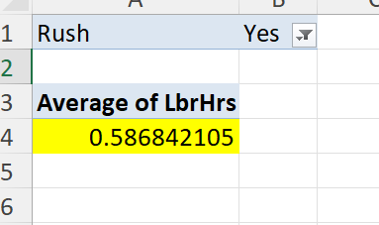
Question-3
The average labour hours for rush jobs is less as compared to average labour hours for non-rush jobs

Slide 5
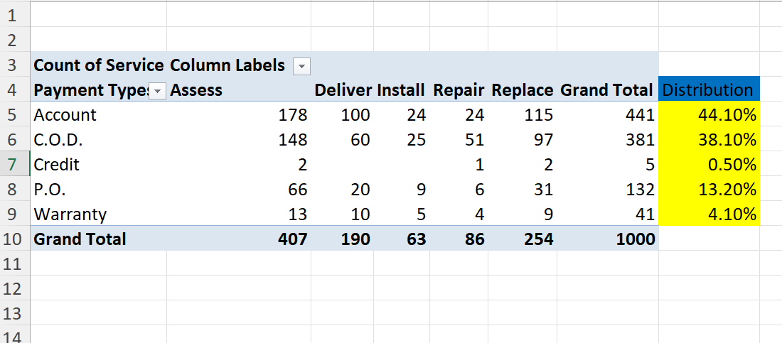
Question-4

Slide 6
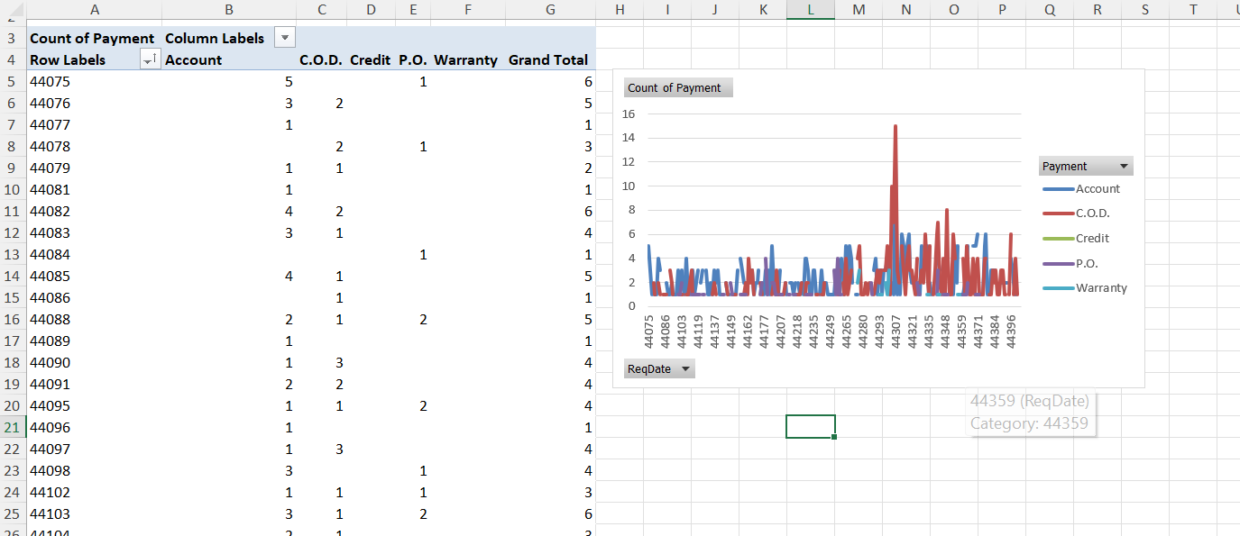
Question-5
As over time more customers preferred C.O.D as you can see the increase in use of C.O.D in above graph.

Slide 7
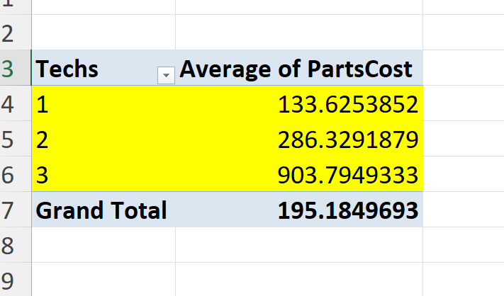
Question-6
As the techs required increases the Average partscost is also getting increased. So we can say that the more the techs required the more the partscost will be

Slide 8
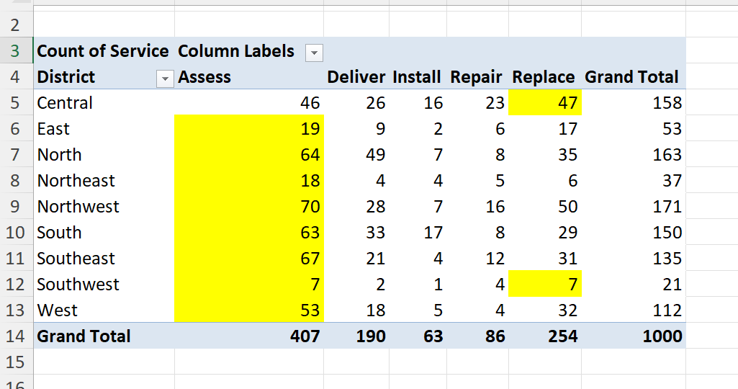
Question-7

Slide 9
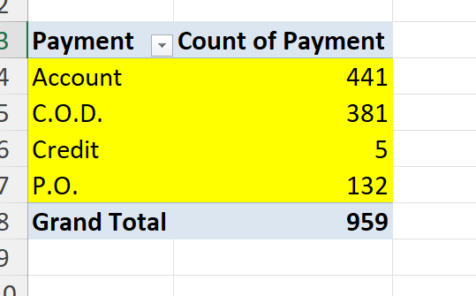
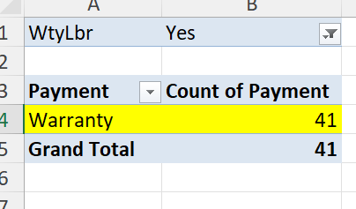
Question-8
Word orders with warranty labour have only payment type of Warranty. Where as, word orders without WtyLbr have done payments with Account,C.O.D,Credit,P.O.

Slide 10
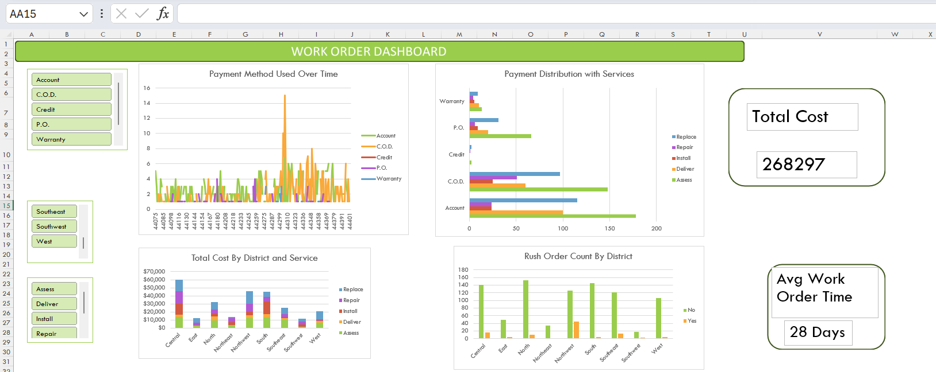
Dashboard

