Slide 1
Case Study
G Naga Mahesh

Slide 2
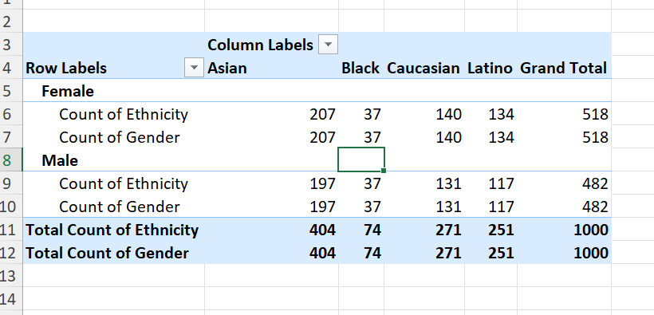
Question-1
Insight: both the genders have diverse ethnicity profiles

Slide 3
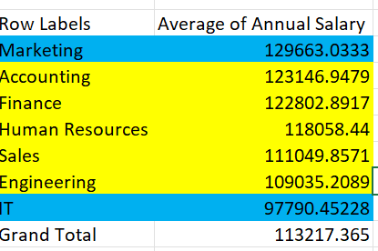
Question- 3
Insight: There’s an significant difference between Marketing and IT departments. Marketing, Accounting, Finance departments have slight difference in their average salaries. That goes same for HR, Sales, Engineering.

Slide 4
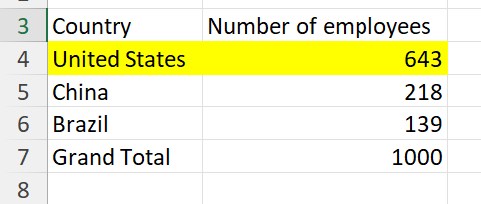
Question - 4
Insight: United states has the highest number of employees

Slide 5
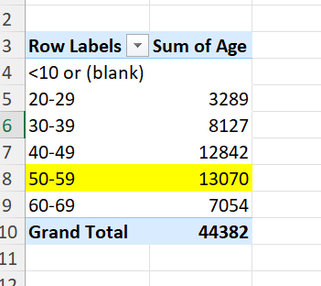
Question-5
Insight: 50-59 range age

Slide 6
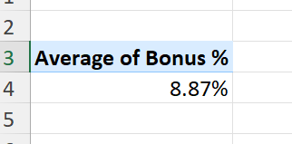
Question - 6
Insight: The average bonus percentage given to employees is 8.87%

Slide 7
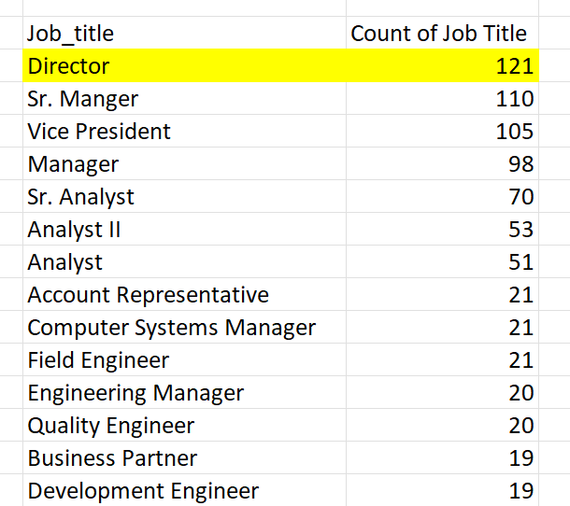
Question-7
Insight: The most frequently occurred job title is Director

Slide 8
Question-8
Insight: There is no feedback or reasons available given in the data but By observing the data you can conclude say bonus could be one of the reason for employee exit

Slide 9
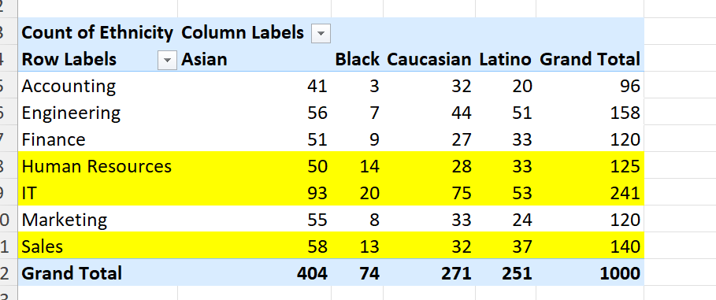
Question-9
Insight: IT,HR,SALES departments are slightly diverse in ethnicity as compared to other departments.

Slide 10
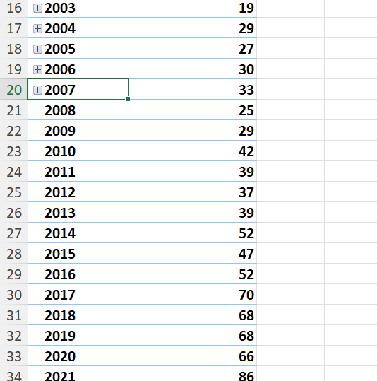
Question-10
Insight: There has been an increase in hires over the past years

