Slide 1
TIME SERIES MODELING
Reid Offringa, PhD
Data Scientist, Glooko

Slide 2
LEARNING OBJECTIVES
TIME SERIES MODELING
Understand how we define time series data
Model and predict from time series data using AR, ARMA, or ARIMA models
Specifically, coding these models in statsmodels

Slide 3
OPENING
TIME SERIES DATA

Slide 4
WHAT IS TIME SERIES DATA?
Any data where the individual data points change over time
Data must be homogenously spaced over time
Typically more than a few time points
IE: RCT not classically considered time series
Presents a challenge for linear regression!
Observations are not independent from each other!

Slide 5
WHAT IS TIME SERIES DATA?
Typically, we are interested in separating the effects of time into two components:
Trends - significant increases or decreases over time
Seasonality - regularly repeating increases or decreases

Slide 6
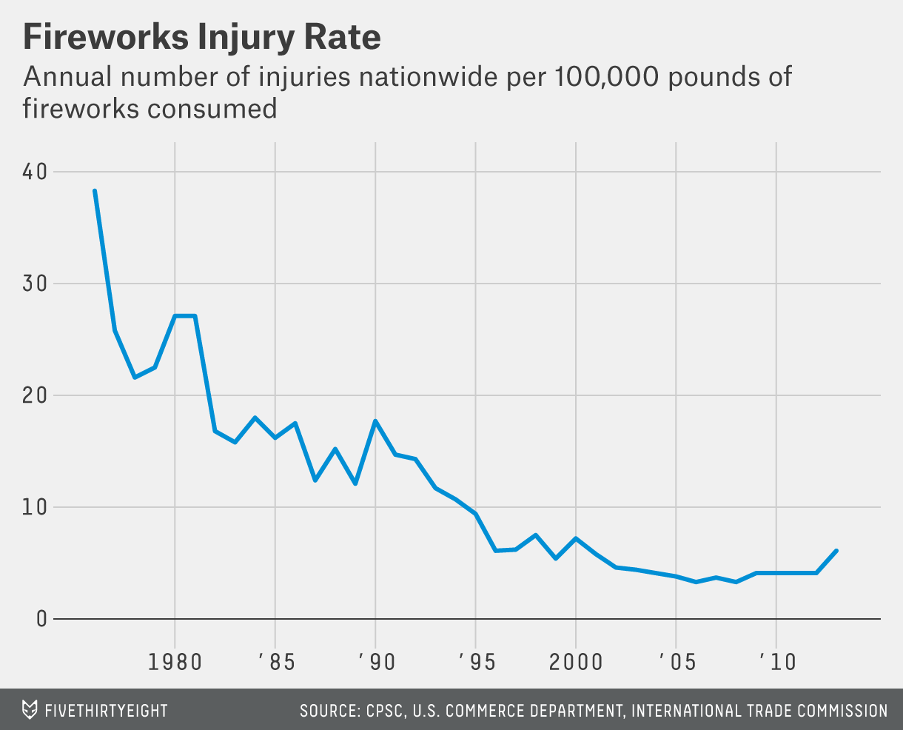
TRENDS
This plot of fireworks injury rates has an overall trend of fewer injuries with no seasonal pattern.

Slide 7
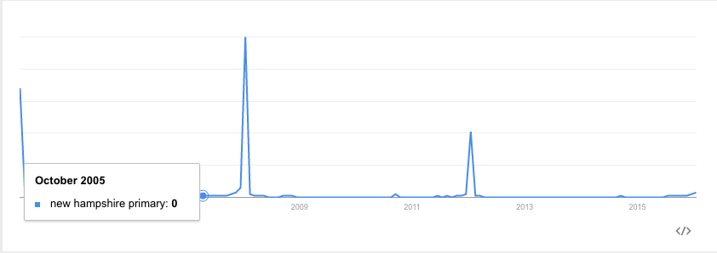
SEASONAL
Meanwhile, the number of searches for the New Hampshire Primary has a clear seasonal component - it peaks every four years and on election years.

Slide 8
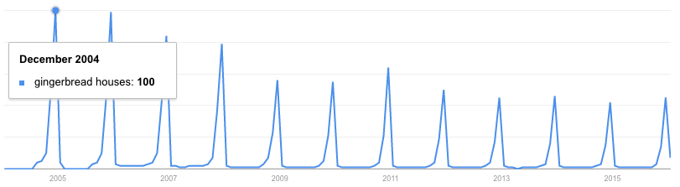
SEASONAL
Similarly, searches for ‘gingerbread houses’ spike every year around the holiday season.
These spikes recur on a fixed time-scale, making them seasonal patterns.

Slide 9
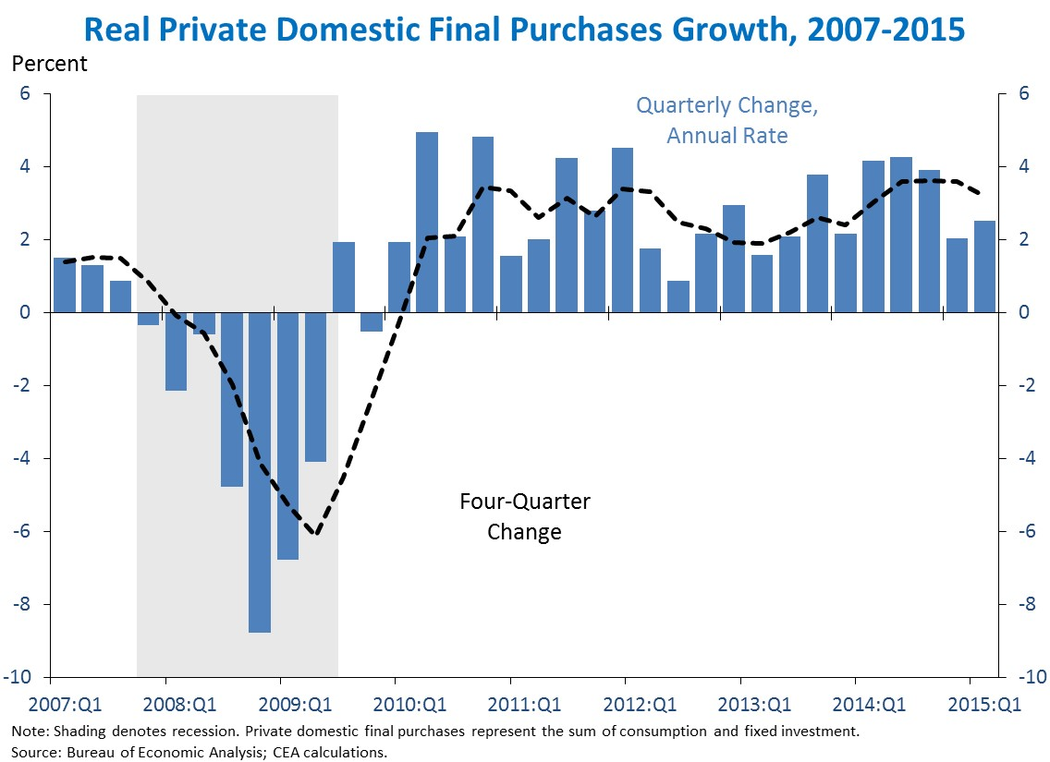
CYCLES
Many other types of regularly occurring up or down swings may occur without a fixed timescale or period (e.g. growth vs. recession for economic trends).

Slide 10
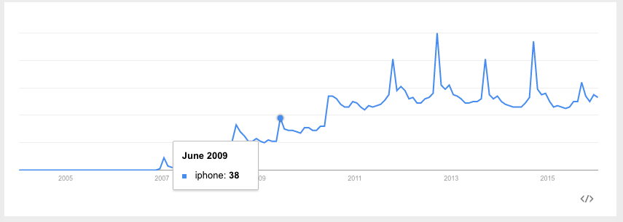
WHAT IS TIME SERIES DATA?
Searches for “iphone” have both a general trend upwards (indicating more popularity for the phone) as well as a seasonal spike in September (which is when Apple typically announces new versions).

Slide 11
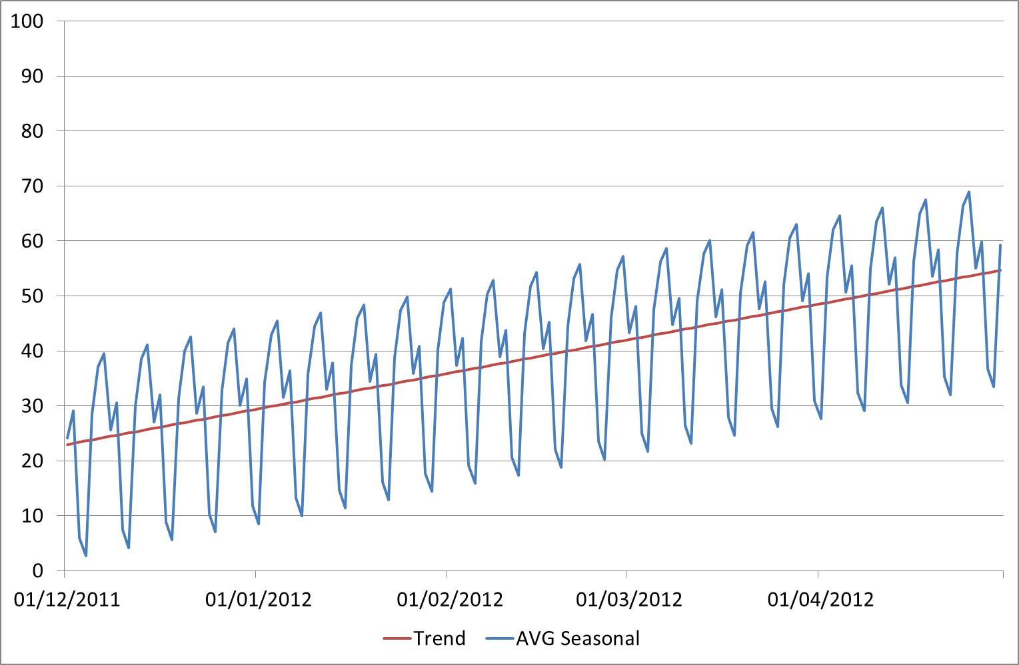
WHAT IS TIME SERIES DATA?
Sometimes we’re interested in trends.
Other times we’re interested in seasonality.
Need to distinguish between the two

Slide 12
WHAT IS TIME SERIES DATA?
Let’s explore the Time series basics!
Open Timeseries_basics.ipynb!

Slide 13
OPENING
TIME SERIES MODELING

Slide 14
TIME SERIES MODELING: PREDICTING THE FUTURE
There are many times when you may want to use a series of values to predict a future value.
The number of sales in a future month
Anticipated website traffic when buying a server
Financial forecasting
The number of visitors to your store during the holidays

Slide 15
INTRODUCTION
WHAT ARE TIME SERIES MODELS?

Slide 16
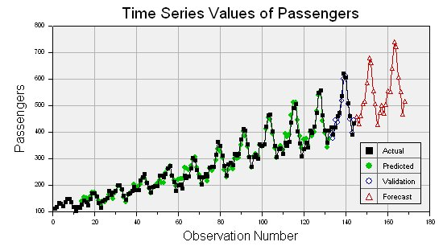
WHAT ARE TIME SERIES MODELS?
Time series models are models that will be used to predict a future value in the time series.
Like other predictive models, we will use prior history to predict the future.
Unlike previous models, we will use the earlier in time outcome variables as inputs for predictions.
IE: can’t randomly choose your training set

Slide 17
WHAT ARE TIME SERIES MODELS?
Like previous modeling exercises, we will have to evaluate the different types of models to ensure we have chosen the best one.
We will want to evaluate on a held-out set or test data to ensure our model performs well on unseen data.

Slide 18
WHAT ARE TIME SERIES MODELS?
Unlike previous modeling exercises, we won’t be able to use standard cross-validation for evaluation.
Since there is a time component to our data, we cannot choose training and test examples at random.
Suppose we did select a random 80% sample of data points for training and a random 20% for testing. What could go wrong?

Slide 19
WHAT ARE TIME SERIES MODELS?
The training dataset would likely contain data from before AND after a test dataset.
This would not be possible in real life (you can’t use future, unseen data points when building your model). Therefore, it’s not a valid test of how our model would perform in practice.

Slide 20
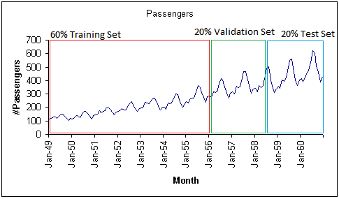
WHAT ARE TIME SERIES MODELS?
Instead, we will exclusively train on values earlier (in time) in our data and test our model on values at the end of the data period.

Slide 21
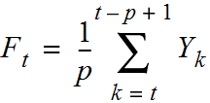
PROPERTIES FOR TIME-SERIES PREDICTION
A moving average is an average of p surrounding data points in time.
… to t - p + 1. This includes t, t + 1, t + 2, …, t-p, t-p+1.
Divide by the p surrounding data points
Get the p points from t ...

Slide 22
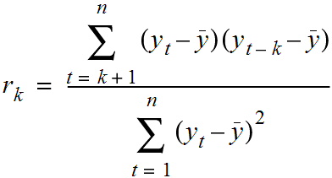
PROPERTIES FOR TIME-SERIES PREDICTION
Autocorrelation is how correlated a variable is with itself. Specifically, how related are variables earlier in time with variables later in time.
We fix a lag, k, which is how many time points earlier we should use to compute the correlation.

Slide 23
PROPERTIES FOR TIME-SERIES PREDICTION
We can use these values to assess how we plan to model our time series.
Typically, for a high quality model, we require some autocorrelation in our data.
We can compute autocorrelation at various lag values to determine how far back in time we need to go.

Slide 24
PROPERTIES FOR TIME-SERIES PREDICTION
Many models make an assumption of stationarity, assuming the mean and variance of our values is the same throughout.
While the values (e.g. of sales) may shift up or down over time, the mean and variance of sales is constant (i.e. there aren’t many dramatic swings up or down).
These assumptions may not represent real world data; we must be aware of that when we are breaking the assumptions of our model.

Slide 25
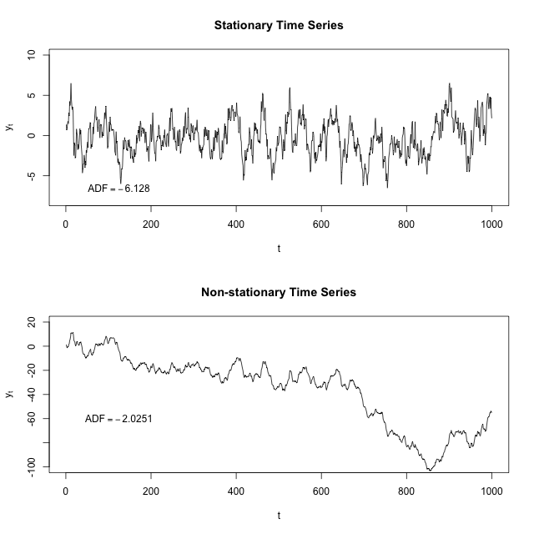
PROPERTIES FOR TIME-SERIES PREDICTION

Slide 26
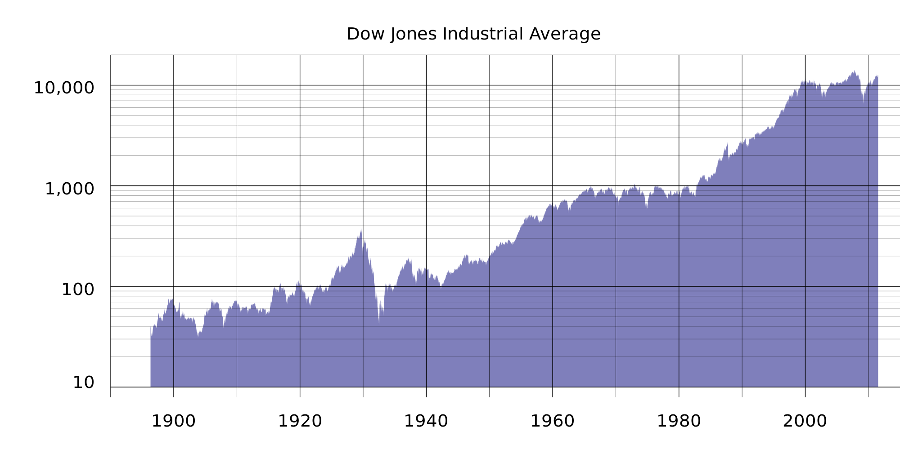
PROPERTIES FOR TIME-SERIES PREDICTION
For example, typical stock or market performance is not stationary. In this plot of Dow Jones performance since 1986, the mean is clearly increasing over time.

Slide 27
PROPERTIES FOR TIME-SERIES PREDICTION
Often, if these assumptions don’t hold, we can alter our data to make them true. Two common methods are detrending and differencing.
Detrending would mean to remove any major trends in our data.
We could do this is many ways, but the simplest is to fit a line to the trend and make a new series that is the difference between the line and the true series.

Slide 28
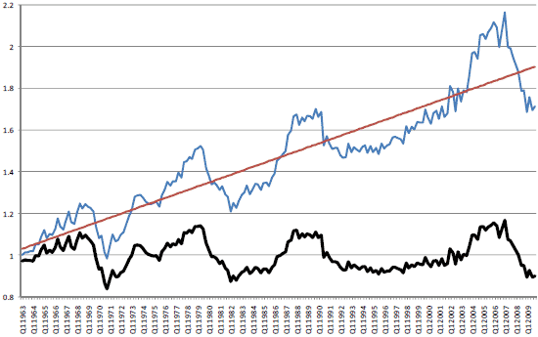
PROPERTIES FOR TIME-SERIES PREDICTION
Below is an example where we look at US housing prices over time. Clearly, there is an upward trend, making the time series non-stationary (ie: the mean house price is increasing).

Slide 29
PROPERTIES FOR TIME-SERIES PREDICTION
We can fit a line that represents the trend. With our trend line, we can subtract the trend line value from the original value to get the bottom figure.

Slide 30
PROPERTIES FOR TIME-SERIES PREDICTION
The data now has a fixed mean and will be easier to model. This pattern is similar to mean-scaling our features in earlier models with StandardScaler.

Slide 31
PROPERTIES FOR TIME-SERIES PREDICTION
A simpler method is differencing. This is very closely related to the diff function we saw in the last class.
Instead of predicting the series (again our non-stationary series), we can predict the difference between two consecutive values.

Slide 32
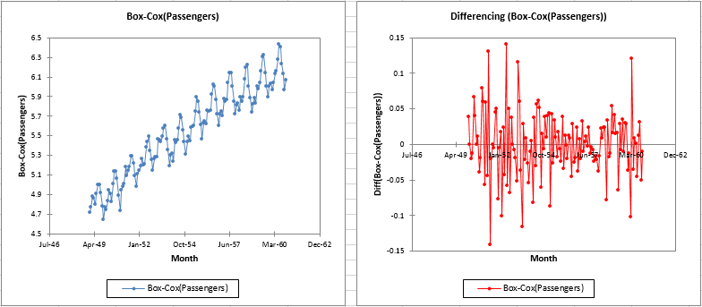
PROPERTIES FOR TIME-SERIES PREDICTION

Slide 33

ACTIVITY: KNOWLEDGE CHECK
ANSWER THE FOLLOWING QUESTIONS
EXERCISE
Non-stationary data is the most common; almost any interesting dataset is non-stationary.
Can you think of some interesting datasets that might be stationary?
DELIVERABLE
Answers to the above questions

Slide 34
TIME SERIES MODELS
In the rest of this lesson, we are going to build up to the ARIMA time series model.
This model combines the ideas of differencing and two models we will see.
AR - autoregressive models
MA - moving average models

Slide 35
AR MODELS
Autoregressive (AR) models are those that use data from previous time points to predict the next.
This is very similar to previous regression models, except as input, we take the previous outcome.
If we are attempting to predict weekly sales, we use the sales from a previous week as input.
Typically, AR models are notes AR(p) where p indicates the number of previous time points to incorporate, with AR(1) being the most common.

Slide 36
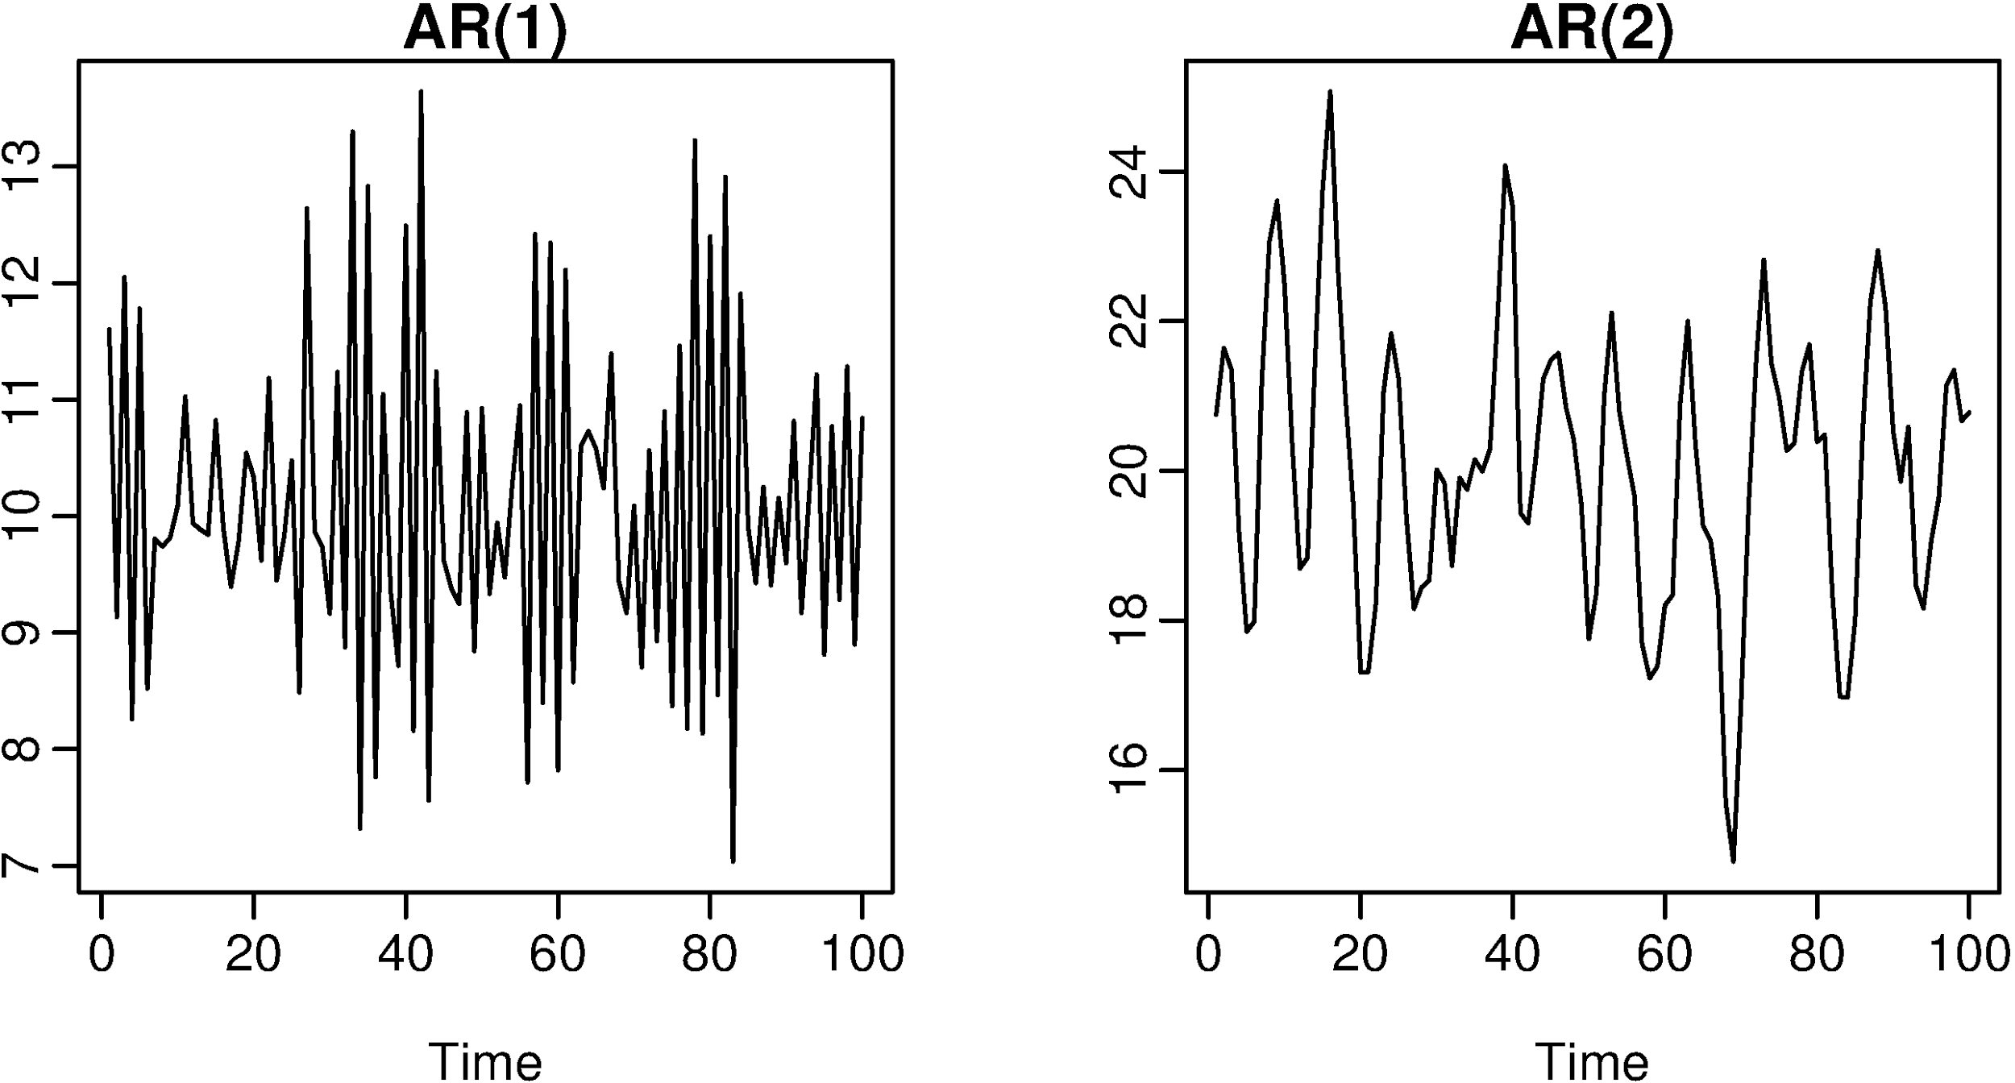
AR MODELS

Slide 37
AR MODELS
In an autoregressive model, similar to standard regression, we are learning regression coefficients for each of the p previous values. Therefore, we will learn p coefficients or 𝛃 values.
If we have a time series of sales per week, y_{i}, we can regress each yi from the last p values.
y_{i} = 𝛃₀ + 𝛃₁y_{i-1} + 𝛃₂y_{i-2} + … + 𝛃_{p}y_{i-p} + 𝜺
As with standard regression, our model assumes that each outcome variable is a linear combination of the inputs and a random error term.

Slide 38
AR MODELS
For an AR(1) model, we will learn a single coefficient.
This coefficient, 𝛃, will tell us the relationship between the previous value, Y_{t - 1}, and the next value, Y_{t}.
Y_{t} = 𝛃·Y_{t - 1}

Slide 39
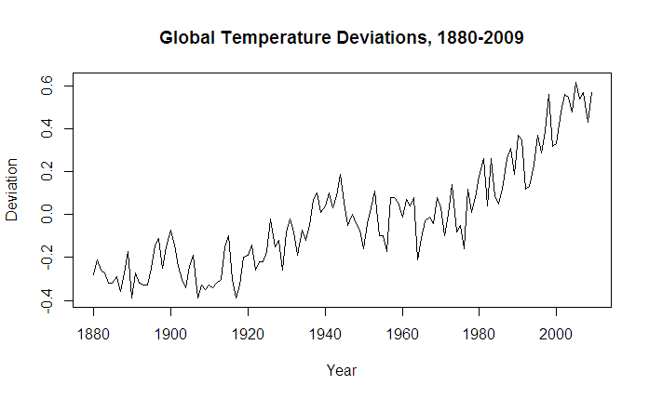
AR MODELS
A value > 1 would indicate a growth over previous values. This would typically represent non-stationary data, since if we compound the increases, the values are continually increasing.

Slide 40
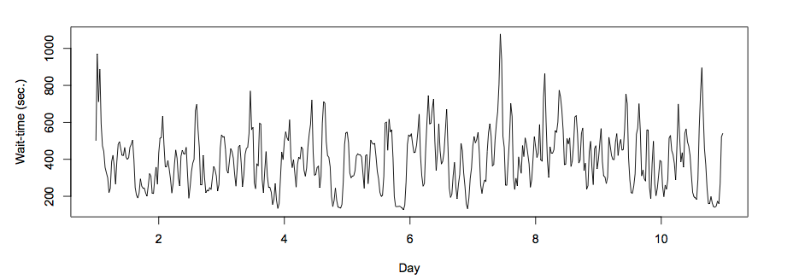
AR MODELS
Values between 1 and -1 represent increasing and decreasing patterns.

Slide 41
AR MODELS
As with other models, interpretation of the model becomes more complex as we add more factors.
Going from AR(1) to AR(2) can add significant multi-collinearity.

Slide 42
AR MODELS
Recall that autocorrelation is the correlation of a value with its series lagged behind.
A model with high correlation implies that the data is highly dependent on previous values and an autoregressive model would perform well.

Slide 43
AR MODELS
Autoregressive models are useful for learning falls or rises in our series.
This will weight together the last few values to make a future prediction.
Typically, this model type is useful for small-scale trends such as an increase in demand or change in tastes that will gradually increase or decrease the series.

Slide 44
ACTIVITY: KNOWLEDGE CHECK
ANSWER THE FOLLOWING QUESTIONS
If we observe an autocorrelation near 1 for lag 1, what do we expect the single coefficient in an AR(1) model to be? >1, between 0 and 1, or <1?
What if we observe an autocorrelation of 0?
EXERCISE
DELIVERABLE
Answers to the above questions

Slide 45
MA MODELS
Moving average (MA) models, as opposed to AR models, do not take the previous outputs (or values) as inputs. They take the previous error terms.
We will attempt to predict the next value based on the overall average and how off our previous predictions were.

Slide 46
MA MODELS
This model is useful for handling specific or abrupt changes in a system.
AR models slowly incorporate changes in the system by combining previous values; MA models use prior errors to quickly incorporate changes.
This is useful for modeling a sudden occurrence - something going out of stock or a sudden rise in popularity affecting sales.

Slide 47
MA MODELS
As in AR models, we have an order term, q, and we refer to our model as MA(q). The moving average model is dependent on the last q errors.
If we have a time series of sales per week, y_{i}, we can regress each y_{i} from the last q error terms.
y_{i} = mean + 𝛃₁𝜺_{i-1} + 𝛃₂𝜺_{i-2} + … + 𝛃_{q}𝜺_{i-q}
We include the mean of the time series (that’s why it’s called a moving average) as we assume the model takes the mean value of the series and randomly jumps around it.

Slide 48
MA MODELS
Of course, we don’t have error terms when we start - where do they come from?
This requires a more complex fitting procedure than we have seen previously.
We need to iteratively fit a model (perhaps with random error terms), compute the errors and then refit, again and again.

Slide 49
MA MODELS
In this model, we learn q coefficients.
In an MA(1) model, we learn one coefficient.
This value indicates the impact of how our previous error term on the next prediction.

Slide 50
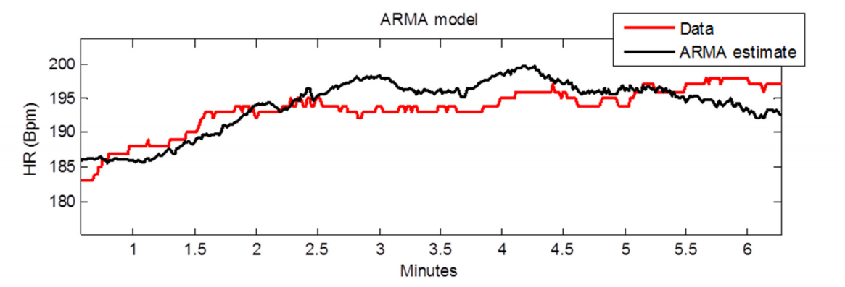
ARMA MODELS
ARMA (pronounced ‘R-mah’) models combine the autoregressive and moving average models.
An ARMA(p,q) model is simply a combination (sum) of an AR(p) model and MA(q) model.

Slide 51
ARMA MODELS
We specify two model settings, p and q, which correspond to combining an AR(p) model with an MA(q) model.
Incorporating both models allows us to mix two types of effects.
AR models slowly incorporate changes in preferences, tastes, and patterns.
Moving average models base their prediction on the prior error, allowing to correct sudden changes based on random events - supply, popularity spikes, etc.

Slide 52
ARIMA MODELS
ARIMA (pronounced ‘uh-ri-mah’) is an AutoRegressive Integrated Moving Average model.
In this model, we learn an ARMA(p,q) model to predict the difference of the series (as opposed to the value of the series).

Slide 53
ARIMA MODELS
Recall the pandas diff function. This computes the difference between two consecutive values.
In an ARIMA model, we attempt to predict this difference instead of the actual values.
y_{t} - y_{t-1} = ARIMA(p,q)
This handles the stationarity assumption we wanted for our data. Instead of detrending or differencing manually, the model does this.

Slide 54
ARIMA MODELS
An ARIMA model has three parameters and is specified ARIMA(p, d, q).
p is the order of the autoregressive component
q is the order of the moving average component
d is the degree of differencing.
d was 1 in our prior example. For d=2, our model would be
diff(diff(y)) = (y_{t} - y_{t-l}) - (y_{t-l} - y_{t-2}) = ARIMA(p,q)

Slide 55
ARIMA MODELS
Compared to an ARMA model, ARIMA models do not rely on the underlying series being stationary.
The differencing operation can convert the series to one that is stationary.
Instead of attempting to predict values over time, our new series is the difference in values over time.
Since ARIMA models include differencing, they can be used on a broader set of data without the assumption of a constant mean.

Slide 56
DEMO
TIME SERIES MODELING IN STATSMODELS

Slide 57
TIME SERIES MODELING IN STATSMODELS
To explore time series models, we will continue to use the Rossmann sales data.
This dataset has sales data for every Rossmann store for a 3-year period and indicators for holidays and basic store information.
Open up your L17 Demo!

Slide 58
TIME SERIES MODELING IN STATSMODELS
import pandas as pd # Load the data and set the DateTime index data = pd.read_csv('rossmann.csv', skipinitialspace=True) data['Date'] = pd.to_datetime(data['Date']) data.set_index('Date', inplace=True) # Filter to Store 1 store1_data = data[data.Store == 1] # Filter to open days store1_open_data = store1_data[store1_data.Open==1] # Plot the sales over time store1_open_data[['Sales']].plot()

Slide 59
ACTIVITY: KNOWLEDGE CHECK
ANSWER THE FOLLOWING QUESTIONS
Compute the autocorrelation of Sales in Store 1 for lag 1 and 2.
Will we be able to use a predictive model, particularly an autoregressive one?
EXERCISE
DELIVERABLE
Answers to the above questions

Slide 60
TIME SERIES MODELING IN STATSMODELS
store1_data.Sales.autocorr(lag=1) # -0.12 store1_data.Sales.autocorr(lag=2) # -0.03
We do see some minimal correlation in time, implying an AR model can be useful. An easier way to diagnose this may be to plot many autocorrelations at once.

Slide 61
TIME SERIES MODELING IN STATSMODELS
%matplotlib inline from pandas.tools.plotting import autocorrelation_plot autocorrelation_plot(store1_data.Sales)
This shows a typical pattern of an autocorrelation plot, that it should decrease to 0 as lag increases. However, it’s hard to observe exactly what the values are.

Slide 62
TIME SERIES MODELING IN STATSMODELS
In this class, we will use statsmodels to code AR, MA, ARMA, and ARIMA models.
statsmodels provides a nice summary utility to help us diagnose models.

Slide 63
TIME SERIES MODELING IN STATSMODELS
statsmodels also has a better autocorrelation plot that allows us to look at fixed number of lag values.
from statsmodels.graphics.tsaplots import plot_acf plot_acf(store1_data.Sales, lags=10)
Here we observe autocorrelation at 10 lag values. 1 and 2 are what we saw before.
This implies a small but limited impact based on the last few values. An autoregressive model might be useful.

Slide 64
TIME SERIES MODELING IN STATSMODELS
We also see a larger spike at 7 (the seventh day in the week).
If we observed a handful of random distributed spikes, a moving average model would be useful.
plot_acf(store1_data.Sales, lags=25)
We can expand the window to 25 days to see that the random spikes occur regularly at 7 days. What does this mean?

Slide 65
AR, MA, AND ARMA MODELS IN STATSMODELS
To explore AR, MA, and ARMA models, we will use sm.tsa.ARMA.
Remember, an ARMA model is a combination of autoregressive and moving average models.
We can train an AR model by turning off the MA component (q=0).
from statsmodels.tsa.arima_model import ARMA store1_sales_data = store1_open_data[['Sales']].astype(float) model = ARMA(store1_sales_data, (1, 0)).fit() model.summary()

Slide 66
AR, MA, AND ARMA MODELS IN STATSMODELS
By passing (1, 0) in the second argument, we are fitting an ARMA model with p=1, q=0. This is the same as an AR(1) model.
In this AR(1) model, we learn an intercept (or base sales) value.
Additionally, we learn a coefficient that tells us how to include the latest sales value.
In this case, we add an intercept of ~4700 to 0.68 times the previous month’s sales. Note that the coefficient is not equal to the lag 1 autocorrelation. This implies the data is not stationary.

Slide 67
AR, MA, AND ARMA MODELS IN STATSMODELS
We can learn an AR(2) model, which regresses each sales value on the last two.
model = ARMA(store1_sales_data, (2, 0)).fit() model.summary()
In this case, we learn two coefficients, which tell us the effect of the last two sales values on the current sales.
While this model may perform better, it may be more difficult to interpret.

Slide 68
ACTIVITY: KNOWLEDGE CHECK
ANSWER THE FOLLOWING QUESTIONS
EXERCISE
To start to diagnose the model, we want to look at residuals.
What are residuals?
In linear regression, what did we expect of residuals?
DELIVERABLE
Answers to the above questions

Slide 69
AR, MA, AND ARMA MODELS IN STATSMODELS
Residuals are the errors of the model or how off our predictions are.
Ideally, we want randomly distributed errors that are small.
If the errors are large, our model does not perform well.
If the errors have a pattern, particularly over time, we may have overlooked something in the model or have periods of time that are different than the rest of the dataset.

Slide 70
AR, MA, AND ARMA MODELS IN STATSMODELS
We can use statsmodels to plot the residuals.
model.resid.plot()
Here we see large spikes at the end of each year, indicating that our model does not account for the holiday spikes.
Our model considers a short period of time, so it does not take into account the longer seasonal pattern.

Slide 71
AR, MA, AND ARMA MODELS IN STATSMODELS
We can also plot the autocorrelations of the residuals. In an ideal world, these would all be near 0 and appear random.
plot_acf(model.resid, lags=50)
This plot shows a problem: the errors are increasing and decreasing every week in a clear pattern.
We may need to expand our model.

Slide 72
AR, MA, AND ARMA MODELS IN STATSMODELS
To expand this AR model to an ARMA model, we can include the moving average component as well.
model = ARMA(store1_sales_data, (1, 1)).fit() model.summary()
Now we learn two coefficients, one for the AR(1) component and one for the MA(1) component.

Slide 73
ACTIVITY: KNOWLEDGE CHECK
ANSWER THE FOLLOWING QUESTIONS
Take a moment to look at the coefficients of our new model.
Offer an interpretation of this model.
EXERCISE
DELIVERABLE
Answers to the above questions

Slide 74
AR, MA, AND ARMA MODELS IN STATSMODELS
Remember that this is an AR(1) + MA(1) model. The AR coefficient represents dependency on the last value and the MA component represents any spikes independent of the last value.
The coefficients here are 0.69 for the AR component and -0.03 for the MA component.
The AR coefficient is the same as before (decreasing values).
The MA component is fairly small (which we should have expected from the autocorrelation plots).

Slide 75
ARIMA MODELS IN STATSMODELS
We can also use statsmodels to fit ARIMA models. Let’s start by using ARIMA(1, 0, 1) to fit an ARMA(1, 1) model.
from statsmodels.tsa.arima_model import ARIMA model = ARIMA(store1_sales_data, (1, 0, 1)).fit() model.summary()
We can see that this model is the same as our previous ARMA model.

Slide 76
ARIMA MODELS IN STATSMODELS
We can also fit a true ARIMA model to predict the difference of the series.
model = ARIMA(store1_sales_data, (1, 1, 1)).fit() model.summary()
We can remove the MA component since it does not appear to be useful.
model = ARIMA(store1_sales_data, (1, 1, 0)).fit() model.summary()
We now have an AR(1) model on the differenced series with a coefficient of -0.18.

Slide 77
ACTIVITY: KNOWLEDGE CHECK
ANSWER THE FOLLOWING QUESTIONS
Does this model match the lag 1 autocorrelation of the differenced series?
Is the data stationary?
EXERCISE
DELIVERABLE
Answers to the above questions

Slide 78
ARIMA MODELS IN STATSMODELS
We can compute the lag 1 autocorrelation of the differenced series and see if they match.
store1_sales_data.Sales.diff(1).autocorr(1) #-0.181
We can also plot it to see the difference.
store1_sales_data.Sales.diff(1).plot()
They match. Note that this is generally true, but the variance is NOT constant. It’s mostly the same throughout the series except around the holidays.

Slide 79
ARIMA MODELS IN STATSMODELS
With our models, we can also plot our predictions against the true series using the plot_predict function.
We can compare the last 50 days of true values against our predictions.
model.plot_predict(0, 50)
The function takes two arguments, the start and end index of the dataframe to plot. Here, we are plotting the last 50 values.

Slide 80
ARIMA MODELS IN STATSMODELS
To plot earlier values with our predictions continuing where the true values stop, we can do the following.
import matplotlib.pyplot as plt fig, ax = plt.subplots() ax = store1_sales_data['2014'].plot(ax=ax) fig = model.plot_predict(0, 200, ax=ax, plot_insample=False)
This plots true values in 2014 and our predictions 200 days out from 2014.

Slide 81
ACTIVITY: KNOWLEDGE CHECK
ANSWER THE FOLLOWING QUESTIONS
We can revisit our diagnostics to check that our models are working well.
Plot the residuals and autocorrelation of the residuals.
Are there patterns or outliers?
EXERCISE
DELIVERABLE
Answers to the above questions

Slide 82
ARIMA MODELS IN STATSMODELS
The two previous problems remain:
Large errors around the holiday period
Errors with high autocorrelation

Slide 83
ARIMA MODELS IN STATSMODELS
We can adjust the AR component of the model to adjust for a piece of this. Let’s increase the lag to 7.
model = ARIMA(store1_sales_data, (7, 1, 2)).fit() model.summary() plot_acf(model.resid, lags=50)
This removes some of the autocorrelation in the residuals but large discrepancies still exist.
However, they exist where we are breaking our model assumptions.

Slide 84
ACTIVITY: KNOWLEDGE CHECK
ANSWER THE FOLLOWING QUESTIONS
Alter the time period of predictions and the p, d, and q parameters.
Do any of these improve diagnostics?
What does changing p and q imply based upon the autocorrelation plot?
How about changing d?
EXERCISE
DELIVERABLE
Answers to the above questions

Slide 85
ARIMA MODELS IN STATSMODELS
Increasing p increases the dependency on previous values further (longer lag). But our autocorrelation plots show this isn’t necessary past a certain point.
Increasing q increases the likelihood of an unexpected jump at a handful of points. The autocorrelation plots show this doesn’t help past a certain point.
Increasing d increases differencing, but d=1 moves our data towards stationarity (other than a few points). d=2 would imply an exponential trend which we don’t have here.

Slide 86
ARIMA MODELS IN STATSMODELS
There are variants of ARIMA that will better handle the seasonal aspect of our data. This is referred to as Seasonal ARIMA.
These models fit two ARIMA models, one on the current frequency (daily in our example) and another on the seasonal frequency (maybe monthly or yearly patterns).
Additionally, issues with seasonality could be handled by preprocessing tricks such as detrending.

Slide 87
INDEPENDENT PRACTICE
WALMART SALES DATA

Slide 88
ACTIVITY: WALMART SALES DATA
DIRECTIONS (50 minutes)
EXERCISE
We will analyze the weekly sales data from Walmart over a two year period from 2010 to 2012. The data is separated by store and department, but we will focus on analyzing one store for simplicity.
To read in the data
import pandas as pd import numpy as np %matplotlib inline data = pd.read_csv('lessons/lesson-16/assets/data/train.csv') data.set_index('Date', inplace=True) data.head()

Slide 89
ACTIVITY: WALMART SALES DATA
DIRECTIONS
EXERCISE
Complete the following tasks:
Filter the dataframe to Store 1 sales and aggregate over departments to compute the total sales per store.
Plot the rolling_mean for Weekly_Sales. What general trends do you observe?
Compute the 1, 2, 52 autocorrelations for Weekly_Sales and/or create an autocorrelation plot.
What does the autocorrelation plot say about the type of model you want to build?

Slide 90
ACTIVITY: WALMART SALES DATA
DIRECTIONS
EXERCISE
Split the weekly sales data in a training and test set - using 75% of the data for training.
Create an AR(1) model on the training data and compute the mean absolute error of the predictions.
Plot the residuals - where are their significant errors?
Compute and AR(2) model and an ARMA(2, 2) model - does this improve your mean absolute error on the held out set?
Finally, compute an ARIMA model to improve your prediction error - iterate on the p, q, and parameters comparing the model's performance..

Slide 91
CONCLUSION
TOPIC REVIEW

Slide 92
CONCLUSION
Time-series models use previous values to predict future values, also known as forecasting.
AR and MA model are simple models on previous values or previous errors respectively.
ARMA combines these two types of models to account for both gradual shifts (due to AR models) and abrupt changes (MA models).

Slide 93
CONCLUSION
ARIMA models train ARMA models on differenced data to account for non-stationary data.
Note that none of these models will perform well for data that has more random variation.
For example, for something like iphone sales (or searches) which may be sporadic, with short periods of increases, these models may not work well.

Slide 94
DUE DATE
BEFORE NEXT CLASS
Project: Final Project!

Slide 95
LESSON
EXIT TICKET
DON’T FORGET TO FILL OUT YOUR EXIT TICKET

