Slide 1
QUICK REVIEW
Reid Offringa, PhD
Data Scientist, Glooko

Slide 2

ACTIVITY: THROWBACK KNOWLEDGE CHECK
ANSWER THE FOLLOWING QUESTIONS
EXERCISE
Define the difference between the precision and recall of a model.
What are some common components and use cases for logistic regression?
DELIVERABLE
Answers to the above questions

Slide 3
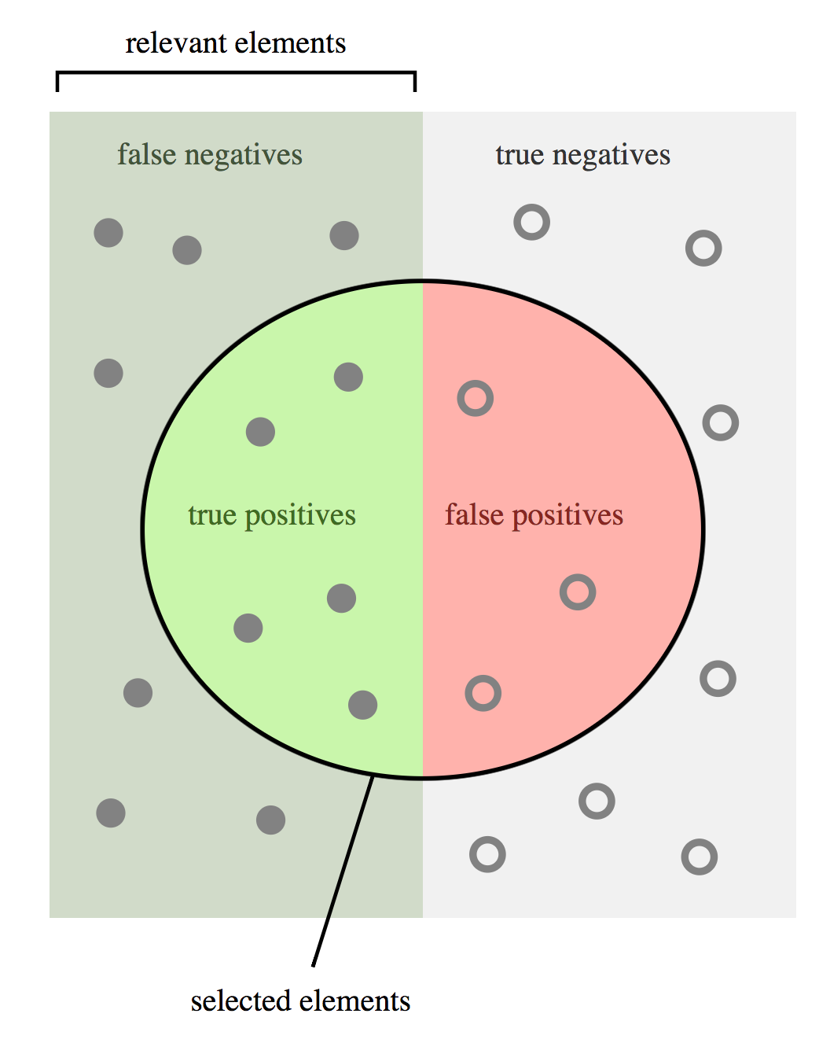
ACTIVITY:
Calculate Precision and Recall
 |  | MODEL
 |  | Positive | Negative
REALITY | Present | 5 | 7
 | Absent | 3 | 7

Slide 4
ACTIVITY:
Calculate Precision and Recall
 |  | MODEL
 |  | Positive | Negative
REALITY | Present | 5 | 7
 | Absent | 3 | 7
Precision: True Positives / Predicted Positives
5/ (5+3)
Recall: True Positives / Total “Present”
5/ (5+7)

Slide 5
DECISION TREES AND RANDOM FORESTS
Reid Offringa, PhD
Data Scientist, Glooko

Slide 6
LEARNING OBJECTIVES
DECISION TREES AND RANDOM FORESTS
Understand and build decision tree models
for classification and regression
Understand the differences
between linear and non-linear models
Extract the most important predictors in a random forest model

Slide 7
OPENING
DECISION TREES AND RANDOM FORESTS

Slide 8

OVERVIEW OF THE DATA SCIENCE WORKFLOW
In this lesson, we will focus on mining the dataset and building a model. We will focus on refining our model for the best predictive ability.

Slide 9
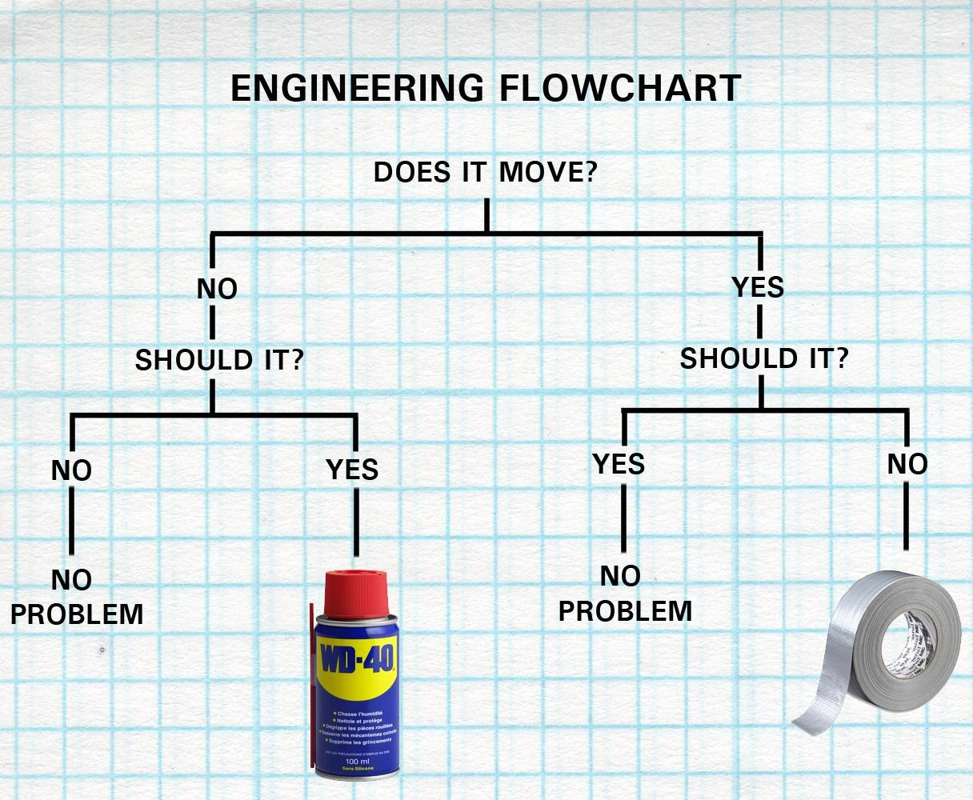
Motivation: Decision Trees
Intuitive machine learning process
Illustrates decision flow
Baseline for building and understanding more complicated algorithms

Slide 10
Should it move?
Item | DIM | SIM | mechanical | metal | Solution
door | no | yes | no | yes | WD40
chair | yes | no | no | yes | Duct tape
table | yes | no | no | yes | Duct tape
wheel | no | yes | yes | yes | WD40
cup | no | no | no | no | Duct tape
fan | no | yes | yes | yes | WD40
shoe | yes | no | no | no | Duct tape
lever | no | yes | yes | yes | WD40
cog | no | yes | yes | yes | WD40
painting | no | no | no | no | Duct tape

Slide 11
Simplest Decision Tree
Should it Move?
No
Yes
Item | Solution
chair | Duct tape
table | Duct tape
cup | Duct tape
shoe | Duct tape
painting | Duct tape
Item | Solution
door | WD40
wheel | WD40
fan | WD40
lever | WD40
cog | WD40

Slide 12
Already an Improvement!
Note: Our example only has two outcomes!
Should it Move?
No
Yes
Item | Solution
chair | Duct tape
table | Duct tape
cup | Duct tape
shoe | Duct tape
painting | Duct tape
Item | Solution
door | WD40
wheel | WD40
fan | WD40
lever | WD40
cog | WD40

Slide 13
More complicated Decision Tree (What if we didn’t know if it SHOULD move)
Does it Move?
Yes
No
Item | Solution
cup | Duct tape
painting | Duct tape
door | WD40
wheel | WD40
fan | WD40
lever | WD40
cog | WD40
Item | Solution
chair | Duct tape
table | Duct tape
shoe | Duct tape

Slide 14
More complicated Decision Tree
Does it Move?
Yes
No
Duct Tape
(3, 0)
WD40
(5, 2)

Slide 15
More complicated Decision Tree
Does it Move?
(5,5)
Yes
No
Duct Tape
(3, 0)
WD40
(5, 2)
Is it Metal?
No
Yes
Duct Tape
(2, 0)
WD40
(5, 0)

Slide 16
How do we make these decisions?
Does it Move?
(5,5)
Gini Impurity!
Yes
No
NOT PURE!
Pure!
Duct Tape
(3, 0)
WD40
(5, 2)
More Pure Than above
Is it Metal?
No
Yes
Pure!
Duct Tape
(2, 0)
WD40
(5, 0)
Pure!

Slide 17
TERMINOLOGY
Does it Move?
(5,5)
Internal Nodes
Branches
Yes
No
Duct Tape
(3, 0)
WD40
(5, 2)
Is it Metal?
No
Yes
Terminal Nodes “Leaves”
Duct Tape
(2, 0)
WD40
(5, 0)

Slide 18
New Data Point! Suit of Armor
Does it Move?
(5,5)
Armor
Yes
No
Duct Tape
(3, 0)
WD40
(5, 2)
Is it Metal?
No
Yes
Duct Tape
(2, 0)
WD40
(5, 0)

Slide 19
EXTRA PRACTICE
EXPLORE THE DATASET

Slide 20
ACTIVITY: EXPLORE THE DATASET
DIRECTIONS (25 minutes)
EXERCISE
We will be using a dataset from StumpleUpon, a service that recommends webpages to users based upon their interests. They like to recommend “evergreen” sites, ones that are always relevant. This usually means websites that avoid topical content and focus on recipes, how-to guides, art projects, etc. We want to determine important characteristics for “evergreen” websites. Follow these prompts to get started:
Break into groups.
Prior to looking at the data, brainstorm 3-5 characteristics that would be useful for predicting evergreen websites.
After looking at the dataset, can you model or quantify any of the characteristics you wanted? See the Notebook for data dictionary and starter code.
Does being a news site affect evergreeness? Compute or plot the percent of evergreen news sites.

Slide 21
ACTIVITY: EXPLORE THE DATASET
DIRECTIONS (25 minutes)
EXERCISE
5. In general, does category affect evergreeness? Plot the rate of
evergreen sites for all Alchemy categories.
6. How many articles are there per category?
7. Create a feature for the title containing “recipe”. Is the percentage of
evergreen websites higher or lower on pages that have “recipe” in
the title?
Check: Were you able to plot the requested features? Can you explain
how you would approach this type of dataset?
DELIVERABLE
Requested features and answers to questions

Slide 22
INTRODUCTION
TRAINING DECISION TREES

Slide 23
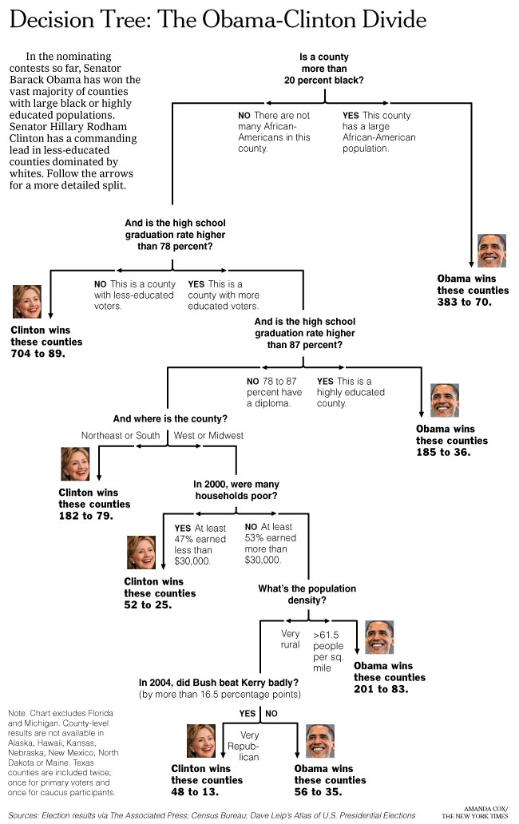
INTUITION BEHIND DECISION TREES
Decision trees are like the game “20 questions”. They make decision by answering a series of questions, most often binary questions (yes or no).
We want the smallest set of questions to get to the right answer.
Each questions should reduce the search space as much as possible.

Slide 24
TREES
Trees are a data structure made up of nodes and branches.
Each node typically has two or more branches that connect it to its children.
Node
Branches
Child
Node
Child
Node

Slide 25
TREES
Each child is another node in the tree and contains its own subtree.
Nodes without any children are known as leaf nodes.
Node
Branches
Child
Node
Leaf Node
Branches
Leaf Node
Leaf Node

Slide 26
DECISION TREES
A decision tree contains a question at every node.
Depending upon the answer to the question, we proceed down the left or right branch of the tree and ask another question.
Once we don’t have any more questions (at the leaf nodes), we make a prediction.
Note: The next question is always dependent on the last.
Question
Question
Leaf Node
Leaf Node
Question
Leaf Node
Leaf Node

Slide 27
DECISION TREES
Let’s suppose we want to predict if an article is a news article.
What questions should we ask to make a prediction?
How many questions should we ask?

Slide 28
DECISION TREES
We may start by asking: does it mention a President?
If it does, it must be a news article.
If not, let’s ask another question: does the article contain other political features?
If not, does the article contain references to political topics?
We could keep going on in this manner until we were satisfied.

Slide 29
ACTIVITY: KNOWLEDGE CHECK
ANSWER THE FOLLOWING QUESTIONS
EXERCISE
Let’s work as a class to accomplish the following:
Using our StumpleUpon dataset, try to predict whether a given article is evergreen.
Build a decision tree to determine the above.
DELIVERABLE
Our decision tree

Slide 30
COMPARISON TO PREVIOUS MODELS
Decision trees are non-linear, an advantage over logistic regression.
A linear model is one in which a change in an input variable has a constant change on the output variable.

Slide 31
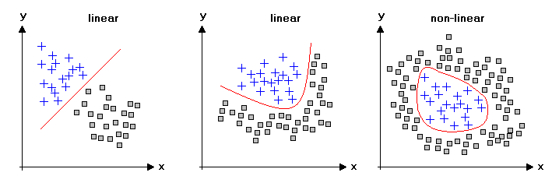
COMPARISON TO PREVIOUS MODELS
Linear vs. non-linear classification models

Slide 32
COMPARISON TO PREVIOUS MODELS
An example of this difference is the relationship between years of education and salary. In a linear model, the increase in salary from 10 to 16 years of education would be the same as the increase in salary from 16 to 22 years of education. In a non-linear model, salary can change dramatically for years 0-16 and negligibly from years 16-22.
Trees automatically contain interaction of features, since each question is dependent on the last.

Slide 33
TRAINING A DECISION TREE MODEL
Training a decision model is deciding the best set of questions to ask.
A good question will be one that best segregates the positive group from the negative group and then narrows in on the correct answer.
For example, in our news article decision tree, the best question is one that creates two groups, one that is mostly news stories and one that is mostly non-news stories.

Slide 34
TRAINING A DECISION TREE MODEL
We can quantify the purity of the separation of groups using Classification Error, Entropy, or Gini Coefficient.
We want to choose the question that gives us the best change in our purity measure. At each step, we can ask, “Given our current set of data points, which question will make the largest change in purity?”
This is done recursively for each new set of two groups until we reach a stopping point.

Slide 35
Advantages
Limitations
Simple
Easy to illustrate
Building block to more complicated classifiers
E.g. Random forests
Not very versatile
Low reliability
Prone to overfitting
Prone to random error
E.g. Order of variables chosen can influence final results
How can we fix this?

Slide 36
How can we fix this?
Randomly sample observations
Randomly sample features
Run a LOT of decision trees
Average together responses
Random Forests!

Slide 37
In Class Exercise
Run a decision tree for sample data set
Using scikit learn
Sample dataset
Iris dataset
What is the outcome for..
Sepal Length: 1
Sepal Width: 2
Petal Length: 1
Petal Width: 0.7

Slide 38
ACTIVITY: KNOWLEDGE CHECK
ANSWER THE FOLLOWING QUESTIONS
EXERCISE
How do we classify a new article?
How do we make predictions from a decision tree?
DELIVERABLE
Answers to the above questions

Slide 39
EXTRA GUIDED PRACTICE
DECISION TREES IN SCIKIT-LEARN

Slide 40
ACTIVITY: DECISION TREES IN SCIKIT-LEARN
DIRECTIONS (15 minutes)
EXERCISE
In the starter code notebook, work through the exercises titled “Decision Trees in scikit-learn”.
In your groups from earlier, work on evaluating the decision tree using cross-validation methods.
What metrics would work best? Why?
Check: Are you able to evaluate the decision tree model using cross-validation methods?
DELIVERABLE
Completed exercises and answer to #3

Slide 41
DEMO
OVERFITTING IN DECISION TREES

Slide 42
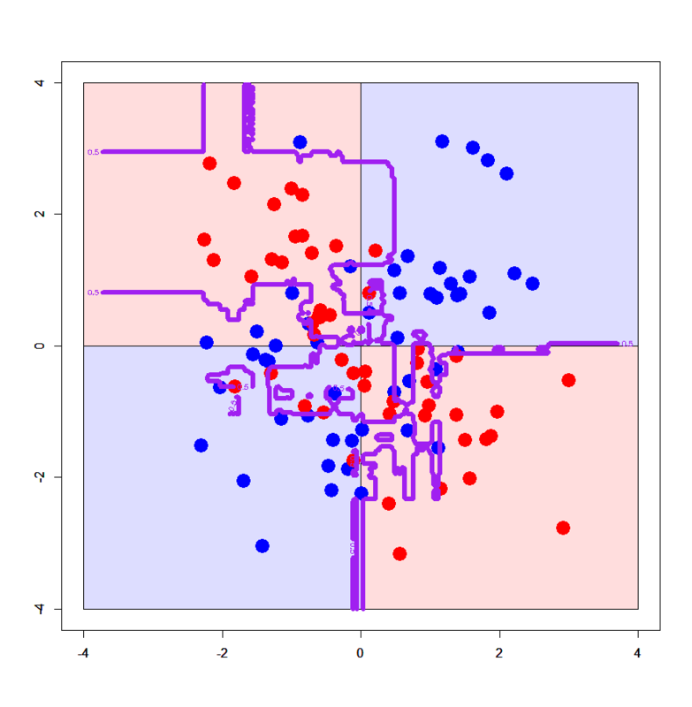
OVERFITTING IN DECISION TREES
Decision trees tend to be weak models
they can easily “memorize” or overfit to a dataset.
A model is overfit when it memorizes or bends to a few specific data points rather than picking up general trends in the data.

Slide 43
OVERFITTING IN DECISION TREES
An unconstrained decision tree can learn an extreme tree (e.g. one feature for each word in a news article).
We can limit our decision trees using a few methods.
Limiting the number of questions (nodes) a tree can have).
Limiting the number of samples in the leaf nodes.

Slide 44
ACTIVITY: KNOWLEDGE CHECK
ANSWER THE FOLLOWING QUESTIONS
EXERCISE
Why are decision trees generally thought of as weak models?
How can we limit our decision trees?
DELIVERABLE
Answers to the above questions

Slide 45
EXTRA GUIDED PRACTICE
ADJUSTING DECISION TREES TO AVOID OVERFITTING

Slide 46
ACTIVITY: ADJUSTING DECISION TREES TO AVOID OVERFITTING
DIRECTIONS (15 minutes)
EXERCISE
You can control for overfitting in decision trees by adjusting one of the following parameters:
max_depth: Control the maximum number of questions.
min_samples_in_leaf: Control the minimum number of records in each node.
Test each of these parameters in the starter code notebook.
DELIVERABLE
Code using the above parameters

Slide 47
INTRODUCTION
RUNNING THROUGH THE RANDOM FORESTS

Slide 48
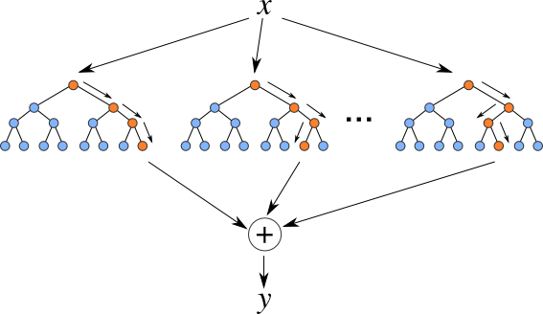
RUNNING THROUGH THE RANDOM FORESTS
Random forest models are one of the most widespread classifiers used.
They are relatively simple to use and help avoid overfitting.
Random Forests are an ensemble or collection of individual decision trees.

Slide 49
PROS AND CONS OF RANDOM FORESTS
Advantages
Easy to tune
Built-in protection against overfitting
Non-linear
Built-in interaction effects
Disadvantages
Slow
Black-box
No “coefficients”
Harder to explain

Slide 50
TRAINING A RANDOM FOREST
Training a random forest model :
involves training many decision tree models.
Since decision trees overfit easily…
We use many decision trees together
randomize the way they are created.

Slide 51
TRAINING A RANDOM FOREST
Random Forest Algorithm
Take a bootstrap sample of the dataset.
Train a decision tree on the bootstrap sample. For each split/feature selection, only evaluate a limited number of features to find the best one.
Repeat this for N trees.

Slide 52
PREDICTIONS USING A RANDOM FOREST
Predictions for a random forest model come from each decision tree.
Make an individual prediction with each decision tree.
Combine the individual predictions and take the majority vote.

Slide 53
GUIDED PRACTICE
RANDOM FORESTS

Slide 54
ACTIVITY: CLASSIFIER WITH RANDOM FORESTS
DIRECTIONS (20 minutes)
EXERCISE
Build a random forest model to predict the evergreeness of a website. Remember to use the parameter n_estimators to control the number of trees used in the model.
Take note of the features that give the best splits to determine the most important features.
DELIVERABLE
The models mentioned above

Slide 55
INDEPENDENT PRACTICE
RANDOM FOREST REGRESSION &
CROSS VALIDATION

Slide 56
ACTIVITY: REGRESSION WITH RANDOM FORESTS
DIRECTIONS (20 minutes)
EXERCISE
Open up decision trees part II
Decision trees and random forests can be used for both classification and regression. In regression, predictions are made by taking the average value of the samples in the leaf node. You can take the average of the individual trees’ predictions. Build a regression based random forest model.
DELIVERABLE
The models mentioned above

Slide 57
ACTIVITY: EVALUATE RANDOM FOREST USING CROSS-VALIDATION
DIRECTIONS (25 minutes)
EXERCISE
Building upon the previous Guided Practice (regression or classification), add any input variables to the model that you think may be relevant.
For each feature:
Evaluate the model for improved predictive performance using cross-validation.
Evaluate the importance of the feature.
Bonus: Just like the ‘recipe’ feature, add in similar text features and evaluate their performance.
DELIVERABLE
Newly created features and models

Slide 58
CONCLUSION
TOPIC REVIEW

Slide 59
REVIEW Q&A
What are decision trees?
What does training involve?
What are some common problems with decision trees?
What are random forests?
What are some common problems with random forests?

Slide 60
BUILD A CRAPPY MODEL FOR YOUR PROJECT
BEFORE NEXT THURSDAY
For your Final Project
(ok it doesn’t have to be crappy)x

Slide 61
LESSON
Q & A

Slide 62
LESSON
EXIT TICKET
DON’T FORGET TO FILL OUT YOUR EXIT TICKET

Slide 63
EXTRA SLIDES
Body Level One
Body Level Two
Body Level Three
Body Level Four
Body Level Five

Slide 64
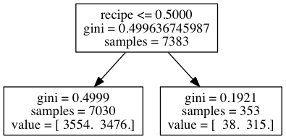
TRAINING A DECISION TREE MODEL
Let’s build a sample tree for our evergreen prediction problem. Assume our features are whether the article contains a recipe, the image ratio, the html ratio.
First, let’s choose the feature that gives us the highest purity, the recipe feature.

Slide 65
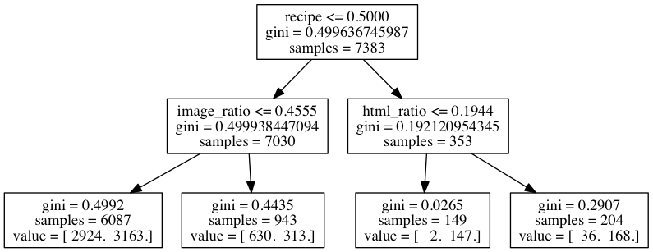
TRAINING A DECISION TREE MODEL
We can take each side of the tree and repeat the process.
We can continue this process until we have asked as many questions as we want or until our leaf nodes are completely pure.

Slide 66
MAKING PREDICTIONS FROM A DECISION TREE
Predictions are made by answering each of the questions.
Once we reach a leaf node, our prediction is made by taking the majority label of the training samples that fulfill the questions.
In our sample tree, if we want to classify a new article, ask:
Does the article contain the word recipe?
If it doesn’t, does the article have a lot of images?
If it does, then 630 / 943 article are evergreen.
So we can assign a 0.67 probability for evergreen sites.

