Slide 1
INTRODUCTION TO LOGISTIC REGRESSION
Reid Offringa, PhD
Data Scientist, Glooko

Slide 2
LEARNING OBJECTIVES
INTRODUCTION TO LOGISTIC REGRESSION
Build a Logistic regression classification model
Using sklearn
Explain coefficients in Logistic Regression
Describe a sigmoid function, odds, and the odds ratio as well as how they relate to logistic regression
Evaluate a model using metrics such as classification accuracy/error, confusion matrix, ROC/AUC curves, and loss functions

Slide 3
INTRODUCTION
LOGISTIC REGRESSION

Slide 4
LOGISTIC REGRESSION
Logistic regression is a linear approach to solving a classification problem.
That is, we can use a “generalized” linear model,
Think of it as similar, but not identical to Linear regression
in order to solve if an item
belongs or does not belong to a class label.

Slide 5

ACTIVITY: KNOWLEDGE CHECK
ANSWER THE FOLLOWING QUESTIONS
EXERCISE
What was the distribution most aligned with OLS/Linear Regression?
DELIVERABLE
Answers to the above questions

Slide 6
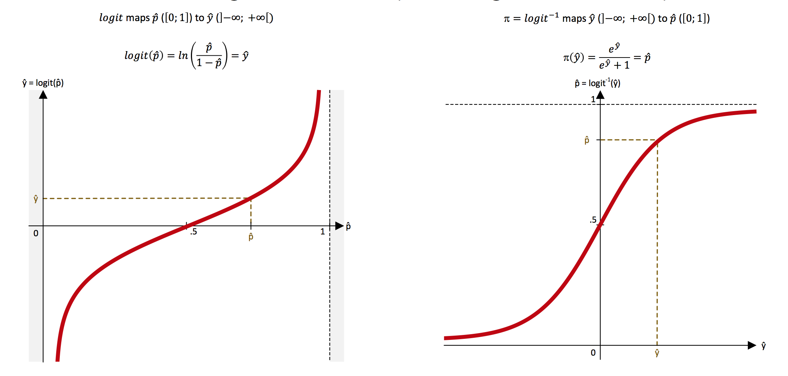
We can “retrofit” linear regression in logistic regression with a
transformation called the logit function (a.k.a., the log-odds function) and its inverse, the logistic function (a.k.a., sigmoid function)

Slide 7
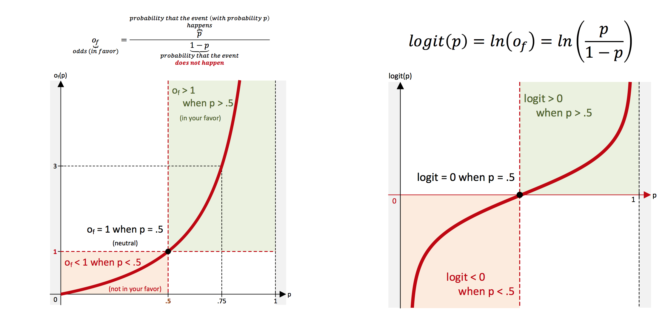
Why is the logit function also called the log-odds function?

Slide 8
THE SIGMOID
For classification,
we need a distribution associated with categories:
given all observations, what is the probability of a given event?
The link function that best allows for this is the logit function,
which is the inverse of the sigmoid function.

Slide 9
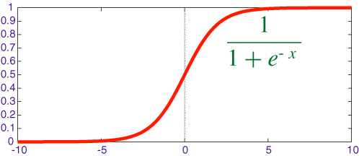

THE SIGMOID
A sigmoid function is a function that visually looks like an s.
Mathematically, it is defined as

Slide 10
THE SIGMOID
Recall that e is the inverse of the natural log.
As x increases, the results is closer to 1. As x decreases, the result is closer to 0.
When x = 0, the result is 0.5.

Slide 11
THE SIGMOID
Since x decides how to much to increase or decrease the value away from 0.5, x can be interpreted as something like a coefficient.
However, we still need to change its form to make it more useful.

Slide 12
DEMO
PLOTTING A SIGMOID FUNCTION

Slide 13
PLOTTING A SIGMOID FUNCTION
Use the sigmoid function definition with values of x between -6 and 6 to plot it on a graph.
Do this by hand or write Python code to evaluate it.
Recall that e = 2.71.
Do we get an the “S” shape we expect?

Slide 14
INTRODUCTION
LOGISTIC REGRESSION

Slide 15
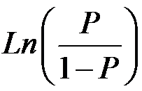
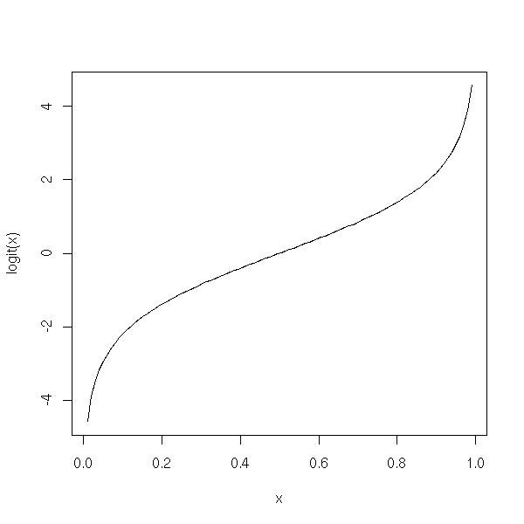
ODDS AND LOG-ODDS
The logit function is the inverse of the sigmoid function.
This will act as our link function for logistic regression.
Mathematically, the logit function is defined as

Slide 16
ODDS AND LOG-ODDS
The value within the natural log, p / (1-p) represents the odds. Taking the natural log of odds generates log odds.

Slide 17
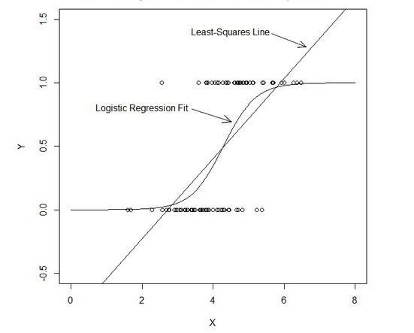
Contrast LOGIT with OLS
The logit function allows for X values between -∞ and ∞, but provides us probabilities between 0 and 1.

Slide 18
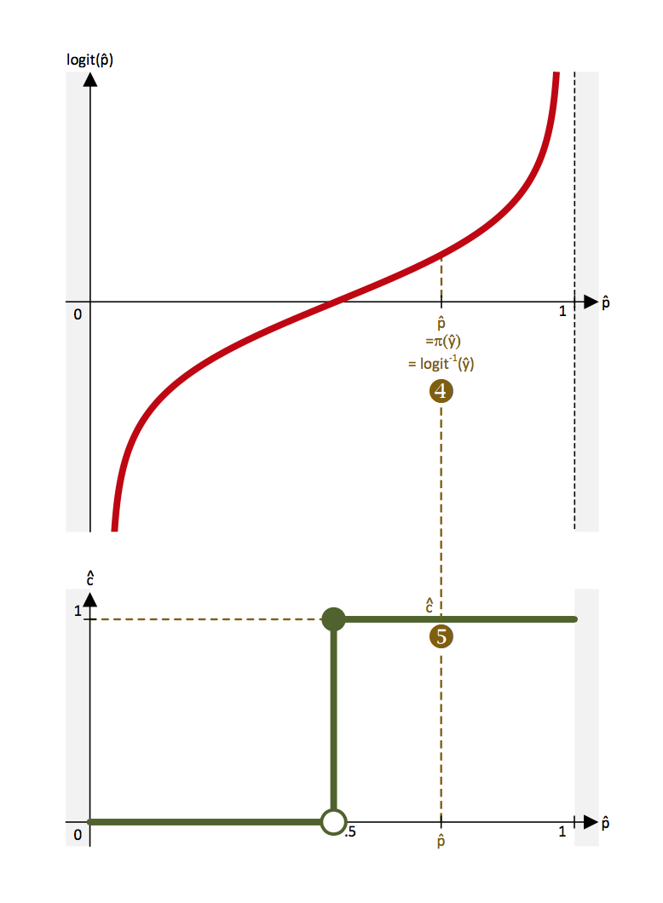
PROBABILITIES are “snapped” to class labels (by thresholding at the 50% level)

Slide 19
OPENING
Knowledge Check

Slide 20
INTRODUCTION TO LOGISTIC REGRESSION
ANSWER THE FOLLOWING QUESTIONS
EXERCISE
Read through the following questions and brainstorm answers for each:
What are the main differences between linear and KNN models? What is different about how they approach solving the problem?
For example, what is interpretable about OLS compared to what's interpretable in KNN?
What would be the advantage of using a linear model like OLS to solve a classification problem, compared to KNN?
What are some challenges for using OLS to solve a classification problem (say, if the values were either 1 or 0)?
Why is it important to take values between -∞ and ∞, but provide probabilities between 0 and 1?
DELIVERABLE
Answers to the above questions

Slide 21
ODDS AND LOG-ODDS
An example: the logit value (log odds) of 0.2
0.2 = ln(p / (1-p) )
With a mean probability of 0.5, the adjusted probability would be ~0.55.
1 / (1 + e^{-0.2})
e^{0.2} / (1 + e^{0.2})
To calculate this in python, we could use the following.
1 / (1 + numpy.exp(-0.2) )

Slide 22
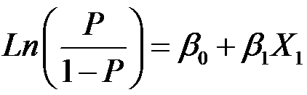

ODDS AND LOG-ODDS
While the logit value represents the coefficients in the logistic function, we can convert them into odds ratios that make them more easily interpretable.
The odds multiply by e^{B1} for every 1-unit increase in x.

Slide 23
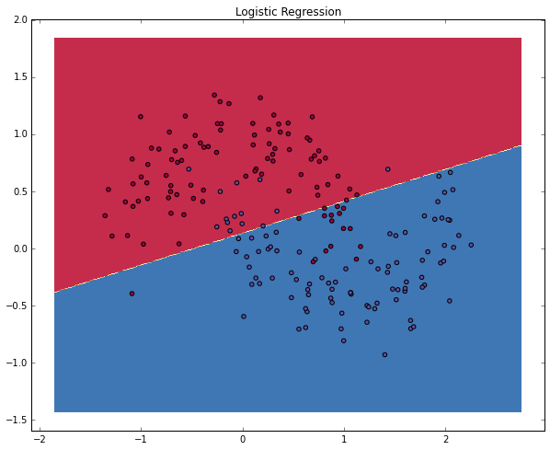
ODDS AND LOG-ODDS
With these coefficients, we get our overall probability: the logistic regression draws a linear decision line which divides the classes.

Slide 24
GUIDED PRACTICE
WAGER THOSE ODDS!

Slide 25
ACTIVITY: WAGER THOSE ODDS!
DIRECTIONS (15 minutes)
EXERCISE
Given the odds below for some football games, use the logit function and the sigmoid function to solve for the probability that the “better” team would win.
Stanford : Iowa, 5:1
Alabama : Michigan State, 20:1
Clemson : Oklahoma, 1.1:1
Houston : Florida State, 1.8:1
Ohio State : Notre Dame, 1.6:1
DELIVERABLE
The desired probabilities

Slide 26
ACTIVITY: WAGER THOSE ODDS!
STARTER CODE
EXERCISE
def logit_func(odds): # uses a float (odds) and returns back the log odds (logit) return None def sigmoid_func(logit): # uses a float (logit) and returns back the probability return None
DELIVERABLE
The desired probabilities

Slide 27
INDEPENDENT PRACTICE
LOGISTIC REGRESSION IMPLEMENTATION

Slide 28
ACTIVITY: LOGISTIC REGRESSION IMPLEMENTATION
DIRECTIONS (15 minutes)
EXERCISE
Use the data collegeadmissions.csv and the LogisticRegression estimator in sklearn to predict the target variable admit.
What is the bias, or prior probability, of the dataset?
Build a simple model with one feature and explore the coef_ value. Does this represent the odds or logit (log odds)?
Build a more complicated model using multiple features. Interpreting the odds, which features have the most impact on admission rate? Which features have the least?
What is the accuracy of your model?
DELIVERABLE
Answers to the above questions

Slide 29
INTRODUCTION
ADVANCED CLASSIFICATION METRICS

Slide 30
ADVANCED CLASSIFICATION METRICS
Accuracy is only one of several metrics used when solving a classification problem.
Accuracy = total predicted correct / total observations in dataset
Accuracy alone doesn’t always give us a full picture.
If we know a model is 75% accurate, it doesn’t provide any insight into why the 25% was wrong.

Slide 31
ADVANCED CLASSIFICATION METRICS
We can split up the accuracy of each label by using the RECALL (true positive rate) and the FALL-OUT (false positive rate).
Prediction
Positive Predictions
Negative Predictions
Positive Observations
True Positive
False Negative
(Type II Error)
Reality
Negative Observations
False Positive
(Type I Error)
True Negative

Slide 32
RECALL / SENSITIVITY
Recall asks, “Out of all of the target class labels, how many were accurately predicted to belong to that class?”
Prediction
Positive Predictions
Negative Predictions
True Positive
Positive Observations
True Positive
False Negative
(Type II Error)
Positive Observations
Reality
Negative Observations
False Positive
(Type I Error)
True Negative
Notes:
For example, given a medical exam that tests for cancer, how often does it correctly identify patients with cancer?

Slide 33
FALSE POSITIVE RATE
False Positive Rate (Fall-out) asks, “Out of all items not belonging to a class label, how many were predicted as belonging to that target class label?”
s
Prediction
Positive Predictions
Negative Predictions
False Positive
(Type I Error)
Positive Observations
True Positive
False Negative
(Type II Error)
Reality
Negative Observations
Negative Observations
False Positive
(Type I Error)
True Negative
Notes:
For example, given a medical exam that tests for cancer, how often does it correctly identify patients with cancer?

Slide 34
SPECIFICITY
Prediction
Positive Predictions
Negative Predictions
True Negative
Positive Observations
True Positive
False Negative
(Type II Error)
Reality
Negative Observations
Negative Observations
False Positive
(Type I Error)
True Negative
Notes:
How often does a test CORRECTLY identify patient as cancer-free?

Slide 35
FALSE NEGATIVE RATE
Prediction
Positive Predictions
Negative Predictions
False Negative
(Type II Error)
Positive Observations
True Positive
False Negative
(Type II Error)
Reality
Positive Observations
Negative Observations
False Positive
(Type I Error)
True Negative
Notes:
How often does a test incorrectly identify patient as cancer-free?

Slide 36
ADVANCED CLASSIFICATION METRICS
We can vary the classification threshold for our model to get different predictions. But how do we know if a model is better overall than other model?
We can compare the RECALL and FPR of the models, but it can often be difficult to optimize two numbers at once.
Logically, we like a single number for optimization.
Can you think of any ways to combine our two metrics?

Slide 37
ADVANCED CLASSIFICATION METRICS
This is where the Receiver Operation Characteristic (ROC) curve comes in handy.
The curve is created by plotting the true positive rate against the false positive rate at various model threshold settings.
Area Under the Curve (AUC) summarizes the impact of RECALL and FPR in one single value.

Slide 38
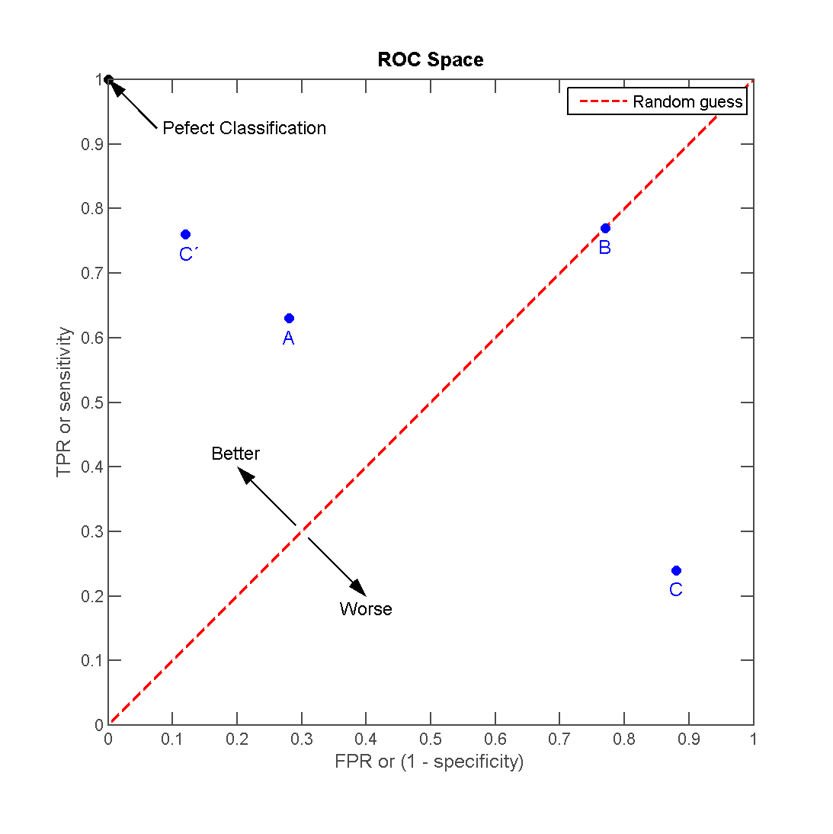
ADVANCED CLASSIFICATION METRICS
There can be a variety of points on an ROC curve.

Slide 39
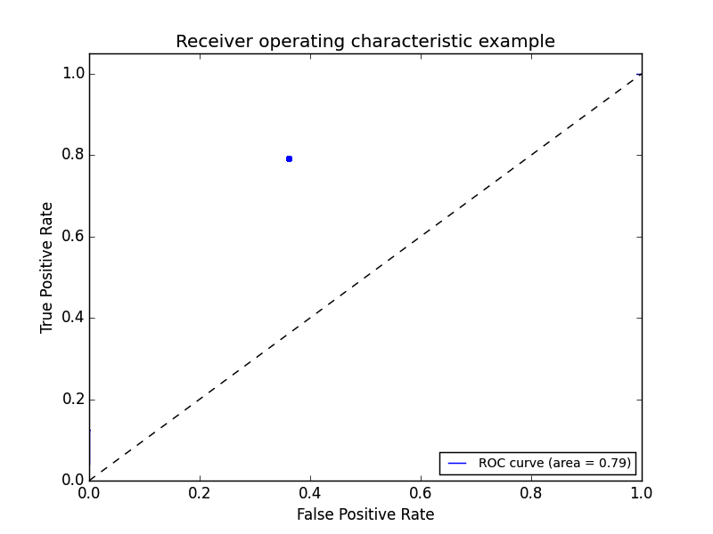
ADVANCED CLASSIFICATION METRICS
We can begin by plotting an individual TPR/FPR pair for one threshold.

Slide 40
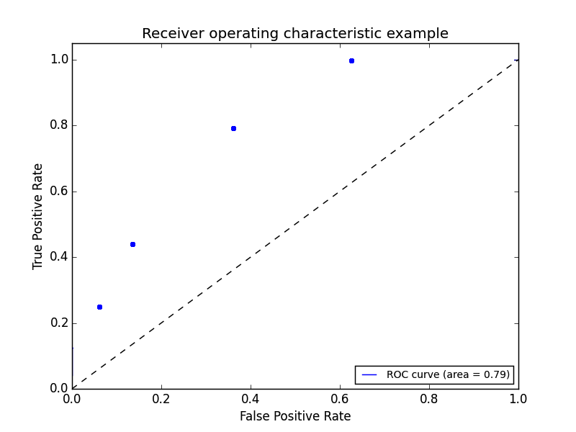
ADVANCED CLASSIFICATION METRICS
We can continue adding pairs for different thresholds

Slide 41
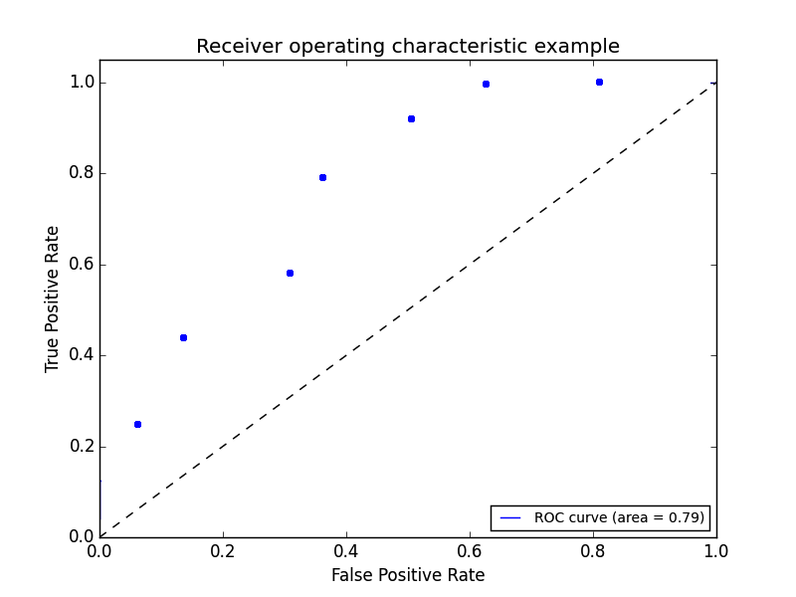
ADVANCED CLASSIFICATION METRICS
We can continue adding pairs for different thresholds

Slide 42
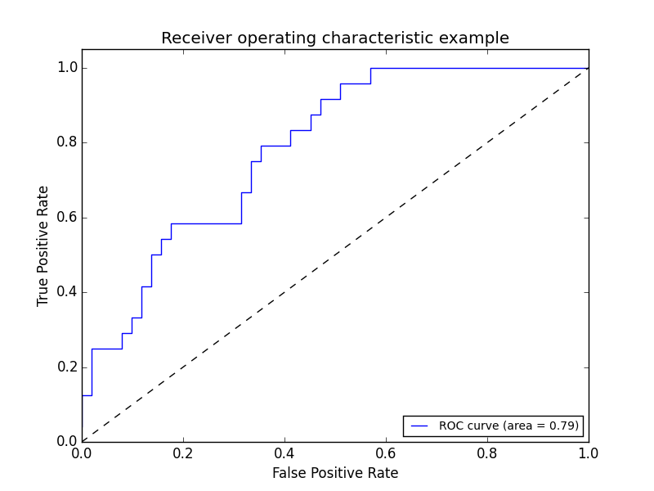
ADVANCED CLASSIFICATION METRICS
Finally, we create a full curve that is described by TPR and FPR.

Slide 43
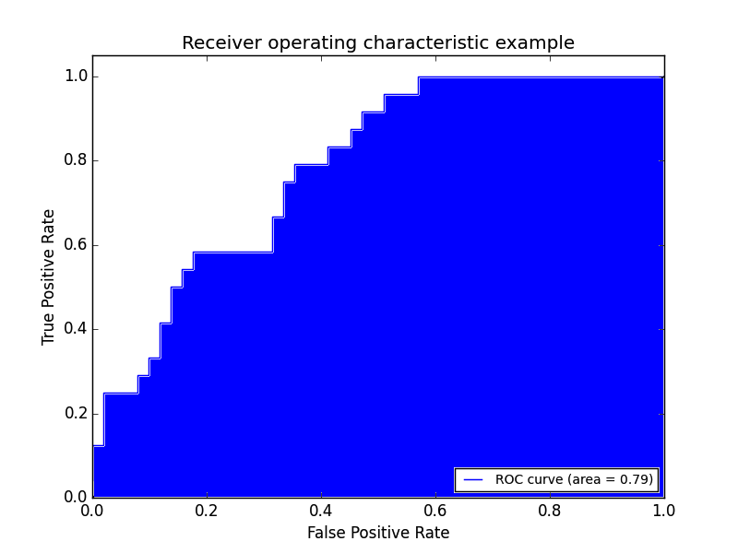
ADVANCED CLASSIFICATION METRICS
With this curve, we can find the Area Under the Curve (AUC).

Slide 44
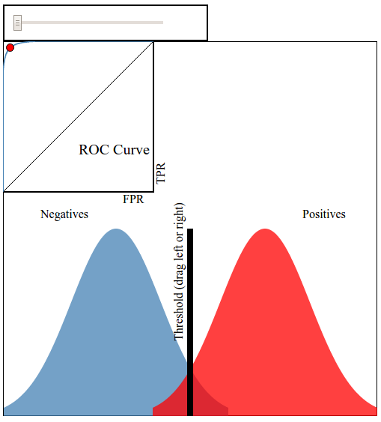
ADVANCED CLASSIFICATION METRICS
This interactive visualization can help practice visualizing ROC curves.
Notes:
http://www.navan.name/roc/

Slide 45
ADVANCED CLASSIFICATION METRICS
If we have a RECALL of 1 (all positives are marked positive) and FPR of 0 (all negatives are not marked positive), we’d have an AUC of 1. This means everything was accurately predicted.
If we have a RECALL of 0 (all positives are not marked positive) and an FPR of 1 (all negatives are marked positive), we’d have an AUC of 0. This means nothing was predicted accurately.
An AUC of 0.5 would suggest randomness (somewhat) and is an excellent benchmark to use for comparing predictions (i.e. is my AUC above 0.5?).

Slide 46
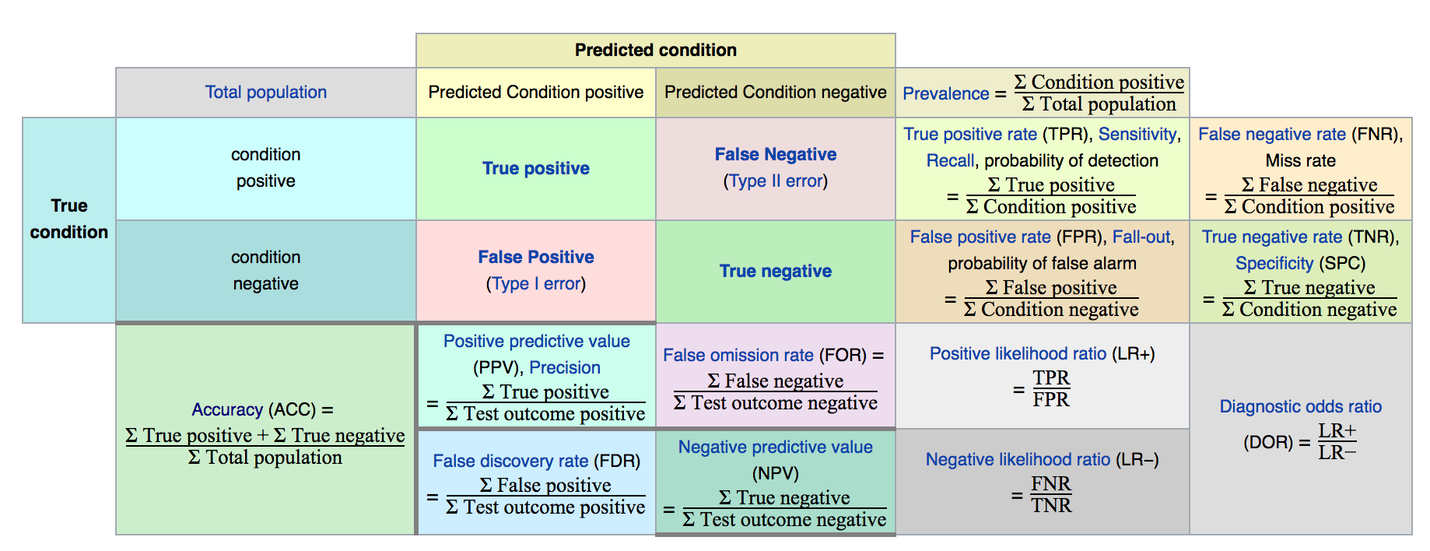
ADVANCED CLASSIFICATION METRICS
Sklearn has all of the metrics located on one convenient page.
Notes:
http://scikit-learn.org/stable/modules/classes.html#sklearn-metrics-metrics

Slide 47
GUIDED PRACTICE
WHICH METRIC SHOULD I USE?

Slide 48
ACTIVITY: WHICH METRIC SHOULD I USE?
DIRECTIONS (15 minutes)
EXERCISE
While AUC seems like a “golden standard”, it could be further improved depending upon your problem. There will be instances where error in positive or negative matches will be very important. For each of the following examples:
Write a confusion matrix: true positive, false positive, true negative, false negative. Then decide what each square represents for that specific example.
Define the benefit of a true positive and true negative.
Define the cost of a false positive and false negative.
Determine at what point does the cost of a failure outweigh the benefit of a success? This would help you decide how to optimize RECALL, FPR, and AUC.
DELIVERABLE
Answers for each example

Slide 49
ACTIVITY: WHICH METRIC SHOULD I USE?
DIRECTIONS (15 minutes)
EXERCISE
Examples:
A test is developed for determining if a patient has cancer or not.
A newspaper company is targeting a marketing campaign for "at risk" users that may stop paying for the product soon.
You build a spam classifier for your email system.
DELIVERABLE
Answers for each example

Slide 50
INDEPENDENT PRACTICE
EVALUATING LOGISTIC REGRESSION WITH ALTERNATIVE METRICS

Slide 51
ACTIVITY: EVALUATING LOGISTIC REGRESSION
DIRECTIONS (35 minutes)
EXERCISE
Kaggle’s common online exercise is exploring survival data from the Titanic.
Spend a few minutes determining which data would be most important to use in the prediction problem. You may need to create new features based on the data available. Consider using a feature selection aide in sklearn. For a worst case scenario, identify one or two strong features that would be useful to include in this model.
DELIVERABLE
Answers to the above question and a Logistic model on the Titanic data
Notes:
https://www.kaggle.com/c/titanic

Slide 52
ACTIVITY: EVALUATING LOGISTIC REGRESSION
DIRECTIONS (35 minutes)
EXERCISE
Spend 1-2 minutes considering which metric makes the most sense to optimize. Accuracy? FPR or RECALL? AUC? Given the business problem of understanding survival rate aboard the Titanic, why should you use this metric?
Build a tuned Logistic model. Be prepared to explain your design (including regularization), metric, and feature set in predicting survival using any tools necessary (such as a fit chart). Use the starter code to get you going.
DELIVERABLE
Answers to the above question and a Logistic model on the Titanic data

Slide 53
CONCLUSION
TOPIC REVIEW

Slide 54
REVIEW QUESTIONS
What’s the link function used in logistic regression?
What kind of machine learning problems does logistic regression address?
What do the coefficients in a logistic regression represent? How does the interpretation differ from ordinary least squares? How is it similar?

Slide 55
REVIEW QUESTIONS
How does True Positive Rate and False Positive Rate help explain accuracy?
What would an AUC of 0.5 represent for a model? What about an AUC of 0.9?
Why might one classification metric be more important to tune than another? Give an example of a business problem or project where this would be the case.

Slide 56
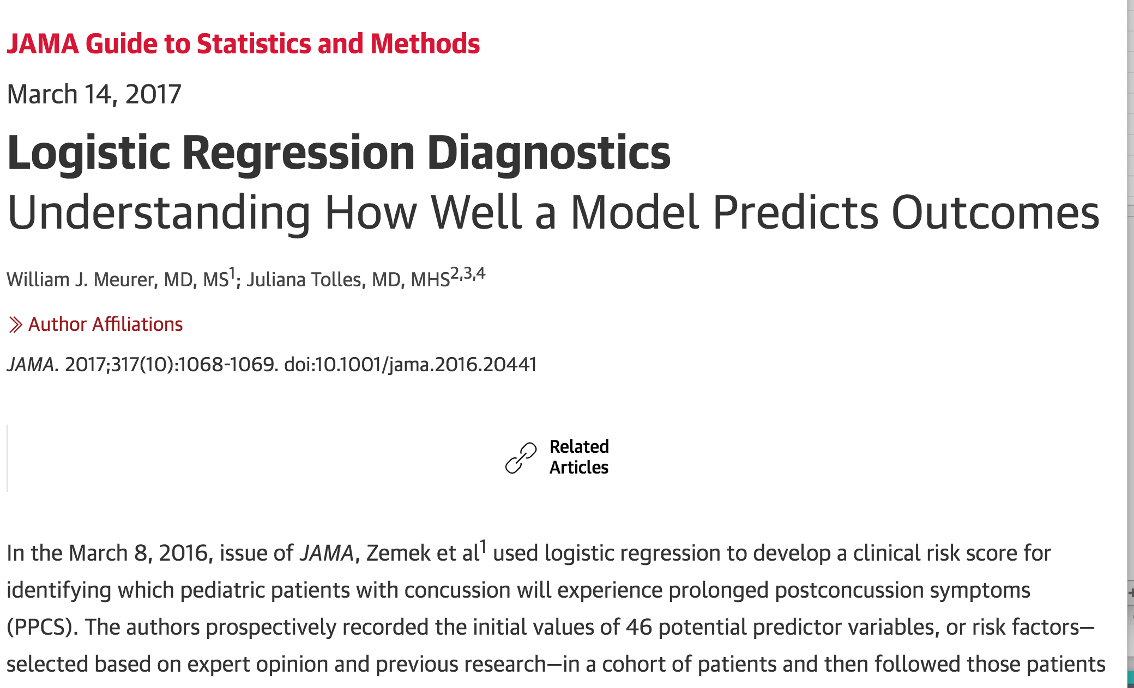
FURTHER READING: Recent Logistic Regression Discussion in JAMA
http://jamanetwork.com/journals/jama/article-abstract/2610320?utm_medium=alert&utm

Slide 57
LESSON
Q & A

Slide 58
LESSON
EXIT TICKET
DON’T FORGET TO FILL OUT YOUR EXIT TICKET

