Slide 1
CLUSTERING
Reid Offringa
Data Scientist, Glooko

Slide 2
LEARNING OBJECTIVES
COMMUNICATING RESULTS
Supervised vs unsupervised algorithms
Understand and apply k-means clustering
Expectation Maximization
Silhouette Metric

Slide 3
OPENING
UNSUPERVISED LEARNING

Slide 4
Types of Machine Learning Problems
Continuous
Categorical
Supervised
Regression
Classification
PCA /
Factor analysis
Clustering
Unsupervised

Slide 5
UNSUPERVISED LEARNING
WHAT: Discovers underlying structure of your data
WHY: Can help explain the contents of a large dataset
Explain “noise” in dataset
Can help to segment
HOW: Clustering
EM
KMeans

Slide 6
UNSUPERVISED LEARNING
Unsupervised learning has a different goal: feature discovery
Think of PCA and LDA!
Clustering is a common and fundamental example of unsupervised learning
Clustering algorithms try to find meaningful groups within data
COMPARE TO Classification - supervised: each observation (row of data) has an objective outcome on which we can train a model.

Slide 7
CLUSTERING
THE PROBLEM WITH HETEROGENEITY

Slide 8
Common Problem: Who are our customers?
Typical Solution:
Descriptive stats!
E.g. Mean age, Median weight
E.g. Standard deviation, range, 95% CI
Limitation:
Heterogenous dataset!
Segmentation?
Suppose the mean user age is 58
Marketing starts targeting 58 year olds!

Slide 9
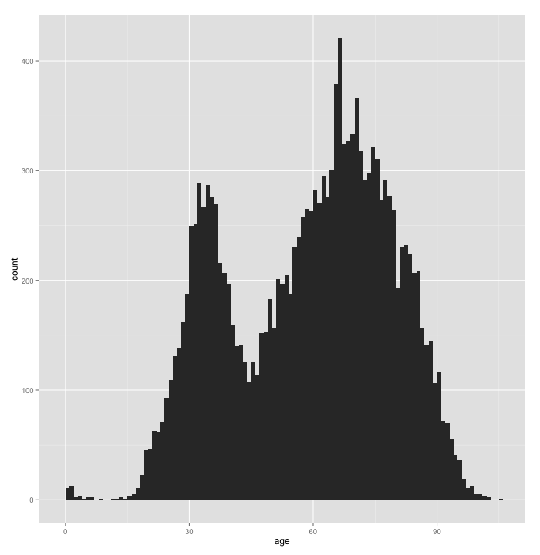
But wait a second…
Mean Age is 58

Slide 10
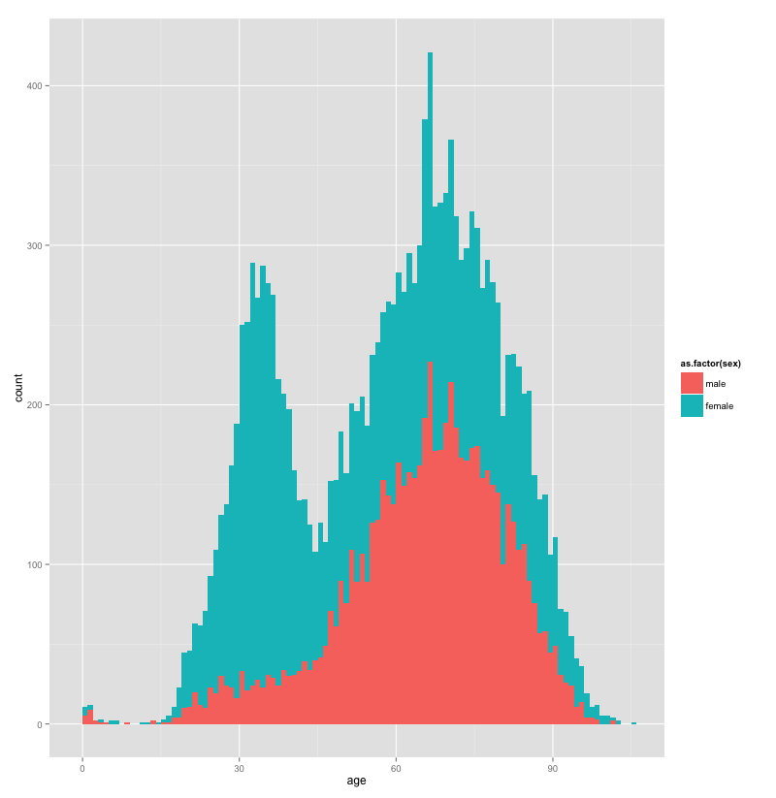
Let’s explore this further
Mean Age is 58
Females
Males

Slide 11
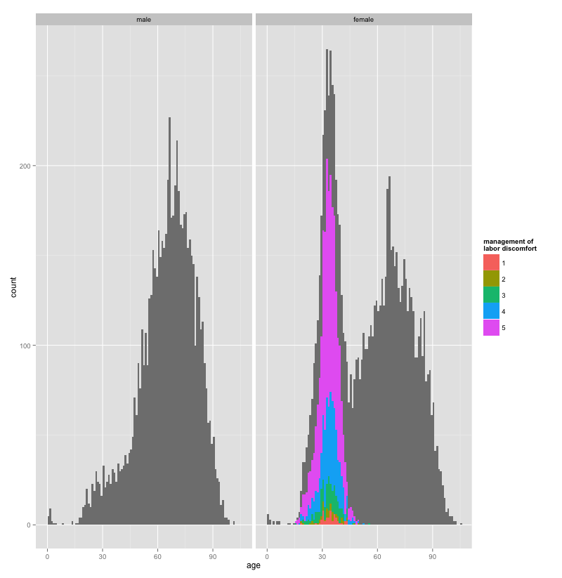
Oh! That makes sense
Males
Females
Reporting Labor Pain

Slide 12
Alternative to Graphing Everything : EM
Take the same data
Extract Two Latent Classes
Latent Class 1, n=13,487
50% Female
Age 62.99
0% Reporting Labor Pain
Latent Class 2, n=2,963
100% Female
Age 32.09
100% Reporting Labor Pain

Slide 13
So, who are our customers?
Most are around 65
NOT 58!
Mix of males and females
But SOME are around 32
100% female!
That’s important!
They’re giving birth!
Not there for old age!
So, how does this clustering method work?

Slide 14
CLUSTERING
EXPECTATION MAXIMIZATION

Slide 15
Expectation Maximization!
Two steps
1) Expectation
2) Maximization
Basically, a guess and check loop

Slide 16
EM: What is it?
Two steps
1) Expectation
Given a guess for missing information
Returns ‘expected’ estimate
2) Maximization
Given ‘expected’ estimate
Optimize missing parameters

Slide 17
EM: What is it?
OK, sort of 3 steps
A) Initial random guess for missing info
1) Expectation
Given a guess for missing information
Returns ‘expected’ estimate
2) Maximization
Given ‘expected’ estimate
Optimize missing parameters

Slide 18
EM: Finding Maximum Likelihood
A) Initial random guess for ML
1) Expectation
Guess for the maximum likelihood
Returns a guess for the expected probabilities
2) Maximization
Given ‘expected’ probabilities
Calculates the maximum likelihood

Slide 19
Coin Flipping Example
A
B
P(Heads | A ) = 0.80
P(Heads | B ) = 0.45

Slide 20
Coin Flipping Example
A
Say we observe the following:
HHHHTHHHHH
Is it A or B?
What about:
HTTTHHTHTH
Is it A or B?
P(Heads | A ) = 0.80
B
P(Heads | B ) = 0.45

Slide 21
Coin Flipping Example
Don’t know group membership
1) HTTTH HTHTH
2) HHHHT HHHHH
3) HTHHH HHTHH
4) HTHTT THHTT
5) THHHT HHHTH
A
Don’t know this!
P(Heads | A ) = ??
B
We can automate these guesses!
With EM!
Don’t know this!
P(Heads | B ) = ??

Slide 22
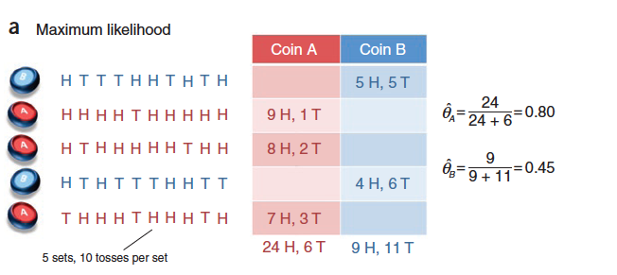
EASY IF YOU KNEW EVERYTHING

Slide 23
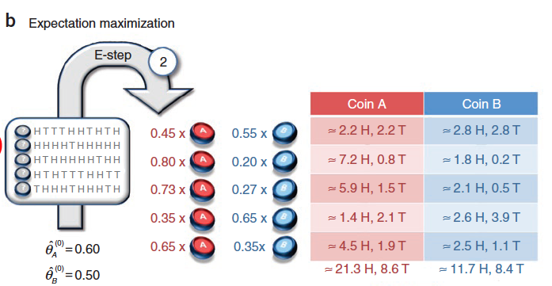
Expectation Step: OVERVIEW
First we make a guess!

Slide 24
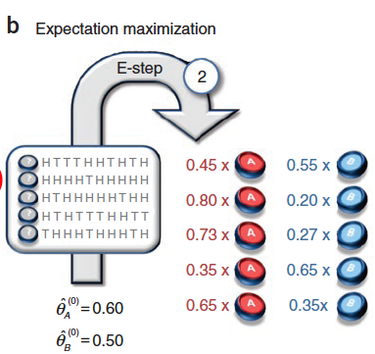
Expectation Step: Part 1
Assume observations are generated by some prior probability (theta)
Given theta sub A, what’s the P(A | o)?
Use binomial formula!
Then find the probability of an observation belonging to A, compared to B:
P(A|o)/[P(A|o)+P(B|o)]

Slide 25
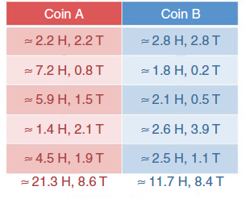
Expectation Step: Part 2
This formula generates a “weight” :
P(A|o)/[P(A|o)+P(B|o)]
For each observation:
Multiply weight by number of heads and tails.
Add them up
Produces a count of heads and tails
Weighted by probability of coin membership

Slide 26
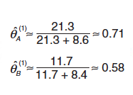
Maximization Step: ML from Weighted Count

Slide 27
Maximization Step: IF YOU KNEW EVERYTHING

Slide 28
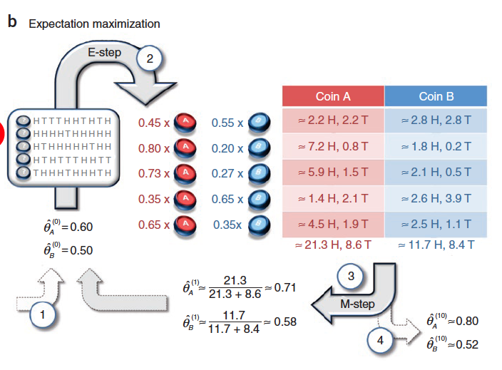
REPEAT

Slide 29
What uses the EM algorithm?
EM clustering
K-means clustering
sometimes called “Hard EM”
Latent class analysis
AKA mixture models
AKA Latent profile analysis
Item response theory
Probit regression

Slide 30
CLUSTERING
CLUSTERING

Slide 31
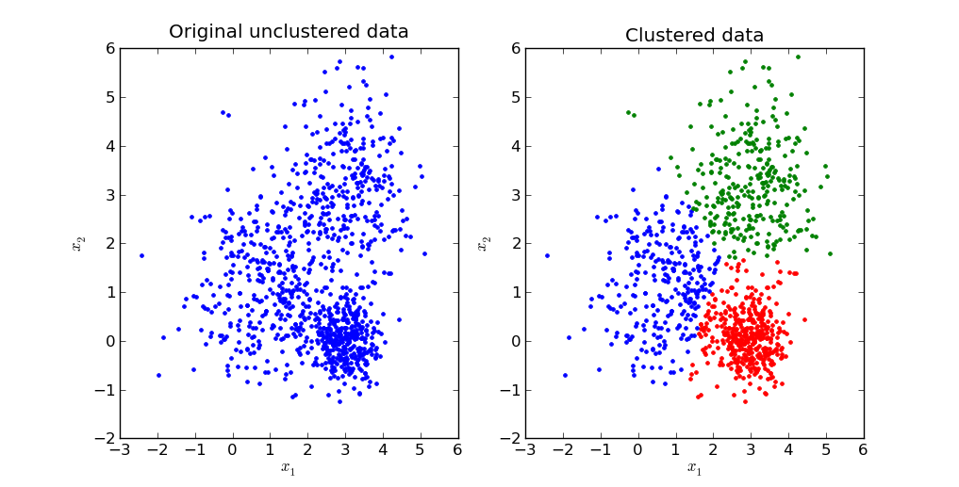
CLUSTERING: Centroids
Source: http://stackoverflow.com/questions/24645068/k-means-clustering-major-understanding-issue

Slide 32

ACTIVITY: KNOWLEDGE CHECK
ANSWER THE FOLLOWING QUESTIONS
Why might data often appear in centered clusters?
EXERCISE
DELIVERABLE
Answers to the above questions

Slide 33
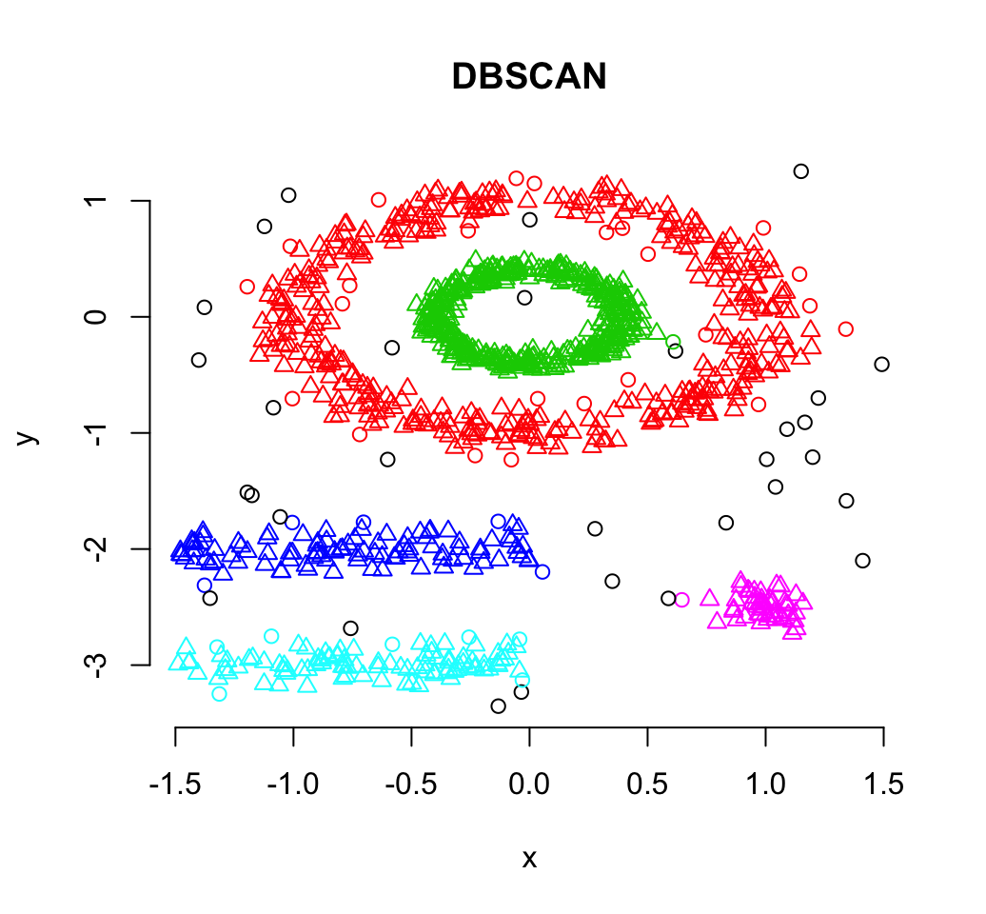
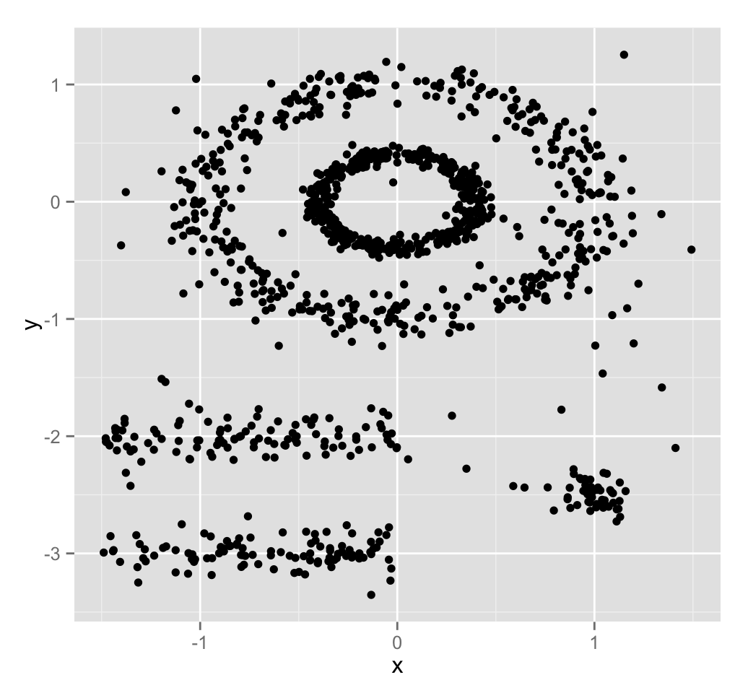
CLUSTERING: Density-Based
Source: http://www.sthda.com/english/wiki/dbscan-density-based-clustering-for-discovering-clusters-in-large-datasets-with-noise-unsupervised-machine-learning

Slide 34
ACTIVITY: KNOWLEDGE CHECK
ANSWER THE FOLLOWING QUESTIONS
Why might data often appear in density-based clusters?
EXERCISE
DELIVERABLE
Answers to the above questions

Slide 35
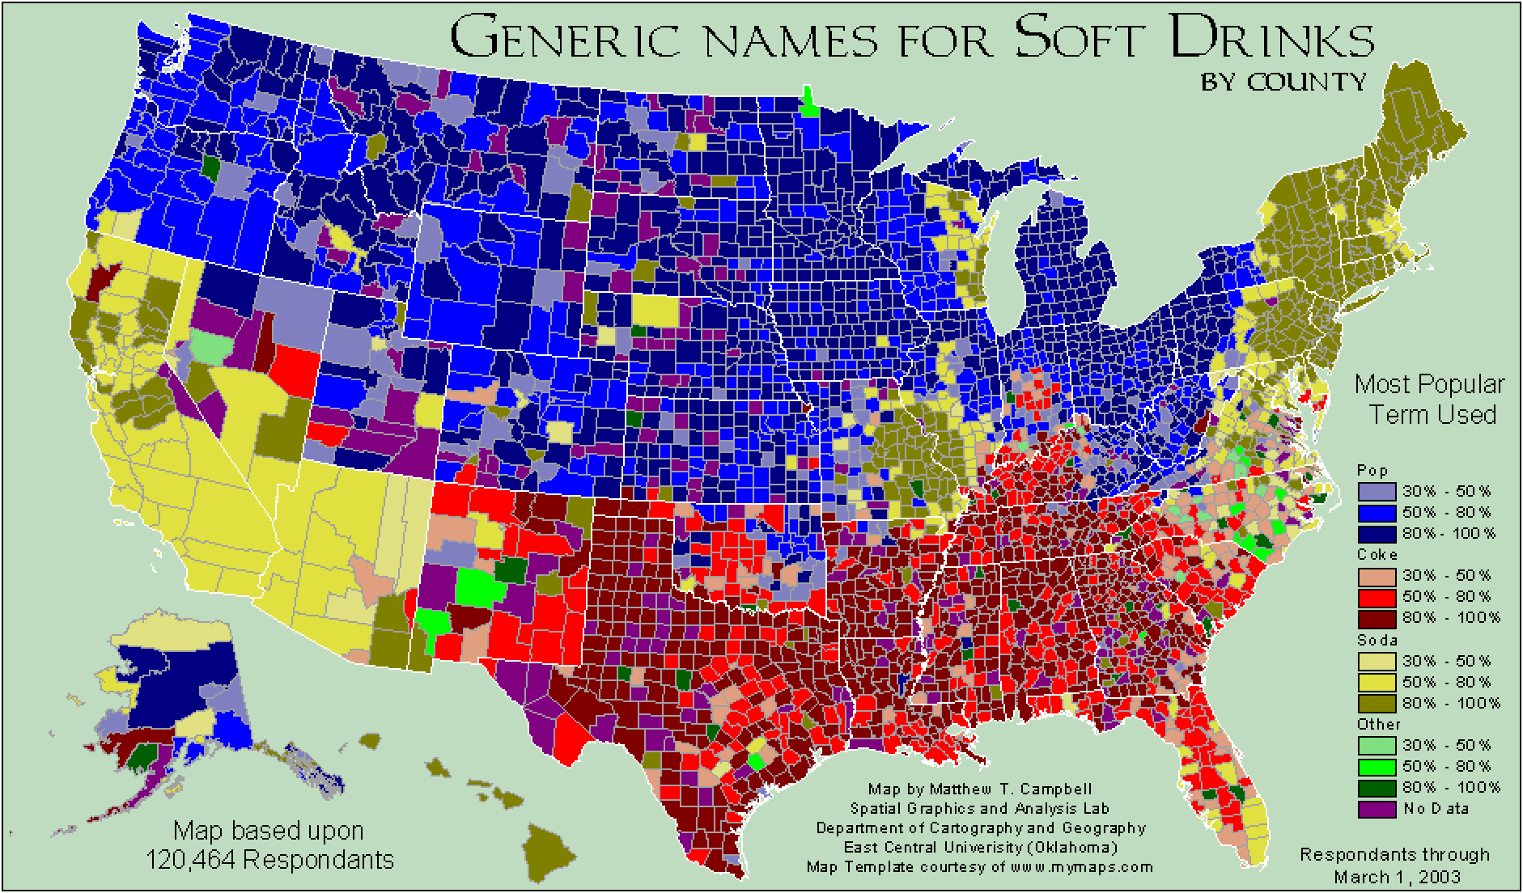
ACTIVITY: KNOWLEDGE CHECK
See also: http://www4.ncsu.edu/~jakatz2/files/dialectposter.png

Slide 36
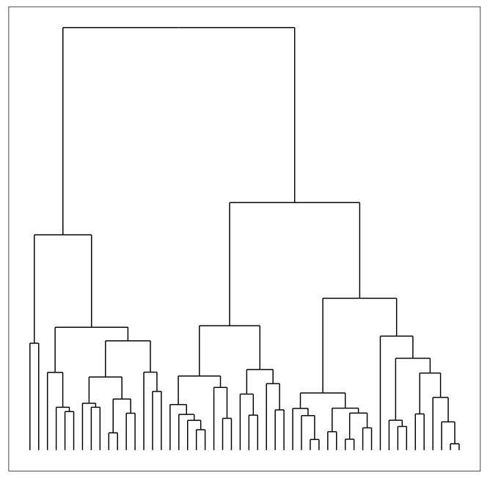
CLUSTERING: Hierarchical
Build hierarchies that form clusters
Based on classification trees (next lesson)

Slide 37
ACTIVITY: KNOWLEDGE CHECK
ANSWER THE FOLLOWING QUESTIONS
How is unsupervised learning different from classification?
EXERCISE
DELIVERABLE
Answers to the above questions

Slide 38
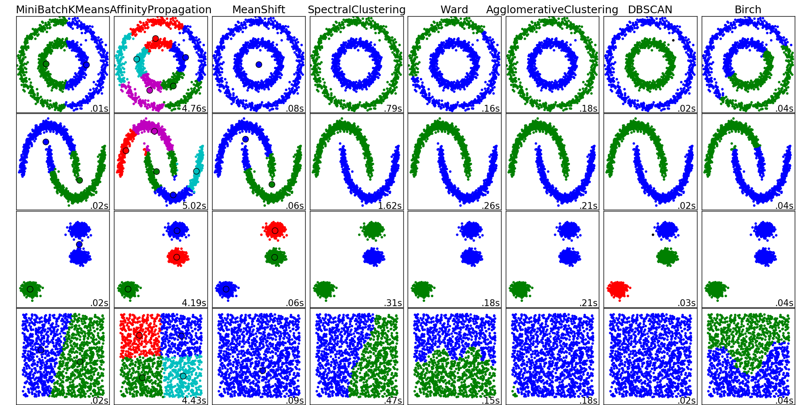
CLUSTERING
There are many clustering algorithms
Notes:
http://scikit-learn.org/stable/auto_examples/cluster/plot_cluster_comparison.html#example-cluster-plot-cluster-comparison-py

Slide 39
ACTIVITY: KNOWLEDGE CHECK
ANSWER THE FOLLOWING QUESTIONS
Can you think of a real-world clustering application?
EXERCISE
DELIVERABLE
Answers to the above questions

Slide 40
ACTIVITY: KNOWLEDGE CHECK
ANSWERS – Note: I’ll record this in class
EXERCISE
Notes:
Recommendation Systems e.g. Netflix genres
Medical Imaging: differentiate tissues
Identifying market segments
Discover communities in social networks
Lots of applications for genomic sequences (homologous sequences, genotypes)
Earthquake epicenters
Fraud detection

Slide 41
CLUSTERING
K-MEANS: CENTRIOD CLUSTERING

Slide 42
K-MEANS CLUSTERING
k-Means clustering is a popular centroid-based clustering algorithm
Basic idea: find k clusters in the data centrally located around various mean points
Awesome Demo
Notes:
http://www.naftaliharris.com/blog/visualizing-k-means-clustering/

Slide 43
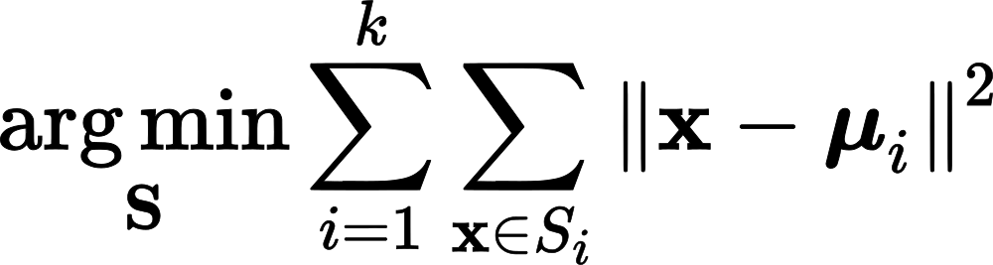
K-MEANS CLUSTERING
k-Means seeks to minimize the sum of squares about the means
Precisely, find k subsets S_1, … S_k of the data with means mu_1, …, mu_k that minimizes:

Slide 44
K-MEANS CLUSTERING
This is a computationally difficult problem to solve so we rely on heuristics
The “standard” heuristic is called “Lloyd’s Algorithm”:
Start with k initial mean values
Data points are then split up into a Voronoi diagram
Each point is assigned to the “closest” mean
Calculate new means based on centroids of points in the cluster
Repeat until clusters do not change
Notes:
https://en.wikipedia.org/wiki/Voronoi_diagram

Slide 45
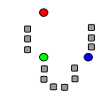
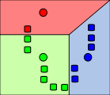
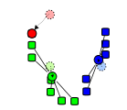
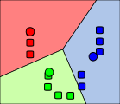
K-MEANS CLUSTERING
Start with initial k mean values
Data points are then split up into a Voronoi diagram
Calculate new means based on centroids

Slide 46
K-MEANS CLUSTERING
from sklearn.cluster import KMeans
est = KMeans(n_clusters=3)
est.fit(X)
labels = est.labels_
Let’s try it out!

Slide 47
ACTIVITY: KNOWLEDGE CHECK
ANSWER THE FOLLOWING QUESTIONS
How do we assign meaning to the clusters we find?
Do clusters always have meaning?
EXERCISE
DELIVERABLE
Answers to the above questions

Slide 48
K-MEANS CLUSTERING
Assumptions are important! k-Means assumes:
k is the correct number of clusters
the data is isotropically distributed (circular/spherical distribution)
the variance is the same for each variable
clusters are roughly the same size
Nice counterexamples / cases where assumptions are not met:
http://varianceexplained.org/r/kmeans-free-lunch/
Scikit-Learn Examples

Slide 49
CLUSTERING – We’re going to skip this section
But I’m including here for people who want to know more
DBSCAN: DENSITY BASED CLUSTERING

Slide 50
DBSCAN CLUSTERING
DBSCAN: Density-based spatial clustering of applications with noise (1996)
Main idea: Group together closely-packed points by identifying
Core points
Reachable points
Outliers (not reachable)
Two parameters:
min_samples
eps

Slide 51
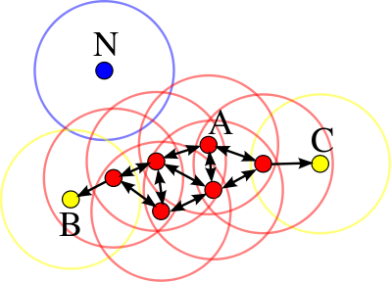
DBSCAN CLUSTERING
Core points: at least min_samples points within eps of the core point
Such points are directly reachable from the core point
Reachable: point q is reachable from p if there is a path of core points from p to q
Outlier: not reachable

Slide 52
DBSCAN CLUSTERING
A cluster is a collection of connected core and reachable points

Slide 53
CLUSTERING: Density-Based
Another example: Page 6
Awesome Demo

Slide 54
ACTIVITY: KNOWLEDGE CHECK
ANSWER THE FOLLOWING QUESTIONS
How does DBSCAN differ from k-means?
EXERCISE
DELIVERABLE
Answers to the above questions

Slide 55
DBSCAN CLUSTERING
from sklearn.cluster import DBSCAN
est = DBSCAN(eps=0.5, min_samples=10)
est.fit(X)
labels = est.labels_
Let’s try it out!

Slide 56
DBSCAN CLUSTERING
DBSCAN advantages:
Can find arbitrarily-shaped clusters
Don’t have to specify number of clusters
Robust to outliers
DBSCAN disadvantages:
Doesn’t work well when clusters are of varying densities
hard to chose parameters that work for all clusters
Can be hard to chose correct parameters regardless

Slide 57
ACTIVITY: CLUSTERING USERS
ANSWER THE FOLLOWING QUESTIONS
How does DBSCAN differ from k-means?
EXERCISE
DELIVERABLE
Answers to the above questions

Slide 58
CLUSTERING
HIERARCHICAL CLUSTERING

Slide 59
CLUSTERING: Hierarchical
Build hierarchies that form clusters
Based on classification trees (next lesson)

Slide 60
HIERARCHICAL CLUSTERING
We’ll discuss the details once we cover decision trees. For now we can black box the model and fit with sklearn
from sklearn.cluster import AgglomerativeClustering
est = AgglomerativeClustering(n_clusters=4)
est.fit(X)
labels = est.labels_
Let’s try it out!

Slide 61
CLUSTERING
CLUSTERING METRICS

Slide 62
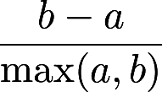
CLUSTERING METRICS
As usual we need a metric to evaluate model fit
For clustering we use a metric called the Silhouette Coefficient
a is the mean distance between a sample and all other points in the cluster
b is the mean distance between a sample and all other points in the nearest cluster
The Silhouette Coefficient is:
Ranges between 1 and -1
Average over all points to judge the cluster algorithm

Slide 63
CLUSTERING METRICS
from sklearn import metrics
from sklearn.cluster import KMeans
kmeans_model = KMeans(n_clusters=3, random_state=1).fit(X)
labels = kmeans_model.labels_
metrics.silhouette_score(X, labels, metric='euclidean')

Slide 64
CLUSTERING METRICS
There are a number of other metrics based on:
Mutual Information
Homogeneity
Adjusted Rand Index (when you know the labels on the training data)

Slide 65
PUTTING IT TOGETHER
CLUSTERING, CLASSIFICATION,
AND REGRESSION

Slide 66
ACTIVITY: KNOWLEDGE CHECK
ANSWER THE FOLLOWING QUESTIONS
How might we combine clustering and classification?
EXERCISE
DELIVERABLE
Answers to the above questions

Slide 67
CLUSTERING, CLASSIFICATION, AND REGRESSION
We can use clustering to discover new features and then use those features for either classification or regression
For classification, we could use e.g. k-NN to classify new points into the discovered clusters
For regression, we could use a dummy variable for the clusters as a variable in our regression

Slide 68
ACTIVITY: CLUSTERING + CLASSIFICATION
EXERCISE
Using the starter code, perform a k-means clustering on the flight delay data
Use the clustering to create a classifier
EXERCISE
DELIVERABLE
A completed notebook

Slide 69
CONCLUSION
TOPIC REVIEW

Slide 70
REVIEW AND NEXT STEPS
Clustering is used to discover features, e.g. segment users or assign labels (such as species)
Clustering may be the goal (user marketing) or a step in a data science pipeline

Slide 71
COURSE
BEFORE NEXT CLASS

Slide 72
UPCOMING
BEFORE NEXT CLASS
Lightning Talks!
Please make a 10-15 minute presentation on your data project so far

Slide 73
LESSON
Q & A

Slide 74
LESSON
EXIT TICKET
DON’T FORGET TO FILL OUT YOUR EXIT TICKET

