Slide 1
WHY
Business Challenges
Plan → Act → Verify: a 2-minute pending window to Cancel, idempotent ticket create/merge in ServiceNow, Status/ETA cards with Refresh and Close, and live KPIs (MTTR, Deflection, CSAT).
KPIs Impacted
Use Case Description
Fragmented tools and repeated
intake
Status pings & manual triage
Duplicate requests under retries
MTTR ↓
Deflection ↑
Duplicate tickets ↓
CSAT ↑
SLA attainment ↑
Teams-first AI agent that turns employee requests into actions across IT/HR/Facilities.
Employee Experience Orchestrator (EE ORCh)
Business Impact
Faster resolution & fewer handoffs
Lower support load
Better employee experience
HOW
WHO
Reduce portal hopping and employee
frustration
Prevent mistaken/duplicate tickets
Shorten turnaround time and improve
satisfaction
Functional Solution
Technical Solution
Stakeholders
Teams bot + Adaptive Cards
2‑min Pending window → Cancel
ServiceNow create/merge + Status/Close
Node/TypeScript bot service
Azure OpenAI (intent) + Content Safety
ServiceNow Table API + telemetry
Employees (request & track)
IT Service Desk / HR / Facilities
Support leads (report KPIs)
Single entry point in Teams
Actions: Create / Cancel / Status / Close
Escalate to humans when needed
Employees
Service Desk
HR/Facilities owners
IT Ops / Security
EE ORCh | Agent Bridge team |

Slide 2





Use Case Scope in the Business Process
Employee Service Delivery — where EE ORCh fits
L1
Campaign Management
L2 processes
Campaign Planning
Campaign Design
Campaign Execution & Follow Up
Campaign Supervision
L3
Covered steps are highlighted: Intake, Validation, Ticket Create/Merge, Status Updates, Cancel, Close, Feedback.
Bottleneck resolution
Approval
Performance Analysis & Territory wise Brand Analysis
Select Territories
Create Collaterals
Content Generation
Content Assembly
Quality & Compliance
Distribute Campaign
Engage Sales Teams
Conversion Tracking
Campaign Adjustments
Content Request
L4 micro tasks
Request Intake
• Teams message
• Capture details
Validate
• Clarify missing info
• Safety check
Create/Merge
• Idempotency
• Merge duplicates
Fulfillment
• Engineer works
• Assign/Resolve
Updates & Close
• Status refresh
• Close + CSAT
AGENT
AGENT
AGENT
GENAI
AGENT
AGENT
AGENT
AGENT
AGENT
Content Manager
Territory Selector
Population
Selector
Brands & Territories List Summary
Real-Time Content Adapter
Compliance Checker
Sales Call Manager
ROI Optimizer
Approval Manager
RAG
Data platform, data governance, data management
KPIs tracked: MTTR, Deflection, Duplicate‑merge rate, Cancel‑in‑window rate, CSAT
Transforming the apps landscape, integrating with apps, infrastructures & data landscapes:
Third Party
Sales Info
Brand Master
CRM
Campaign Master
SFA System
Handheld & Interactive Systems
Other Tools
Human
RPA/script
AI/ML
Gen AI
+ 40-80%
+ 20-35%
>90+%
+ 50-70%
Faster Campaign Cycle Time
More time on Strategy
Automated QA & Compliance Checks
Productivity (FTE Hours Saved)
EE ORCh | Agent Bridge team |

Slide 3




Functional Solution + AI-Human Chemistry
Functional Solution + AI‑Human Chemistry
Request missing/ conflicting information
Service Agreement
Interaction (customer, third- party or internal teams)
Employee (Teams)
• Submit request
• Cancel/Check status
Gather approval if needed
Service Desk (Human)
• Work the ticket
• Add notes
• Resolve
EE ORCh Agent
• Plan (Pending)
• Create/Merge
• Post cards
Agent1
Text to Insight
Agent interacting only with systems not with humans
Inbound Channels
Contract Created
Customer placorderes an
Email
Validate Information
Create contract
Update pricing & Block
Sales raises request to modify agreement
ServiceNow
Language Translation
Communicate to customer/Sales & AR team
Update Contract
AI handles repetitive intake and routing; humans focus on fulfillment and exceptions.
Agent posts status/ETA updates and reflects engineer comments back to the employee.
Cancel + compensation prevents unnecessary tickets when the user changes their mind.
Rebates Payout
Agent2
Create/upload Settlement
Inbound Channels
Credit Note created
Sales request for Settlement of Agreement
ServiceNow
Gather CN approval
(get approval in case out of def. threshold)
Create Credit Note
EE ORCh | Agent Bridge Team |

Slide 4
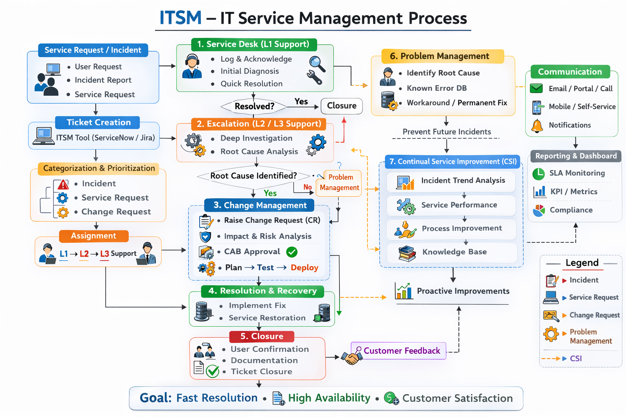
Technical Solution
Provide a Diagram with the Technical components of the solution and the key Microsoft components that will be used
Technical Solution (high‑level)
technologies
Teams App
• Bot UI
Bot Service
• (Node/TS)
Safety + Intent
• (OpenAI + Shields)
ServiceNow
• Table API
Adaptive Cards
• Status/Metrics
GitHub Copilot
Microsoft Foundry
Microsoft Fabric
M365 Copilot
Copilot Studio
D365 Copilot
Local dev: Dev Tunnel → /api/messages;
Production: Azure Bot Service + App hosting.
Security: Entra ID auth (OBO), least privilege;
Safety checks before tool calls.
Observability: traceId + logs;
KPIs computed from event stream.
EE ORCh | Agent Bridge team |

Slide 5
Business Case Proposal – AI Assistant
Business Case (proposal)
BUSINESS CASE
KPIs Impacted
Current Costs
Current Income
Expected impact (targets):
• 30–50% reduction in time‑to‑resolve for routine requests
• 20–40% fewer duplicate/mistaken tickets
• +10 pt improvement in employee satisfaction (CSAT) for support journeys
• 15–25% deflection via policy answers (no ticket)
⬆️ 25–35% Reduction in clinician administrative workload ⬆️ 20–30% Faster patient response time ⬆️ 15–25% Improvement in patient satisfaction scores ⬆️ 10–20% Increase in operational efficiency
Manual documentation workload: High operational cost Administrative staff dependency: ₹15–20 Lakhs/year Delayed patient handling → indirect revenue loss
Revenue (Rv1): Revenue impacted due to delays and inefficiencies Estimated Annual Revenue: ₹1–2 Crores
New Costs
New Income
Business Impact
Model Development (Mistral Fine-tuning): ₹8–10 Lakhs Azure Deployment & Infrastructure: ₹5–7 Lakhs/year Maintenance & Updates: ₹3–5 Lakhs/year
Revenue (Rv2): Increased patient handling capacity Faster turnaround → more consultations Improved service quality → higher retention
Expected Revenue Increase: +10–20% (₹20–40 Lakhs/year)
Reduces clinician burnout by automating documentation and routine queries
Improves patient experience through faster triage and appointment handling
Enables doctors to focus more on critical care instead of paperwork
Enhances decision-making with AI-powered clinical support
Ensures standardized and accurate medical documentation
Cost & feasibility:
• Leverages existing Teams + ServiceNow
• Incremental AI usage (intent + safety) and app hosting
• MVP achievable in hackathon phase; scalable to HR/Facilities
• Break‑even expected within months via hours saved and reduced rework
Total New Cost (Year 1): ~₹15–20 Lakhs
BREAK EVEN:
Time to recover implementation cost: 12–18 months through: Reduced admin staffing costs Faster workflows
BREAK EVEN: Time to recover via extra revenue: 8–12 months due to: Increased patient throughput Better service quality
KPIs tracked live in Teams: MTTR • Deflection • Duplicate‑merge rate • Cancel‑in‑window • CSAT
BREAK EVEN: The solution becomes financially viable within the first year
EE ORCh | Agent Bridge team |

