Slide 1
Retail / Consumer Goods
WHY
Channel Proof
Business Challenges
Use Case Description
KPIs Impacted
FMCG organizations invest significantly across distributor activities, trade promotions, in‑store activations, modern trade, and e‑commerce channels, yet face challenges in understanding which touchpoints truly influence sales outcomes. Traditional last‑touch or channel‑biased attribution models limit visibility into actual revenue drivers and lead to inefficient trade and promotion spend. Channel Proof is a Microsoft Dynamics 365 Model‑Driven App that captures all sales‑influencing activities as structured touchpoints and applies multi‑touch revenue attribution when orders are closed. It enables accurate measurement of both brand‑level long‑term contribution and campaign‑level short‑term incremental impact, supported by Copilot‑powered insights. This helps FMCG leaders optimize channel investments, improve promotion ROI, and recover 3–5% of annual revenue lost due to misattribution.
Channel Proof enables FMCG organizations to measure how multiple sales and promotion touchpoints influence revenue across the customer journey. It captures distributor activities, trade promotions, and digital campaigns as structured touchpoints and applies multi‑touch revenue attribution when orders are closed. The solution supports brand‑level long‑term contribution analysis and campaign‑level incremental lift and ROI measurement, enabling data‑driven decisions for trade spend, channel investment, and promotion optimization.
Misattribution of revenue across distributor and campaign channels
Low transparency into true promotion ROI
Inefficient trade, pricing and marketing investments
Business Impact
Improves visibility into true revenue drivers by moving from last‑touch to multi‑touch attribution Optimizes trade promotion and campaign investments, improving ROI and reducing ineffective spend Enables recovery of 3–5% of annual revenue lost due to misattribution Supports faster, data‑driven decisions across Sales, Marketing, and Finance through a unified attribution view Strengthens alignment between brand strategy and campaign execution
WHO
HOW
Stakeholders
Functional Solution
Technical Solution
"Sales, Marketing, and Finance teams aligned on trade promotions, campaigns, and distributor activities to enable informed brand vs campaign decision‑making, revenue attribution, ROI measurement, and investment planning."
Channel Proof captures all sales‑influencing touchpoints and distributes revenue proportionally across channels and campaigns using multi‑touch attribution. It enables brand‑level strategy decisions and campaign‑level ROI and elasticity insights for trade and promotion optimization
Built on Dynamics 365 and Dataverse, Channel Proof uses a multi‑touch attribution engine with Copilot‑powered insights. Power BI dashboards provide explainable, scalable analysis of channel and campaign contribution and ROI.

Slide 2
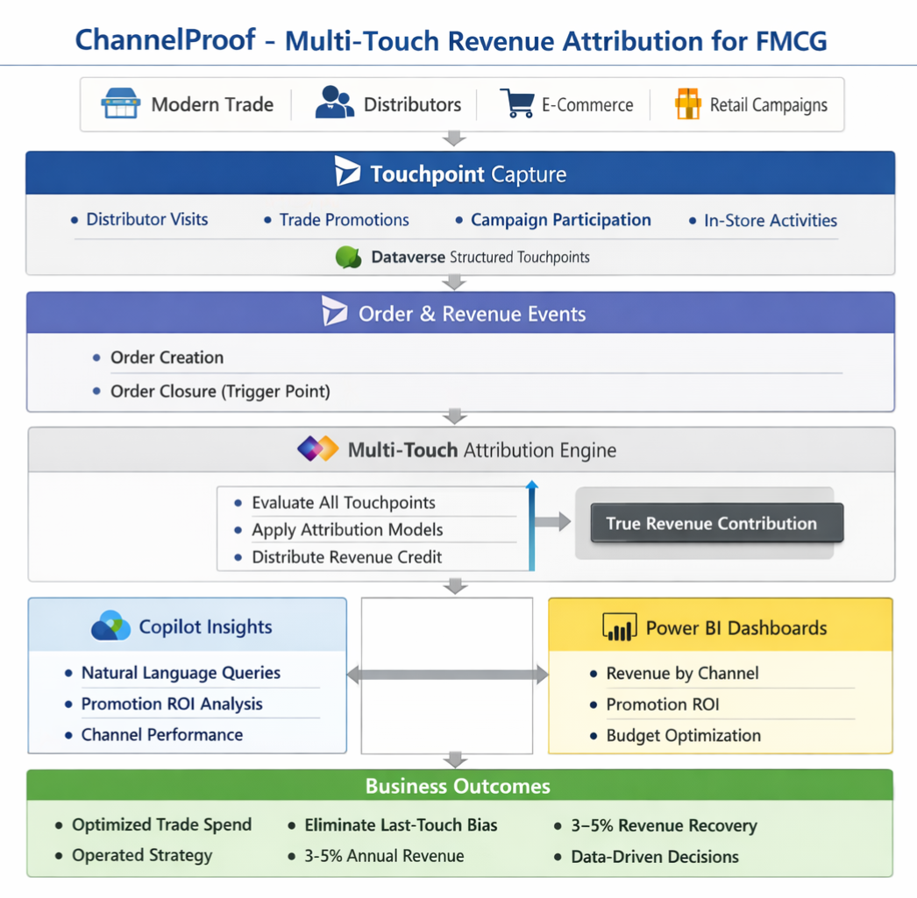
High Level Architecture Diagram

