Slide 1
Enhanced AI‑Powered .NET Project Auto‑Generator
Streamlining software creation with intelligent automation tools

Slide 2

Enterprise‑Grade Autonomous Application Generation
AI-Driven Full-Stack Generation
Agentic AI autonomously produces full-stack .NET applications from initial requirements to final packaging.
Automation of Development Patterns
Automates solution structuring, dependency injection, controller creation, and testing framework setup consistently.
Standardized Enterprise Lifecycle
Standardizes development processes reducing variance and accelerating delivery within enterprise teams.
AI-Centered Workflow
Positions AI agents centrally to autonomously scaffold applications, integrate databases, create APIs, etc.

Slide 3

Strategic Fit for Agentic Workflows
Alignment with Agentic Workflows
The autonomous .NET generator aligns tightly with agentic workflows, enabling advanced multi-step automation.
Rapid Prototyping and Collaboration
On demand fast prototyping and teamwork, supported by AI-generated production-ready systems created within minutes.
Integrated Technology Ecosystem
The solution leverages Foundry, Copilot Studio, Fabric, and GitHub to provide a seamless and scalable automation ecosystem.
Showcasing AI-powered Engineering Impact
The end-to-end agent-powered pipeline demonstrates practical AI benefits, impressing both technical and business audiences.

Slide 4

Solution Overview and Configurable Parameters
Project and Architecture Types
Supports multiple project types like Web API and Microservices and architectural patterns including Clean and Hexagonal Architecture.
Design Patterns and Languages
Incorporates modern design patterns like Repository and CQRS, supporting languages such as C#, TypeScript, and Python.
Database and Security Features
Offers flexible database options including SQL Server and MongoDB, with integrated authentication and JWT authorization.
Automation and DevOps Support
Automates API documentation, logging, telemetry for robust enterprise solutions.

Slide 5

End‑to‑End Orchestration Pipeline Details
User Input Extraction
The system captures user inputs via forms, documents, or conversational interfaces and extracts structured metadata using AI.
Template Selection and Code Generation
Metadata drives selection of architectural templates and automatic generation of project structure, logic, APIs, and database scripts.
Deployment
The pipeline sets up GitHub repositories and delivers a ready-to-deploy solution package.
Benefits of Automation
Automation reduces manual coding, ensures architectural consistency, and accelerates innovation and prototyping processes.

Slide 6

Role and Importance of Metadata in Generation
Metadata as Core Intelligence
Metadata drives code generation, modeling, and endpoint creation ensuring structural consistency throughout the solution.
Blueprint for Generation
Metadata acts as the blueprint generating all components like schemas, models, DTOs, controllers, and services.
Ensures Consistency and Adaptability
Using metadata reduces ambiguity, enforces governance, and enables easy adaptation to changing requirements.
Supports Scalability and Extensibility
Metadata-driven generation allows scalable solutions across architectures and languages, future-proofing the system.

Slide 7
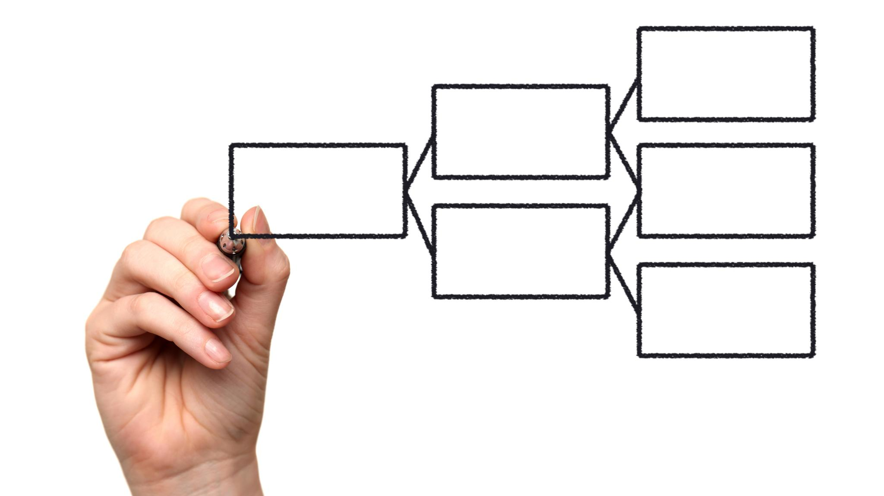
Architectural and Process Flow Diagrams
Requirement Capture and Metadata Synthesis
User inputs initiate the process, triggering metadata extraction that structures insights from content.
Template Resolution and Code Generation
Templates align system needs with design standards; code generation orchestrates files, models, and services.
Packaging and Deployment Automation
Final output is packaged as ZIP and optionally pushed to GitHub.
Visual Diagrams for Clarity and Governance
Visual flows clarify dependencies and agent collaboration, aiding debugging, governance, and planning.
Notes:
Visualization of the system’s operation illustrates how user inputs transition through multiple intelligent stages before resulting in deployable output. The flow typically begins with requirement capture, which activates the metadata synthesis engine responsible for extracting structured insights from the provided content. This metadata then feeds into a template resolver that aligns system needs with predefined architectural and design templates. Following selection, the system’s code generation module orchestrates file creation, domain modeling, database integration, and service layering. The final phase packages the result as a downloadable ZIP file and optionally pushes it to GitHub alongside automated CI/CD pipelines. Visual diagrams help stakeholders understand dependencies, workflow ordering, and the interactions between decentralized AI agents collaborating across the agentic framework. Such clarity aids debugging, enhances governance, and improves extensibility planning. By formalizing this process flow into an intuitive visual representation, organizations gain transparency into a sophisticated AI‑powered pipeline capable of generating robust and scalable enterprise applications.

Slide 8
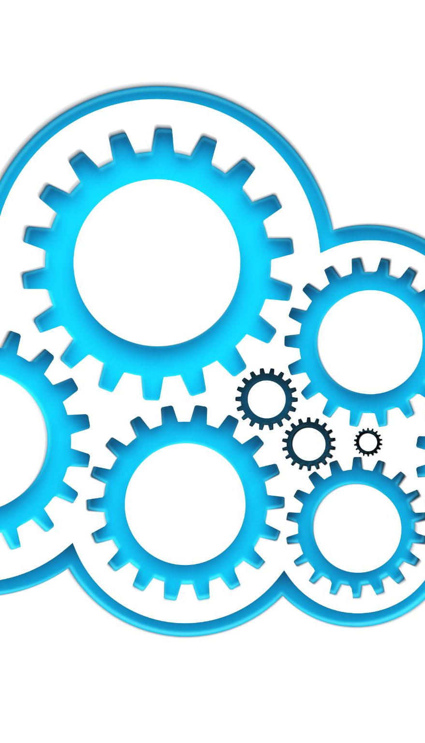
Justification for Feasibility Across Microsoft Ecosystem
Conversational AI Interfaces
Copilot Studio delivers conversational and workflow interfaces for capturing user needs and triggering automated routines.
Hosting and Execution Environment
Microsoft Foundry hosts tool‑calling agents, providing observability, governance, and scalable execution support.
Storage and Version Control
Microsoft Fabric serves as a storage layer for templates and metadata, ensuring version control and analytics capabilities.
Automated Repository Management
GitHub automates repository creation, branch management, and CI/CD setup for seamless deployment workflows.

Slide 9
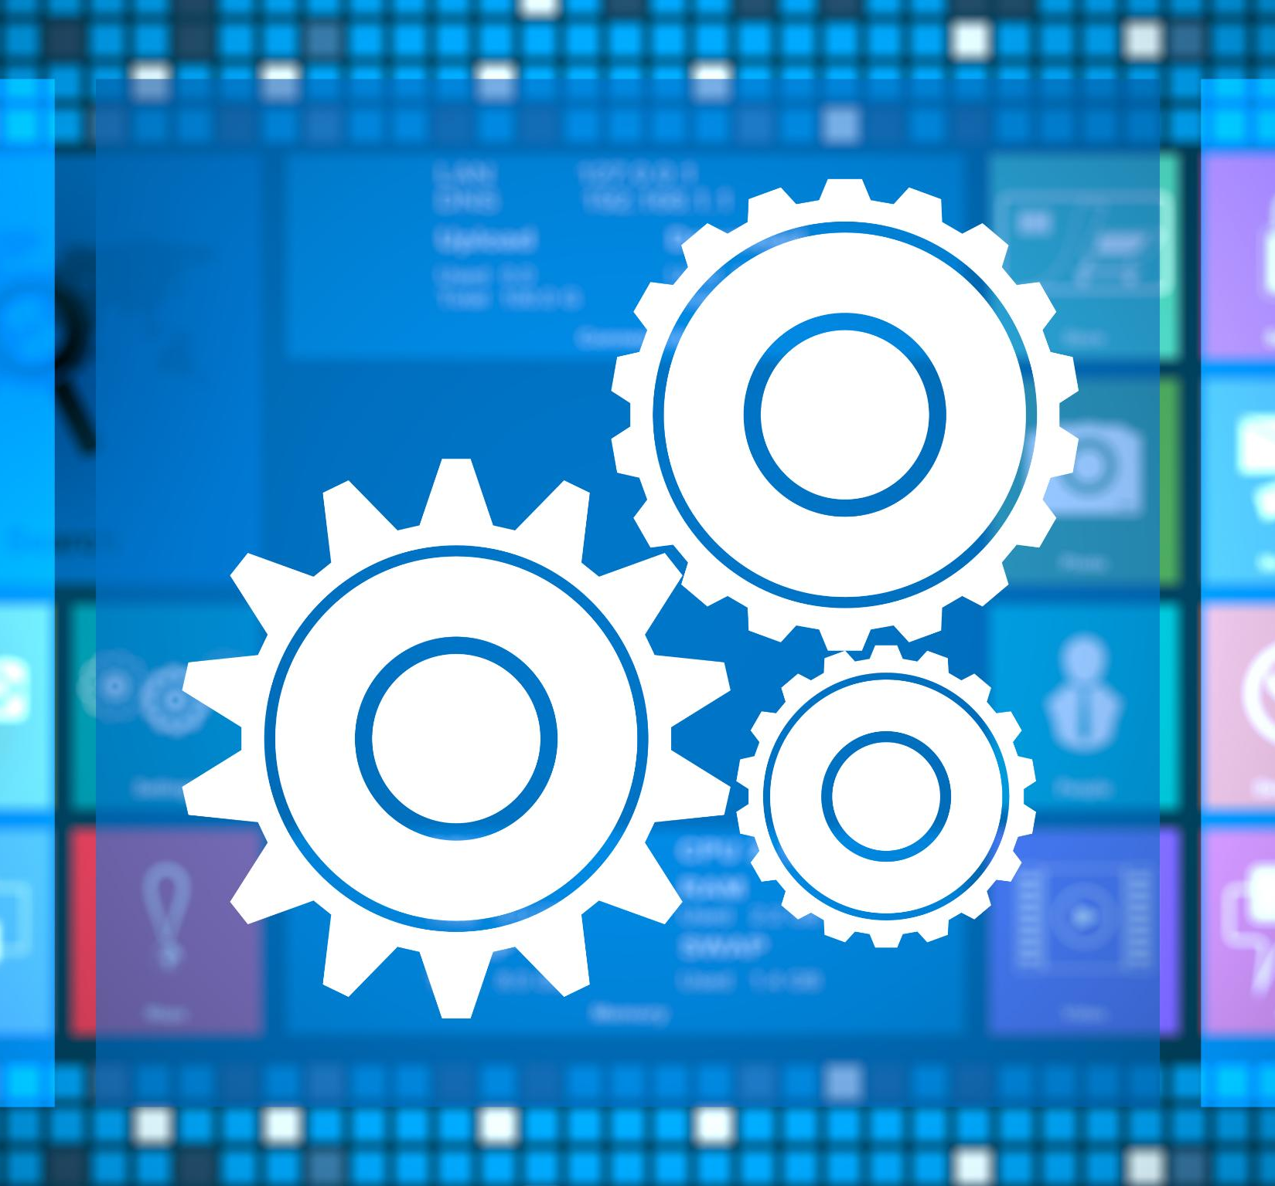
Key Advantages of the Autonomous Generator
Accelerated Engineering Velocity
Eliminates repetitive coding and boosts development speed for teams.
Multi-Platform Flexibility
Supports multiple architectures, languages, and databases to fit diverse technological ecosystems.
AI-Driven Maintainable Code
Uses AI reasoning to produce structured, maintainable code reducing long-term technical debt.
Real-Time Project Generation
Creates live project demos showcasing modern agentic system intelligence and autonomy.
Notes:
The system brings substantial advantages, making it an attractive solution for both enterprise development. It significantly accelerates engineering velocity by eliminating repetitive and boilerplate coding tasks while ensuring architectural consistency and best‑practice adherence. Its multi‑architecture, multi‑language, and multi‑database support enhances flexibility, allowing teams to tailor outputs to their technological ecosystem. By leveraging AI‑driven reasoning and planning, the solution produces highly structured, maintainable code that reduces long‑term technical debt. The real‑time project‑generation capability creates a powerful demonstration effect, showcasing the intelligence and autonomy of modern agentic systems. This combination of speed, consistency, and intelligent automation positions the system as a transformative tool in software development.

Slide 10

Challenges and Mitigation Strategies
Code Quality Assurance
Robust validation layers such as linters and testing harnesses ensure consistent high code quality across diverse use cases.
Template Version Governance
Disciplined governance over template repositories is essential to manage complexity introduced by template versioning.
Security of Sensitive Inputs
Securing input artifacts containing sensitive business logic prevents unauthorized access and ensures compliance.
Focus on MVP
Focusing on a minimum viable product during time-constrained and helps achieve demonstrable success.

Slide 11

User‑Selectable Options for Project Generation
Versatile Configuration Options
Users can customize application model, architectural style, design patterns, programming language, and database engine.
Enterprise-Grade Add-Ons
Optional add-ons like Swagger, JWT authentication, telemetry, logging, and CI/CD automate enterprise enhancements.
Broad Business Applicability
Customizations support scenarios from small internal tools to large enterprise microservices.
AI-Driven Alignment
AI agents autonomously guide decisions to align technical output with organizational standards.

Slide 12

Minimum Viable Product
Core Functionality Focus
MVP highlights autonomous code generation by demonstrating essential system functions reliably and efficiently.
Key Component Modules
Includes input capture, metadata extraction, CRUD API generation, and database schema creation for seamless integration.
Operational Automation
Automatic GitHub repository setup showcases real-world operational capabilities and workflow automation.
Delivery Strategy
MVP enables teams to present compelling demos by focusing on impactful features without full system complexity.

Slide 13
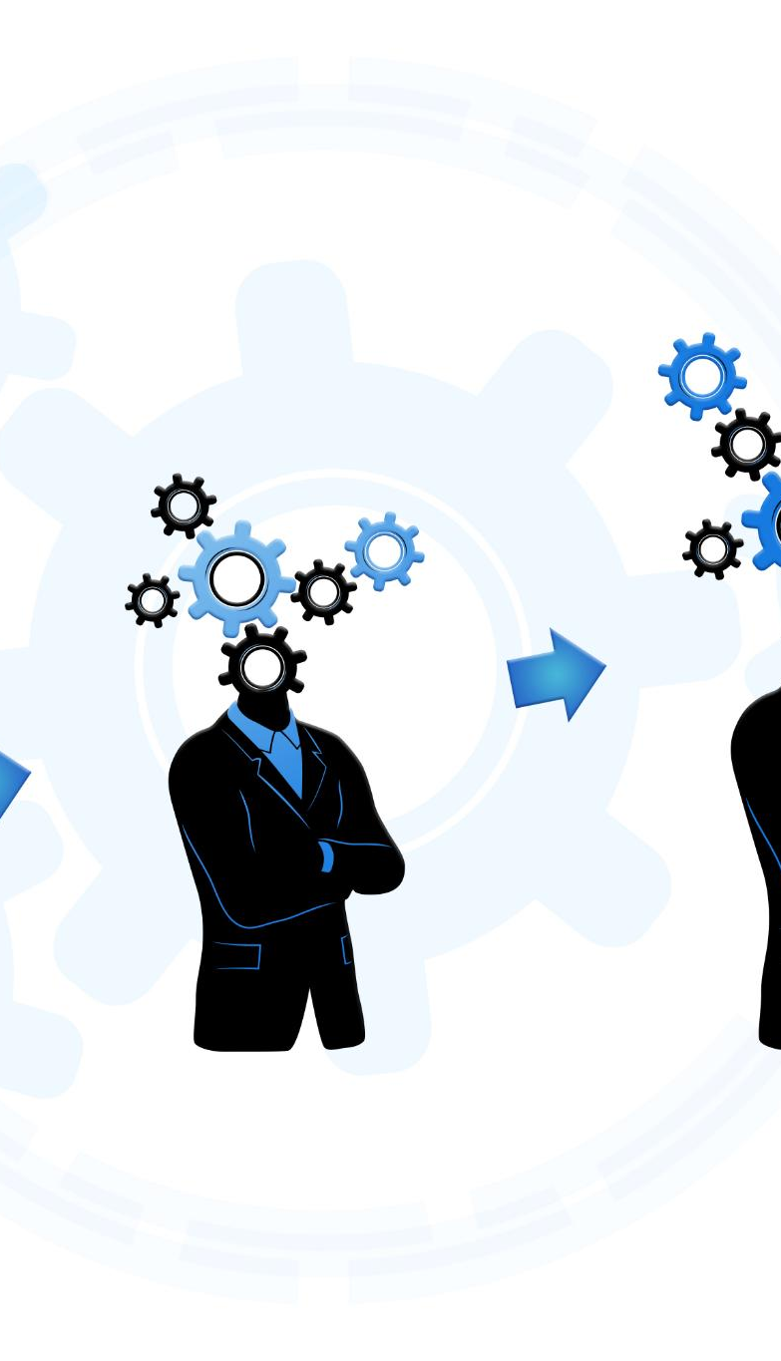
Task Breakdown for Collaborative Development
User Interface and Input Parsing
The input collection team builds user interfaces and parsing engines to capture and process requirements effectively.
Metadata and Template Engines
Metadata and template engine teams create structured data formatters and architectural templates for integration.
Code Generation and Database Design
Code generation team builds AI-driven domain models and database specialists create schema generators for SQL and NoSQL.
Automation and Testing
GitHub automation engineers set up repositories and CI/CD, while testing teams validate functionality and prepare demos.
Notes:
A structured team task breakdown ensures efficient collaboration and systematic progress throughout the development process. The input collection team focuses on building the user interface or parsing engine responsible for capturing requirements. The metadata team constructs the engine that formats and interprets inputs into structured domain elements. The template engine team develops architectural templates and integrates them into the resolver pipeline. The code generation team builds the AI agent responsible for generating domain models, controllers, services, and infrastructure layers. Database specialists create schema generators for SQL and NoSQL systems. GitHub automation engineers implement repository creation, workflow setup, and CI/CD initialization. Finally, the testing and demo team validates functionality, ensures stability, and prepares the presentation. This breakdown enhances efficiency, parallelism, and clarity of responsibilities.

Slide 14

Conclusion and Overall Evaluation
Strategic AI Alignment
The project generator aligns closely with strategic agentic AI principles, supporting advanced automation and innovation.
Integrated Technology Stack
Combines Foundry, Agent Framework, Copilot Studio, Fabric, and GitHub automation for seamless enterprise software generation.
Business and Innovation Impact
Delivers rapid delivery, architectural consistency, and intelligent automation, boosting business value and innovation potential.

