Slide 1
WHY
Business Challenges
Use Case Description
KPIs Impacted
No real-time data ingestion from enterprise systems
Delayed insights → slow decision-making
Manual data validation & transformation
Lack of unified analytics platform
Difficulty detecting anomalies early
Build a real-time intelligent data processing system that:
Ingests live events from enterprise systems
Uses Agentic AI for transformation & enrichment
Stores structured data in Fabric Lakehouse
Provides live dashboards via Power BI
Detects anomalies & trends automatically
60–80% faster data processing
Real-time dashboard availability
Improved anomaly detection accuracy (~30%)
Reduced data latency (batch → real-time)
Intelligent Real-Time Processing using Fabric & Agentic AI
Business Impact
Faster decision-making using live insights
Reduced operational inefficiencies
Improved data reliability & trust
Enables AI-driven automation
Better customer & business outcomes
HOW
WHO
Functional Solution
Technical Solution
Stakeholders
Event ingestion via Azure Service Bus
Real-time streaming using Fabric Event Streams
AI-based transformation layer:
Schema detection
Metadata tagging
Data validation
Storage in Lakehouse (Delta tables)
Azure Service Bus (ASB) → Event ingestion
Microsoft Fabric Event Streams → Real-time pipeline
Agentic AI Processor (LLM-based) → Intelligence layer
Fabric Lakehouse → Storage
Power BI → Visualization
Data Engineers
Business Analysts
Product Managers
Operations Teams
Leadership / Decision Makers

Slide 2
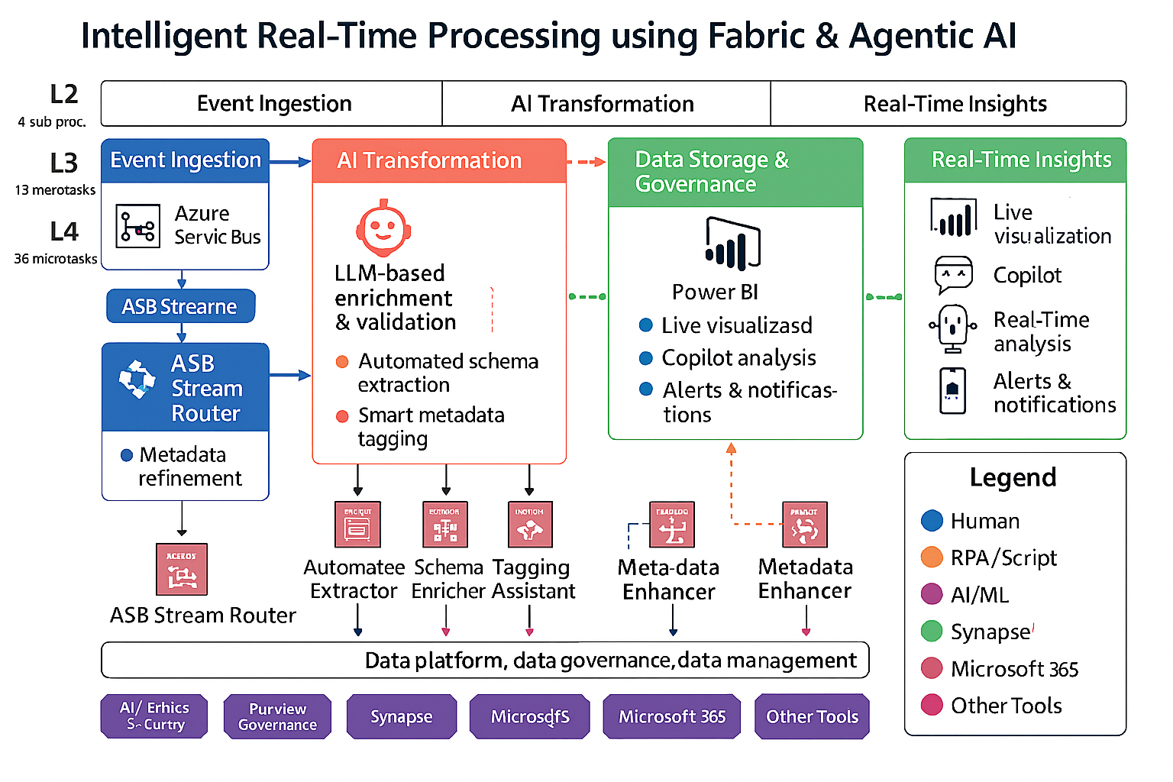
Use Case Scope in the Business Process
Faster Campaign Cycle Time
Automated QA & Compliance Checks
Productivity (FTE Hours Saved)

Slide 3
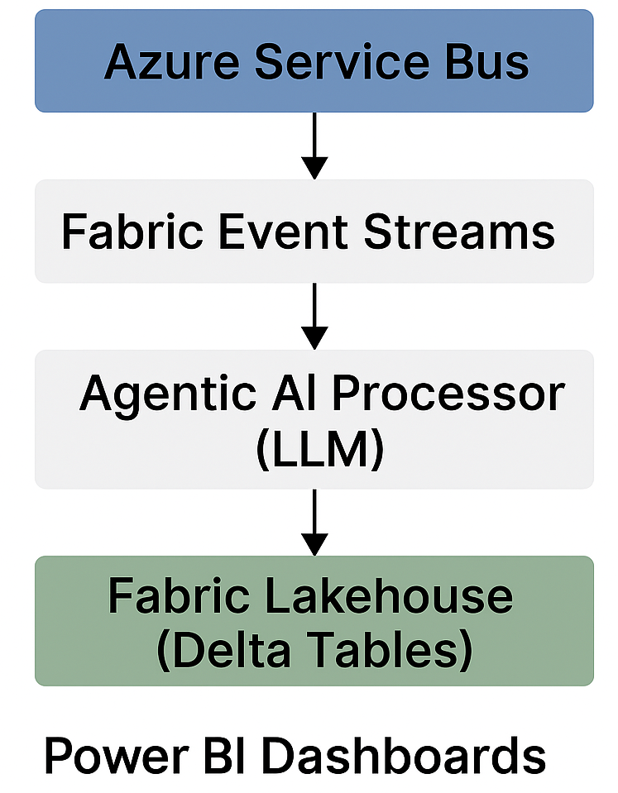
End to End Real Time Intelligence Flow
Event Ingestion Real‑time data flows from Azure Service Bus into Fabric with zero manual intervention. Fabric Event Streams instantly clean, refine, and route incoming events. AI Transformation Agentic AI performs schema extraction, validation, and smart metadata tagging automatically. AI reduces processing time from minutes to seconds enabling instant decisions. Data Storage & Governance Processed data lands in the Lakehouse with enterprise‑grade governance via Purview. Unified Fabric ecosystem ensures single source of truth across analytics and AI Real‑Time Insights Power BI updates in real time, showing anomalies, trends, and insights instantly. Copilot adds natural‑language intelligence for fast, human‑friendly decision‑making

Slide 4
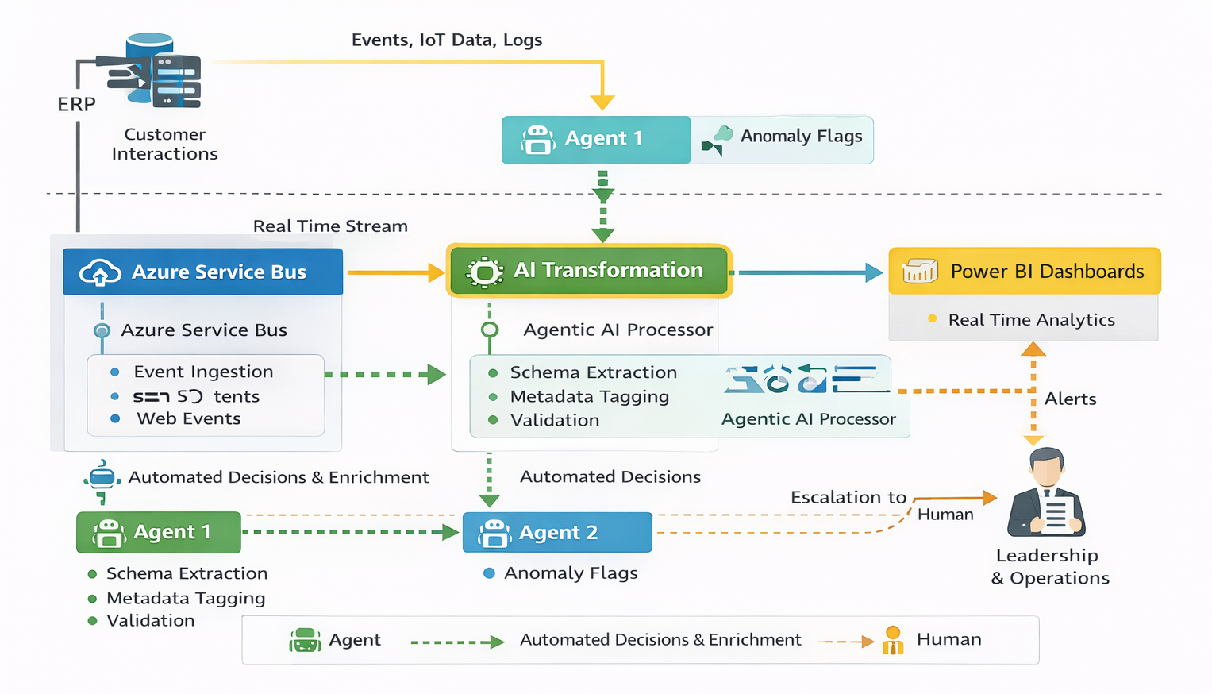
Functional Solution + AI-Human Chemistry
Intelligent Real-Time Processing using Fabric & Agentic AI
AI does the fast work - ingesting events, enriching data, spotting anomalies. Humans handle only escalations - decisions that need judgment. Together they create a smart loop - AI speeds execution, humans ensure control.

Slide 5
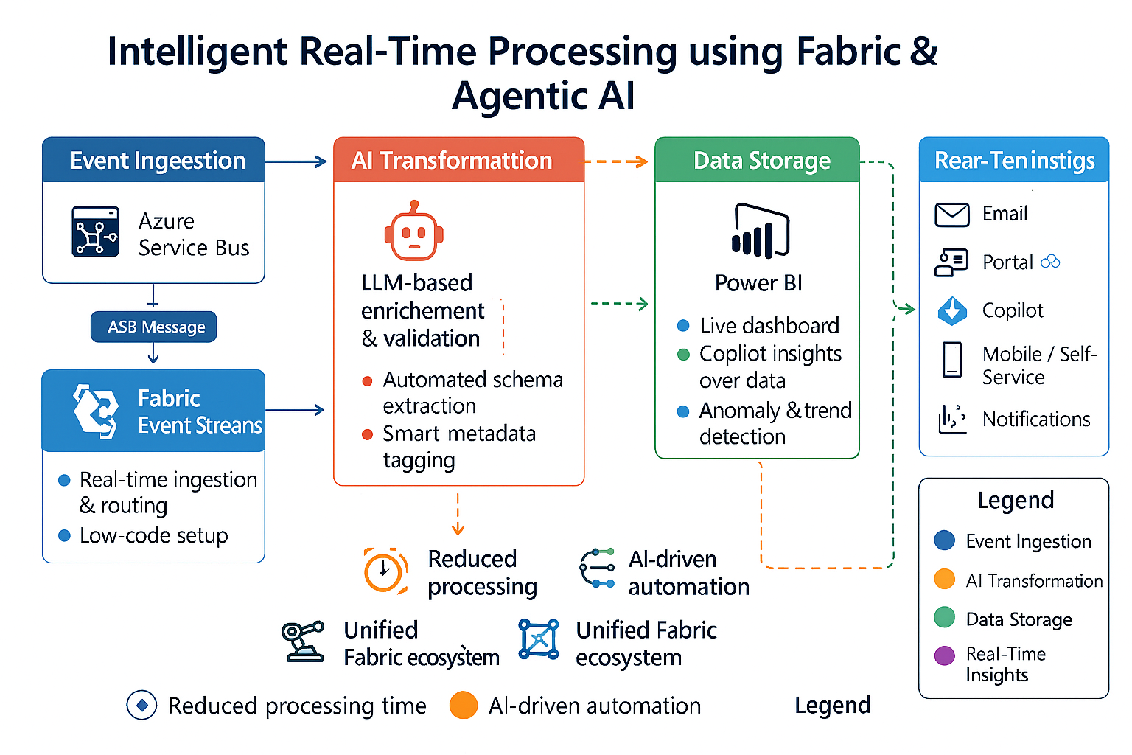
Technical Solution
technologies
Ms Fabric Event Streams Ms Fabric Lakehouse Ms Fabric AI Studio Open AI service Power BI Microsoft Purview

Slide 6
Business Case Proposal
WHY
BUSINESS CASE
Intelligent Real-Time Processing using Fabric & Agentic AI
Current Costs
Current Income
Heavy operational workload due to manual data handling and delayed processing.
High dependency on engineering teams for message parsing, validation, and routing.
Slow insight generation due to scattered systems and non‑real‑time data pipelines.
Revenue impacted due to slow data-driven decisions.
Limited visibility into real-time anomalies leading to missed opportunities.
Estimated annual revenue: ₹1–2 Crores.
New Costs
New Income
Initial model development & AI agent setup: ₹8–10 Lakhs.
Fabric infrastructure & Event Streams deployment: ₹5–7 Lakhs/year.
Maintenance & updates: ₹3–5 Lakhs/year.
BREAK EVEN:
Time to recover implementation cost: 8–12 months, driven by
Reduced engineering effort.
Faster automated data workflows
Higher throughput from automated real-time processing.
Improved decision-making from instant AI-enriched insights.
Expected annual revenue increase: +10–20% (₹20–40 Lakhs/year)
.
BREAK EVEN:
Time to recover via additional revenue: 6–10 months, driven by
Higher real-time intelligence.
Faster operational responses.
Overall Benefits
BREAK EVEN: ROI achieved within 6–12 months through:
+15–25% increase in operational efficiency thanks to AI agents.
Lower engineering and manual processing costs.
Higher analytics quality leading to better business outcomes.
Continuous improvement enabled through automated enrichment + human oversight.

