Slide 1
Decreased Stockouts
Increased OTIF Impact on Working capital Reduced Expedite/markdown cost SLA meet less than accepted time
Faster reaction to demand/supply changes, reduced stockouts & costs, improved service levels, fewer manual interventions, increased planner productivity.
WHAT
WHY
Retail
Use Case Description- Build a Retail Autonomous Inventory Control Tower using three Azure AI Foundry agents- Inventory Planning, Supplier & Risk, and Logistics & Fulfilment. These agents sense demand spikes, supplier delays, and logistics risks in real time and autonomously generate replenishment, transfer, and sourcing actions with guardrails, approvals, and dynamic goal switching.
Business Challenges- Demand is volatile (weather, trends, events) causing 300–450% spikes; rule-based planning reacts too late.
Existing systems cannot switch dynamically between service, margin, and sell-through goals.
Supplier integration is slow (EDI refresh 24–48 hrs); too late for disruptions.
Inventory decisions are fragmented across ERP, WMS, TMS, suppliers.
No autonomous multi-objective reasoning in current retail systems.
Business Challenges
Use Case Description
KPIs Impacted
Inventory Replenishment & Supply Chain Control Tower
Business Impact
Functional Solution-
Sales Manager Agent : Monitors the transactions, Stock alert, promotions and Store KPIs
Supplier Manager Agent : Purchase orders, supplier performance and replenishments
Business Analysts : Sales forecast, anomaly detection, aggregates
Technical Solution-
Azure AI Foundry (Agent Service), Microsoft Agent Framework, Fabric/ADLS, PostgreSQL Flexible Server, Azure AI Search (policy-as-code), Event Grid/Service Bus, Logic Apps/Durable Function, Copilot Studio.
Buyers/Planners, Supply Planners, Logistics Managers, Store/DC Operations, Merchandising Leaders.
HOW
WHO
Functional Solution
Technical Solution
Stakeholders

Slide 2




Functional Solution + AI-Human Chemistry
Provide a Diagram with the functional components of the solution and the points where the Agent(s) will take decisions or will handle it to humans
Supply Agent
Request missing/ conflicting information
Service Agreement
Interaction (customer, third- party or internal teams)
Gather approval if needed
Detect Low​
Stock​
Update ERP​
& Stock​
Agent interacting only with systems not with humans
Inbound Channels
PO Created
ERP / IoT Alert​
Email
Analyse​
Demand​
Generate​
PO Draft​
Gather
Approval​
if Needed​
Manual Request​
ServiceNow
Communicate to​
Procurement &​
WH Team​
Update PO
Sales Agent
Rebates Payout
Gather approval if needed
Inbound Channels
Customer Order​
/ CRM Request​
CRM / ServiceNow
Credit Note​
Created​
Validate​
Stock Avail.​
Create /​
Update
Settlement​
Get
Approval​
(out-of-
threshold)​
Create
Credit​
Note​
Demand​
Forecast Input​
Communicate to​
Customer/Sales​
& AR Team​

Slide 3
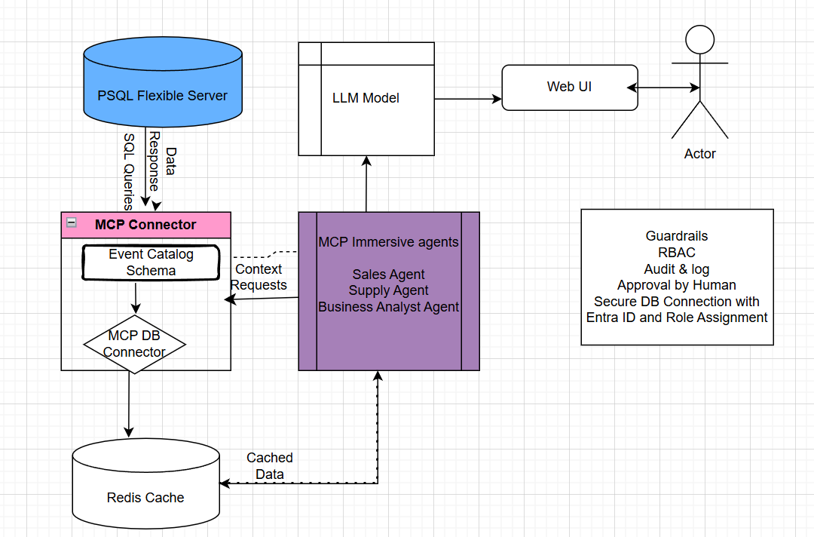
Technical Solution
Provide a Diagram with the Technical components of the solution and the key Microsoft components that will be used
technologies
GitHub Copilot
Microsoft Foundry
Microsoft Fabric
M365 Copilot
Copilot Studio
D365 Copilot

Slide 4
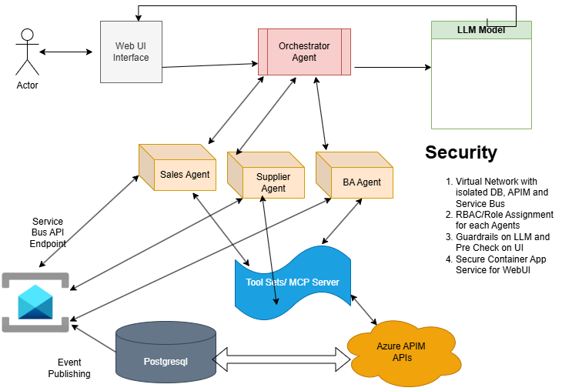
Technical Solution - Option2

