Slide 1


AI‑Driven Portfolio Intelligence Agent for Private Banking
TEAM – AGENTIC PANDAS
Notes:
AI-generated content may be incorrect. ---

Slide 2
Problem Context and Use Case Definition
1
TEAM – AGENTIC PANDAS
Notes:
Operational Challenges in Pre‑Review Portfolio Analysis, AI‑Driven Portfolio Intelligence Agent Use Case Overview

Slide 3

Operational Challenges in Pre‑Review Portfolio Analysis
TEAM – AGENTIC PANDAS
Data & Operations Challenges
High Manual Workload
Analysts spend 40–60% of their time manually gathering, cleaning, and validating data—limiting capacity for high‑value analysis.
Fragmented Data Landscape
Portfolio information is distributed across multiple custodians, internal systems, and unstructured PDFs, making consolidation slow and inconsistent.
High Error Risk Manual spreadsheet processes significantly increase the likelihood of data inconsistencies, reconciliation errors, and reporting inaccuracies.
Slow Insight & Narrative Production
Teams struggle to produce client narratives, performance summaries, and review materials quickly due to upstream data delays.
Scalability Constraints
Administrative bottlenecks prevent teams from scaling client coverage, reducing their ability to deliver timely, strategic advisory.
Notes:
Private banking institutions face a persistent operational challenge during the pre‑review phase of portfolio management, where analysts and junior bankers must manually gather, validate, and consolidate data before a client review. Empirical industry studies show that between 40 and 60 percent of an analyst’s working time is consumed by low‑value administrative tasks such as copying data from PDFs, reconciling figures across spreadsheets, validating inconsistent reports from multiple custodians, and normalizing currency or timestamp mismatches. This inefficiency is amplified for high‑net‑worth and ultra‑high‑net‑worth clients who intentionally distribute assets across multiple banks, trusts, and corporate entities. Each entity uses different data taxonomies, reporting frequencies, and formats, making manual consolidation error‑prone and slow. The reliance on unstructured documents, such as quarterly letters, trust agreements, and investment reports, further compounds the problem, as extracting usable data from PDFs requires significant manual effort. These structural inefficiencies create downstream business risks, including inaccurate performance reporting, delayed client reviews, compliance exposure, and reduced ability for relationship managers to focus on strategic advisory conversations. Instead of generating insights or identifying new investment opportunities, highly trained professionals are trapped in repetitive data preparation cycles. As private banking margins tighten and client expectations increase for real‑time, personalized insights, this manual operating model becomes unsustainable. Addressing this problem requires more than incremental automation; it demands a fundamental shift toward agentic AI systems that can autonomously gather, validate, and synthesize portfolio data across structured and unstructured sources while maintaining enterprise‑grade security and governance.

Slide 4

AI‑Driven Portfolio Intelligence Agent Use Case Overview
AI‑Driven Multi‑Agent System (WHAT IT DOES)
Autonomously consolidates multi‑entity portfolio data from diverse banks, custodians, and internal systems, harmonizing formats, taxonomies, and classifications into a unified, high‑quality dataset.
Parses and interprets unstructured documents such as PDFs, statements, contracts, and emails using LLM‑based document understanding, extracting key financial fields with built‑in validation.
Fetches real‑time market benchmarks and index data across asset classes to ensure all portfolio insights, comparisons, and valuations stay current and market‑aligned.
Performs Brinson‑Fachler performance attribution, breaking down allocation, selection, and interaction effects to clearly identify sources of over‑ or under‑performance.
Automatically generates strategic client narratives summarizing performance drivers, risks, allocation changes, and investment rationale—creating polished, client‑ready material for relationship managers.
Enables end‑to‑end workflow automation, reducing manual analyst effort, accelerating portfolio review cycles, and enhancing consistency across client reporting.
Integrates securely with internal systems (CRM, portfolio management tools, reporting engines) while maintaining audit trails and compliance monitoring.
Scales across thousands of client portfolios, enabling teams to expand coverage without increasing analyst workload.
Stakeholders (WHO)
Relationship Managers (RMs)
Portfolio Analysts & Investment Specialists
Data Engineering Team
Compliance & Risk Teams
Private Banking Clients (end‑beneficiaries)
TEAM – AGENTIC PANDAS
Notes:
The AI‑Driven Portfolio Intelligence Agent is designed to transform the pre‑review data gathering stage of private banking into a fully automated, insight‑driven process. The core use case focuses on autonomously consolidating multi‑entity portfolio data, extracting information from unstructured documents, retrieving real‑time benchmark data, computing performance attribution, and generating a strategic narrative ready for relationship managers. When an RM submits a natural‑language request, such as preparing a quarterly portfolio review for a complex client structure, the system decomposes the task into specialized subtasks handled by dedicated AI agents. These agents retrieve internal holdings and transaction data, parse PDFs containing historical context, fetch external market benchmarks, and compute Brinson‑Fachler performance attribution. The final output is not just a numerical report but a coherent, client‑ready narrative explaining portfolio performance, allocation decisions, and forward‑looking insights. The primary stakeholders include relationship managers, portfolio analysts, compliance teams, and private banking clients. Key performance indicators impacted by this use case include a projected 60 percent reduction in manual data preparation time, a 40 to 50 percent improvement in analyst productivity, a significant reduction in human error, and faster client review cycles. By shifting analysts from administrative work to value‑generating activities, the solution directly supports revenue growth, client satisfaction, and scalable advisory coverage.

Slide 5
Solution Architecture and Agent Design
2
TEAM – AGENTIC PANDAS
Notes:
Functional Architecture and AI‑Human Collaboration Model, Technical Architecture Using Microsoft AI and Data Platforms

Slide 6
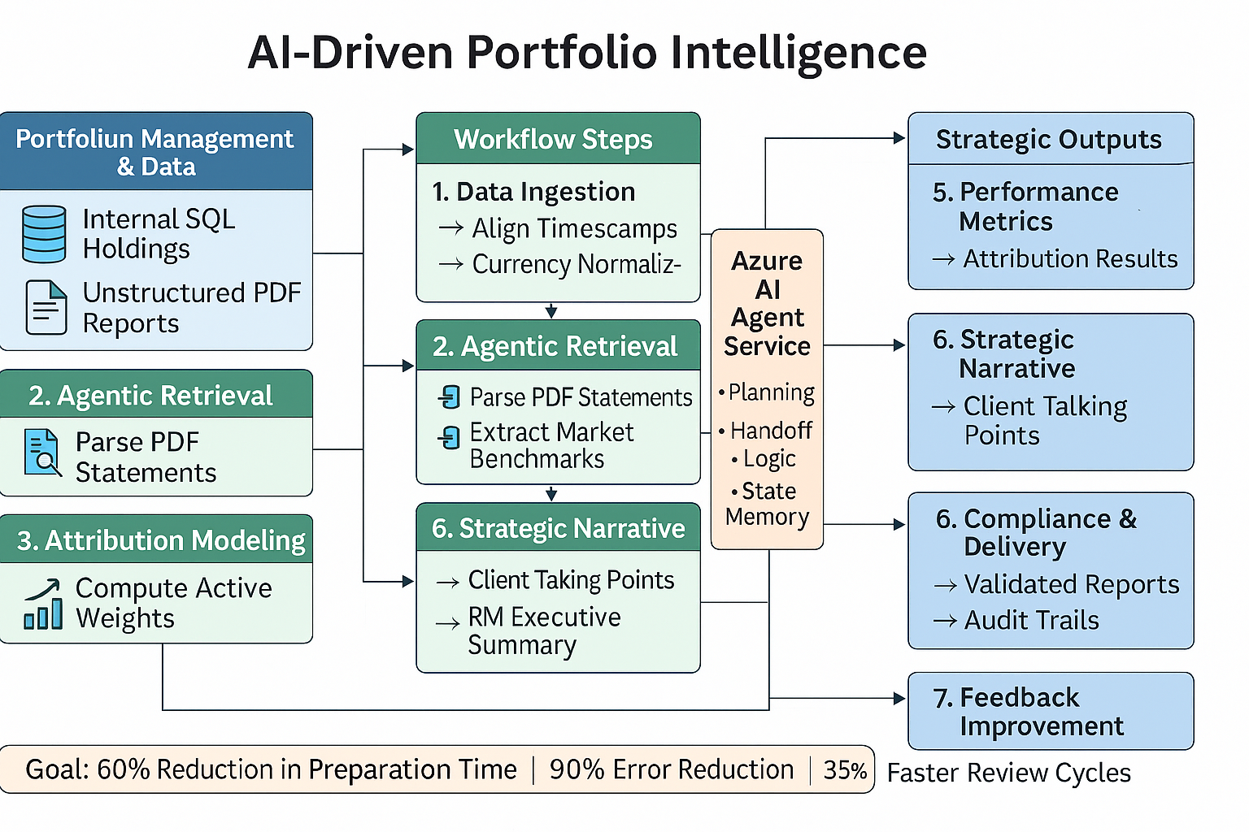
Functional Architecture
TEAM – AGENTIC PANDAS
Multi-Agent Orchestration
Orchestrator Agent coordinates specialized agents by decomposing complex tasks into manageable subtasks, ensuring efficient collaboration.
Data Retrieval and Processing
SQL Data Agent and Document Intelligence Agent securely extract structured and unstructured financial data from various sources.
Narrative Generation
Narrative Generation Agent synthesizes data into coherent strategic stories for client communication, enhancing clarity and engagement.
AI-Human Collaboration
Human analysts review AI-generated insights, maintain judgment and accountability, fostering trust and regulatory compliance.
Notes:
The functional architecture of the Portfolio Intelligence Agent is built on a multi‑agent orchestration paradigm that mirrors how human analyst teams collaborate on complex financial tasks. At the center is an Orchestrator Agent that acts as a cognitive router, analyzing the RM’s request, decomposing it into subtasks, and coordinating execution across specialized agents. The SQL Data Agent securely retrieves structured holdings and transaction data from internal databases using text‑to‑SQL techniques grounded in metadata. The Document Intelligence Agent processes unstructured PDFs, extracting tables, key‑value pairs, and contextual commentary. The Market API Agent interfaces with external financial data providers to retrieve benchmark returns and index weights required for attribution modeling. A Narrative Generation Agent synthesizes all outputs into a structured strategic story suitable for client conversations. Human involvement is intentionally preserved at critical decision points: relationship managers review insights, apply judgment, and conduct client discussions, while AI handles repetitive, data‑intensive tasks. This AI‑human chemistry ensures trust, transparency, and regulatory alignment. The design improves speed and accuracy while maintaining human accountability where it matters most, enabling advisors to focus on strategic value rather than operational friction.

Slide 7
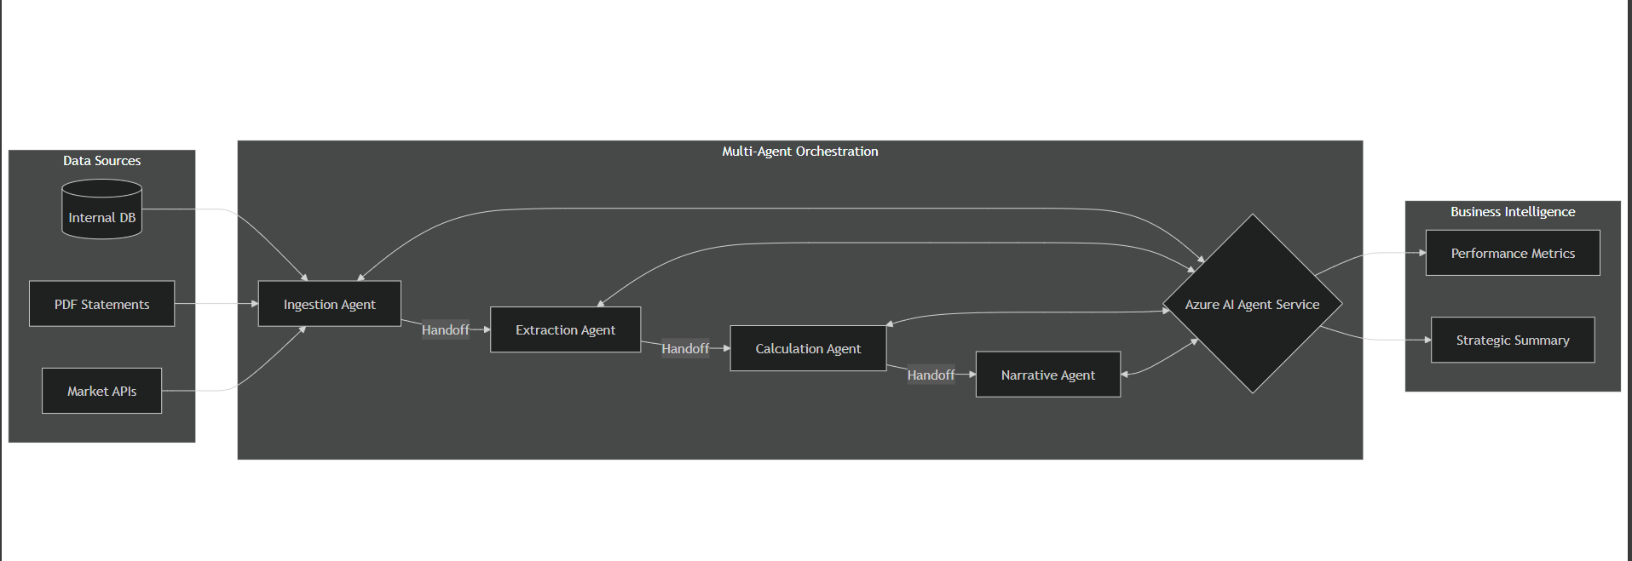
Technical Architecture (high-level)
AI Workflow Orchestration
Azure AI Foundry and Microsoft Agent Framework enable scalable multi-agent workflow orchestration for AI solutions.
Data Storage and Semantic Search
Azure SQL Database with vector search supports semantic entity matching across complex data structures.
Secure Data Access and Governance
Microsoft Entra ID and Azure Role-Based Access Control enforce least-privilege policies with network isolation and secrets management.
Advanced Document and Query Capabilities
Azure AI Document Intelligence and AI Search enable high-precision data extraction and semantic queries across enterprise knowledge.
TEAM – AGENTIC PANDAS
Notes:
The technical architecture leverages Microsoft’s enterprise AI ecosystem to deliver scalability, security, and governance. Azure AI Foundry provides the core environment for building and orchestrating multi‑agent workflows using the Microsoft Agent Framework. Structured data is stored and queried in Azure SQL Database, enhanced with vector search to support semantic entity matching across complex ownership structures. Azure AI Document Intelligence enables high‑precision extraction of data from unstructured PDFs, while Azure AI Search with Agentic Retrieval supports advanced semantic queries across enterprise knowledge. External market data is accessed through the Model Context Protocol, ensuring secure and standardized API interactions. Microsoft Entra ID workload identities and Azure Role‑Based Access Control enforce least‑privilege access, while Azure Key Vault manages secrets and credentials. Network isolation is achieved through Azure Virtual Networks and Private Link, and Microsoft Purview Data Loss Prevention provides runtime governance over AI inputs and outputs. Together, these components create a secure, compliant, and production‑ready architecture capable of supporting real‑time portfolio intelligence in highly regulated private banking environments.

Slide 8
Technical Architecture Using Microsoft AI and Data Platforms
TEAM – AGENTIC PANDAS
Notes:
The technical architecture leverages Microsoft’s enterprise AI ecosystem to deliver scalability, security, and governance. Azure AI Foundry provides the core environment for building and orchestrating multi‑agent workflows using the Microsoft Agent Framework. Structured data is stored and queried in Azure SQL Database, enhanced with vector search to support semantic entity matching across complex ownership structures. Azure AI Document Intelligence enables high‑precision extraction of data from unstructured PDFs, while Azure AI Search with Agentic Retrieval supports advanced semantic queries across enterprise knowledge. External market data is accessed through the Model Context Protocol, ensuring secure and standardized API interactions. Microsoft Entra ID workload identities and Azure Role‑Based Access Control enforce least‑privilege access, while Azure Key Vault manages secrets and credentials. Network isolation is achieved through Azure Virtual Networks and Private Link, and Microsoft Purview Data Loss Prevention provides runtime governance over AI inputs and outputs. Together, these components create a secure, compliant, and production‑ready architecture capable of supporting real‑time portfolio intelligence in highly regulated private banking environments.

Slide 9
Business Value, technical view and Financial Justification
3​
TEAM – AGENTIC PANDAS
Notes:
Operational and Strategic Business Impact, Business Case, Cost Structure, and Break‑Even Analysis

Slide 10

Operational and Strategic Business Impact
TEAM – AGENTIC PANDAS
Operational Impacts
Operational Efficiency: Automation reduces manual effort, saving analyst time and enabling efficient management of complex portfolios.
Accuracy & Compliance: Deterministic data retrieval minimizes errors and strengthens compliance confidence and auditability.
Strategic Insights: Timely, high‑quality insights help relationship managers deliver more personalized and effective advice.
Scalable Growth: Faster turnaround and consistent outputs build client trust, enabling growth without increasing operational costs.
KPIs Impacts
↓ 60% reduction in manual data preparation time
↑ 40–50% increase in analyst productivity
↓ 90% reduction in human error in reporting
↑ 25–35% faster client review cycles
↑ Higher RM coverage capacity (multi‑entity clients)
Notes:
The operational impact of deploying the Portfolio Intelligence Agent is immediate and measurable. By automating data gathering, validation, and attribution, analysts reclaim significant time previously lost to manual processes. This reclaimed capacity allows teams to handle more complex client portfolios without proportional increases in headcount. Error rates are reduced through deterministic data retrieval and calculation, improving compliance confidence and auditability. Strategically, relationship managers gain faster access to high‑quality insights, enabling more timely and personalized client interactions. The solution enhances the quality of advisory conversations by shifting focus from historical data explanation to forward‑looking strategy and opportunity identification. Improved turnaround times and consistency strengthen client trust and satisfaction, which are critical differentiators in private banking. Over time, the organization benefits from higher RM coverage ratios, better utilization of skilled talent, and a scalable operating model capable of supporting growth without escalating operational costs.

Slide 11

Technical & Functional Solution
Technical Solution
Core Azure Components
Azure AI Foundry
Microsoft Agent Framework
Azure SQL Database
Azure AI Document Intelligence
Azure AI Search (Agentic RAG)
MCP Tooling
Azure Key Vault
Microsoft Entra ID
Azure VNet + Private Link
Purview DLP
Functional Solution
Client Request Intake & Orchestration
Unified Data Access (Structured & Unstructured)
Intelligent Document Understanding
Market Benchmark & External Data Enrichment
Attribution & Performance Analysis
Explainable Insights & Narratives
Reviewer‑Ready Final Reports
Security, Compliance & Governance by Design
TEAM – AGENTIC PANDAS
Architecture Overview
Client RM → Orchestrator Agent → SQL Agent (internal structured data) → Document Agent (unstructured PDFs) → Market API Agent (benchmarks) → Attribution Engine (BF model) → Narrative Agent → Final Review Report

Slide 12

Business Case, Cost Structure, and Break‑Even Analysis
Initial and Ongoing Costs
Initial costs include AI setup, development, and infrastructure estimated at ₹20–30 lakhs, with ongoing cloud and enhancement expenses.
Financial Benefits
Savings come from reduced analyst workload, fewer errors, and improved efficiency driving significant operational cost reductions.
Revenue Uplift and Break‑Even
Increased client throughput and faster reviews support revenue growth; break‑even is projected within 8 to 12 months.
Scalability and ROI
Post break‑even, scalable architecture enables continued value creation with minimal cost increase, aligning with digital transformation goals.
Business Benefits
↑ RM can handle more clients (multi‑entity)
↑ Faster delivery → improved client retention
↑ Strategic insights → better investment outcomes
↓ Operational overhead → fewer analysts needed for prep work
↑ Reduction in SLA delays with clients
TEAM – AGENTIC PANDAS
Notes:
The business case for the Portfolio Intelligence Agent demonstrates strong financial viability. Initial costs include Azure AI Foundry setup and configuration, agent development, and supporting infrastructure, estimated in the range of ₹20–30 lakhs for the first year, including maintenance. Ongoing annual costs are primarily related to cloud infrastructure and incremental enhancements. These investments are offset by substantial savings from reduced analyst workload, lower error remediation costs, and improved operational efficiency. Additionally, increased client throughput and faster review cycles contribute to revenue uplift through higher retention and expanded advisory capacity. Based on conservative assumptions, the solution is expected to reach break‑even within 8 to 12 months. Beyond break‑even, the scalable nature of the architecture allows incremental value generation with marginal cost increases, making the solution ROI‑positive and strategically aligned with long‑term digital transformation goals in private banking.

