Slide 1
Use Case Description Business – MeetSpark
The Problem
Many action points discussed in meetings go unrecorded. Teams spend significant time summarizing discussions manually.
Conversations are unstructured, making it easy to miss important items and Follow‑ups do require repetitive effort across emails, chats, and task tools.
The Opportunity
Convert unstructured conversations into structured actionable items using reasoning‑capable AI agents by eliminating human dependency for note‑taking, summarization, and action extraction.
Use agentic AI powered by Azure OpenAI + Teams/Outlook + JIRA + SQL + Graph API Actions to automate entire lifecycle tasks.
Agents reason, plan and act within mentioned tools—reducing manual intervention.
Vision
Empower organizations with autonomous, agentic AI → that listens, understands, and converts every meeting into actionable execution.
Drive faster decisions → clearer ownership → and seamless, end‑to‑end execution without manual effort..

Slide 2
Functional Use case – MeetSpark
Process Covered by MeetSpark
Automated Meeting Capture
Collects audio, chat, and notes from Teams or Zoom without manual effort.
AI‑Driven Transcription
Converts conversations into accurate, structured text for downstream processing.
Intelligent Summarization
Produces concise summaries of key discussions, decisions, and insights.
Action Item Extraction
Identifies owners, deadlines, and next steps directly from meeting content.
Reasoning‑Based Validation
Ensures tasks are complete, clear, conflict‑free, and ready for execution.
Automated Task Creation
Creates and updates tasks in Jira, Planner, or Confluence with consistent formatting.
Proactive Follow‑Ups
Sends reminders, nudges, and escalations through Outlook or Teams to ensure closure.

Slide 3
Use Case Overview
Use Case
WHAT
WHY
Process
Business Challenges
Use Case Description
KPIs Impacted
Capture → Transcribe → Summarize → Extract Actions → Validate → Create Tasks → Follow‑up.
Manual and time‑consuming follow‑ups, Low accountability across teams and Inconsistent task tracking
AI that turns meetings into actions, Autonomous meeting‑to‑execution workflow and AI‑driven action extraction and task creation.
• On‑time task completion
• Follow‑up efficiency
• Accountability score
HOW
WHO
Business Impact
Functional Solution
Stakeholders
Higher accountability & ownership
Scalable automation with AI
Improved meeting productivity
Technical Solution
Capture meeting inputs (audio, chat, notes),Extract action items automatically, Validate owners , deadlines using reasoning agents & Create tasks in Jira/Planner/Confluence
Azure OpenAI, Azure App Service, Microsoft Graph API, Teams Bot Framework, Outlook APIs, Jira APIs, Confluence APIs, Python, Node.js, Azure SQL DB, Azure Blob Storage
Team Leads & People Managers, IT / Engineering Teams, Product Owners / Business Owners

Slide 4
Key Capabilities of MeetSpark
Automates the entire meeting‑to‑execution process, eliminating manual summaries, note‑taking, and task creation.
Transforms conversations into structured, validated action items with clear owners, deadlines, and priorities.
Improves accountability & on‑time task completion through autonomous reminders, nudges, and escalations.
Reduces time‑to‑recap significantly, delivering instant summaries and action logs.
Ensures zero context loss by retaining meeting memory, decisions, and pending items across sessions.
Boosts transparency & alignment with auto‑published summaries and action lists in Confluence / task systems.
Scales effortlessly with agentic AI, managing large meeting volumes and complex workflows autonomously.

Slide 5
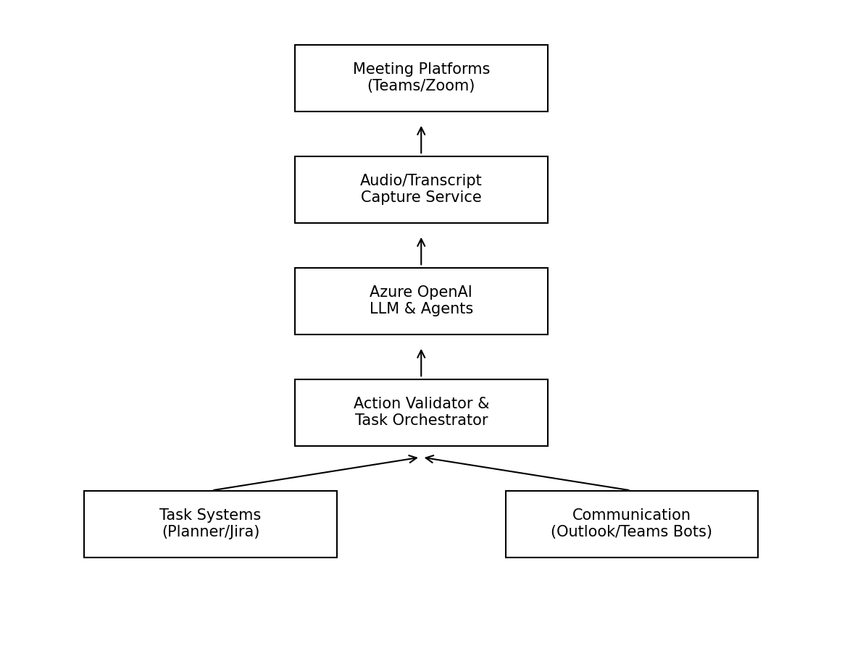
High-Level Technical Architecture

Slide 6
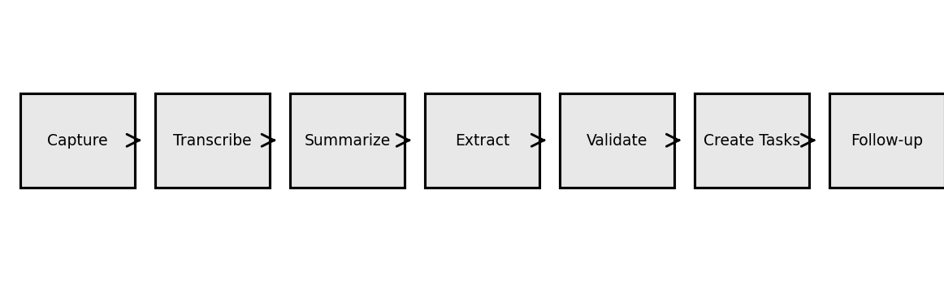
MeetSpark WorkFlow
Capture meeting inputs from Teams/Zoom (audio, chat, notes).
Transcribe audio into clean, structured text using STT.
Summarize discussion into key points, decisions, and insights.
Extract action items (owners, deadlines, tasks) using AI.
Validate details for clarity, completeness, and feasibility.
Create tasks automatically in Jira/Planner/Confluence.
Trigger follow‑ups with automated reminders & escalations.

