Slide 1
SSO
X - Equadis
11.06.2024

Slide 2

01
SSO technologies
02
Implementation
03
Frequently questions

Slide 3
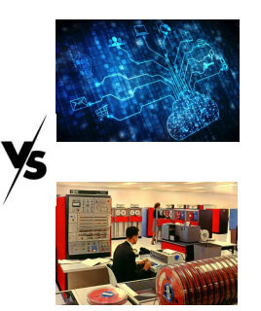
01
SSO technologies
Oauth 2.0 : The technology chosen by EQUADIS
  The simplest to implement, as it is the identity provider's responsibility (i.e., our client) to supply an identification token used by Spring Security
  A future-oriented technology developed and promoted by the GAFAM
Old technologies
  SAML 2.0
  OpenID Connect
In both cases, it is the application's (Equadis) responsibility to connect to the client's Active Directory.
These technologies are not future-oriented, so we do not use them.

Slide 4
01
SSO technologies
Sources
  https://www.okta.com/fr/identity-101/whats-the-difference-between-oauth-openid-connect-and-saml/
  https://zestedesavoir.com/articles/1616/comprendre-oauth-2-0-par-lexemple

Slide 5
02
Implementation
In Spring Security, a client variable needs to be created on both « Production » and « Preproduction » for the authentication URLs.
  https://customer.equadis.com/#login-sso/Client_Name
  https://gaia.equadis.com/#login-sso/Client_Name
  Optional and recommended: the client can request the current list of users to configure the SSO tool.

Slide 6
02
Implementation
CLIENT: These URLs will be used by the client to generate variables in their SSO identity system
  Application ID
  Secret Key
  Discovery URL
  (If not discovery URL) issuer
  (If not discovery URL) token_url
  (If not discovery URL) scope
  (If not discovery URL) userinfo_url
  (optional) Redirect URL

Slide 7
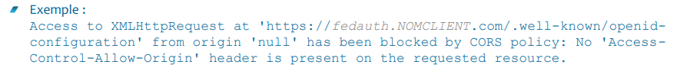
03
Frequently questions
Two SSOs (Production and Pre-production) per catalog.
Do not confuse Customer's HTACCESS authentication with SSO.
When SSO is enabled, authentication occurs on the client side.
When SSO is enabled, users of the client must use a link provided by their company to access Gaia; they will no longer be able to use the standard URLs https://gaia.equadis.com & https://customer.equadis.com
When SSO is enabled, login/password management no longer occurs within Gaia.
When SSO is enabled, the deactivation of users after a certain number of days no longer occurs within Gaia.
Please ensure that the equadis.com domain is whitelisted on the client's firewalls to prevent SSO functionality issues due to « CORS polities »

Slide 8
Thank you

