Slide 1
Project Presentation on
Store Management System Using C
Course Code: CSE178
Presented By
Name : Jamil Rayhan
Student ID : 18CSE061
Dept. of CSE,
Bangabandhu Sheikh Mujibur Rahman Science and Technology University
Gopalganj, Bangladesh
Supervised By
Dr. Saleh Ahmed
Associate Professor
Dept. of CSE,
Bangabandhu Sheikh Mujibur Rahman Science and Technology University
Gopalganj, Bangladesh
18th July, 2023

Slide 2
Outlines
Introduction
Related Works
Methodology
Visualization
Conclusion
References

Slide 3
Introduction
Increasing Complexity of Departmental Store Operations
Competitive Retail Landscape
Inventory Management Challenges
Sales Tracking and Reporting
Customer Relationship Management
Technology Advancements
Backgrounds
Aims and Objectives
Contribution

Slide 4
Introduction
Backgrounds
The aim behind developing this Store Management System is to overcome the limitations and inefficiencies associated with manual store management processes.
This project seeks to leverage technology to automate and streamline these processes, resulting in improved accuracy, efficiency, and customer satisfaction.
Aims and Objectives
Contribution

Slide 5
Introduction
Backgrounds
Developed a C-based Store Management Project with robust functionality aimed at
Streamlining operations,
Enhancing inventory management,
Improving sales tracking and analysis,
Facilitating customer relationship management,
Providing an efficient user interface.
The project focuses on optimizing store performance through advanced techniques and efficient implementation.
Aims and Objectives
Contribution

Slide 6
Outlines
Introduction
Related Works
Methodology
Visualization
Conclusion
References

Slide 7
Related Works
Related Works : Several projects have been developed in this concept of Store Management using various techniques and algorithm. Some of them are:
Inventory Management System
Customer Relationship Management (CRM) Systems
Point-of-Sale (POS) Systems
E-commerce Platforms
Retail Store Management Systems

Slide 8
Outlines
Introduction
Related Works
Methodology
Visualization
Conclusion
References

Slide 9
Methodology
Materials:
Programming Language: C
Window Design: Utilizes a user-friendly graphical user interface (GUI) following industry-standard practices.
Window Toolkit: Visual Studio Code, Sublime Text

Slide 10
Methodology (cont.)
Project Structure:
Add Goods
Inventory
Calculate Bill
Delete Goods
Edit Goods
Customer
Fig.1: Project Structure

Slide 11
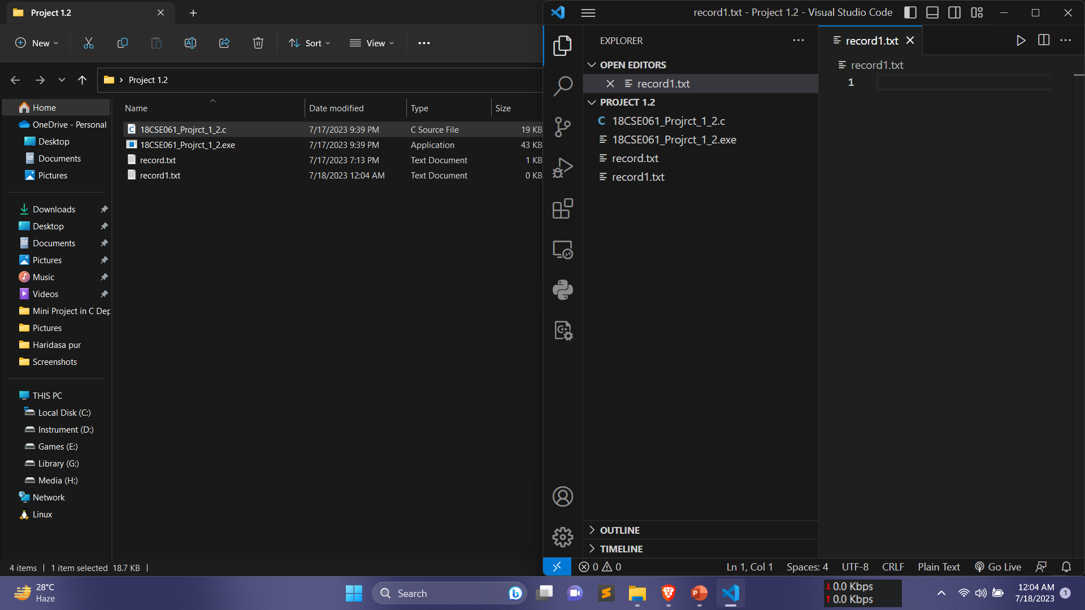
Methodology (cont.)
File Structure:
Fig.2: File Structure

Slide 12
Outlines
Introduction
Related Works
Methodology
Visualization
Conclusion
References

Slide 13
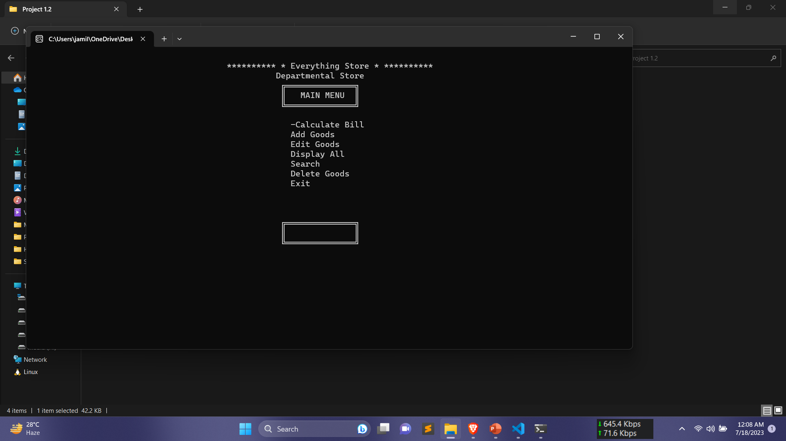
Project Visualization
Main Window:

Slide 14
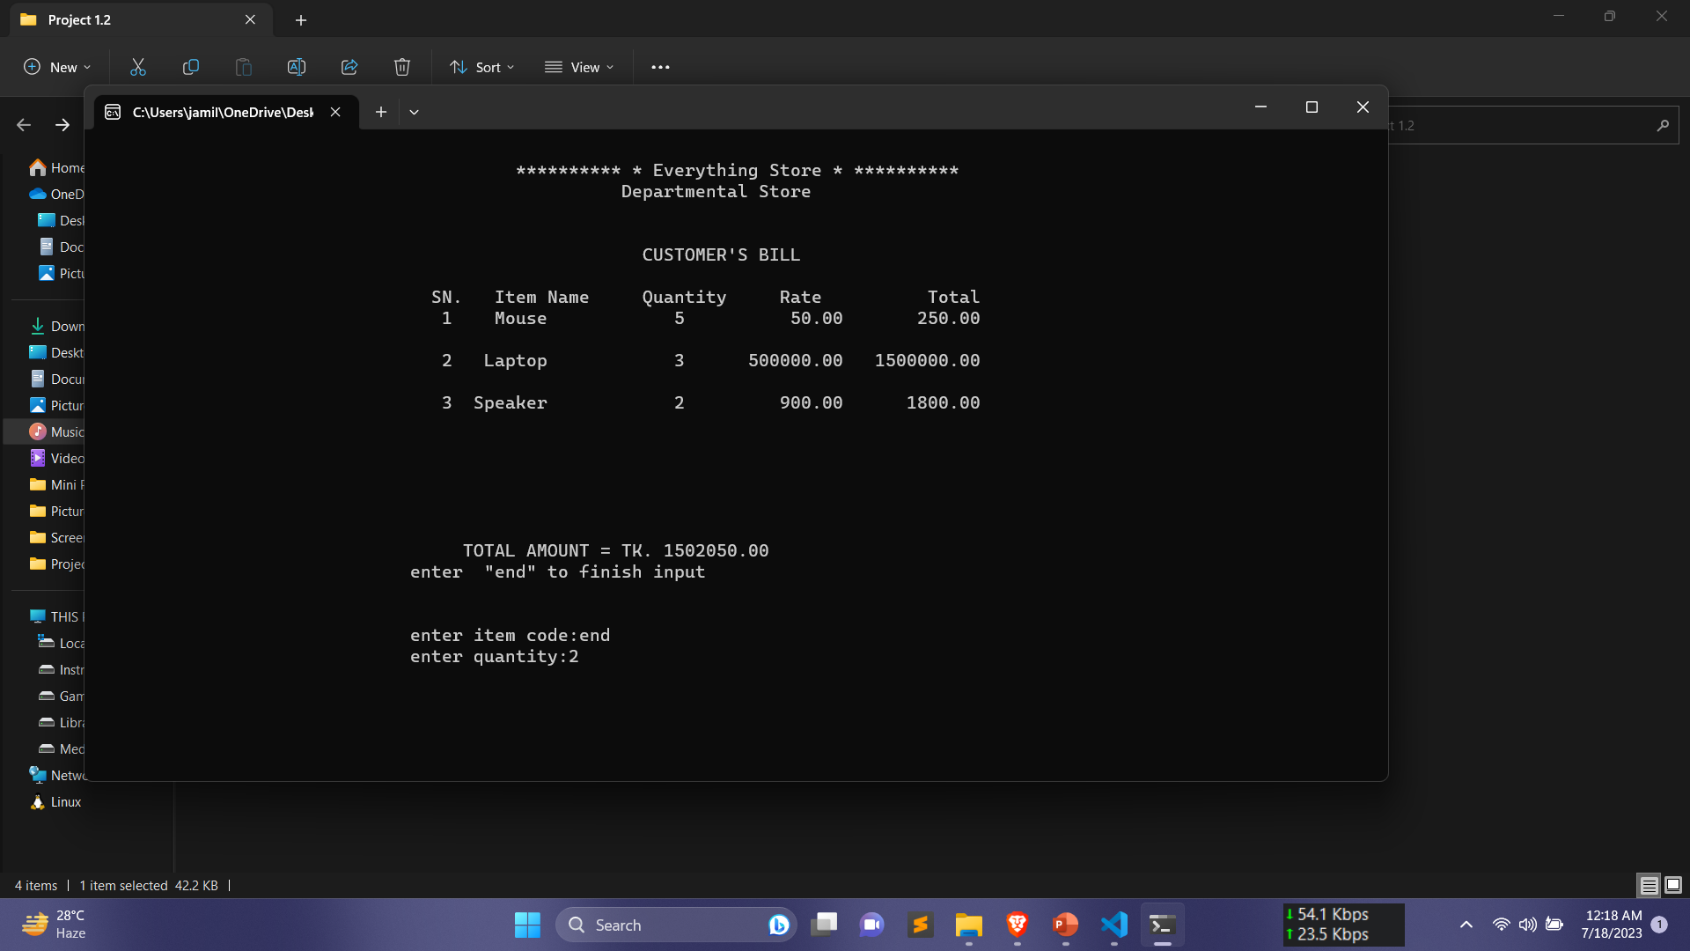
Project Visualization
Calculate Bill Window:

Slide 15
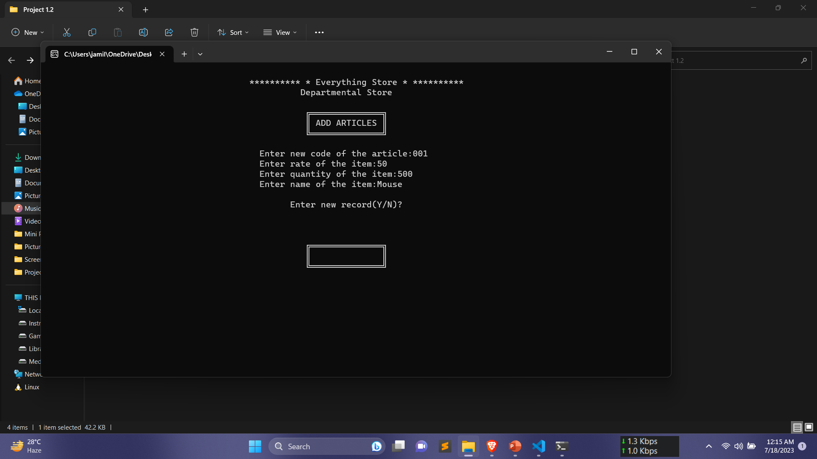
Project Visualization
Add Goods Window:

Slide 16
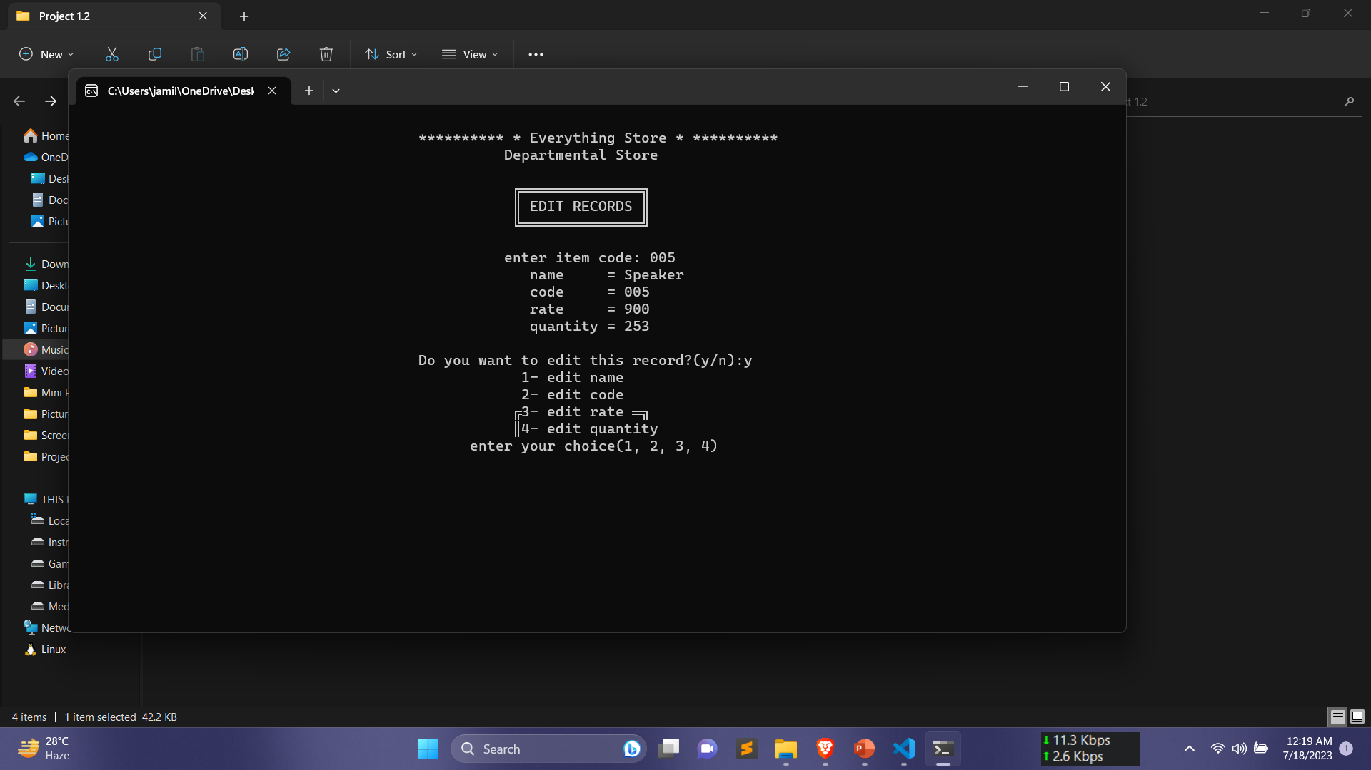
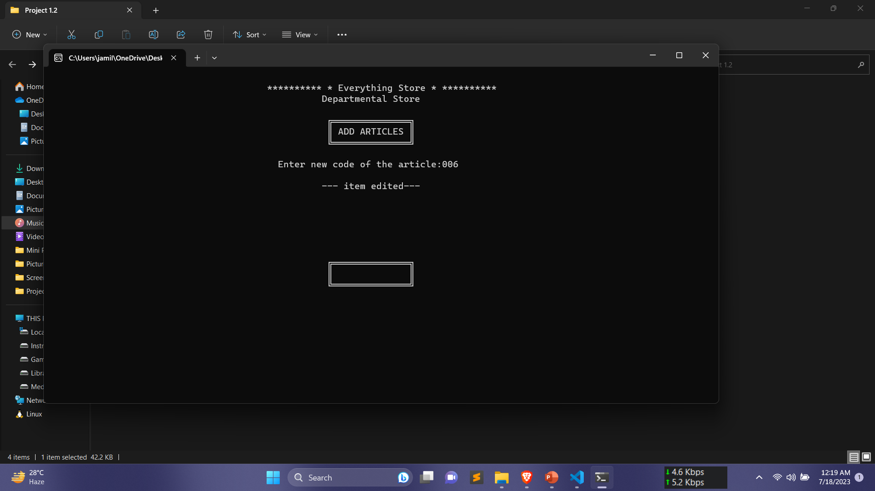
Project Visualization (cont.)
Edit Goods Window:

Slide 17
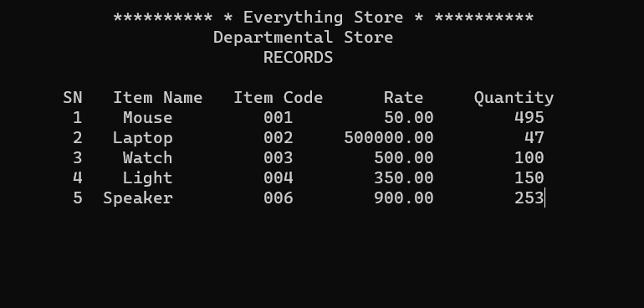
Project Visualization (cont.)
Display All Window:

Slide 18
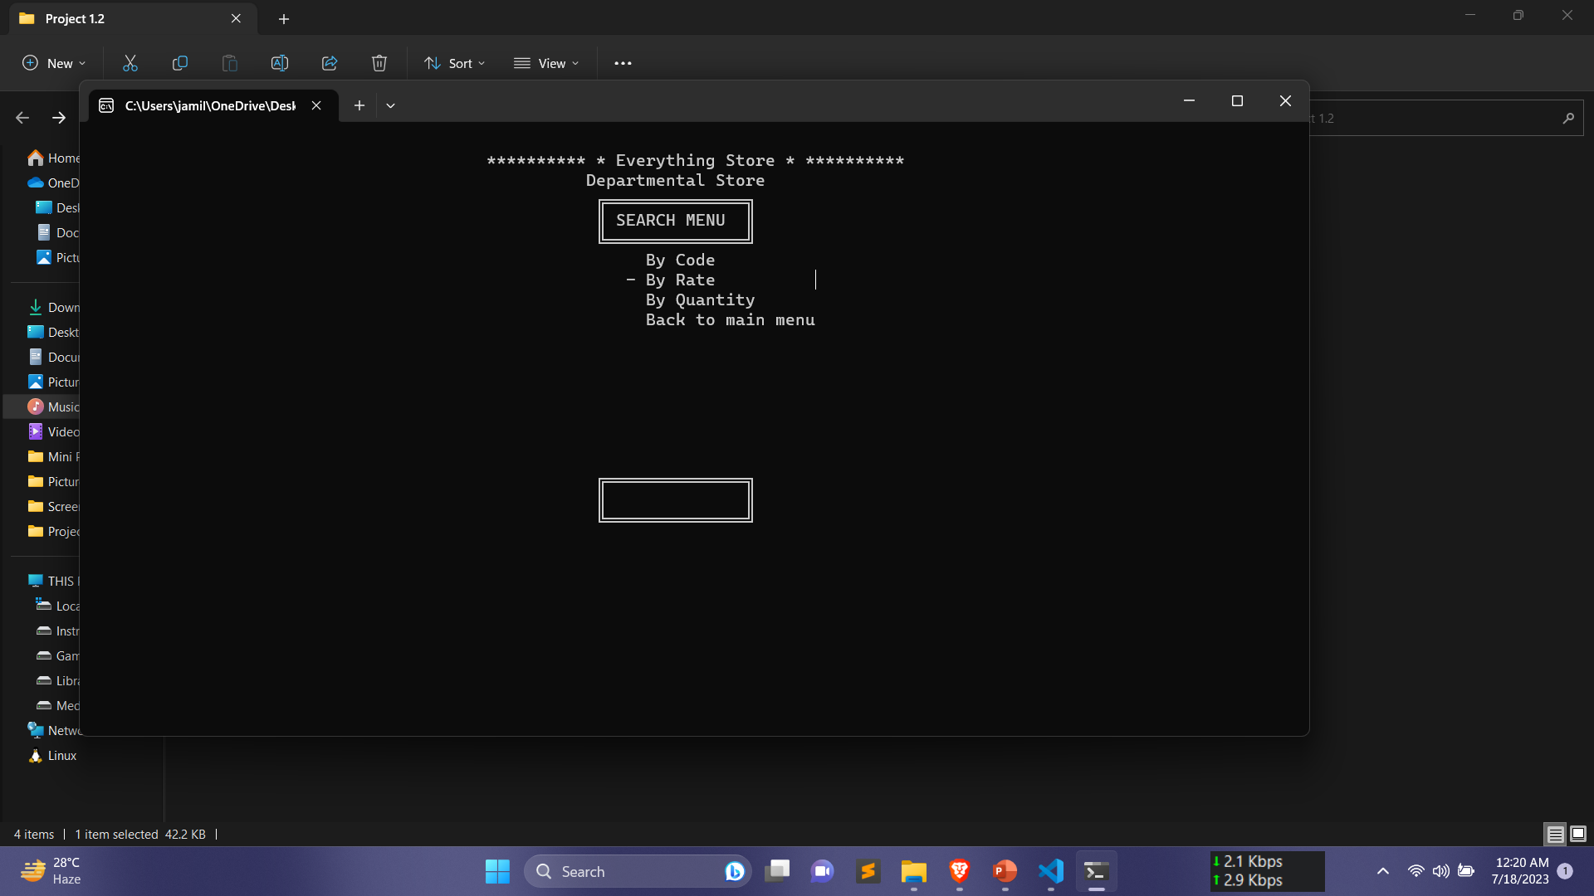
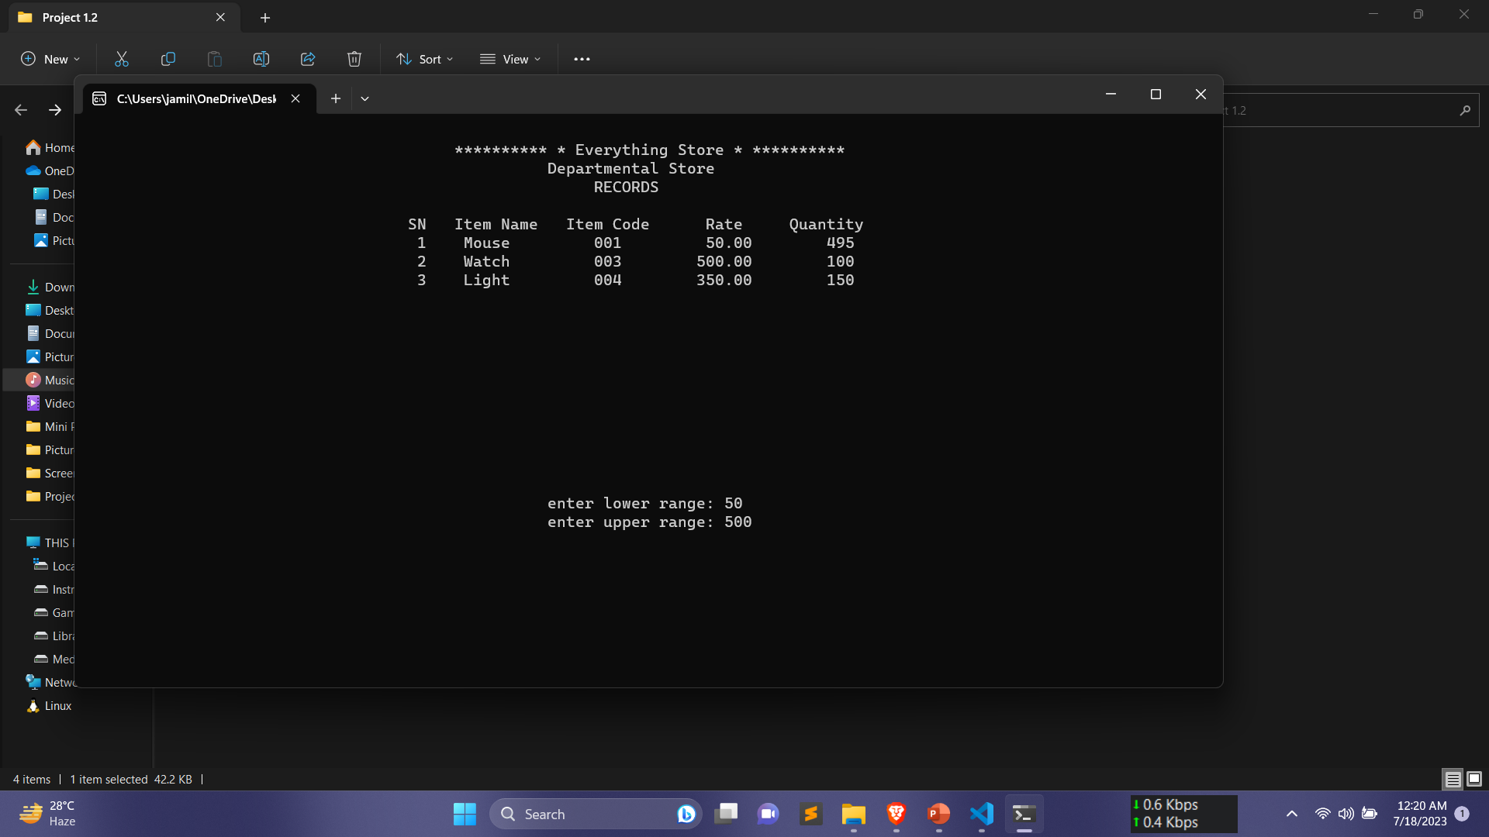
Project Visualization (cont.)
Search Window:

Slide 19
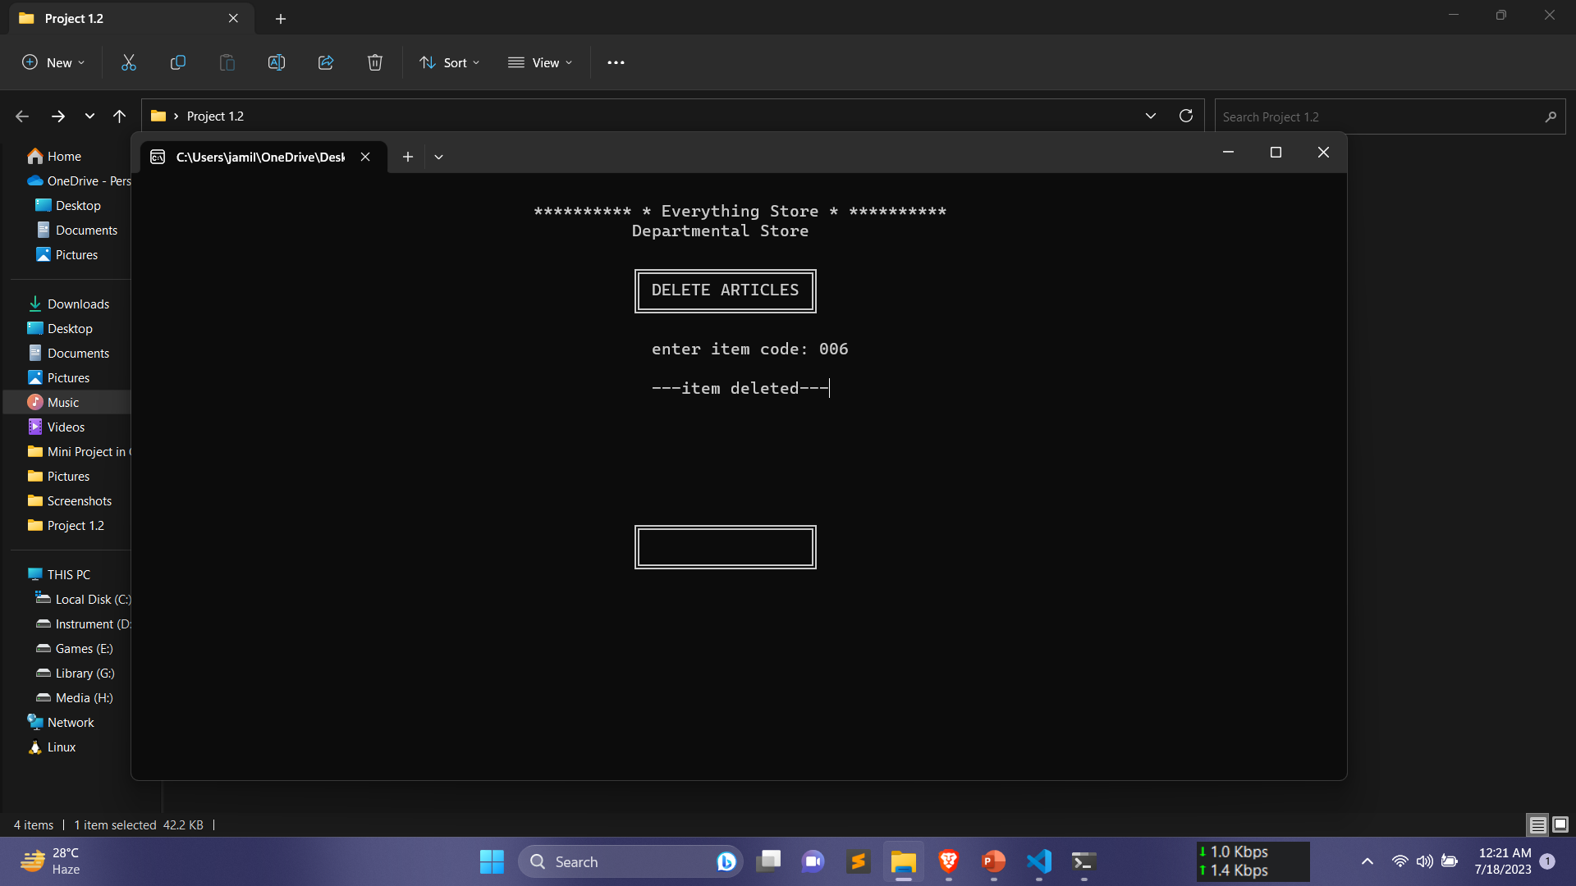
Project Visualization (cont.)
Delete Goods Window:

Slide 20
Outlines
Introduction
Related Works
Methodology
Visualization
Conclusion
References

Slide 21
Conclusion & Future Work
Usages of Store Management
Efficiently manage inventory, track sales, and enhance customer satisfaction in departmental stores.
User Friendly Interface
The project’s user friendly interface and intuitive functionality make it accessible to users of all technical expertise levels.
Future Work
Further enhance the Store Management System with advanced analytics and integration with e-commerce platforms.

Slide 22
Outlines
Introduction
Related Works
Methodology
Visualization
Conclusion
References

Slide 23
Reference
Smith, J. (2020). Retail Store Management Systems: A Comparative Study. International Journal of Business and Management, 15(5), 142-156.
Brown, A., & Johnson, M. (2018). Inventory Management Best Practices for Retail Stores. Journal of Supply Chain Management, 25(3), 78-92.
Anderson, C. (2019). Sales Tracking and Analysis: Strategies for Improved Performance. Journal of Sales and Marketing, 12(2), 45-62.
Richard, M., & Thompson, L. (2017). Customer Relationship Management in Retail: Strategies and Best Practices. Journal of Retail Marketing, 20(4), 78-92.
McConnell, S. (2018). Code Complete: A Practical Handbook of Software Construction. Pearson Education.

Slide 24
Thank You

