Slide 1
Stacks
Presented by Jamil Rayhan
ID: 18CSE061

Slide 2
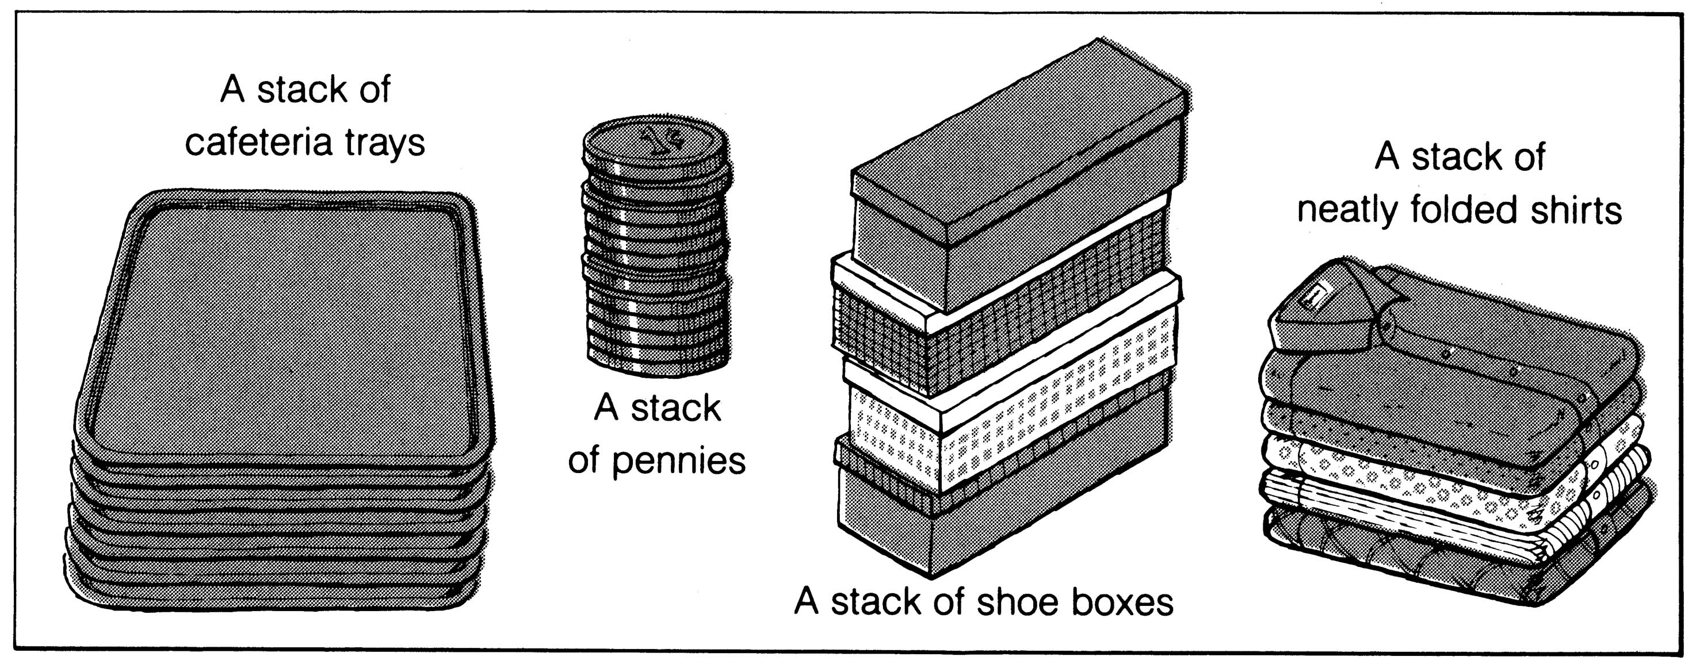
What is a stack?
It is an ordered group of homogeneous items of elements.
Elements are added to and removed from the top of the stack (the most recently added items are at the top of the stack).
The last element to be added is the first to be removed (LIFO: Last In, First Out).

Slide 3
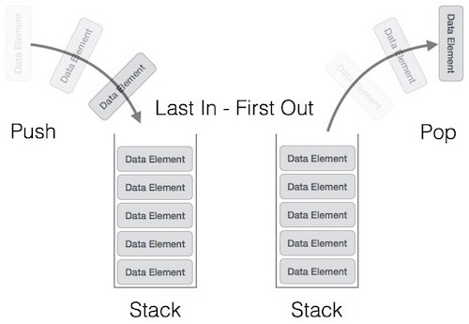
Last in , First out(LIFO)

Slide 4
Operation
MakeEmpty
Boolean IsEmpty
Boolean IsFull
Push (ItemType newItem)
Pop (ItemType& item)

Slide 5
Push (ItemType newItem)
Function: Adds newItem to the top of the stack.
Preconditions: Stack has been initialized and is not full.
Postconditions: newItem is at the top of the stack.

Slide 6
Pop (ItemType& item)
Function: Removes topItem from stack and returns it in item.
Preconditions: Stack has been initialized and is not empty.
Postconditions: Top element has been removed from stack and item is a copy of the removed element.

Slide 7
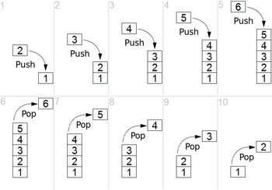

Slide 8
Stack Implementation
#include <iostream>
using namespace std;
int stack[100], n=100, top=-1;
void push(int val) {
if(top>=n-1)
cout<<"Stack Overflow"<<endl;
else {
top++;
stack[top]=val;
}
}
void pop() {
if(top<=-1)
cout<<"Stack Underflow"<<endl;
else {
cout<<"The popped element is "<< stack[top] <<endl;
top--;
}
}

Slide 9
Stack Implementation (cont.)
void display() {
if(top>=0) {
cout<<"Stack elements are:";
for(int i=top; i>=0; i--)
cout<<stack[i]<<" ";
cout<<endl;
}
Else
cout<<"Stack is empty";
}

Slide 10
Stack Implementation (cont.)
int main() {
int ch, val;
cout<<"1) Push in stack"<<endl;
cout<<"2) Pop from stack"<<endl;
cout<<"3) Display stack"<<endl;
cout<<"4) Exit"<<endl;
do {
cout<<"Enter choice: "<<endl;
cin>>ch;
switch(ch) {
case 1: {
cout<<"Enter value to be pushed:"<<endl;
cin>>val;
push(val);
break;
}

Slide 11
Stack Implementation (cont.)
case 2: {
pop();
break;
}
case 3: {
display();
break;
}
case 4: {
cout<<"Exit"<<endl;
break;
}
default: {
cout<<"Invalid Choice"<<endl;
}
}
}while(ch!=4);
return 0;
}

Slide 12
Stack overflow
The condition resulting from trying to push an element onto a full stack.
if(!stack.IsFull())
stack.Push(item);
Stack underflow
The condition resulting from trying to pop an empty stack.
if(!stack.IsEmpty())
stack.Pop(item);

Slide 13
Thank You

