Slide 1
Linear Search
Submitted by Jamil Rayhan
ID: 18CSE061

Slide 2
Contents
Definitions(Search, Linear Search)
Example
Pseudocode
Time complexity
Advantages
Disadvantages
Discussion
Sources

Slide 3
What is a Search?
Searching is a process of finding a particular element among several given elements.
The search is successful if the required element is found
Example : An example of search is a quest to find a missing person.

Slide 4
What is Linear search?
Linear search is the simplest searching algorithm
It traverses the array sequentially to locate the required element.
It searches for an element by comparing it with each element of the array one by one.
So, it is also called as Sequential Search

Slide 5
Linear search example
If you are asked to find the name of the person having phone number say “3245” with the help of a telephone Directory.
Since telephone directory is sorted by name not by numbers, we have to go through each and every number of the directory

Slide 6
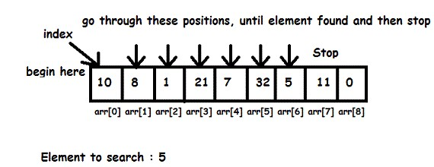
linear search Example

Slide 7
Pseudocode for linear search
LinearSearch(list, taeget_element)
{
INITIALIZE index=0
While(index<number of items in the list)
{
IF(list[index] == target_element)
{
RETURN index
}
INCREMENT index by 1
}
RETURN -1
}

Slide 8
Time Complexity
Time complexity of linear search Algorithm is O(n).
Here, n is the number of elements in the linear array

Slide 9
Advantages
Easiest to understand and implement.
No sorting required.
Suitable for small list sizes.

Slide 10
Disadvantages
Not efficient (What if item is the last one?)
In average case, n/2 comparisons will be made.
In worst case, n comparisons will be made.
Thus, time complexity of Linear Search: O(n)

Slide 11
Discussion
Sorted array is not needed.
Works fine for small number of elements. Search time increases with number of elements.
Elements with higher probability of being searched should be kept in the beginning.

Slide 12
Sources
Google.com
Wikipedia.org
Slideshare.net

Slide 13
Thank you

