Slide 1
Linked Lists
Presented by Jamil Rayhan
ID: 18CSE061
Date: 10/07/2021

Slide 2
Contents
Introduction
Insertion
Deletion
Basic Node Implementation
Conclusion

Slide 3
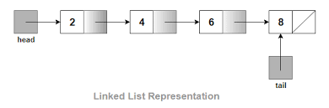
Introduction
Definitions
A linked list is a sequence of items(objects)
Where every item is linked to the next.
Graphically:
Linked lists are used to create trees and graphs

Slide 4
Types of Linked Lists
There are three different implementations of Linked Lists available, they are:
Single Linked List
Double Linked List
Circular Linked List

Slide 5
Single linked lists
Every nodes have a data part and an address part which points to the next node,

Slide 6
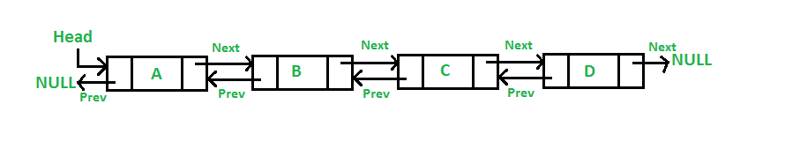
Double Linked Lists
Each node contains a data part and two addresses

Slide 7
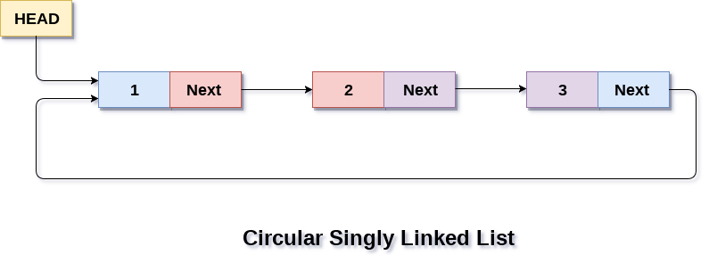
Circular Lists
The last node of the list holds the address of the first node.

Slide 8
Advantages
They are a dynamic in nature which allocates the memory when required.
Insertion and deletion operations can be easily implemented.
Stacks and queues can be easily executed.
Linked List reduces the access time.

Slide 9
Disadvantages
The memory is wasted as pointers require extra memory for storage.
No element can be accessed randomly ; it has to access each node sequentially.
Reverse Traversing is difficult in linked list. `

Slide 10
Applications
Linked lists are used to implement stacks, queues, graphs, etc.
Linked lists let you insert elements at the beginning and the end of the list.
In Linked lists we don’t need to know the size in advance.

Slide 11
Insertion
Insertion at the top of the list
Insertion at the end of the list
Insertion in the middle of the list

Slide 12
Insertion at the top
Steps:
Create a Node
Set the node data Values
Connect the pointers

Slide 13


Insertion Description
head
48
17
142
//
Step 1
Step 2
Step 3
head
93

Slide 14
Insertion at the end
Steps:
Create a Node
Set the node data Values
Connect the pointers

Slide 15



Insertion Description
head
48
17
142
//
Step 1
Step 2
Step 3

Slide 16
Insertion in the middle
Steps:
Create a Node
Set the node data Values
Break pointer connection
Re-connect the pointers

Slide 17




Insertion Description
Step 1
Step 2
Step 3
Step 4

Slide 18
Deletion
Deleting from the top of the list
Deleting from the end of the list
Deleting from the middle of the list

Slide 19
Deleting from the top
Steps
Break the pointer connection
Re-connect the nodes
Delete the node

Slide 20
Deleting from the end
Steps
Break the pointer connection
Set previous node pointer to NULL
Delete the node

Slide 21
Deleting from the Middle
Steps
Set previous Node pointer to next node
Break Node pointer connection
Delete the node

Slide 22
Basic Node Implementation
The following code is written in C++:
Struct Node
{
int data; //any type of data could be another struct
Node *next; //this is an important piece of code “pointer”
};

Slide 23
Thank You

