Slide 1
Flip-Flop
Presented by Jamil Rayhan
ID: 18CSE061

Slide 2
What is Flip-flop ?
A flip-flop or latch is a circuit that has two stable states and can be used to store state information
It is a Sequential Circuits / an electronic circuit which has two stable states and thereby is capable of serving as one bit of memory , bit 1 or bit 0.

Slide 3
What is Flip-flop ?(cont.)
Flip-flop have two stable conditions and can be switched from one to the other by appropriate inputs. These stable conditions are usually called the states of the circuit.
They are 1 (HIGH) or 0 (LOW) Whenever we refer to the state of flip flop, we refer to the state of its normal output (Q).
More complicated Flip flop use a clock as the control input. These clocked flip-flops are used whenever the input and output signals must occur within a particular sequence.

Slide 4
Flip-flops
3 classes of flip-flops
Latches: outputs respond immediately while enabled (no timing control)
Pulse-triggered flip-flops: outputs response to the triggering pulse.
Edge-triggered flip-flops: outputs response to the control input edge.

Slide 5
Types of Flip-Flop
SR Flip-Flop
Clocked SR Flip-Flop
JK Flip-Flop
T Flip-Flop
D Flip-Flop

Slide 6
SR Flip-Flop
The most basic Flip Flop is called SR Flip Flop.
The basic SR flip flop is an asynchronous device.
In asynchronous device, the outputs is immediately changed anytime one or more of the inputs change just as in combinational logic circuits.
It does not operate in step with a clock or timing.
These basic Flip Flop circuit can be constructed using two NAND gates latch or two NOR gates latch.
SR Flip Flop Active Low = NAND gates
SR Flip Flop Active High = NOR gates

Slide 7
SR Flip-Flop
The SR Flip Flop has two inputs, SET (S) and RESET (R).
The SR Flip Flop has two outputs, Q and Q’
The Q output is considered the normal output and is the one most used.
The other output Q’ is simply the compliment of output Q.

Slide 8
SR Flip Flop - NAND GATE LATCH
The NAND gate version has two inputs, SET (S) and RESET (R).
Two outputs, Q as normal output and Q’ as inverted output and feedback mechanism.
The feedback mechanism is required to form a sequential circuit by connecting the output of NAND-1 to the input of NAND-2 and vice versa.
The circuit outputs depends on the inputs and also on the outputs.

Slide 9
SR Flip Flop - NAND GATE LATCH
From the description of the NAND gate latch operation, it shows that the SET and RESET inputs are active LOW.
The SET input will set Q = 1 when SET is 0 (LOW).RESET input will reset Q = 0 when RESET is 0 (LOW)
In the prohibited/INVALID state both outputs are 1. This condition is not used on the RS flip-flop. The set condition means setting the output Q to 1.
Likewise, the reset condition means resetting (clearing) the output Q to 0. The last row shows the disabled, or hold , condition of the RS flip-flop. The outputs remain as they were before the hold condition existed. There is no change in the outputs from the previous states

Slide 10
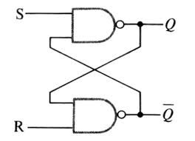
SR Flip Flop - NAND GATE LATCH

Slide 11
SR Flip Flop - NOR GATE LATCH
The latch circuit can also be constructed using two NOR gates latch.
The construction is similar to the NAND latch except that the normal output Q and inverted output Q’ have reversed positions.

Slide 12
SR Flip Flop - NOR GATE LATCH
S = 1, R = 0; This will set Q to 1, it works in SET mode operation.
S = 1, R = 1; This condition tries to set and reset the NOR gate latch at the same time, and it produces Q = Q’ = 0 This is an unexpected condition and are not used.
Since the two outputs should be inverse of each other. If the inputs are returned to 1 simultaneously, the output states are unpredictable.
This input condition should not be used and when circuits are constructed, the design should make this condition SET=RESET = 1 never arises

Slide 13
SR Flip Flop - NOR GATE LATCH
From the description of the NOR gate latch operation, it shows that the SET and RESET inputs are Active HIGH.
The SET input will set Q = 1 when SET is 1 (HIGH). RESET input will reset Q when RESET is 1 (HIGH).

Slide 14
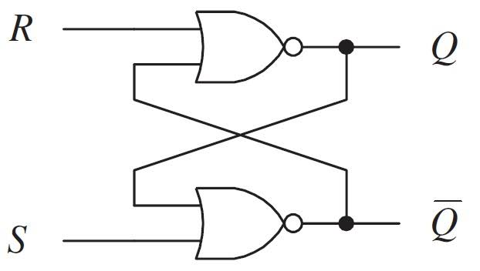
SR Flip Flop - NOR GATE LATCH

Slide 15
The CLOCK
When the clock changes from a LOW state to a HIGH state, this is called the positive-going transition (PGT) or positive edge triggered.
When the clock changes from a HIGH state to a LOW state, it is called negative going transition (NGT) or negative edge triggered.

Slide 16
Clocked SR Flip Flop
Additional clock input is added to change the SR flip- flop from an element used in asynchronous sequential circuits to one, which can be used in synchronous circuits.
The clocked SR flip flop logic symbol that is triggered by the PGT is shown in Figure.
Its means that the flip flop can change the output states only when clock signal makes a transition from LOW to HIGH.

Slide 17
Clocked SR Flip Flop
The Truth Table in figure shows how the flip flop output will respond to the PGT at the clocked input for the various combinations of SR inputs and output.
The up arrow symbol indicates PGT.

Slide 18
Clocked SR Flip Flop
The clocked SR Flip Flop logic symbol that is triggered by the NGT is shown in Figure.
It means that the Flip flop can change the output states only when clocked signal makes a transition from HIGH to LOW

Slide 19
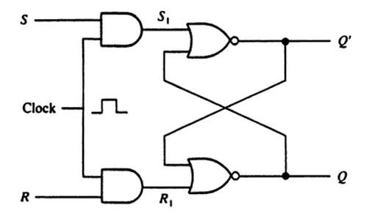
Clocked SR Flip Flop

Slide 20
JK Flip Flop
Another types of Flip flop is JK flip flop.
It differs from the RS flip flops when J=K=1 condition is not indeterminate but it is defined to give a very useful changeover (toggle) action.
Toggle means that Q and Q’ will switch to their opposite states.
The JK Flip flop has clock input Cp and two control inputs J and K.
Operation of JK Flip Flop is completely described by truth table in Figure.

Slide 21
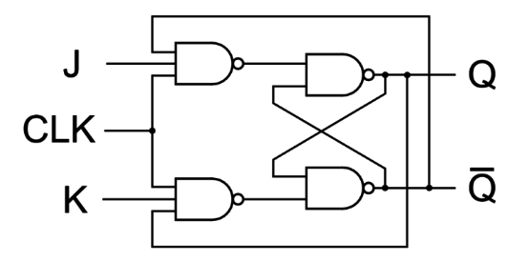
JK Flip Flop –Logic Circuit

Slide 22
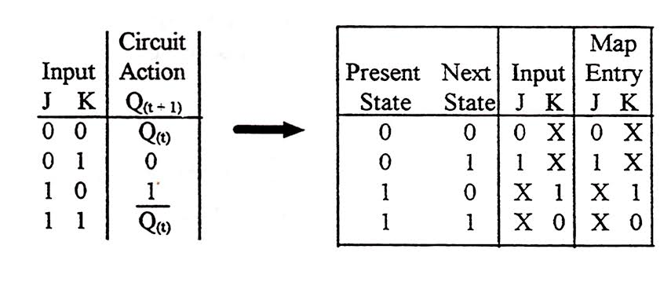
JK Flip Flop – truth table

Slide 23
T Flip Flop
The T flip flop has only the Toggle and Hold Operation.
If Toggle mode operation. The output will toggle from 1 to 0 or vice versa.

Slide 24
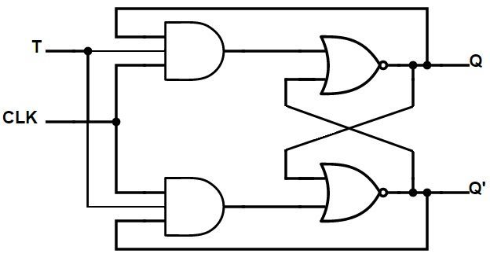
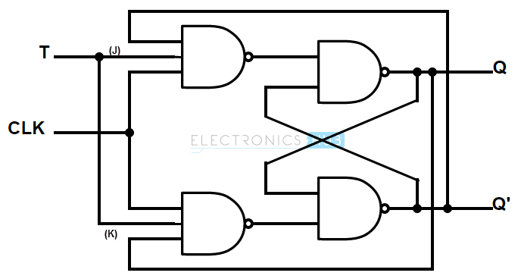
T Flip Flop – Logic Circuit
Logic circuit T Flip flop using NOR gate
Logic circuit T Flip flop using NAND gate

Slide 25
D Flip Flop
Also Known as Data Flip flop
Can be constructed from RS Flip Flop or JK Flip flop by addition of an inverter.
Inverter is connected so that the R input is always the inverse of S (or J input is always complementary of K).
The D flip flop will act as a storage element for a single binary digit (Bit).

Slide 26
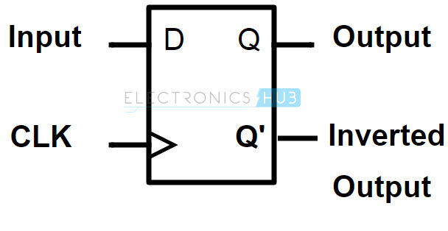
D Flip Flop - Symbol

Slide 27
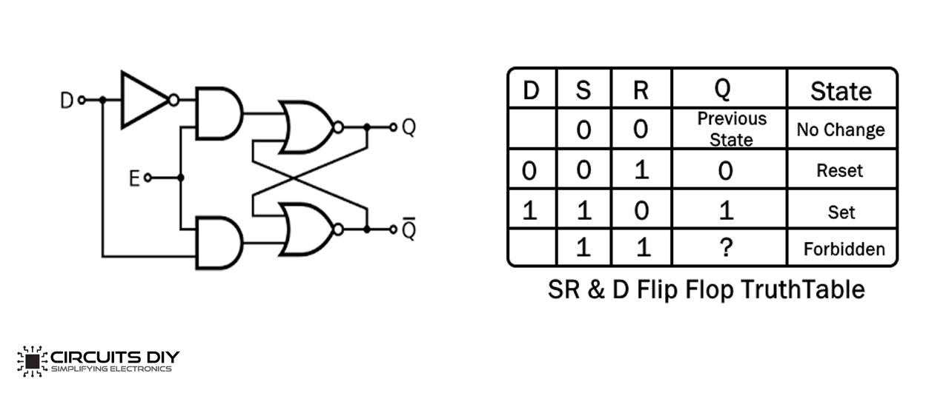
D Flip Flop- Logic circuit-Truth Table

Slide 28
The Used of Flip Flop
For Memory circuits
For Logic Control Devices
For Counter Devices
For Register Devices

Slide 29
Application of flip flop
For Register Devices:
Flip flops can store a single bit of data i.e. 1 or 0. Registers are used to store multiple bits of data. So flip flops are used to design Registers. According to digital electronics, a Register is a device which is used to store the information.
Data Transfer:
The process of transferring the data from one register to another register

Slide 30
Thank You

