Slide 1
Gradient, Divergence And Curl
Presented By Jamil Rayhan ID: 18CSE058

Slide 2

Gradient
The gradient : Let $ϕ$(x, y, z) be defined and differentiable at each point (x, y, z) in a certain region of space . Then the gradient of $ϕ$, written $∇ϕ$ or grad $ϕ$, is defined by
$∇ϕ\text{=}(\frac{δ}{δx}ⅈ+\frac{δ}{δy}j+\frac{δ}{δz}k$) $ϕ$
= $\frac{δϕ}{δx}ⅈ+\frac{δϕ}{δy}j+\frac{δϕ}{δz}k$

Slide 3
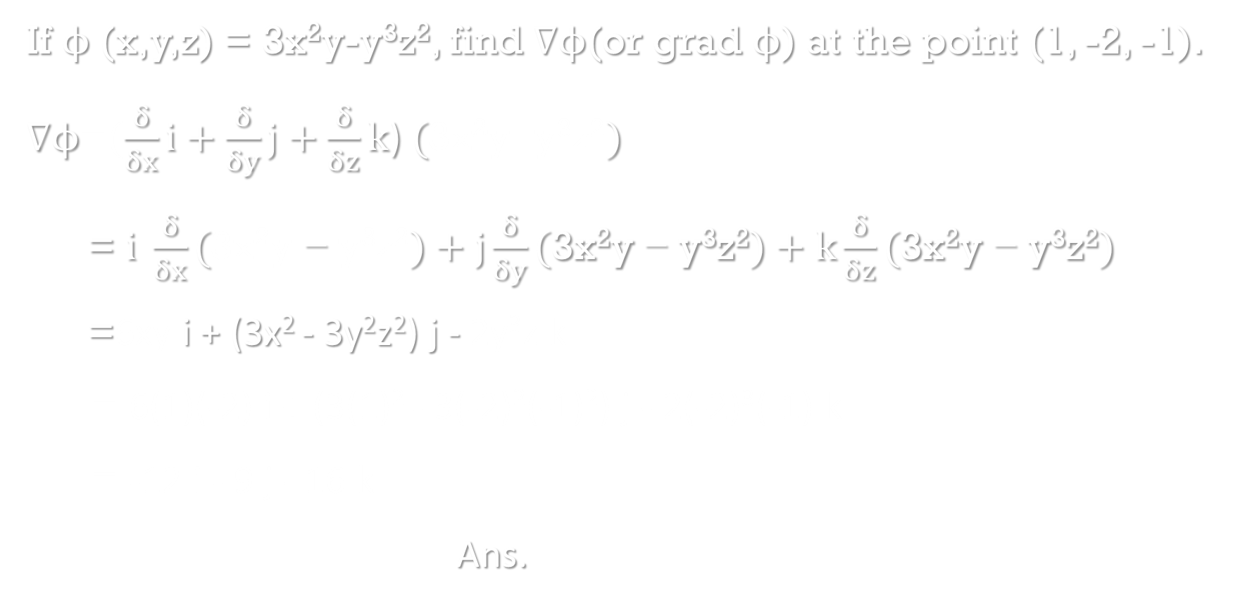
Example -1
If $ϕ$(x,y,z) = 3x²y-y³z², find $∇ϕ$(or grad $ϕ$) at the point (1, -2, -1).
$∇ϕ\text{=}(\frac{δ}{δx}ⅈ+\frac{δ}{δy}j+\frac{δ}{δz}k$) $(\text{3}\text{x}\text{2}\text{y}\text{−}\text{y}\text{3}\text{z}\text{2})$
= $ⅈ \frac{δ}{δx}(\text{3}\text{x}\text{2}\text{y} \text{− }\text{y}\text{3}\text{z}\text{2})+j\frac{δ}{δy}(\text{3}\text{x}\text{2}\text{y} \text{− }\text{y}\text{3}\text{z}\text{2})+k\frac{δ}{δz}(\text{3}\text{x}\text{2}\text{y} \text{− }\text{y}\text{3}\text{z}\text{2})$
=6xy i + (3x² - 3y²z²) j - 2y³z k
= 6(1)(-2) i + (3(1)² - 3(-2)²(-1)²) j - 2(-2)³(-1) k
= -12 i - 9 j - 16 k
Ans.

Slide 4
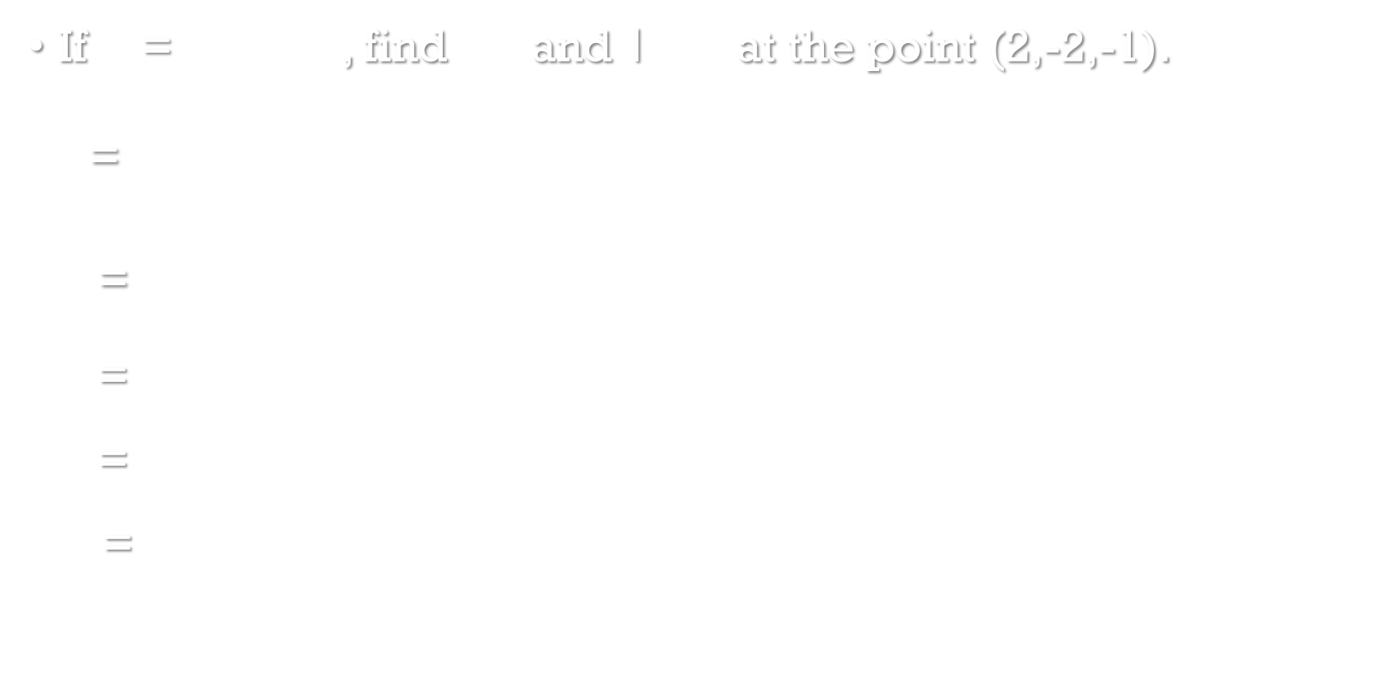
Example -2
If $φ\text{=}$2xz⁴-x²y, find $∇φ$ and ।$∇φ।$ at the point (2,-2,-1).
$∇φ\text{=}(\frac{δ}{δx}ⅈ+\frac{δ}{δy}j+\frac{δ}{δz}k$) $(\text{2}\text{xz}\text{4}\text{−}\text{x}\text{2}\text{y})$
= $ⅈ \frac{δ}{δx}(\text{2}\text{xz}\text{4} \text{−} \text{x}\text{2}\text{y})+j\frac{δ}{δy}(\text{2}\text{xz}\text{4} \text{−} \text{x}\text{2}\text{y})+k\frac{δ}{δz}(\text{2}\text{xz}\text{4} \text{−} \text{x}\text{2}\text{y})$
= (2z⁴ - 2xy) i - x² j + 8xz³ k
= (2(-1)⁴ - 2(2)(-2)) i – (2)² j + 8(2)(-1)³ k
= 10 i – 4 j -16 k
Ans.

Slide 5
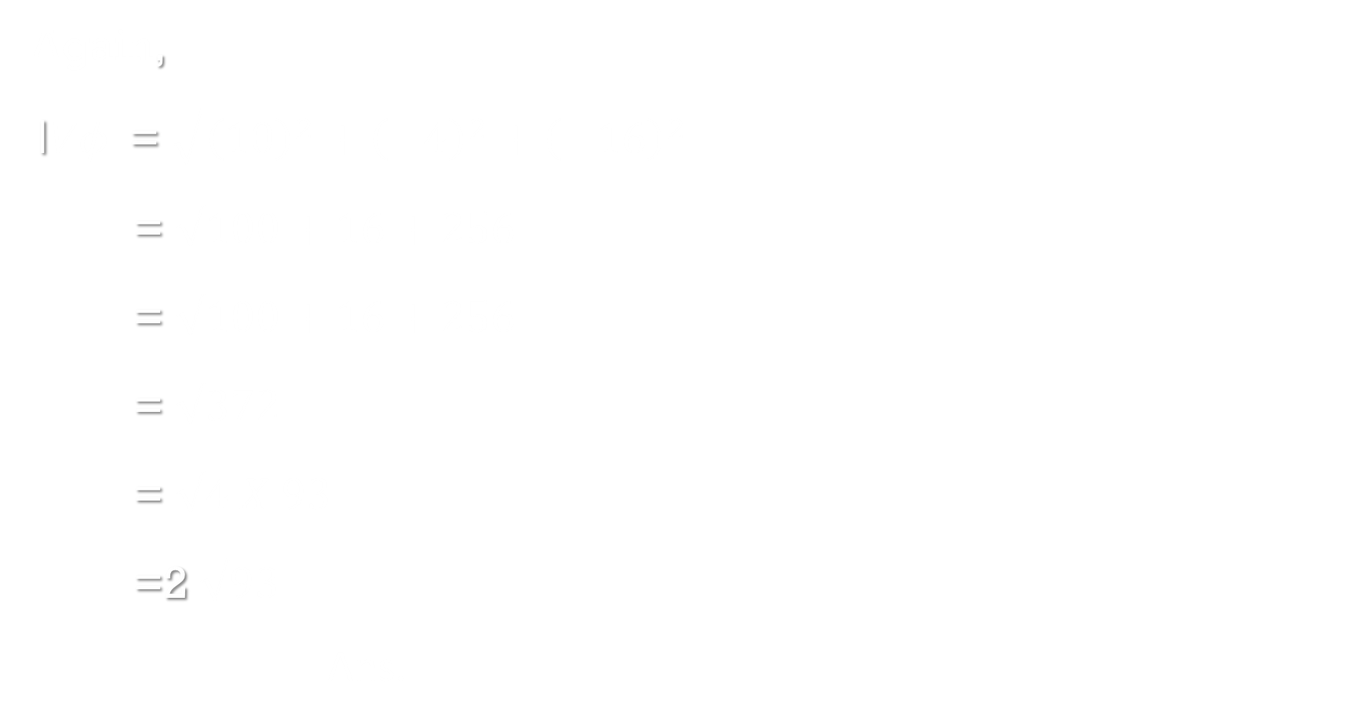
Example -2
Again,
।$∇φ।$= $\sqrt{{\left(10\right)}^{2}+{\left(−4\right)}^{2}+{\left(−16\right)}^{2}}$
= $\sqrt{100+16+256}$
= $\sqrt{100+16+256}$
= $\sqrt{372}$
= $\sqrt{4 X 93}$
=2 $\sqrt{93}$
Ans.

Slide 6

Divergence
The divergence : Let V(x, y, z) = V₁i+V₂j+V₃k be defined and differentiable at each point (x , y , z) in a certain region of space . Then the divergence of $\vec{v},$ written $∇.\vec{v}$ or div $\vec{v}$, is defined by
$∇.\vec{v}\text{=}(\frac{δ}{δx}ⅈ+\frac{δ}{δy}j+\frac{δ}{δz}k\text{)}$.(V₁i+V₂j+V₃k )
$$\text{=}(\frac{δ}{δx}\text{V}\text{1}+\frac{δ}{δy}\text{V}\text{2}+\frac{δ}{δz}\text{V}\text{3}\text{)}$$

Slide 7
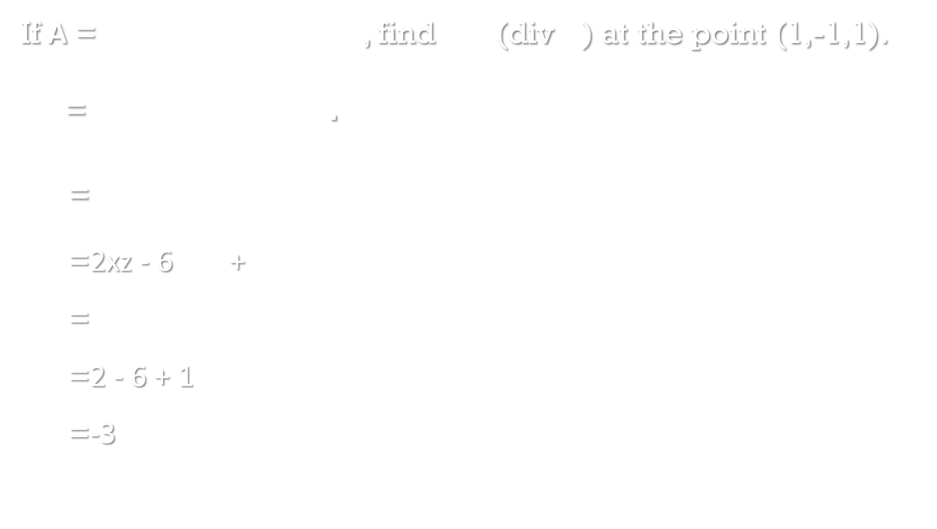
Example -1
If A = x²z i - 2y³z² j + xy²z k, find $∇.\vec{A}$(div $\vec{A}$) at the point (1,-1,1).
$∇.\vec{A}\text{=}(\frac{δ}{δx}ⅈ+\frac{δ}{δy}j+\frac{δ}{δz}k\text{)}$.(x²z i - 2y³z² j + xy²z k)
$\text{=}\frac{δ}{δx}(\text{x}\text{2}\text{z} )+\frac{δ}{δy}(\text{− 2}\text{y}\text{3}\text{z}\text{2})+\frac{δ}{δz}\text{(}\text{xy}\text{2}\text{z}\text{)}$
=2xz - 6$\text{y}\text{2}\text{z}\text{2}$ + $\text{xy}\text{2}$
=2(1)(1) - 6(-1)²(1)² + (1)(-1)²
=2 - 6 + 1
=-3
Ans.

Slide 8

Example -2
Given $ϕ$= 2x³y²z⁴, Find $∇$.$∇ϕ$(div grad $ϕ$).
$∇ϕ\text{=}(\frac{δ}{δx}ⅈ+\frac{δ}{δy}j+\frac{δ}{δz}k$) $(\text{2}\text{x}\text{3}\text{y}\text{2}\text{z}\text{4})$
= $ⅈ \frac{δ}{δx}(\text{2}\text{x}\text{3}\text{y}\text{2}\text{z}\text{4})+j\frac{δ}{δy}(\text{2}\text{x}\text{3}\text{y}\text{2}\text{z}\text{4})+k\frac{δ}{δz}(\text{2}\text{x}\text{3}\text{y}\text{2}\text{z}\text{4})$
= 6x²y²z⁴ i + 4x³yz⁴ j + 8x³y²z³ k
Then, $∇.∇ϕ\text{=}(\frac{δ}{δx}ⅈ+\frac{δ}{δy}j+\frac{δ}{δz}k\text{)}$.(6x²y²z⁴ i + 4x³yz⁴ j + 8x³y²z³ k)
$\text{=}\frac{δ}{δx}(\text{6}\text{x}\text{2}\text{y}\text{2}\text{z}\text{4})+\frac{δ}{δy}(\text{4}\text{x}\text{3}\text{yz}\text{4})+\frac{δ}{δz}\text{(}\text{8}\text{x}\text{3}\text{y}\text{2}\text{z}\text{3}\text{)}$
= $\text{1}\text{2}\text{xy}\text{2}\text{z}\text{4}$ + $\text{4}\text{x}\text{3}\text{z}\text{4}$ +$\text{24}\text{x}\text{3}\text{y}\text{2}\text{z}\text{2}$
Ans.

Slide 9

Curl
The curl : If V(z, y, z) is a differentiable vector field then the curl or rotation of $\vec{v}$, written $∇$ $\text{x} \vec{v}$, curl $\vec{v}$or rot $\vec{v}$, is defined by
$∇\text{x}\vec{v}\text{=}(\frac{δ}{δx}ⅈ+\frac{δ}{δy}j+\frac{δ}{δz}k\text{)} \text{x}$ (V₁i+V₂j+V₃k )
= $\left|\begin{matrix}i & j & k \\ \frac{δ}{δx} & \frac{δ}{δy} & \frac{δ}{δz} \\ \text{V}\text{1} & \text{V}\text{2} & \text{V}\text{3}\end{matrix}\right|$
=($\frac{δ\text{V}\text{3}}{δy}$ - $\frac{δ\text{V}\text{2}}{δz}$)i + ($\frac{δ\text{V}\text{1}}{δz}$ - $\frac{δ\text{V}\text{3}}{δx}$)j + ($\frac{δ\text{V}\text{2}}{δx}$ - $\frac{δ\text{V}\text{1}}{δy}$)k

Slide 10

Example -1
If A = xz³ i - 2x²yz j + 2yz⁴ k, find $∇\text{x}\vec{A}$(or curl $\vec{A}$).
$∇\text{x}\vec{A}\text{=}(\frac{δ}{δx}ⅈ+\frac{δ}{δy}j+\frac{δ}{δz}k\text{)} \text{x}$(xz³ i - 2x²yz j + 2yz⁴ k)
= $\left|\begin{matrix}i & j & k \\ \frac{δ}{δx} & \frac{δ}{δy} & \frac{δ}{δz} \\ \text{xz}\text{3} & \text{− }\text{2}\text{x}\text{2}\text{yz} & \text{2}\text{yz}\text{4}\end{matrix}\right|$
=[$\frac{δ}{δy}$ (2yz⁴) - $\frac{δ}{δz}$(- 2x²yz )]i + [$\frac{δ}{δz}$(xz³) - $\frac{δ}{δx}(\text{2}\text{yz}\text{4})]$j + [$\frac{δ}{δx}$(- 2x²yz ) - $\frac{δ}{δy}(\text{xz}\text{3})]$k
=(2z⁴ + 2x²y)i + (3xz²)j + (- 4xyz)k
=(2z⁴ + 2x²y)i + 3xz² j - 4xyz k
Ans.

Slide 11

Example -2
If A = yz² i – 3xz² j + 2xyz k, find $∇\text{x}\vec{A}$(or curl $\vec{A}$).
$∇\text{x}\vec{A}\text{=}(\frac{δ}{δx}ⅈ+\frac{δ}{δy}j+\frac{δ}{δz}k\text{)} \text{x}$(yz² i – 3xz² j + 2xyz k)
= $\left|\begin{matrix}i & j & k \\ \frac{δ}{δx} & \frac{δ}{δy} & \frac{δ}{δz} \\ \text{yz}\text{2} & \text{– }\text{3}\text{xz}\text{2} & \text{2}\text{xyz}\end{matrix}\right|$
=[$\frac{δ}{δy}$ (2xyz) - $\frac{δ}{δz}$(- 3xz²)]i + [$\frac{δ}{δz}$(yz²) - $\frac{δ}{δx}(\text{2}\text{xyz})]$j + [$\frac{δ}{δx}$(- 3xz² ) - $\frac{δ}{δy}(\text{yz}\text{2})]$k
=(2xz + 6xz)i + (2yz-2yz)j + (-3z² - z²)k
=8xz i - 4z² k
Ans.

Slide 12
Thank you

