Slide 1
Vector Differentiation
Presented by Jamil Rayhan
ID: 18CSE061

Slide 2

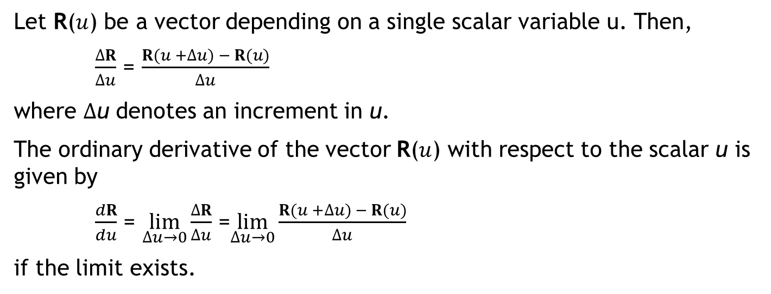
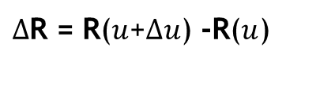

ORDINARY DERIVATIVES OF VECTOR
Let R($u$) be a vector depending on a single scalar variable u. Then,
$\frac{ΔR}{Δu}$ = $\frac{R(u +Δu) − R(u)}{Δu}$
where $Δ$u denotes an increment in u.
The ordinary derivative of the vector R($u$) with respect to the scalar u is given by
$\frac{dR}{du}$ = $\lim_{Δu→0}{\frac{ΔR}{Δu}}$ =$\lim_{Δu→0}\frac{R(u +Δu) − R(u)}{Δu}$
if the limit exists.
$Δ$R = R($u$+$Δu$) -R($u$)
R($u$+$Δu$)
R($u$)

Slide 3

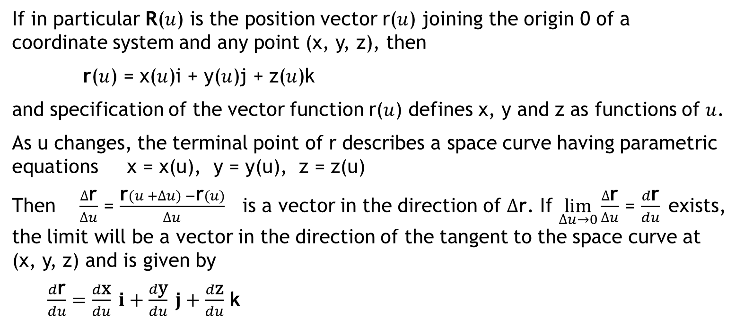
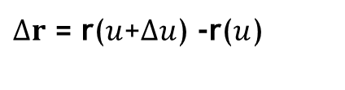

Space Curve
If in particular R($u$) is the position vector r($u$) joining the origin 0 of a coordinate system and any point (x, y, z), then
r($u$) = x($u$)i + y($u$)j + z($u$)k
and specification of the vector function r($u$) defines x, y and z as functions of $u$.
As u changes, the terminal point of r describes a space curve having parametric equations x = x(u), y = y(u), z = z(u)
Then $\frac{Δ\text{r}}{Δu}$ = $\frac{\text{r}(u +Δu) −\text{r}(u)}{Δu}$is a vector in the direction of $Δ$r. If $\lim_{Δu→0}{\frac{Δ\text{r}}{Δu}}$ = $\frac{d\text{r}}{du}$exists, the limit will be a vector in the direction of the tangent to the space curve at (x, y, z) and is given by
$\frac{d\text{r}}{du}=\frac{d\text{x}}{du} i+\frac{d\text{y}}{du} j+\frac{d\text{z}}{du}$ k
r($u$+$Δu$)
$Δr$ = r($u$+$Δu$) -r($u$)
r($u$)

Slide 4
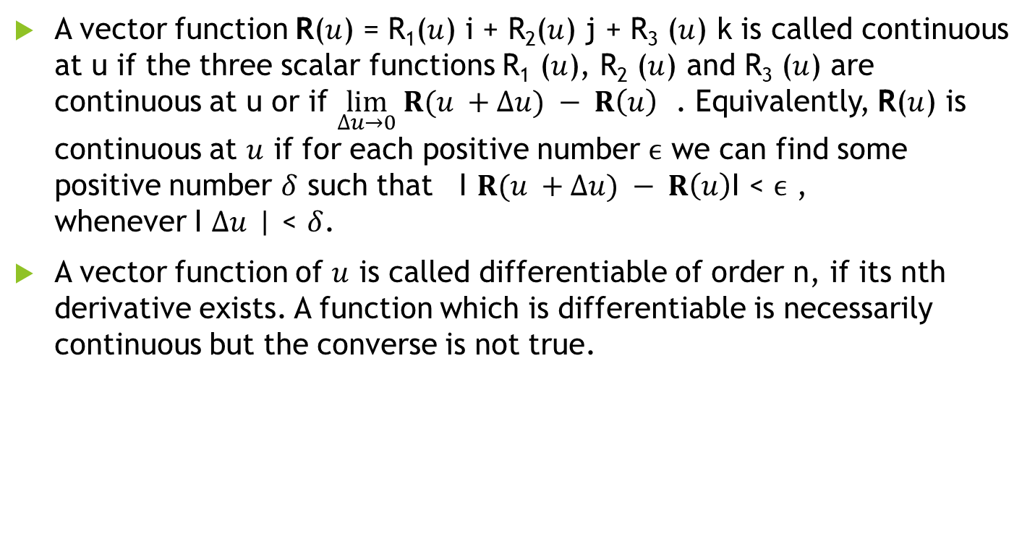
Continuity and differentiability
A vector function R($u$) = R₁($u$) i + R₂($u$) j + R₃ ($u$) k is called continuous at u if the three scalar functions R₁ ($u$), R₂ ($u$) and R₃ ($u$) are continuous at u or if $\lim_{Δu→0} R(u +Δu) − R\left(u\right)$ . Equivalently, R($u$) is continuous at $u$ if for each positive number $ϵ$ we can find some positive number $δ$ such that I $R(u +Δu) − R\left(u\right)$I < $ϵ$ , whenever I $Δu$ | < $δ$.
A vector function of $u$ is called differentiable of order n, if its nth derivative exists. A function which is differentiable is necessarily continuous but the converse is not true.

Slide 5
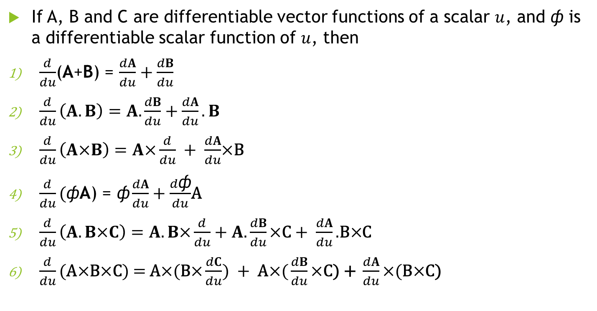
Differentiation formulas
If A, B and C are differentiable vector functions of a scalar $u$, and ф is a differentiable scalar function of $u$, then
$\frac{d}{du}$(A+B) = $\frac{dA}{du}+\frac{dB}{du}$
$\frac{d}{du}\left(A.B\right)=A.\frac{dB}{du}+\frac{dA}{du}.B$
$\frac{d}{du}\left(A\text{×}B\right)=A\text{×}\frac{d}{du} + \frac{dA}{du}$×B
$\frac{d}{du}\text{(}\text{ф}\text{A}\text{)}\text{ = }\text{ф}\frac{dA}{du}+\frac{d\text{ф}}{du}$A
$\frac{d}{du}\left(A.B\text{×}C\right)=A.B\text{×}\frac{d}{du}+A.\frac{dB}{du}\text{×}\text{C}+ \frac{dA}{du}\text{.}\text{B}\text{×}$C
$\frac{d}{du}\text{(}\text{A}\text{×}\text{B}\text{×}\text{C}\text{) = }\text{A}\text{×}\text{(}\text{B}\text{×}\frac{dC}{du}) + \text{A}\text{×}\text{(}\frac{dB}{du}\text{×}\text{C}\text{) + }\frac{dA}{du}\text{×}\text{(}\text{B}\text{×}\text{C}\text{)}$

Slide 6
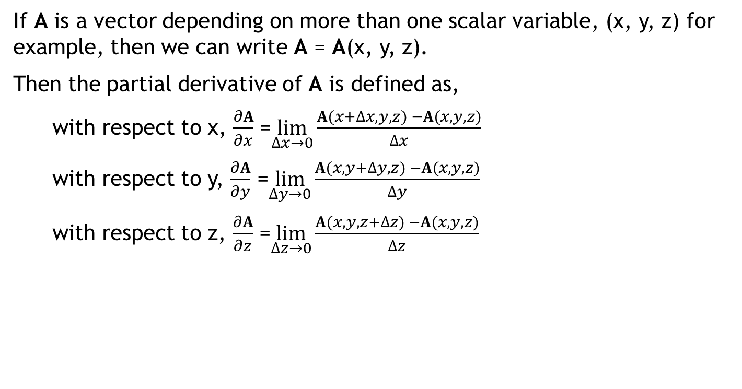
Partial derivatives of vectors
If A is a vector depending on more than one scalar variable, (x, y, z) for example, then we can write A = A(x, y, z).
Then the partial derivative of A is defined as,
with respect to x, $\frac{∂A}{∂x}$ =$\lim_{Δx→0}\frac{A(x+Δx, y, z) −A(x,y,z)}{Δx}$
with respect to y, $\frac{∂A}{∂y}$ =$\lim_{Δy→0}\frac{A(x,y+Δy,z) −A(x,y,z)}{Δy}$
with respect to z, $\frac{∂A}{∂z}$ =$\lim_{Δz→0}\frac{A(x,y,z+Δz) −A(x,y,z)}{Δz}$

Slide 7
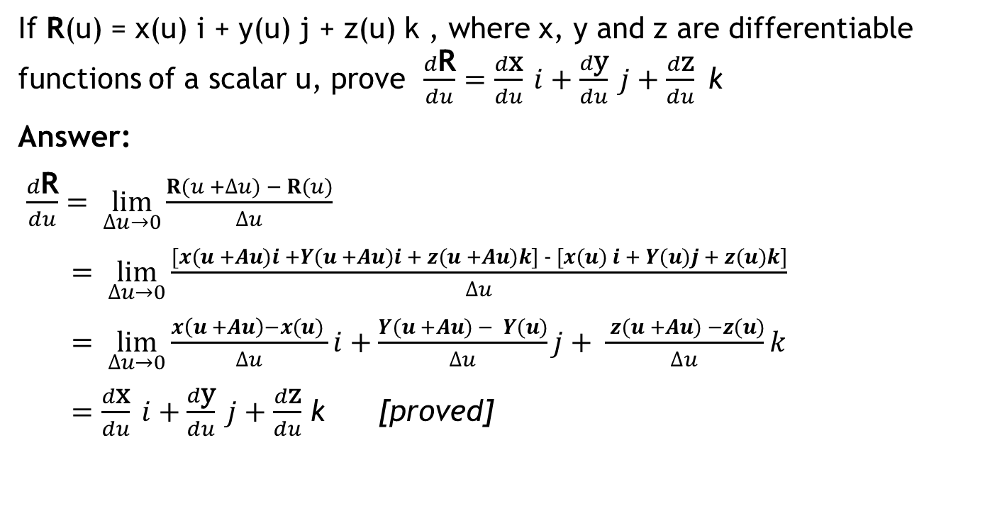
Example 1
If R(u) = x(u) i + y(u) j + z(u) k , where x, y and z are differentiable functions of a scalar u, prove $\frac{d\text{R}}{du}=\frac{d\text{x}}{du} i+\frac{d\text{y}}{du} j+\frac{d\text{z}}{du} \text{k}$
Answer:
$\frac{d\text{R}}{du}= \lim_{Δu→0}\frac{R(u +Δu) − R(u)}{Δu}$
$= \lim_{Δu→0}\frac{[x(u +Au)i +Y(u +Au)i + z(u +Au)k] − [x(u) i + Y(u)j + z(u)k]}{Δu}$
$= \lim_{Δu→0}\frac{x\left(u +Au\right)−x(u) }{Δu}i$ +$\frac{Y(u +Au) − Y(u)}{Δu}j+ \frac{ z(u +Au) −z(u)}{Δu}k$
$=\frac{d\text{x}}{du} i+\frac{d\text{y}}{du} j+\frac{d\text{z}}{du}$ k [proved]

Slide 8
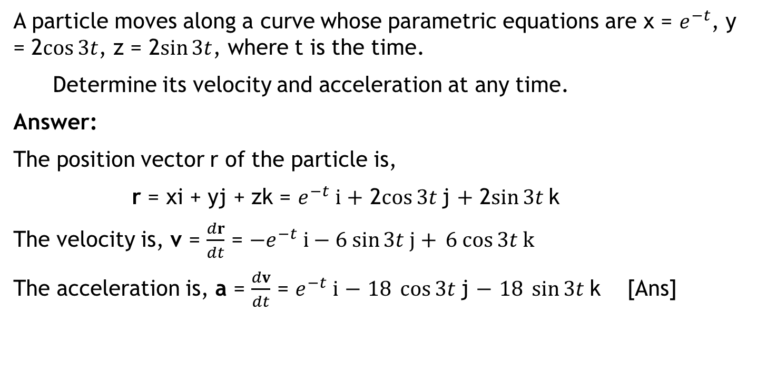
Example 2
A particle moves along a curve whose parametric equations are x = $e^{−t}$, y = 2$\cos{3t}$, z = 2$\sin{3t}$, where t is the time.
Determine its velocity and acceleration at any time.
Answer:
The position vector r of the particle is,
r = xi + yj + zk = $e^{−t} i$ $+$ 2$\cos{3t}$j $+$ 2$\sin{3t}$k
The velocity is, v = $\frac{dr}{dt}$ = $−e^{−t} i−6 sin{3t j+ }6 cos{3t k}$
The acceleration is, a = $\frac{dv}{dt}$ = $e^{−t} i$ $−$ $18 \cos{3t}$j $−$ $18 \sin{3t}$k [Ans]

Slide 9
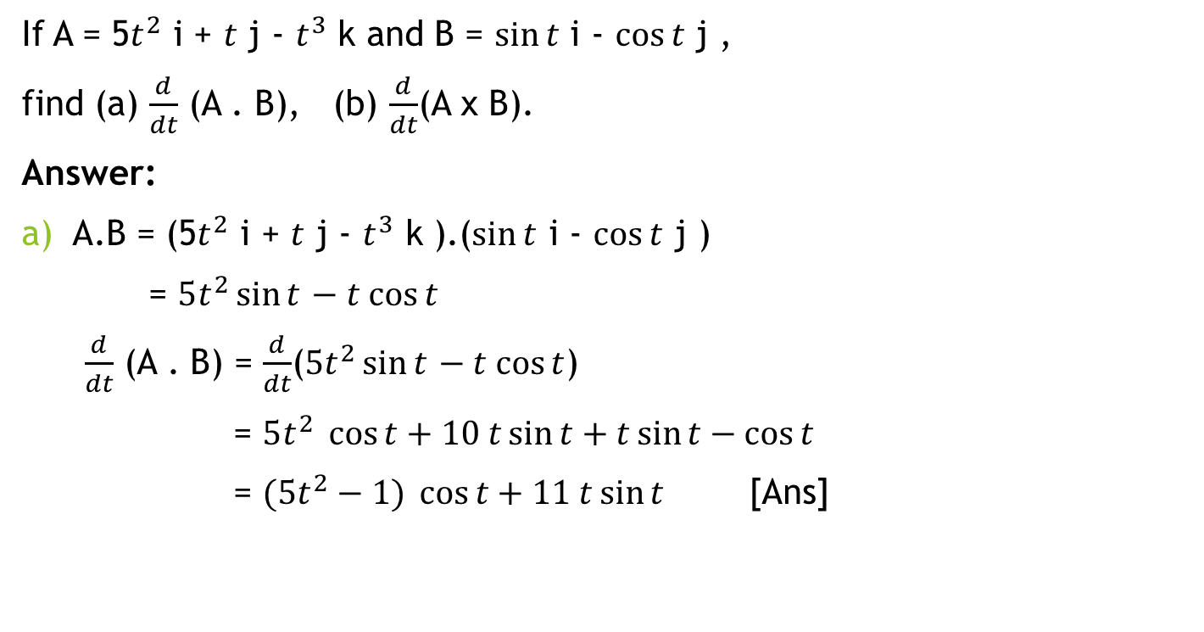
Example 3
If A = 5$t^{2}$ i + $t$ j - $t^{3}$ k and B = $\sin{t}$ i - $\cos{t}$ j ,
find (a) $\frac{d}{dt}$ (A . B), (b) $\frac{d}{dt}$(A x B).
Answer:
a) A.B = (5$t^{2}$ i + $t$ j - $t^{3}$ k ).($\sin{t}$ i - $\cos{t}$ j )
= $5t^{2}\sin{t}$ $− t cos{t}$
$\frac{d}{dt}$ (A . B) = $\frac{d}{dt}$($5t^{2}\sin{t}$ $− t cos{t}$)
= $5t^{2}\cos{t}+10 t\sin{t+t\sin{t−\cos{t}}}$
= $(5t^{2}−1)\cos{t}+11 t\sin{t}$ [Ans]

Slide 10

Example 3
b) A x B = (5$t^{2}$ i + $t$ j - $t^{3}$ k ).($\sin{t}$ i - $\cos{t}$ j )
= $\left[\begin{matrix}i & \text{j} & k \\ 5t^{2} & t & −t^{3} \\ \sin{t} & −cos{t} & 0\end{matrix}\right]$
= ${−t}^{3}\cos{t \text{i}−}t^{3}\sin{t}\text{j}+\left(−5 t^{2}\cos{t −t\sin{t}}\right)$ k
$\frac{d}{dt}$ (A x B) = $\frac{d}{dt}\{{−t}^{3}\cos{t \text{i}−}t^{3}\sin{t}\text{j}+\left(−5 t^{2}\cos{t −t\sin{t}}\right)$ k$\}$
= ${(t}^{3}\sin{t −3 t^{2}\cos{t}})\text{i}−\left(t^{3}\cos{t+3 t^{2}\sin{t}}\right)\text{j}+(5t^{2}\sin{t −11t\cos{t −\sin{t) }}}$k
[Ans]

Slide 11
Thank You

