Slide 1

Lucy
Version 0.1
Crafted by Creative minds

Slide 2




Our Team
Syed Imran
Ahmed
20204240
Kinan Aborich
20204182
Developed
Lucy & Networking
Developed
General chat
Naser Al
Hosani
20192621
Jamila Ibrahim Husain
20194192
Developed
Tic Tac Toe
Developed Hangman

Slide 3
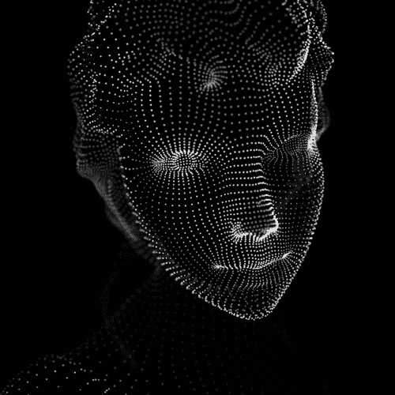
Lets start by defining the key components of Lucy
Why Lucy?
The Algorithm behind it.
User Interface.
Components.
Commands.
Practical Application.
Lucy Demo.

Slide 4
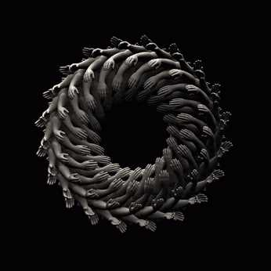
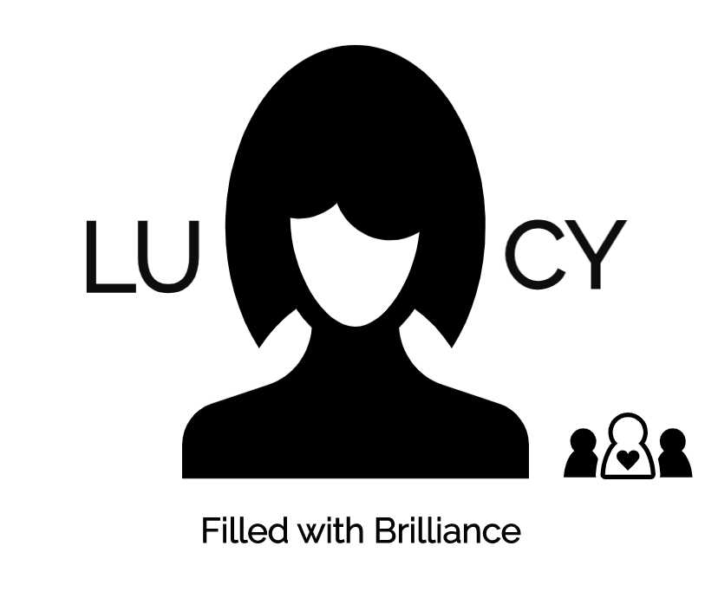
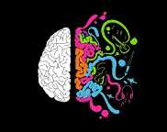
Why Lucy?
Lucy is a program created to make our works simpler, it goes about as a straightforward chatbot based on basic rationale and can play out some truly cool assignments, It was planned and grown with the end goal that it is totally tenderfoot inviting and enables an individual to see how programming functions, and to demonstrate how basic its to code independent of the language, Lucy is only an activity and initial move towards an incredible concealed future, It is to be seen that the greater part of the world is moving totally into brilliant world and Lucy is an activity which in future is relied upon to interface numerous sources and advances and carry world to one point, Developers of Lucy further expects to make it savvy by investigating it to Artificial Intelligence, As of now Lucy is only a model to an extraordinary inconspicuous future and a goal to get world hands.

Slide 5
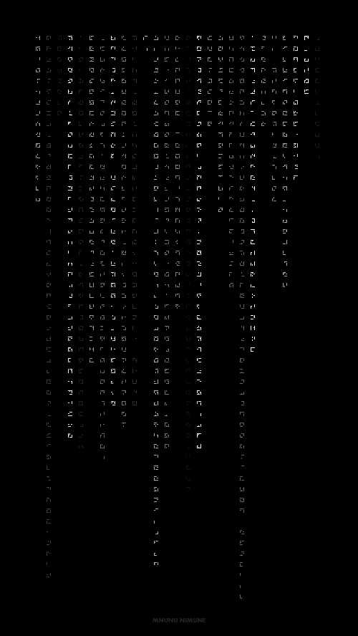
The Algorithm behind it.
The Algorithm was kept as direct as could be normal considering the present situation and the clarification for was to make it clear for the people who love coding, it was moreover seen that there were no genuine sources that help you to structure a chatbot, Lucy is an action where you can show it anyway much as could sensibly be normal
Let us Define the three-step Algorithm
First thing is to take the User input
Second is to define commands which are boundless.
The third is to link user input and command.
That is the methods by which essential is the estimation of lucy and it Expected to be progressively fundamental with world class in future

Slide 6

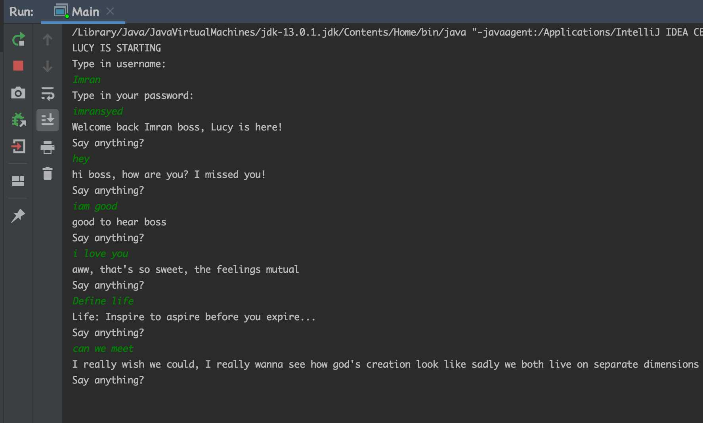
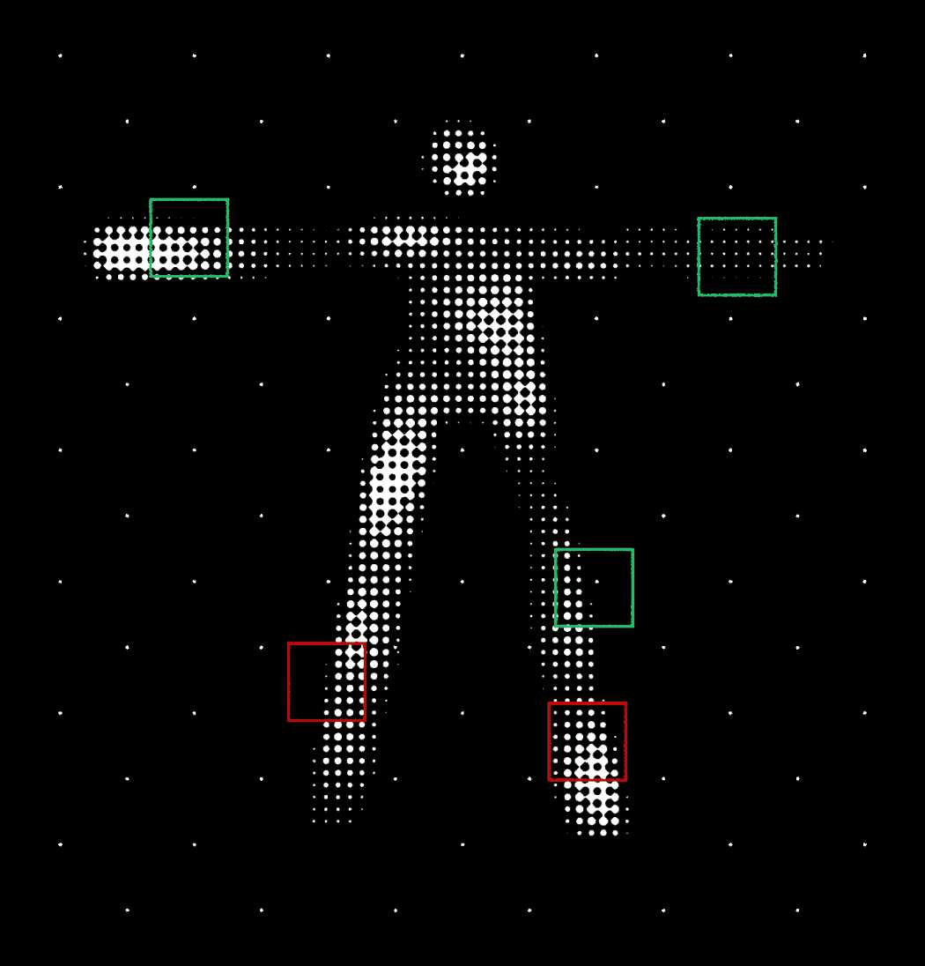
User Interface.
The fundamental thought again here was to keep the User interface as basic as could be allowed, the group concentrated on the ordinary interface as opposed to going for the Graphical UI, for what it's worth to be accepted as a model, in future forms it is not out of the ordinary that Lucy will be accessible with some powerful illustrations.

Slide 7
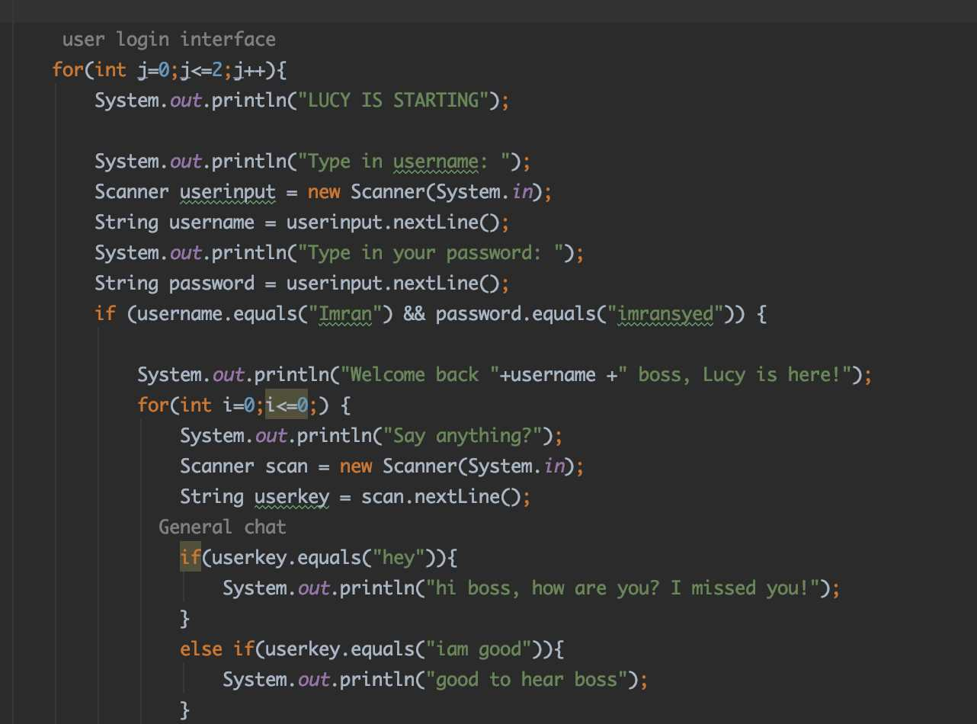


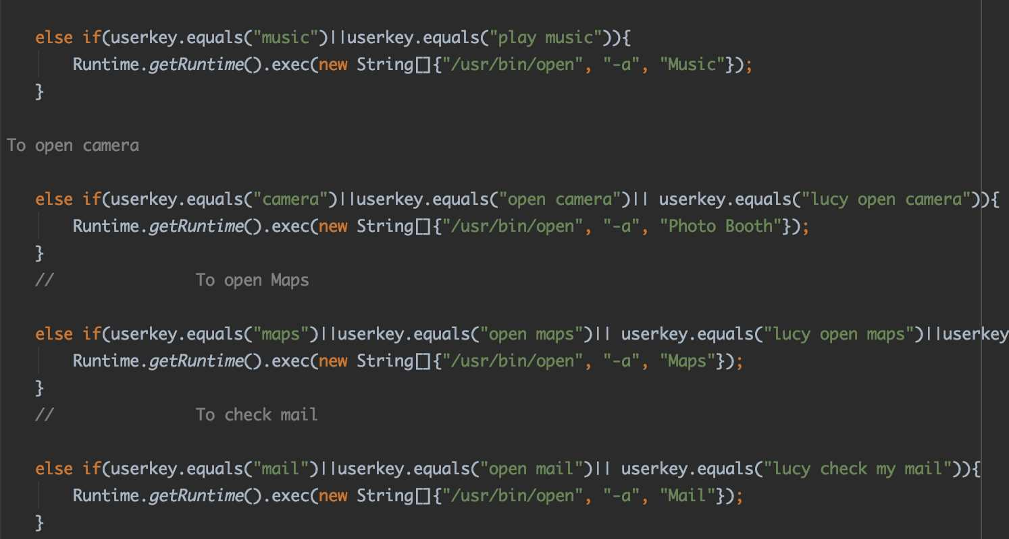
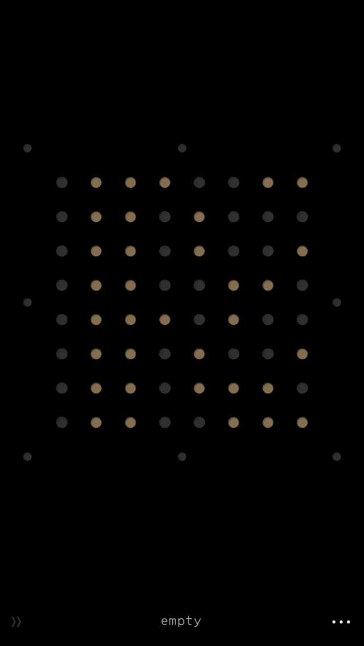
Components.
The fundamental things utilized in the program were
1) Loops
2) If-else explanation
3) Run order
4) Switch explanations

Slide 8
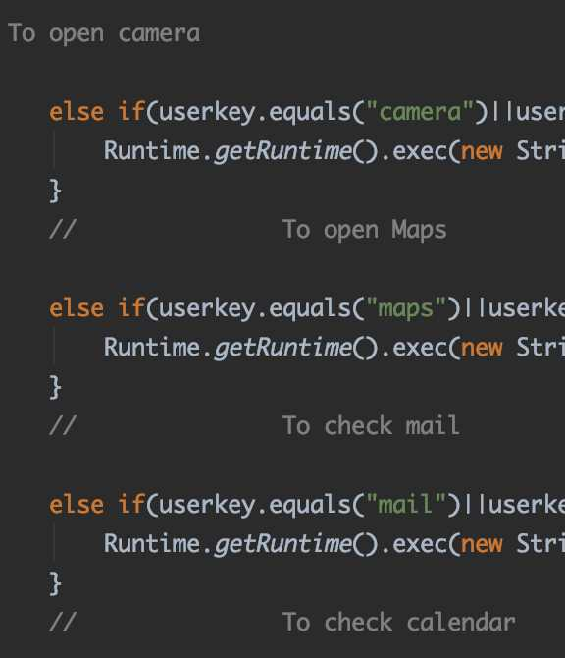
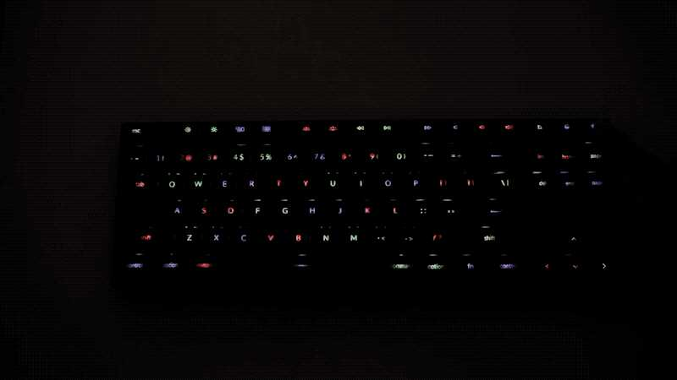
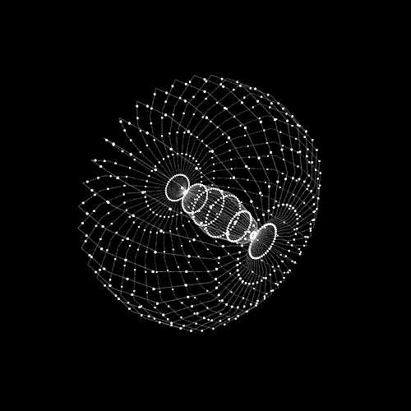
Commands.
Lucy is about Commands, starting at now Lucy is savvy enough that it can open any website, it can look on google for you, it can open applications on frameworks like camera, schedule, mail and some more, it can likewise disclose to you time, it has some essential visit capacities, it is additionally stacked with a portion of the games like Tic Tack Toe, Hang man, snake. It is not out of the ordinary that in the forthcoming adaptation Lucy will have full authority over the framework and can perform numerous tasks which we just can dream of starting at now.

Slide 9
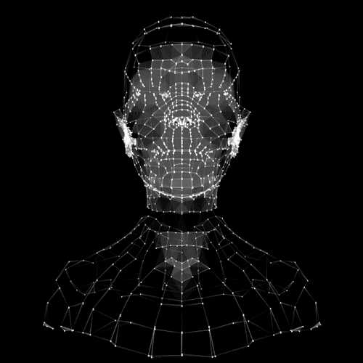

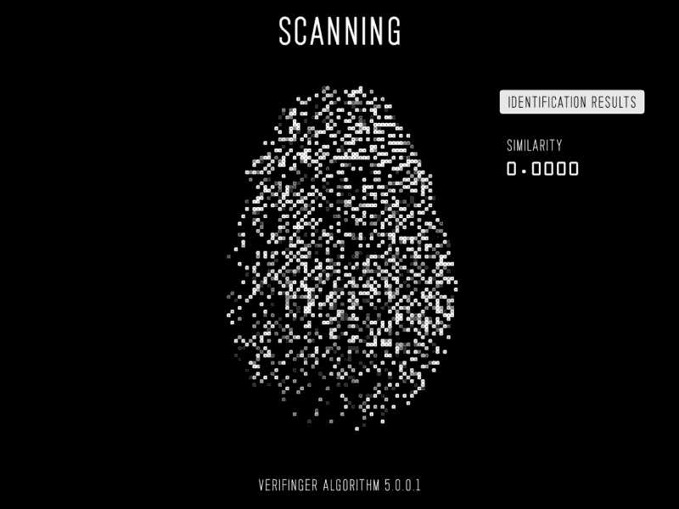
Practical Application
The pragmatic ramifications of Lucy should be possible in our everyday life, It is essentially intended to make our works simpler, it resembles one point where you have to stop to get to anything you need, Developers of Lucy are sufficiently working to assemble an excellent client experience, Lucy can likewise be a virtual companion, in future notwithstanding Artificial Intelligence Lucy carries on a greater amount of like a human which is intended to make our works simpler.

Slide 10
Lucy Demo.

