Slide 1
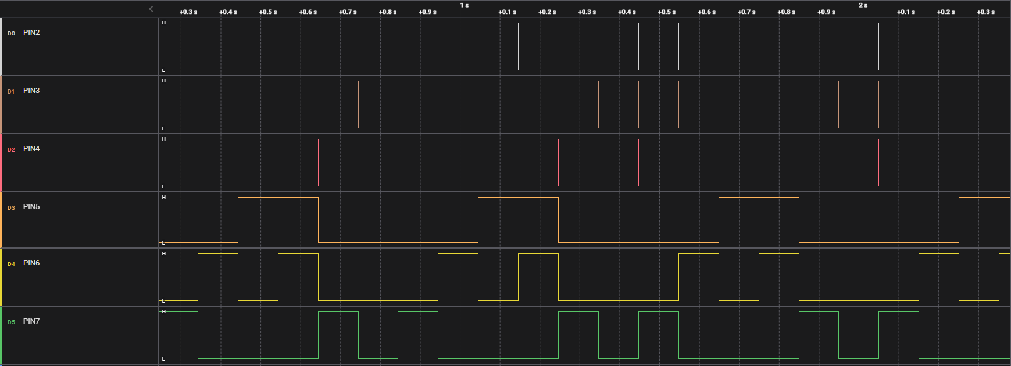
Phase(3)
Phase(6)
Phase(4)
Phase(5)
Phase(2)
Phase(1)
Phase(3)
Phase(6)
Phase(4)
Phase(5)
Phase(2)
Phase(1)
Phase(3)
1
0
1
0
0
0
1
0
1
0
0
0
1
0
1
0
0
0
1
0
1
0
0
0
1
0
0
0
0
0
1
1
0
0
0
0
1
1
0
0
0
1
1
0
0
0
0
1
1
0
0
0
0
1
0
1
0
0
0
1
0
1
0
0
0
1
0
0
0
1
0
1
0
0
0
1
0
1

