Slide 1
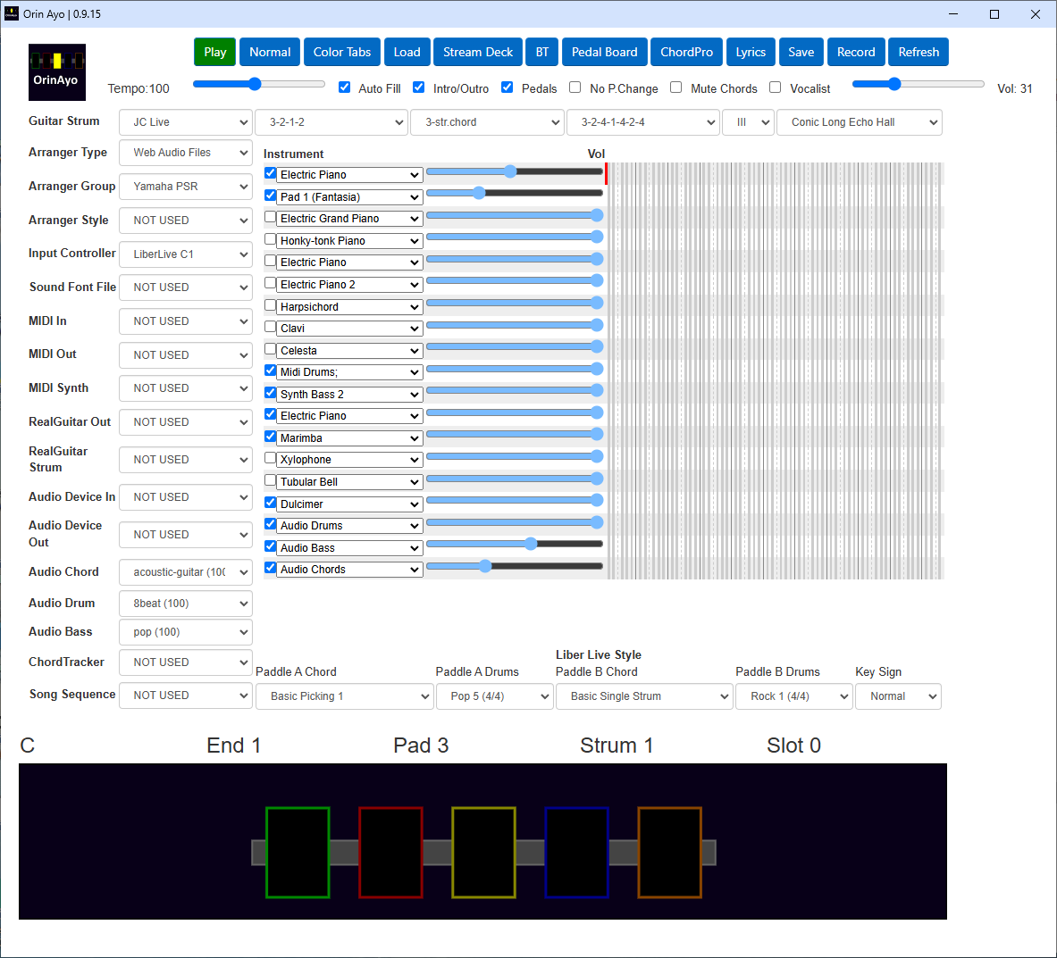
1
27
26
2
25
3
4
5
6
7
8
9
24
10
11
12
13
14
15
16
17
18
19
23
20
21
22

Slide 2
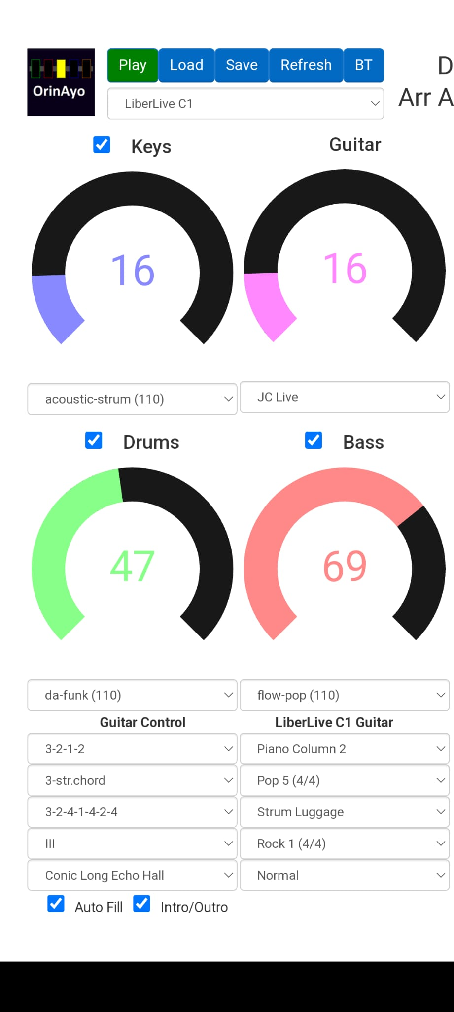
1
20
6
24
15
2
24
16
17
25
23
26

Slide 3
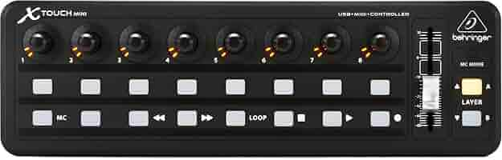

Main Guitar Volume. Press to mute/unmute
Style Drums Volume. Press to mute/unmute
Style Bass Volume. Press to mute/unmute
Style Chords Volume. Press to mute/unmute
Guitar Chorus Effect. Press to enable/disable
Guitar Reverb Effect. Press to enable/disable
Guitar Delay Effect. Press to enable/disable
Guitar Drone Effect. Press to enable/disable
Overall Volume
Recall reg slot 7/15
Recall reg slot 6/14
Recall reg slot 5/13
Recall reg slot 4/12
Top- Style Variation B. Bottom – Style Variation D. Idle – Recall reg slot 3/11
Top- Style Variation A. Bottom – Style Variation C. Idle – Recall reg slot 2/10
Top- Drum Fill. Bottom – Drum Break. Idle – Recall reg slot 1/9
Top- Start/stop style. Bottom – Start/stop style with intro

Slide 4
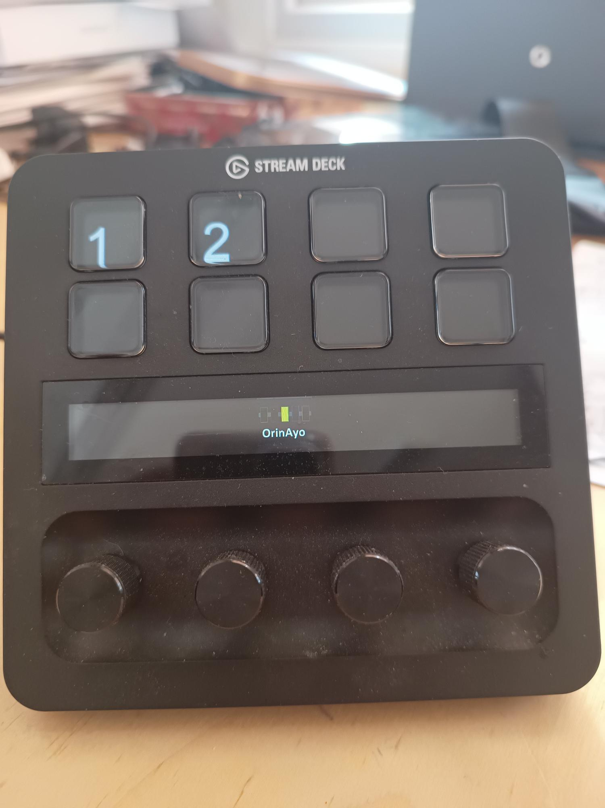
When idle, recall settings from slot number Press encoders below to change pages 1-4
Swipe to start/stop style
Style Chords Volume. Press to mute/unmute
Style Bass Volume. Press to mute/unmute
Style Drums Volume. Press to mute/unmute
Main Guitar Volume. Press to mute/unmute

Slide 5
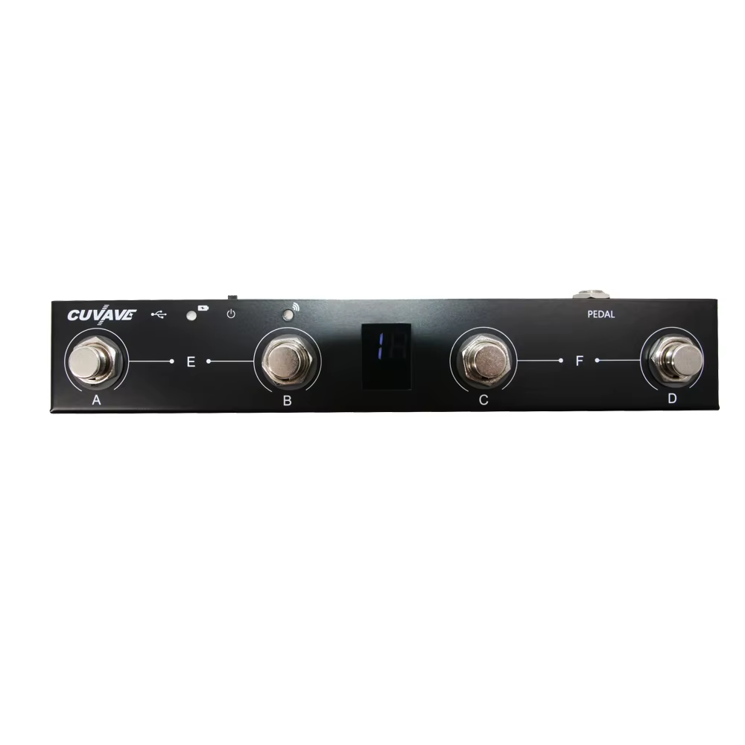
Style Chords Volume. Press to mute/unmute
Style Bass Volume. Press to mute/unmute
Style Drums Volume. Press to mute/unmute
Main Guitar Volume. Press to mute/unmute

Slide 6
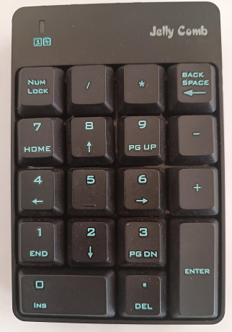
5b
7b
5
5/7
3m
Transpose Down
1
1/3
6m
Transpose Up
2m
4/6
4
Next Style Variation
Previous Style
Start / Stop
Backspace + 1 – Mute/unmute Drums
Backspace + 2 – Mute/unmute Bass
Backspace + 3 – Mute/unmute Chords
Keys 7 + 8 is 3 maj
Keys 1 + 2 is 2 maj Keys 4 + 5 is 6 maj
Keys 5 + 6 is 1 sus
Keys 8 + 9 is 5 sus
Keys 2 + 3 is 4 min

