Slide 1
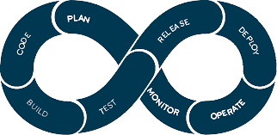
Understanding CI/CD
A Presentation For The UdaPeople Project
By
Benjamin Okoli
(Team lead)

Slide 2

UNDERSTANDING
CI/CD
CI/CD known as Continuous Integration (CI) / Continuous Delivery (CD) can be easily described as a method used to frequently deliver customers’ apps using automation in the different stages of app development.
It is divided into 3 main paths, as explained below:
Continuous Integration (CI): This is the practice of automating the integration of code changes from multiple contributors into a single software project. This is where developers merge code changes from multiple machines repository being built and tested simultaneously.
Continuous Deployment (CD): This involves software release strategies when committed codes that has passed testing phase is automatically released into production environment, thereby making changes that are visible to customers.
Continuous Delivery: This is simply an engineering process where teams produce and release updates in short cycles.

Slide 3
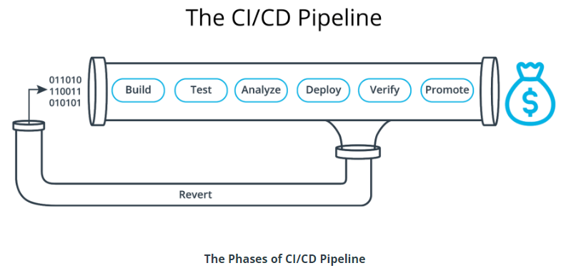
How CI/CD Works
“The most powerful tool we have as developers is automation.”
—Scott Hanselman
SInce automation increases productivity, this means more money to be made.

Slide 4
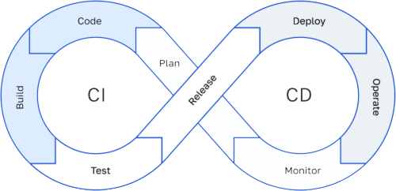
Technical Language | Business Value | Translation
Catch Compile Errors After Merge | Avoid Cost | Less developer time on issues from new developer code
Catch Unit Test Failure | Avoid Cost | Less bugs in production and less time in testing
Detect Security Vulnerabilities | Avoid Cost | Prevent embarrassing or costly security holes
Automate Infrastructure Creation | Avoid Cost | Less human error, Faster deployments
Automate Infrastructure Cleanup | Reduce Cost | Less infrastructure costs from unused resources
Faster and More Frequent Production Deployment | Increase Revenue | New value-generating features released more quickly
Deploy to Production Without Manual Checks | Increase Revenue | Less time to market
Automated Smoke Tests | Protect Revenue | Reduced downtime from a deploy-related crash or major bug
Automated Rollback Triggered by Job Failure | Protect Revenue | Quick undo to return production to working state

Slide 5


THANK YOU!!!
QUESTIONS ?

