Slide 1
ACTIVATOR POWERPOINT MASTER AND TEMPLATE SLIDE LIBRARY
Version 1.0
March 2020

Slide 2
How to use this document
01
02
03
Download and save a copy of this presentation
To start a new document, open your copy of this presentation, then click ‘file > save as’.
You can then use these templated slides in your new file, as well as adding more layouts by clicking ‘new slide’
If you wish to copy slides from this, over to another document, be sure to paste by ‘Keeping Source Formatting’ (ctrl+k)
For good quality, free images, we recommend https://unsplash.com/
Refer to the Slide Document Handbook on Sharepoint for more guidance
Navigation, dividers & icons
Core content templates
Preformatted charts & tables
xx
xx
xx
04
05
06
Headlines, quotes & callouts
Activator journey & process flows
Maps, teams, cases & credentials
xx
xx
xx

Slide 3
01
Navigation, dividers + icons

Slide 5
CONTENTS

Slide 6
contents

Slide 13


































ICONS
Services
Find more icons here
Activator Approach
Misc.

Slide 14
02
Core content templates

Slide 26
03
Preformatted charts & tables

Slide 27
STANDING
BAR CHART

Slide 28
GROUPED
STANDING
BAR CHART

Slide 29
STACKED STANDING
BAR CHART
Label 1
Label 2
Label 3

Slide 30
GROUPED
HORIZONTAL
BAR CHART
Custom Legend
Group 1
Group 2
Group 3

Slide 31
DONUT

Slide 32
RADAR

Slide 33
SCATTERPLOT
Axis label
Axis label

Slide 34
LINE CHART

Slide 35
GREY TABLE
Heading | Heading | Heading
item | info | info
item | info | info
item | info | info
item | info | info
item | info | info
item | info | info
item | info | info
item | info | info
item | info | info
item | info | info

Slide 36
BLUE TABLE
Heading | Heading | Heading
item | info | info
item | info | info
item | info | info
item | info | info
item | info | info
item | info | info
item | info | info
item | info | info
item | info | info
item | info | info

Slide 37
Anthesis operates a flat organisational structure, where we will always endeavor to match your needs to our deep subject matter expertise, irrespective of grade, the breakdown of hours and percentage by grade are as follows:
Deliverable |  | One Time | Annual | Assumptions
1 | Program Development | $55,000
2 | Prioritize Hot Spots | $74,000 |  | Assumes assessing 30,000 suppliers
3 | Implementation Audit Survey System Full Audits | $525,000 | $203,000 $6,000/full audit | Surveying 8,000 suppliers Full audits for undetermined percentage of surveyed
All provided numbers are in USD and are excluding travel costs, VAT (if legally required to be charged) and other charges payable under the legal scheme agreed.
Travel costs and required out-of-pocket expenses will be charged based on MGM's Vendor Travel Policy. Travel time in excess of 2 hours in one direction will be charged at 50% of the hourly fee of the respective project consultant

Slide 38
Project timings
 | Month | Jan |  |  |  | Feb |  |  |  | Mar
Phase | Week | 6 > 10 | 13 >17 | 20 > 24 | 27 > 31 | 3 > 7 | 10 >14 | 17 >21 | 24 > 28 | 2 > 6 | 9 >13 | 16 > 20 | 23 > 29
ANALYTICS
Kick off
Desk research
Service audit
Internal consultation
Expert consultation
Client consultation
Analytics debrief
SOLUTION
Concept development
Refinement workshop
Stakeholder screening
Final recommendation
Activation briefing
IMPLEMENTATION
Team alignment
Key
Key
Key
Praesent varius ligula neque, non tempor libero fringilla vitae. Fusce laoreet lacus a nisl lacinia interdum vinis.

Slide 39
We recognise that no ‘one size fits all’ and you may wish to flex the scope of work based on a number of reasons (e.g. budget constraints, previously work performed, known material issues etc.). Below details a number of options by which you can increase or decrease the scope of work proposed:
Add-in | $ | Description
Additional materiality workshops (per workshop) | 3,306 | If the same process needed to be repeated by business &/or geography, this reflects the cost of each additional 0.5 days session, analysis and write up). It does not preparation (this is included above) and does not include travel and accommodation.
Data remediation | To be agreed | At the conclusion of Stage 2, if there were pervasive data gaps that we could not easily work around, we are well placed to help you remediate and find solutions to such gaps. Time/cost will depend on the nature and extent of gaps and resource required.
Additional 5 products | 4,536 | The by the same rationale, if you wanted to reduce the proposed coverage by 5 products then this multiplier would apply.
Additional climate scenario | 3,944 | This would allow comparison of various temperature change (e.g. RCP 2.6 vs RCP 8.5) scenarios or transition risk scenarios (2DS vs B2DS).
Additional risk driver (out of others presented) | 1,682 | Assumes 30 products as proposed above and will only impact 1 of 4 value chain areas only. Refer to risk drivers in grey on page 9.
Additional new & bespoke risk drive | 1,972 | Assumes 30 products as proposed above and will only impact 1 of 4 value chain areas only. Additional time required to identify proxy data sources and amend model structure in response to materiality assessment outcomes and/or management preferences.
Additional Tableau dashboard licence | 870 | Per additional license meeting multiple stakeholders can access at once
Annual refresh estimate (Year 2) | 45,000 -50,000 | Excludes materiality assessment, assumes new values, volumes and sourcing location data is provided for the same products & risk drivers as are selected this year, with same reporting & presentation needs. Some efficiency gains on TCFD element as template will be available from Year 1. Fee is indicative only. We would look to tailor to your requirements after Year 1 completion.
Training delivery for Year 2+ | 3,350 | Assumes 3 x 0.5 day webinars.
Training materials for Year 2+ | 3,000 | Assumes a step by step user guide for Jeronimo Martins to help source the correct data and overwrite data within the Excel tool provided (see part Ivd for further information).

Slide 40
04
Headlines, quotes + callouts

Slide 46
05
Activator journey & process flows

Slide 52
GENERAL PROCESS
PART 1
PART 2
PART 3
BOX TITLE
BOX TITLE
BOX TITLE
Put a description in here
Put a description in here
Put a description in here

Slide 53
GENERAL PROCESS
When illustrating any complex processes or flows, focus on clarity. Try to avoid anything decorative, such as most word art effects (drop-shadows, embossing, gradients etc). You can use different colours, fonts and shapes, but should only choose these where they add or clarify useful information.
Put a description in here
Put a description in here
Put a description in here
Put a description in here
Put a description in here
Put a description in here

Slide 54
06
Maps, teams, cases + credentials

Slide 56
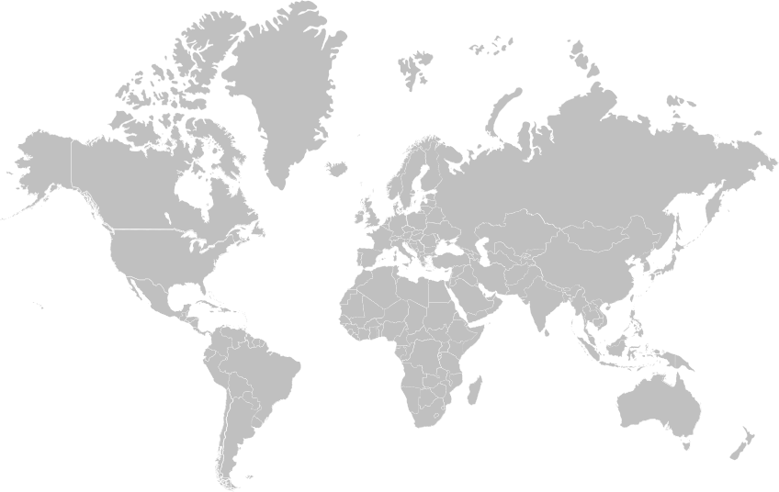




EMEA
14
10-25+
800+
North America
8
Asia Pacific
12-30
10
800+
9-24+
750+
Team members
Global
Offices
Latin America
2
5
Clients
8-25+
12-20+
550+
500+

Slide 65
THANK
YOU

