Slide 1
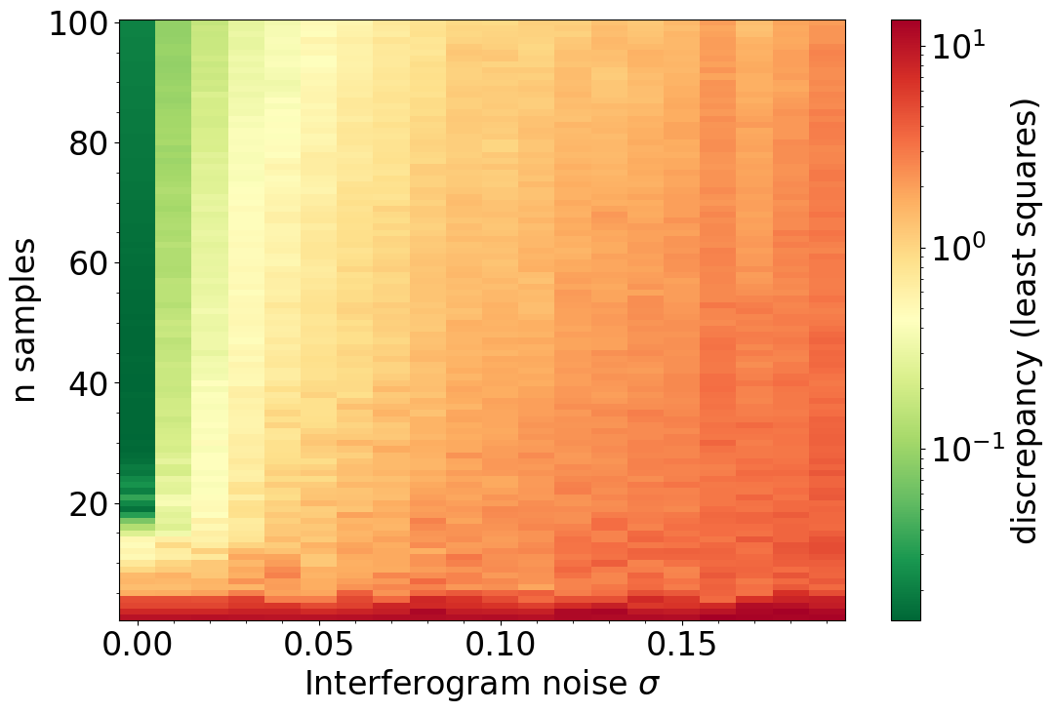
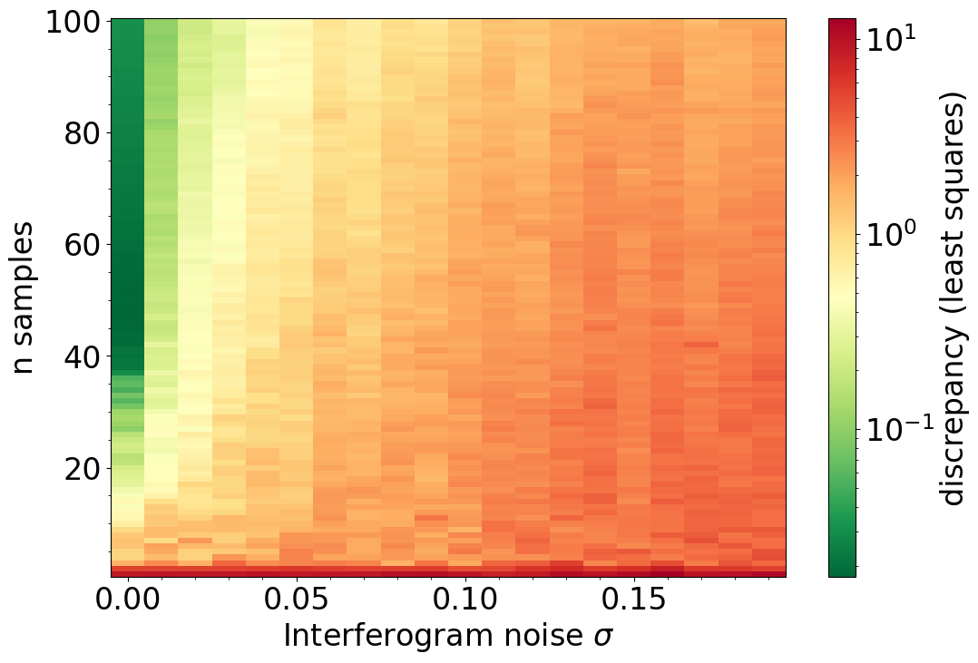
Peak = 3thz, FWHM = 0.5thz
Peak = 3thz, FWHM = 1.5thz

Slide 2
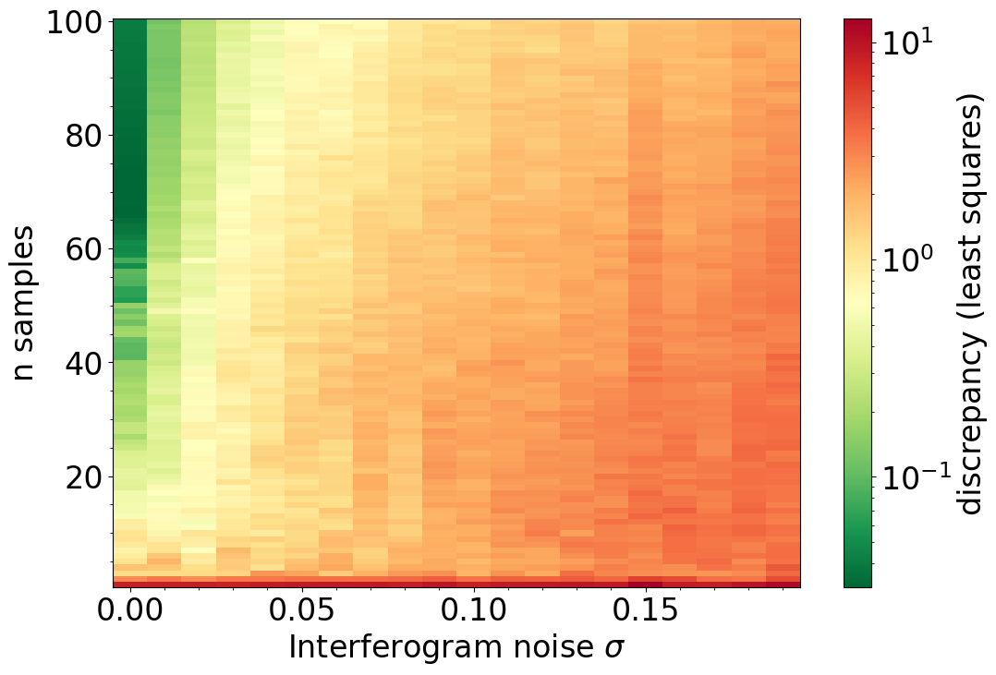
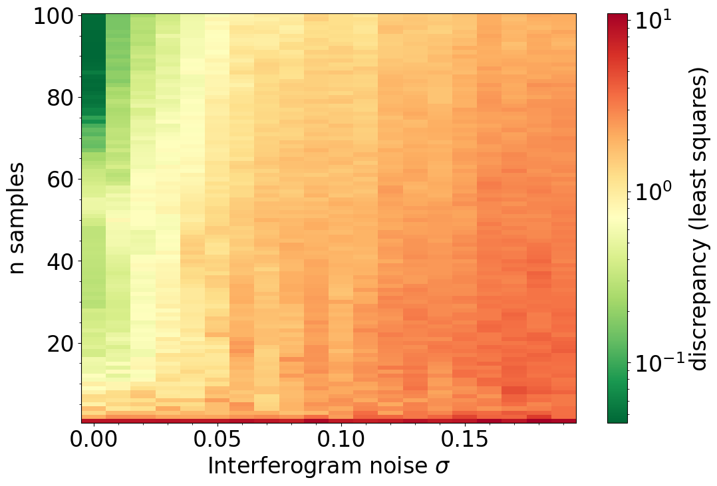
Peak = 3thz, FWHM = 3thz
Peak = 3thz, FWHM = 5thz
Conclusion: Douglas-Peucker is not suitable for noisy data. Its solutions quickly deteriorate after 2% noise for all bandwidths.

