Slide 1
Using Natural Language to Model Strong Gravitational Lenses
James Nightingale, Richard Hayes

Slide 2
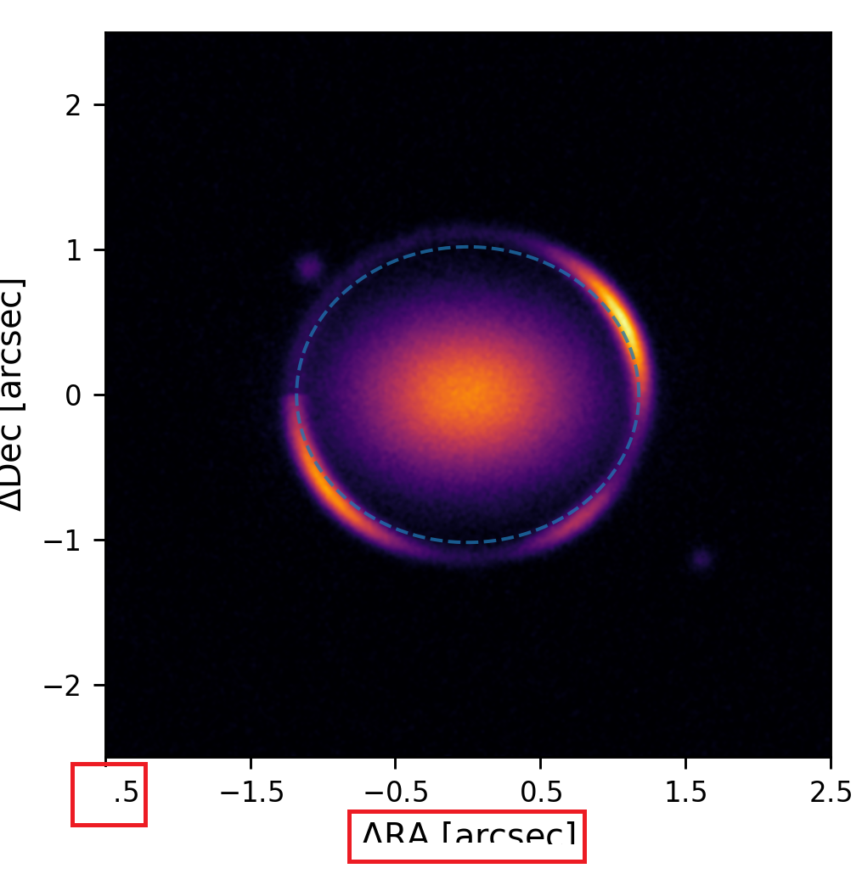
Remember This?
You spot a tiny issue with a matplotlib figure.

Slide 3
Remember This?
You spot a tiny issue with a matplotlib figure.
You change the python code, but it doesn’t change the figure.

Slide 4
Remember This?
You spot a tiny issue with a matplotlib figure.
You change the python code, but it doesn’t change the figure.
You blindly trial-and-error solutions from StackOverflow for the next 4 hours.

Slide 5
Remember This?
You wish you could just “Tell matplotlib what you want the image to look like”.

Slide 6
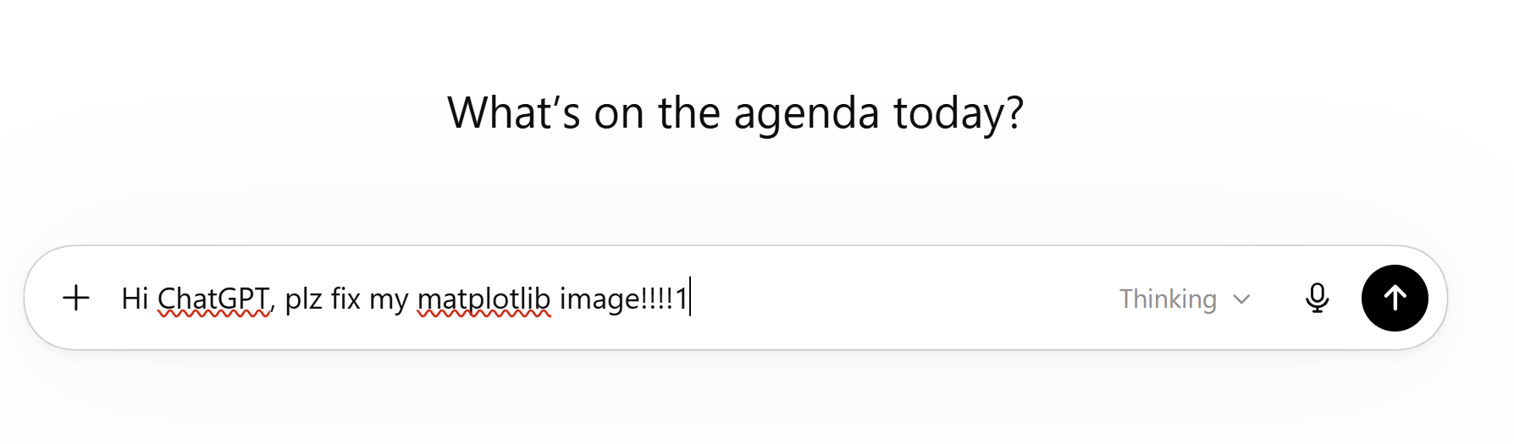
Remember This?

Slide 7
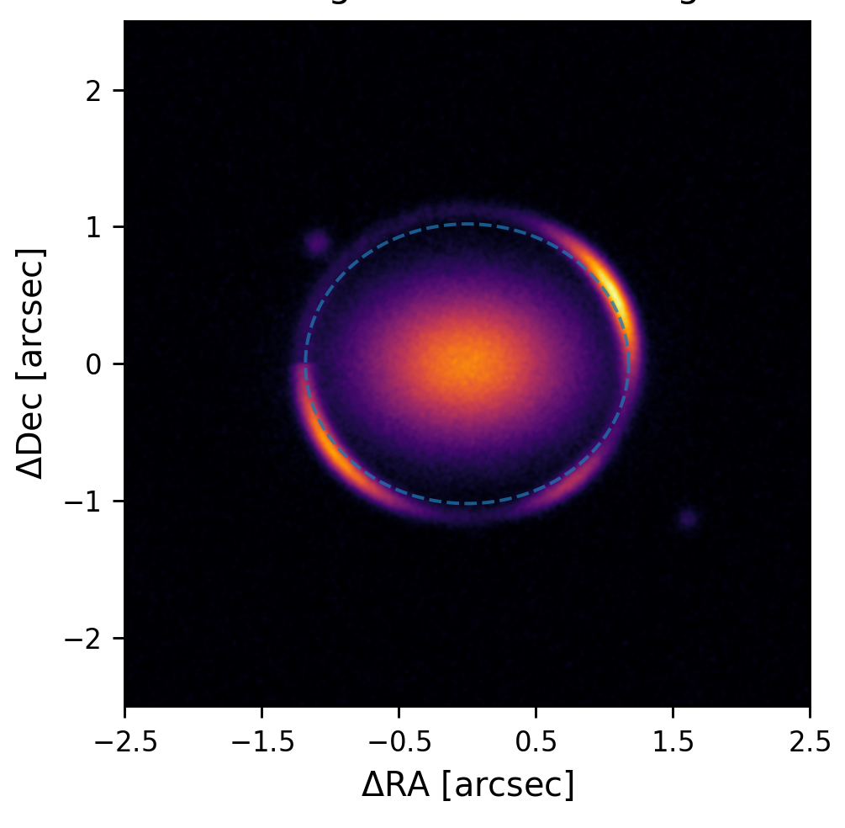
Remember This?
We don’t have this problem anymore, because AI allows us to use natural language to interface with matplotlib.

Slide 8
Remember This?
It was of no benefit to any of us as scientists learning the syntax required to make matplotlib do what we want.
[Is this a controversial statement? Who Disagrees?]

Slide 9
[Demo 1 - CLI Agents]

Slide 10
Demo 1 (Claude)
Claude -> PyAuto:
The folders @PyAutoGalaxy and @PyAutoLens contain the PyAutoLens Source code. Find the power-law mass model used by PyAutoLens.
Then, compare its parameterization to the Coolest Lens model standard: https://github.com/aymgal/COOLEST
Then, on the PyAutoLens GitHub repository, put up an issue comparing the two parameterizations and how they differ.

Slide 11
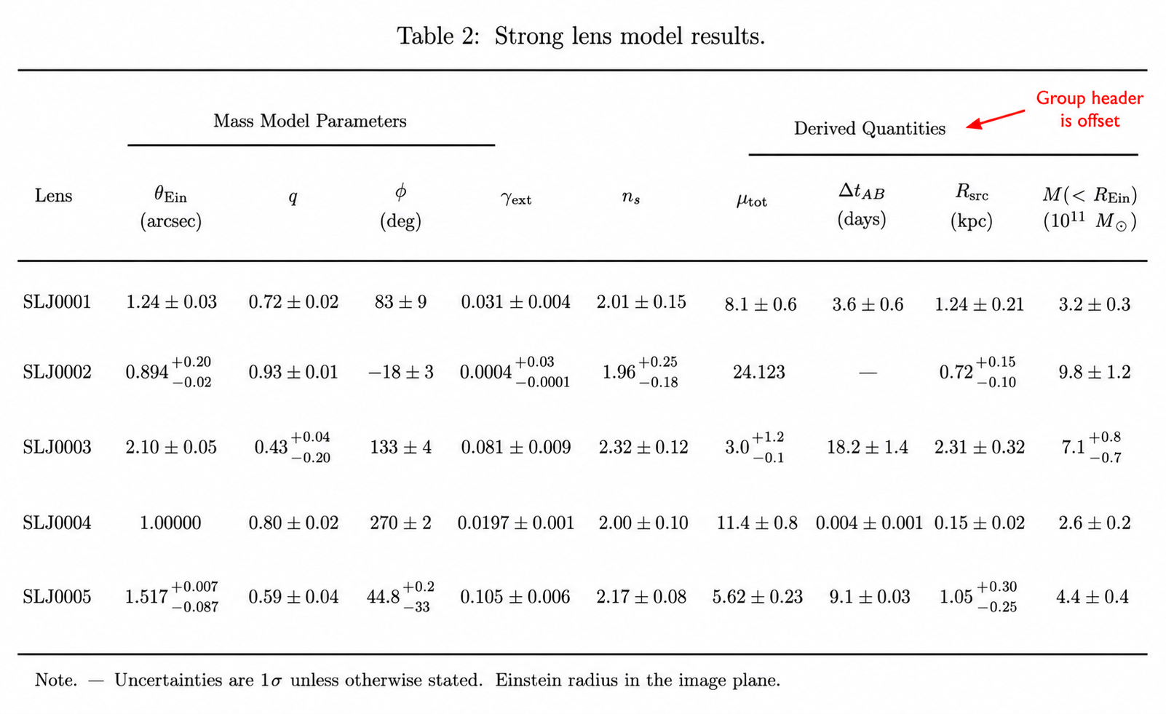
No More LaTex!
I’ve lost many evening trying to make a latex table in a paper “look right”.

Slide 12
No More LaTex!
Now I just tell codex the results I want to be in the Latex table, what I want the Latex table to look like and it pretty much does it.

Slide 13
[Demo 2 - Paper Latex]

Slide 14
Demo 2 (Codex)
codex -> PyAuto:
The folder @z_projects/subhalo_los/output contains lens modeling results for 3 Slacs lenses.
Make a folder @z_projects/subhalo_los/paper, with a main.tex using the MNRAS template. Then, make a latex table containing the name and Einstein radii of each lens, including 3 sigma errors, using the model.results file in each mass_total[1] folder.
Add a table caption describing its contents.

Slide 15
No More LaTex!
It was of no benefit to any of us as scientists learning the syntax required to make LaTex do what we want.
[Still reckon this is not too controversial? Although some might be worried more of the paper writing ends up with the AI?]

Slide 16
[Demo 3 - HPC Use]

Slide 17
Demo 3 (Claude)
I modeled 3 SLACS lenses using scripts/imaging.py, which fitted the last mass model as a power-law plus shear.
Can you refit mass_total[1], calling it mass_total[1]b, by rerunning the jobs on the HPC?
However, I’ve just been told the GPUs we used previously are unavailable, therefore can you submit each job to run on 8 CPUs, using 8 cores per job?
Inspector and monitor the runs to make sure they start correctly.

Slide 18
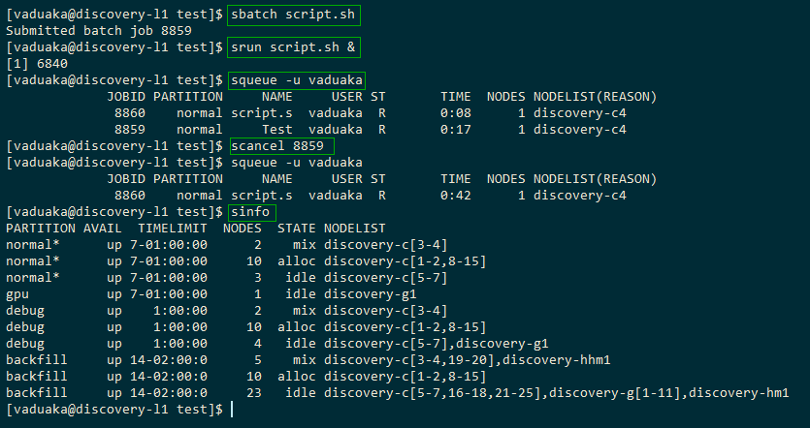
No More slurm, batch script management, etc!
It was of no benefit to any of us as scientists learning the syntax required to make rsync, ssh, slurm do what we want.
[Surely we can all agree on this one?]

Slide 19
Using Natural Language For Software Development

Slide 20
Software Development
PyCharm: Describe how CLI agent can see all source code.
GitHub: Show PyAutoLens issues documenting features.
Pull Requests: Show the PR’s with the code updates.
PyAutoPrompt: Show how I just describe code feature using natural language.

Slide 21
[Demo 4 - Live Feature Development]

Slide 22
Demo 4 (Claude)
The following GitHub URL describes the implementation of a new light profile, the Hernquist light profile:
https://github.com/PyAutoLabs/PyAutoLens/issues/168 . Implement this in the PyAutoGalaxy light profiles package.

Slide 23
Demo 4 (Claude)
Now go to PyAutoPrompt/autoarray/oversampling.md

Slide 24
Am I Vibe Coding?
This setup alone is not a long term strategy to maintainable software development.
We need less vibe coding and more natural language assisted software development.

Slide 25
Software Testing Is Key
Unit Tests: Show how I have over 2000 human-written unit tests run against the software ecosystem.
Science Examples: show autolens_workspace examples, with over 1000 scientific examples scripts with bespoke environment variables for fast run times.
Integration Test Workspaces: End-to-end dedicated test files which confirm high-level functionality works, show example comparing PSF convolutions.
PyAutoPulse: The heartbeat of the software; a live agent running all of the above 24:7, providing near immediate feedback when functionality breaks.

Slide 26

Testing Must Be FAST
In AI-assisted development, test runtime = human waiting time
In my early time using Claude, I spent over a week simply making all unit & integration tests run much faster (e.g. seconds to minutes).
PyAutoPulse monitors test run time and flags slow down.

Slide 27
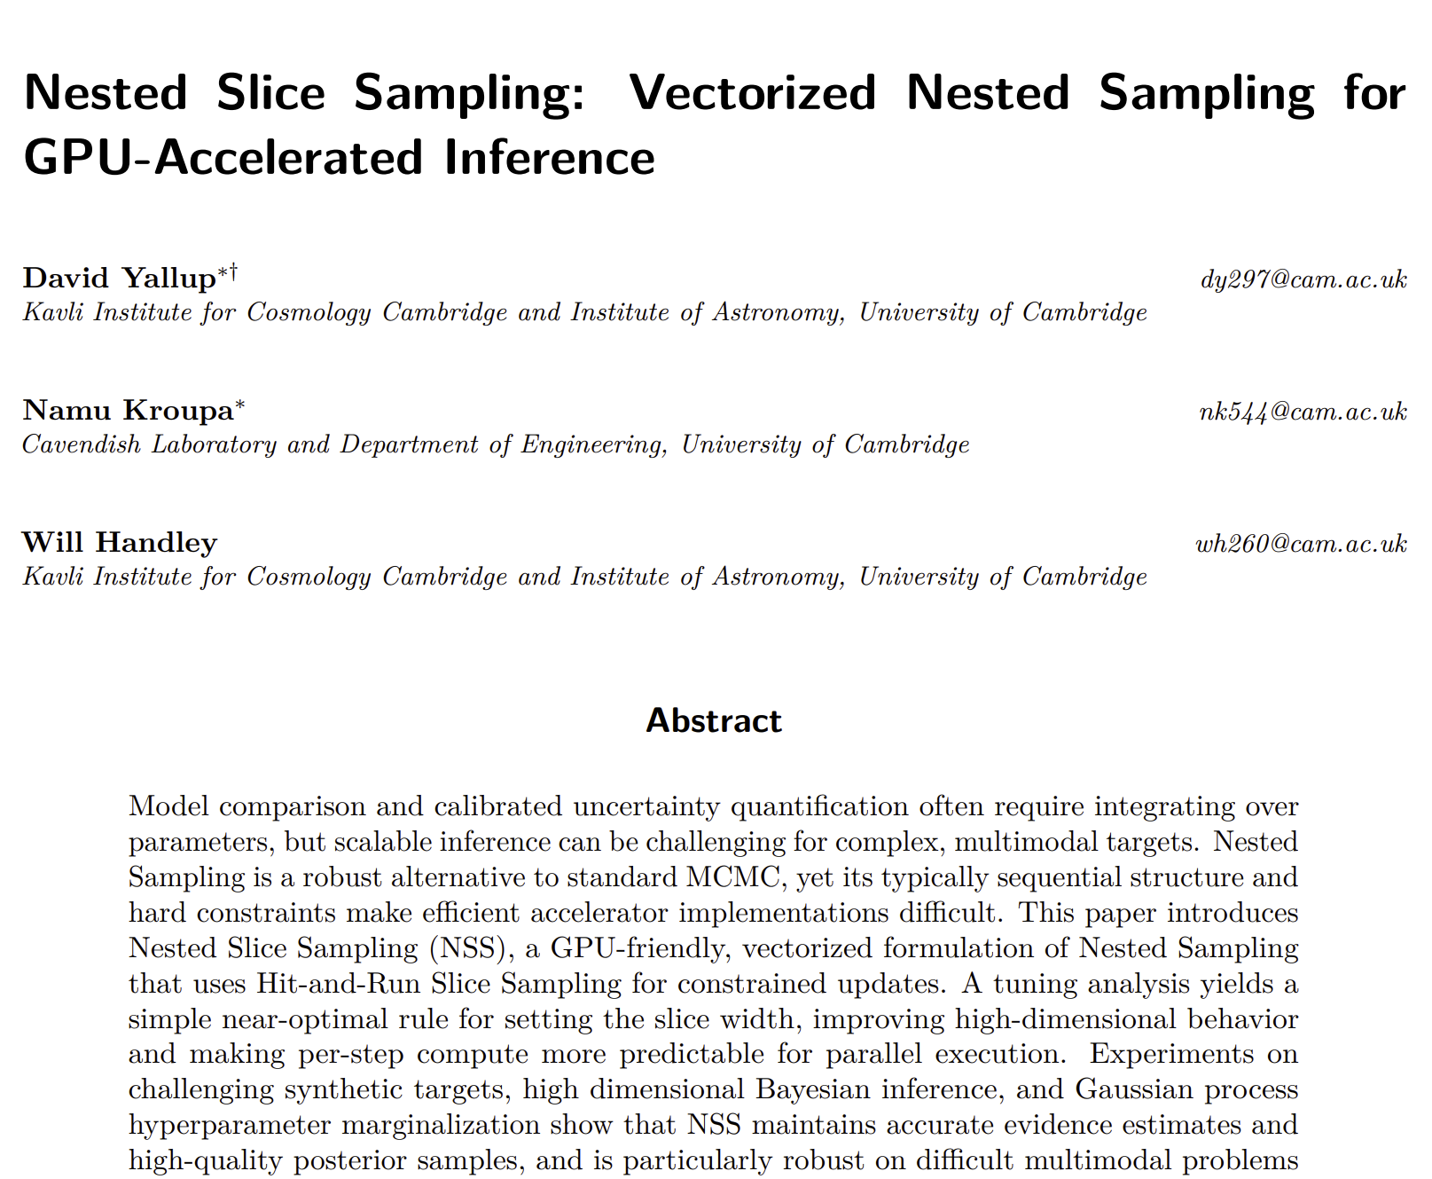
Implemented a whole new sampling in PyAutoLens in an hour with minimal human oversight.
[SHOW PROFILING DEMO]

Slide 28
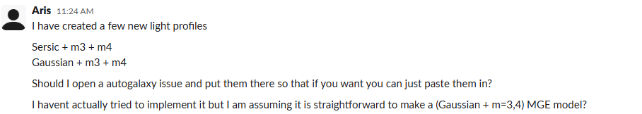
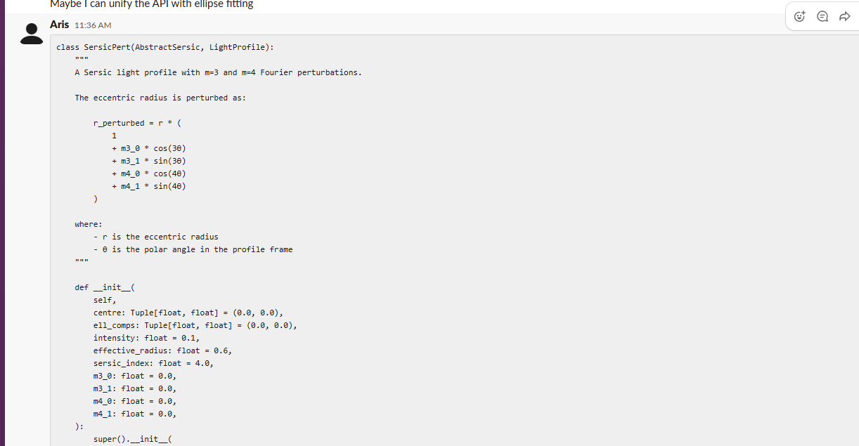
SLACK Development
I literally just copy and paste SLACK conversations in order to develop features now.

Slide 29
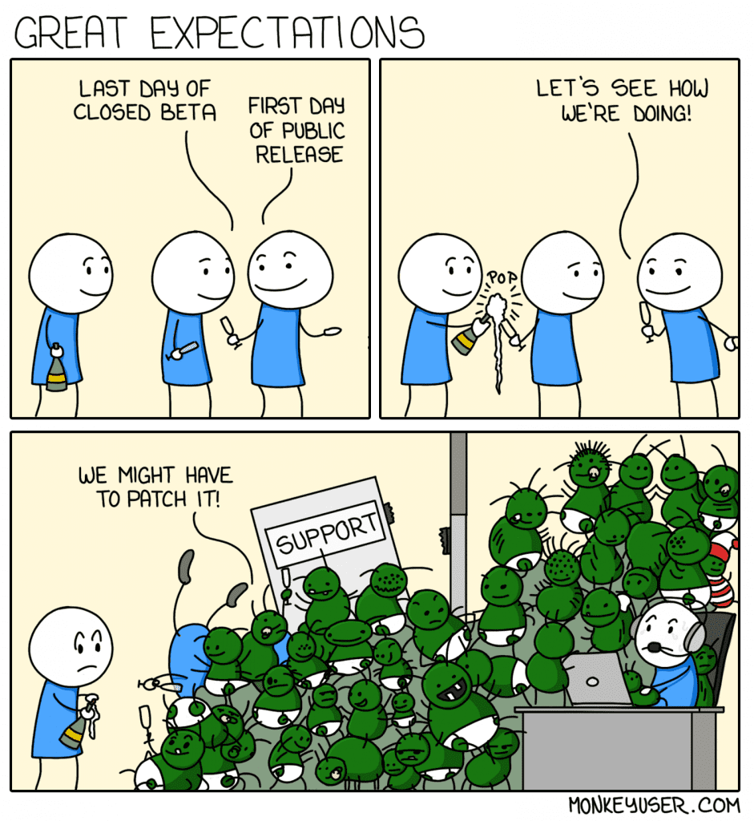
Using Natural Language To Develop Software
It was of no benefit to any of us as scientists learning the syntax required to make Python, c, Fortran and others do what we want.
[Maybe I’m getting a little controversial now?]

Slide 30
Giving Natural Language Science Context

Slide 31
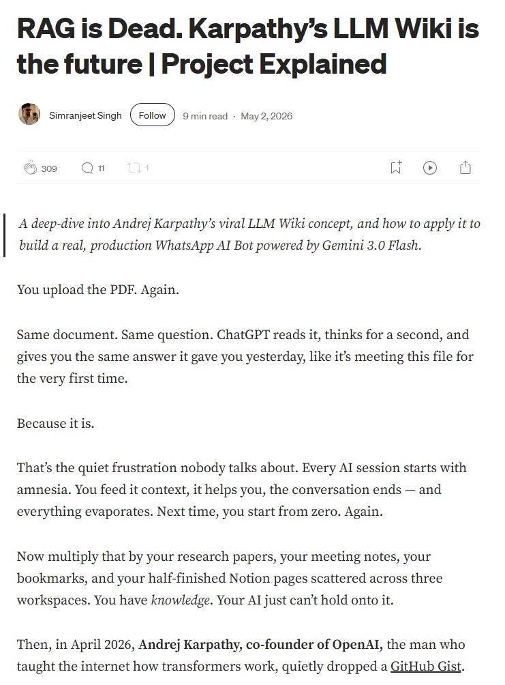
Scientific Context
https://ai.plainenglish.io/rag-is-dead-karpathys-llm-wiki-is-the-future-project-explained-2ae6541616cb
What does one of these LLM Wiki’s look like?
What does it do?
[Go To PyAutoPaper]
Explain: Indexing, concepts, memory.

Slide 32

Using Natural Language To Read Papers
It was of no benefit to any of us as scientists having to read all those papers to do science.

Slide 33
Using Natural Language To Read Papers
It was of no benefit to any of us as scientists having to read all those papers to do science.
[I’m Joking.]
But having AI with this context is extremely powerful.

Slide 34
Using Natural Language To Model Strong Lenses

Slide 35
[Go to autolens_assistant]

Slide 36
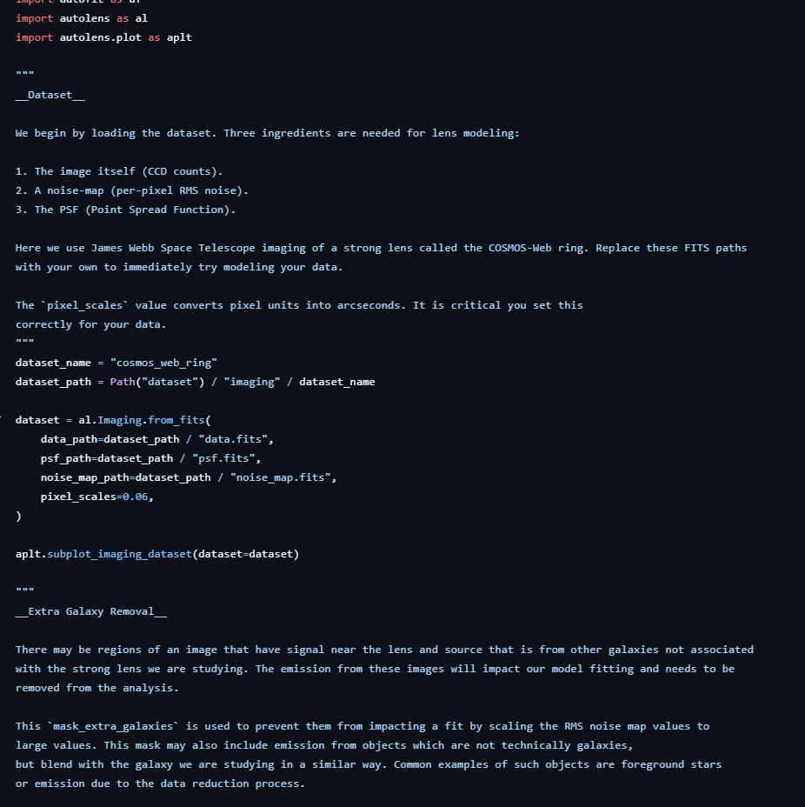
Why PyAutoLens Suits an AI assistant
Extensive tutorials and examples offer huge amounts of context.
autolens_assistant converts the over 1000 end-to-end science examples into a wiki, in the same style as PyAutoPaper.

Slide 37
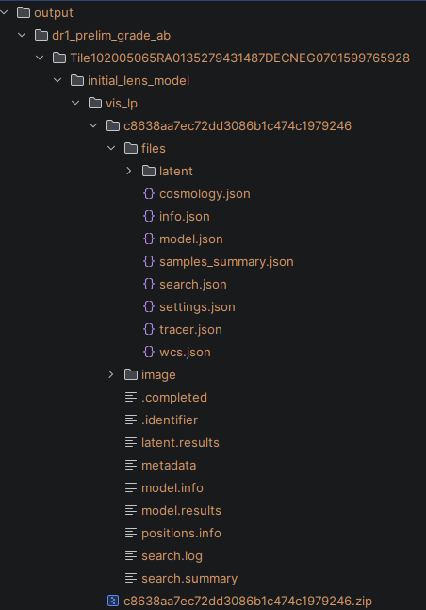
Why PyAutoLens Suits an AI assistant
PyAutoLens stores the full modelling state, Python objects, results, metadata, priors, samples and diagnostics, as human-readable .json files.
This makes results easy for both humans and AI agents to inspect, query, modify and reproduce, without needing to reconstruct the original Python script that generated them.

Slide 38
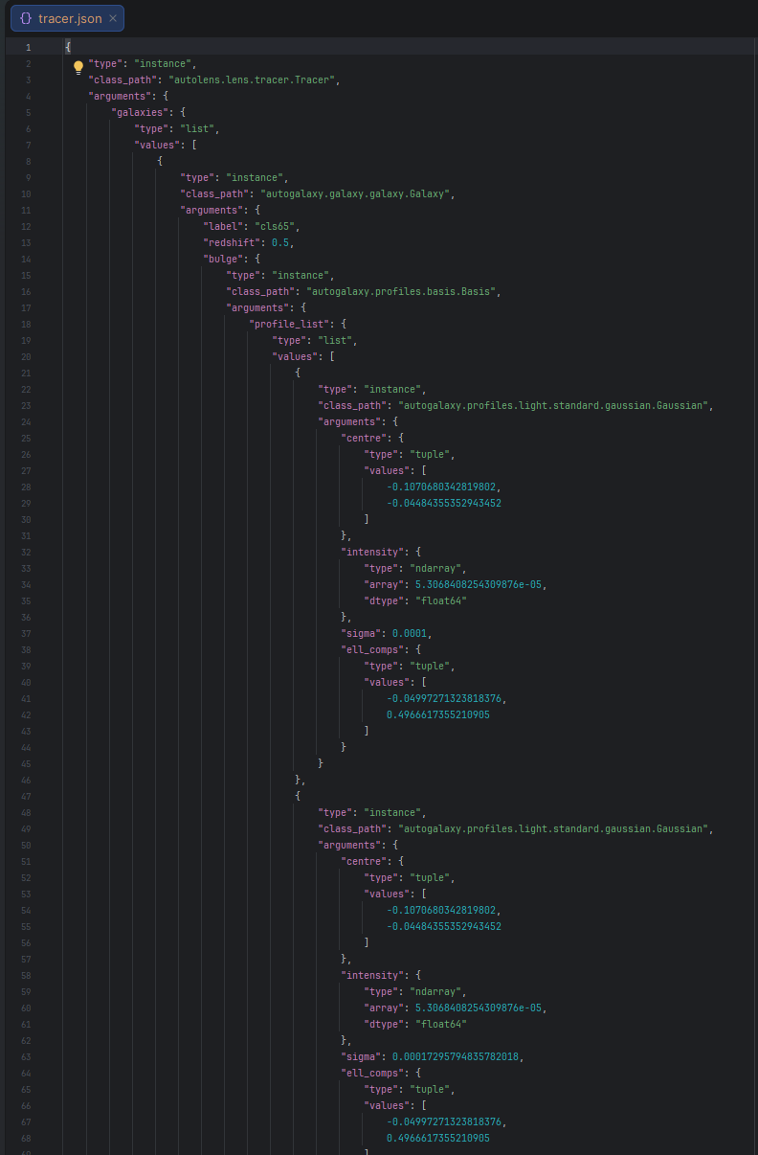
Why PyAutoLens Suits an AI assistant
PyAutoLens stores the full modelling state, Python objects, results, metadata, priors, samples and diagnostics, as human-readable .json files.
This makes results easy for both humans and AI agents to inspect, query, modify and reproduce, without needing to reconstruct the original Python script that generated them.

Slide 39
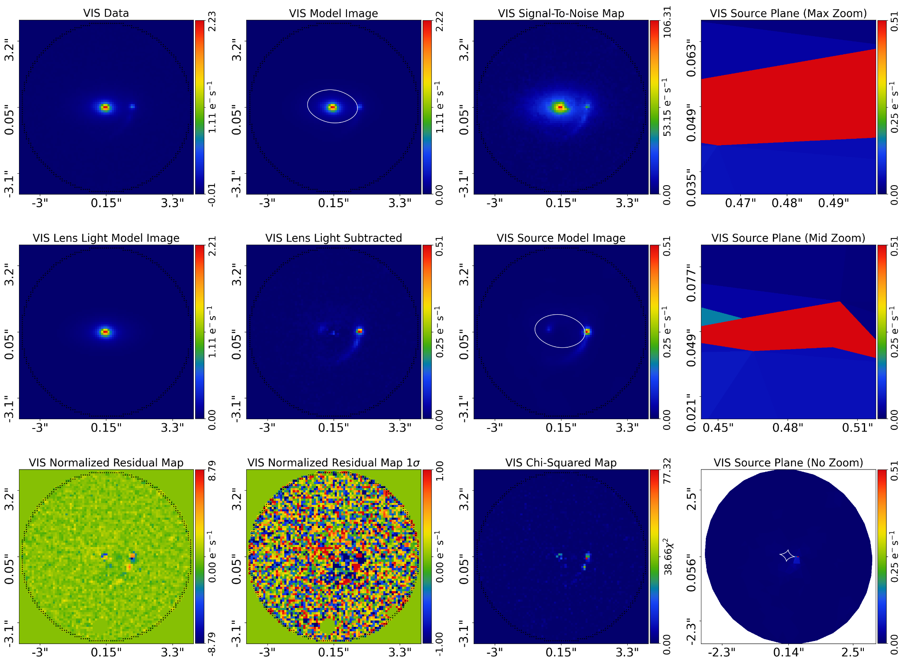

Slide 40
❯ I am writing a paper on lens modeling of euclid data in @z_projects/euclid/paper , I want to produce the images described by this text: First, we will consider successful lens models. Figure ? shows an
overview of successful lens model fits to three
example lenses. This image shows only 6 panels to show the fit (RGB, Data, Lens Light Model, Lens Light subtracted, Lensed Source MOdel Image, Source Reconstruction (Mid Zoom))
to briefly show the result, note however this reduced image was not used for the actual visual inspection. I want to give you the name of a lens, and you use @autolens_assistant to produce this image for
the paper, remember that you need to replot the image by loading the results and whatnot, including loading and plotting the RGB images which are Euclid specific. Can you do this for the lens called
Tile102008532RA0683495100072DECNEG0642073858939

Slide 41
