Slide 1
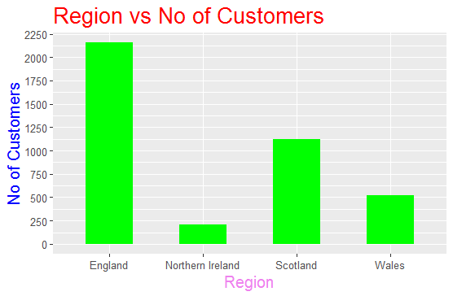
UK-Bank-Customer-Analysis

Slide 2
Region vs No of Customers
Region | No of Customers
England | 2159
Northern Ireland | 211
Scotland | 1124
Wales | 520

Slide 3
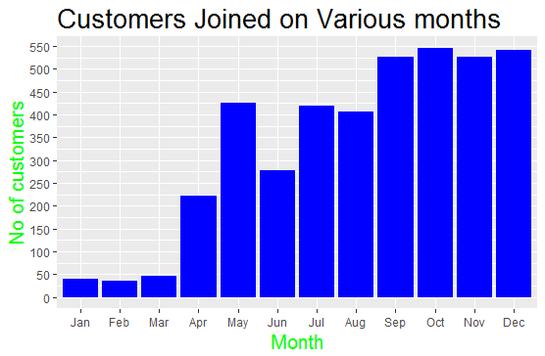

Slide 4
Region vs Customers
Month | England | Northern Ireland | Scotland | Wales | Total
Jan | 20 | 2 | 11 | 7 | 40
Feb | 19 | 3 | 12 | 2 | 36
Mar | 28 | 3 | 13 | 3 | 47
Apr | 187 | 2 | 24 | 9 | 222
May | 114 | 62 | 151 | 98 | 425
Jun | 146 | 15 | 82 | 35 | 278
Jul | 231 | 18 | 117 | 54 | 420
Aug | 206 | 28 | 105 | 67 | 406
Sep | 265 | 41 | 161 | 60 | 527
Oct | 324 | 25 | 128 | 68 | 545
Nov | 311 | 9 | 137 | 69 | 526
Dec | 308 | 3 | 183 | 48 | 542
Total | 2159 | 211 | 1124 | 520 | 4014

Slide 5
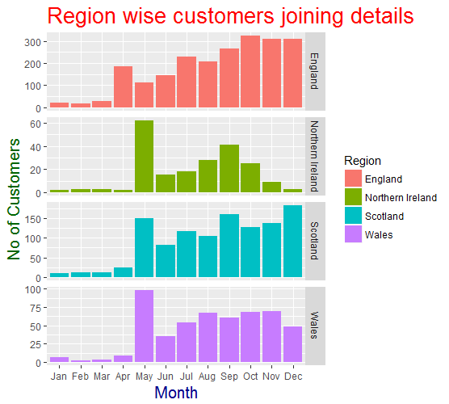

Slide 6
Region | Gender | JobClassification | No of Customers
England | Female | Blue Collar | 163
 |  | Other | 171
 |  | White Collar | 757
 | Male | Blue Collar | 181
 |  | Other | 143
 |  | White Collar | 744
Northern Ireland | Female | Blue Collar | 29
 |  | Other | 93
 |  | White Collar | 35
 | Male | Blue Collar | 12
 |  | Other | 12
 |  | White Collar | 30
Scotland | Female | Blue Collar | 27
 |  | Other | 263
 |  | White Collar | 29
 | Male | Blue Collar | 517
 |  | Other | 233
 |  | White Collar | 55
Wales | Female | Blue Collar | 36
 |  | Other | 57
 |  | White Collar | 189
 | Male | Blue Collar | 84
 |  | Other | 38
 |  | White Collar | 116

Slide 7
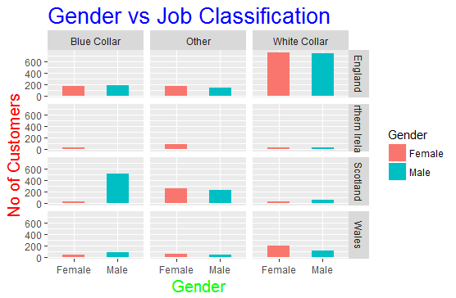

Slide 8
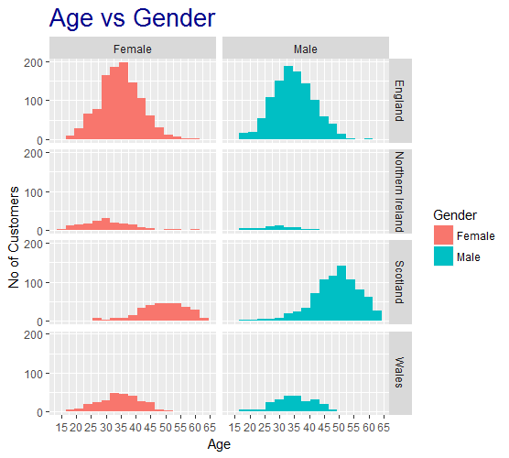

Slide 9
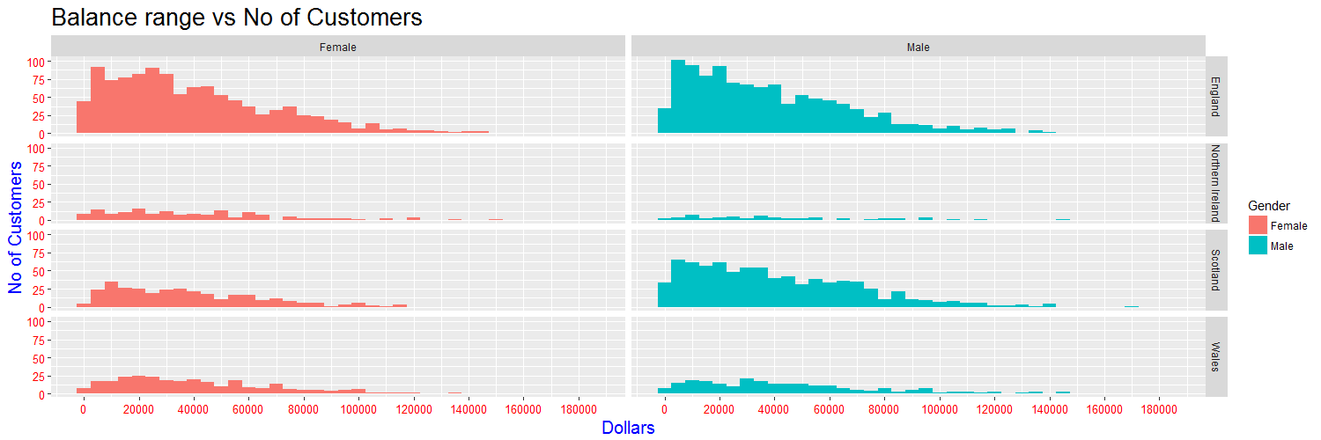

Slide 10
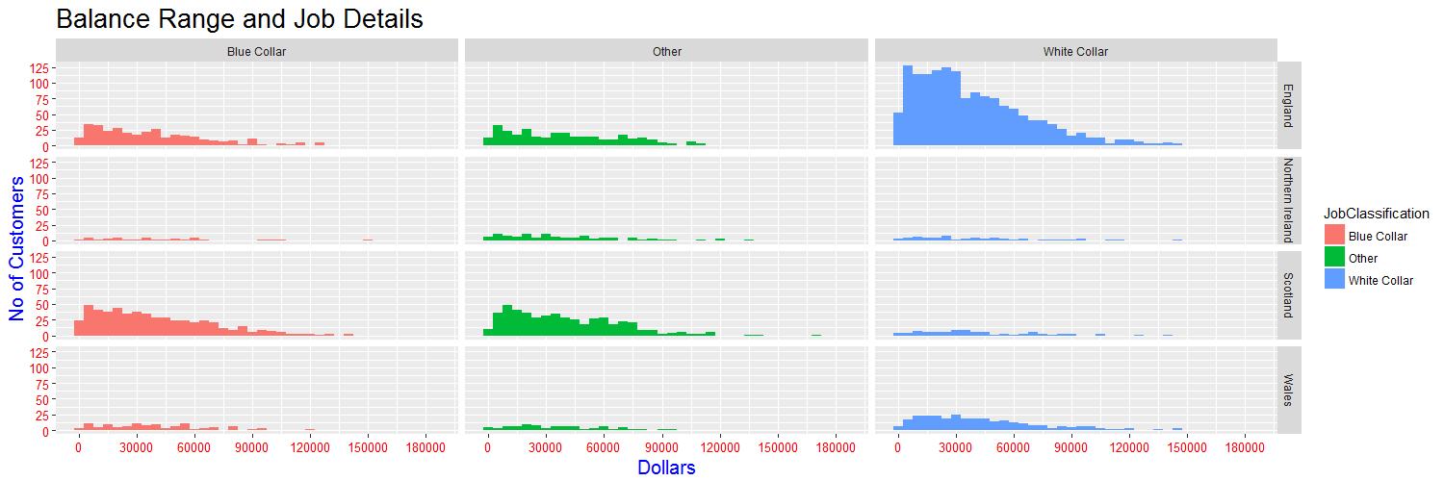

Slide 11
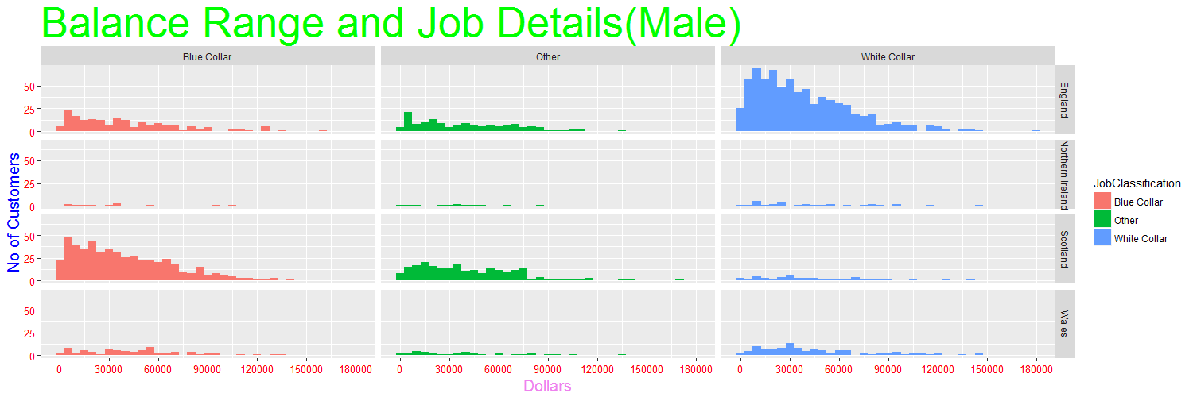

Slide 12
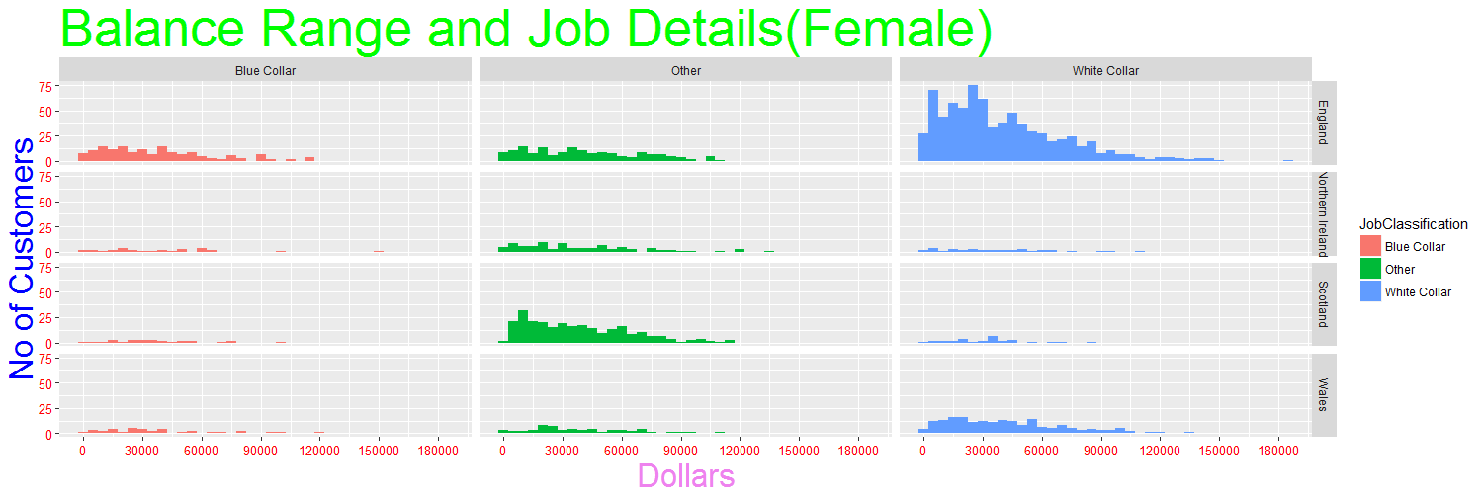

Slide 13
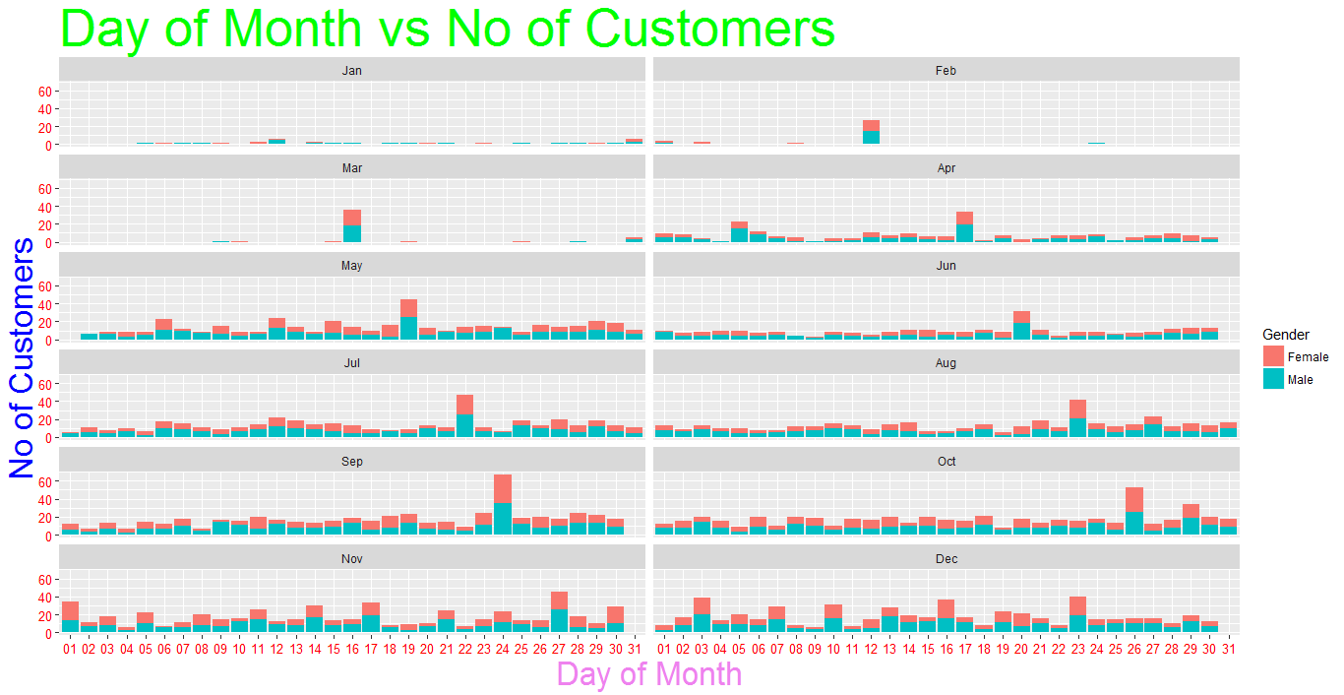

Slide 14
Top Five Customers
CustomerID | CustomerName | Age | Region | JobClassification | Date | Balance
100001307 | Ms. Dorothy Jackson | 31 | England | White Collar | 2015-Jul-22 | 183467.7
100003450 | Mr. Carl Fraser | 35 | England | White Collar | 2015-Nov-30 | 181681
200002010 | Mr. Connor North | 50 | Scotland | Other | 2015-Sep-11 | 172085.5
100003832 | Mr. Sebastian Arnold | 44 | England | Blue Collar | 2015-Dec-20 | 161517.8
400000914 | Ms. Anna Randall | 25 | Northern Ireland | Blue Collar | 2015-Jun-18 | 149698.1

Slide 15
England Top Five
CustomerID | CustomerName | Age | Region | JobClassification | Date | Balance
100001307 | Ms. Dorothy Jackson | 31 | England | White Collar | 2015-Jul-22 | 183467.7
100003450 | Mr. Carl Fraser | 35 | England | White Collar | 2015-Nov-30 | 181681
100003832 | Mr. Sebastian Arnold | 44 | England | Blue Collar | 2015-Dec-20 | 161517.8
100001823 | Ms. Natalie Paige | 34 | England | White Collar | 2015-Aug-28 | 149684.4
100003108 | Mr. David Metcalfe | 27 | England | White Collar | 2015-Nov-11 | 146892.4

Slide 16
Scotland Top Five
CustomerID | CustomerName | Age | Region | JobClassification | Date | Balance
200002010 | Mr. Connor North | 50 | Scotland | Other | 2015-Sep-11 | 172085.48
200001502 | Mr. Stewart Vaughan | 57 | Scotland | Blue Collar | 2015-Aug-03 | 141792.5
200002025 | Mr. Dan Forsyth | 58 | Scotland | White Collar | 2015-Sep-12 | 139610.13
200002634 | Mr. Paul Sanderson | 57 | Scotland | Other | 2015-Oct-15 | 139509.54
200002353 | Mr. Leonard Lyman | 64 | Scotland | Blue Collar | 2015-Sep-28 | 139415.88

Slide 17
Wales Top Five
CustomerID | CustomerName | Age | Region | JobClassification | Date | Balance
300000524 | Mr. Brandon Clark | 31 | Wales | White Collar | 2015-May-16 | 145996
300003185 | Mr. Piers Dyer | 39 | Wales | White Collar | 2015-Nov-14 | 144607.4
300002335 | Mr. Benjamin Howard | 36 | Wales | White Collar | 2015-Sep-27 | 144209.8
300002539 | Mr. Julian Mackay | 35 | Wales | Other | 2015-Oct-09 | 136365.5
300001034 | Mr. Julian Carr | 35 | Wales | Blue Collar | 2015-Jun-29 | 134324.7

Slide 18
Northern Ireland Top Five
CustomerID | CustomerName | Age | Region | JobClassification | Date | Balance
400000914 | Ms. Anna Randall | 25 | Northern Ireland | Blue Collar | 2015-Jun-18 | 149698.12
400000639 | Mr. Peter Miller | 28 | Northern Ireland | White Collar | 2015-May-22 | 146569.77
400002618 | Ms. Alison McGrath | 28 | Northern Ireland | Other | 2015-Oct-14 | 133050.09
400000692 | Ms. Hannah Hudson | 34 | Northern Ireland | Other | 2015-May-26 | 121806.79
400000540 | Ms. Fiona Baker | 31 | Northern Ireland | Other | 2015-May-17 | 121133.06

Slide 19
Top five Male Customers
CustomerID | CustomerName | Age | Region | JobClassification | Date | Balance
100003450 | Mr. Carl Fraser | 35 | England | White Collar | 2015-Nov-30 | 181681
200002010 | Mr. Connor North | 50 | Scotland | Other | 2015-Sep-11 | 172085.5
100003832 | Mr. Sebastian Arnold | 44 | England | Blue Collar | 2015-Dec-20 | 161517.8
100003108 | Mr. David Metcalfe | 27 | England | White Collar | 2015-Nov-11 | 146892.4
400000639 | Mr. Peter Miller | 28 | Northern Ireland | White Collar | 2015-May-22 | 146569.8

Slide 20
Top Five Female Customers
CustomerID | CustomerName | Age | Region | JobClassification | Date | Balance
100001307 | Ms. Dorothy Jackson | 31 | England | White Collar | 2015-Jul-22 | 183467.7
400000914 | Ms. Anna Randall | 25 | Northern Ireland | Blue Collar | 2015-Jun-18 | 149698.12
100001823 | Ms. Natalie Paige | 34 | England | White Collar | 2015-Aug-28 | 149684.4
100003732 | Ms. Faith Ince | 34 | England | White Collar | 2015-Dec-15 | 143879.62
100002742 | Ms. Alison Manning | 30 | England | White Collar | 2015-Oct-22 | 143808.39

