Slide 1

Coin Recognition App
Jason Moran
C18394953
DT211C (TU857)
Supervisor: Brendan Tierney

Slide 2
Project Idea
Develop an algorithm for detecting euro coins and their value
Develop an mobile phone app allowing users to actually use this algorithm
Make the app easy to use, read and understand

Slide 3

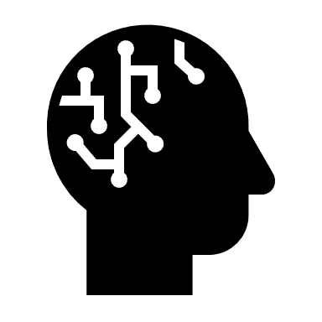

Research
Different technologies to host the app with
Different algorithms for coin detection
Different methods of value recognition

Slide 4
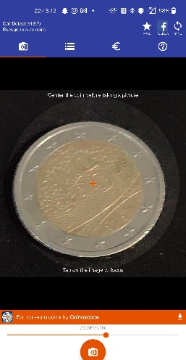
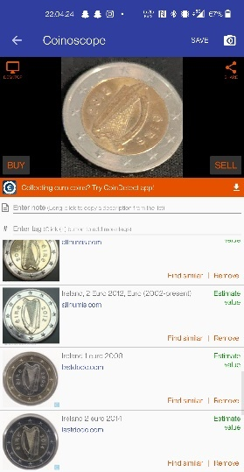
Similar existing apps
CoinDetect
Coinoscope

Slide 5
Different technologies
Android
IOS
React Native
The advantages to using android are numerous, They are 71% of the mobile operating system market share meaning a lot more phones for the app to work on
It’s open source, meaning the app can be customized for each individual brand/phone
Lastly, the default language is Java also with the ability to run python, both of which I’m very comfortable with
IOS is a mobile OS developed by apple exclusively for apple devices
IOS applications are developed through XCode on the Swift platform, meaning developing an app here would require learning a whole new platform and language
The main benefit to IOS is it is designed to run on one device and that alone, allowing it to perform better
It is a JavaScript framework for writing natively rendering mobile applications for iOS and Android
Allows the developer to create a web app, and wrap it for whatever OS it will be running on
While beneficial to run on both OS’s, I personally was not very comfortable with Javascript and felt this would show through in the final app

Slide 6
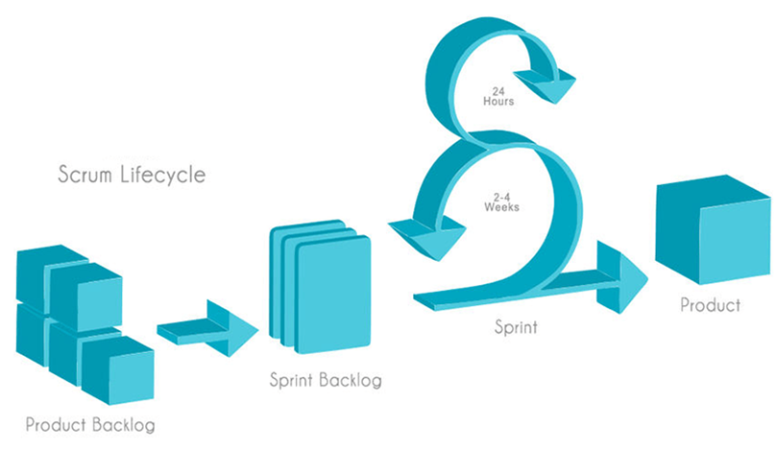
Software Methodology
Agile Approach – Combination of feature and Test Driven

Slide 7
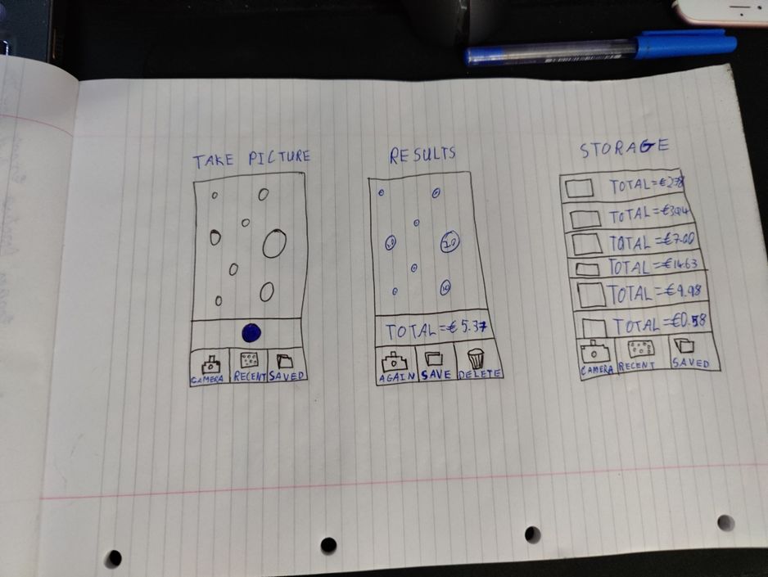
Front End

Slide 8
Back End
For the back end I opted against using a database as adding more layers would ultimately slow the application, when the goal of the app is to make the user’s life easier
I instead decided to just store any images and results in the devices local storage, making it quicker to access

Slide 9
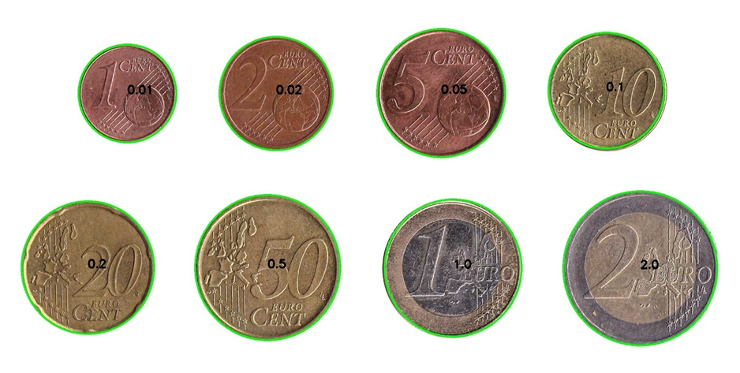
Testing
Testing will be mainly performed using 3 different methods, these would be Unit Testing and Black box Testing, and towards the end of development there would be a small focus on User Evaluation
The idea is to rule out as many problems as possible before user’s get their hands on it, so their focus can be on things they would like to see, rather than simple bugs

Slide 10
What’s Left?
All of the focus has been on the algorithm development so far, so the app will need to be developed and the algorithm either ported into Java or made to run on python through the app
The algorithm may need some minor tinkering depending on light level/device used, this will be focussed on after the app’s development
Finally some minor changes to the User Interface may be required depending on the User Evaluation portion of the testing

Slide 11

Thank you!
Any Questions?

