Slide 1

Bank Default Predictor
Using Data Science and analytics to Predict Loan Defaults
MEMBERS
2410030019 EADUNUR HARINI SRI REDDY
2410030113 JAMPA PRANAV TEJA
2410030068 D.Bharani Amoolya

Slide 2
Problem Statement
Banks lose significant revenue due to loan defaults.
Manually checking each customer’s creditworthiness is time consuming and prone to human error.
goal
To predict whether a customer is likely to default on a loan using their financial and personal information.

Slide 3



Our Solution
Approach:
Use machine learning to build a prediction model
Train the model using real banking data
Predict loan default risk for new or existing customers
Benefits:
Faster and more accurate credit decisions
Reduces financial risk for banks

Slide 4
How We Use Python in This Project

Slide 5
Features:
Uses customer data like
income
age
loan amount
Cleans and prepares the data for analysis
Trains a machine learning model to learn patterns
Predicts if a customer will default or not
Shows accuracy of the model

Slide 6
Project Outcome
Expected Outcome:
A working model that predicts loan default probability
High Accuracy of based on selected algorithm
Helps banks take better loan approval decisions
Future Scope:
Deploy as a web app for banks
Add real time data and advanced models

Slide 7
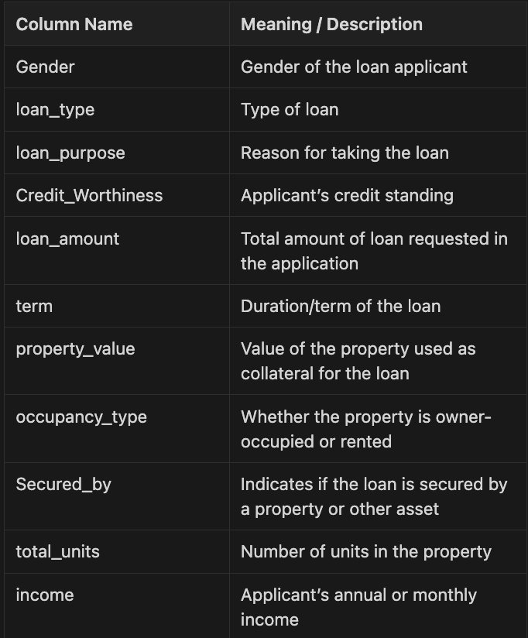
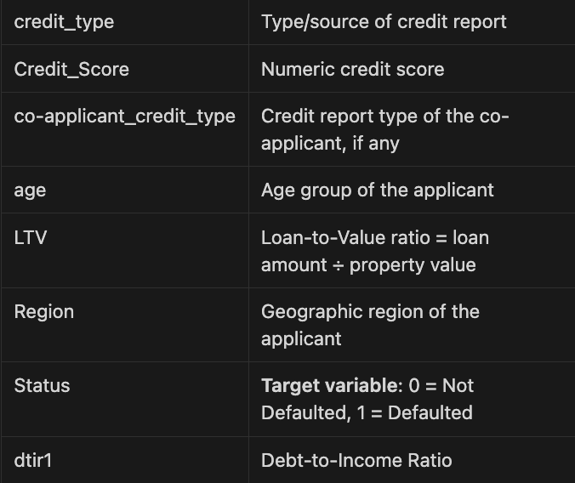
DATASET: (kaggle.com)

Slide 8
THANKYOU

