Slide 1











BANK LOAN DEFAULT PREDICTOR

Slide 2







Objectives
Develop an AI model that analyzes 18 key factors to predict loan default risk.
Evaluate multiple aspects of a customer’s profile, including:
Personal demographics and credit history
Loan characteristics and terms
Financial capacity and debt ratios
Property and collateral information
Provide risk assessment guidance to support financial institutions in data-driven loan decisions.
Ensure the tool serves as decision support, to be used alongside human judgment for final approvals.

Slide 3

Where did we get the dataset?
Platform: Kaggle
Dataset Name: “Bank Loan Default Prediction” (or actual Kaggle title)
Rows: 173559 Columns: 34
Contains details of personal demographics, financials, and loan information.

Slide 4
original dataset
Personal Information | Gender | age
Loan Details | loan_type | loan_purpose | loan_amount | term | Neg_ammortization | interest_only | lump_sum_payment
Financial Information | Credit_Worthiness | open_credit | rate_of_interest | Interest_rate_spread | Upfront_charges | income | dtir1
Property Information | property_value | construction_type | occupancy_type | Secured_by | total_units | Region
Additional Information | ID | year | loan_limit | approv_in_adv | submission_of_application | Security_Type | Status

Slide 5
why we preprocessed it?
Raw data contains missing values, duplicates, and irrelevant columns.
Categorical data needs to be converted to numerical format for modeling.
Ensures the dataset is clean, consistent, and ready for machine learning.

Slide 6


steps in preprocessing the data
Removed unnecessary columns (irrelevant identifiers)
01.
03.
Handled missing values
02.
Loaded the dataset using Pandas
04.
Removed duplicate records

Slide 7
Detected and removed outliers using the IQR method
05.
Fixed data types (e.g., converted date columns)
07.
Saved the cleaned dataset for further modeling
06.
Renamed columns to standardized names
08.

Slide 8
The final dataset
Personal Information | Loan Details | Financial Information | Property Information | Additional Information
Gender | Loan_Type | Annual_Income | Property_Value | Secured_By
Age | Loan_Purpose | Credit_Score | Loan_to_Value_Ratio (LTV) | Credit_Type
Loan_Amount | Credit_Worthiness | Occupancy_Type | Applicant_Credit_Type
Term | Debt_to_Income_Ratio (DTIR) | Total_Units | Region
Status (Target Variable)

Slide 9
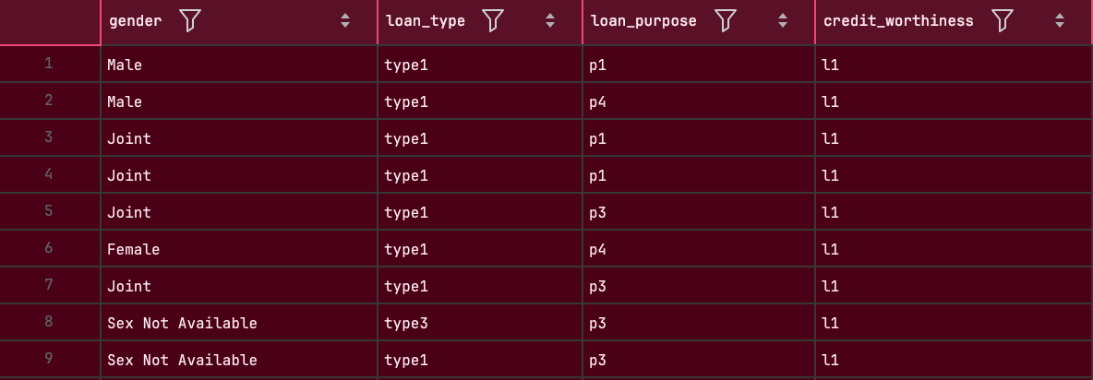
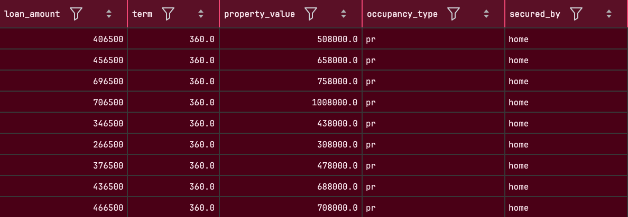

Slide 10
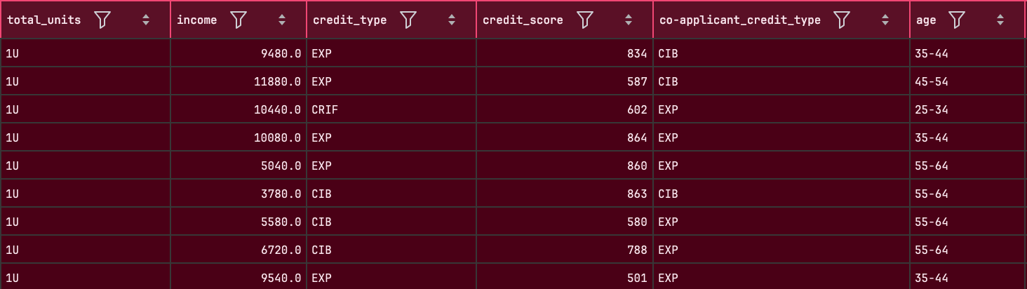
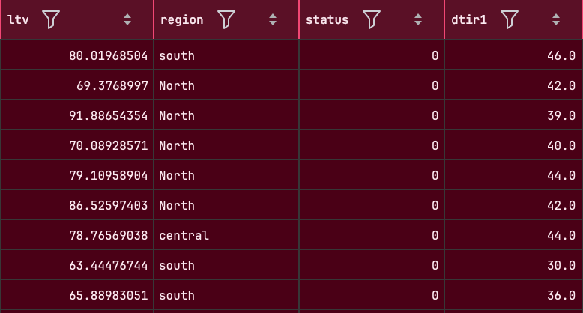

Slide 11
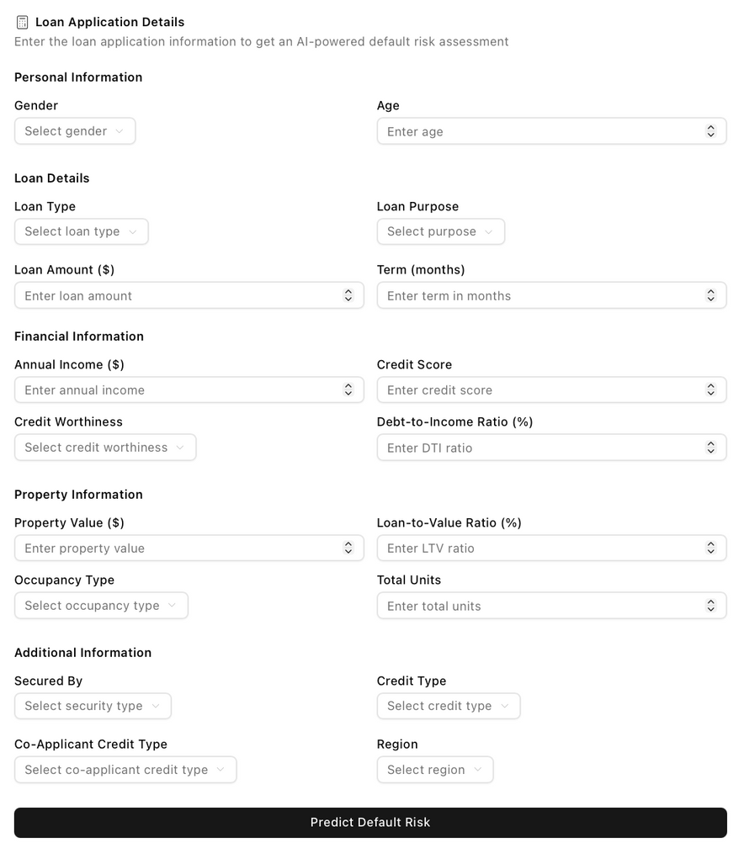



FrontEnd for the project
JS

Slide 12
thank you!

