Slide 1

React Native
Mobile Application Dev - TTOW0610
Jani Kerttula & Lauri virtanen

Slide 2
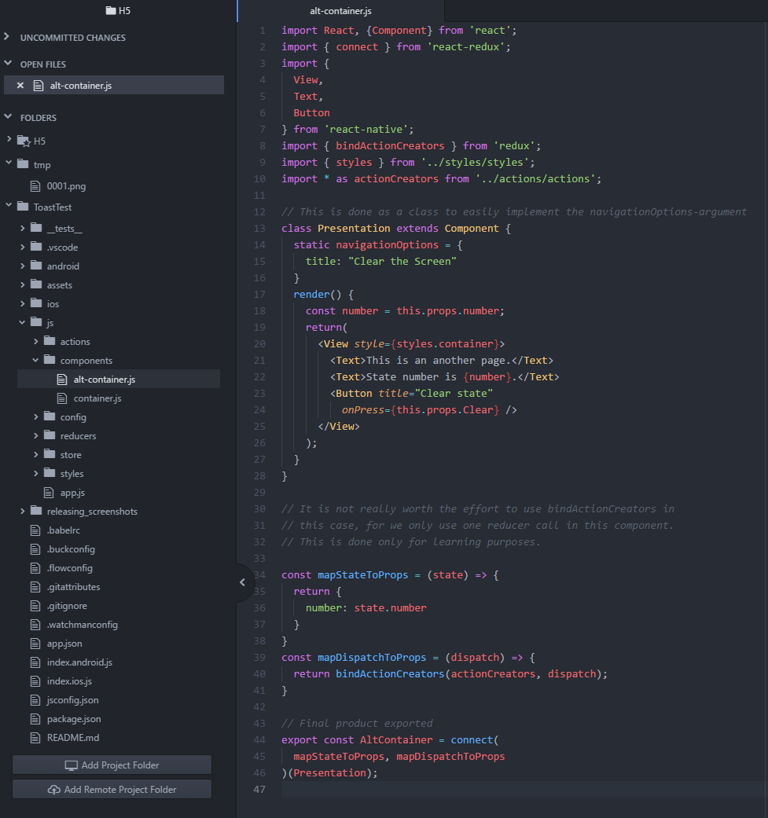
React Native is multiplatform framework
You can create apps for iOS and Android using only JavaScript
Hot Reloading

Slide 3



Needed architectures
Android
Nodejs
Java development kit (JDK)
Python 2
iOs
You need to use MacOS with Watchman
Check react-native docs

Slide 4
Setup
You should use Chocolatey for installing
Node version 4 or higher
JDK V.8 or higher
Node comes with npm what we use to install react-native CLI
npm install -g react-native-cli
Notes:
choco install -y nodejs.install python2 jdk8
Node comes with npm

Slide 5
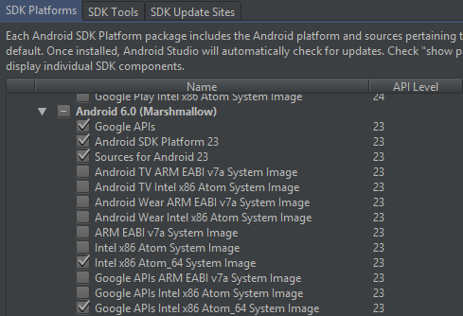
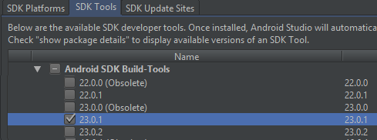
Android Setup
Install/start Android Studio
Open SDK-manager make sure you have installed
Google Api
Android SDK platform 23
Intel x86 Atom_64 system image
Google Apis intel x86 Atom_64 system image
Android SDK build tools 23.0.1

Slide 6
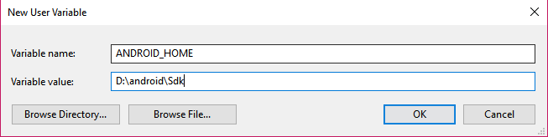
Define env. variables
adb.exe path -> open variable Path, add new, SDK_folder/platform-tools
sdk location -> new variable ANDROID_HOME = sdk location
After that you can generate a new react native project in CMD with react-native init ProjectName

Slide 7
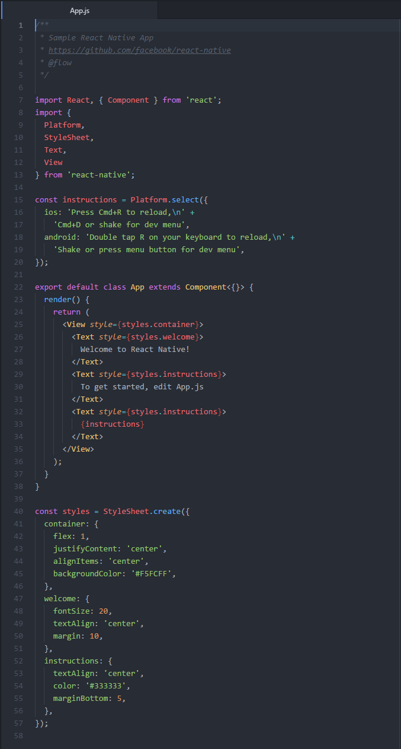
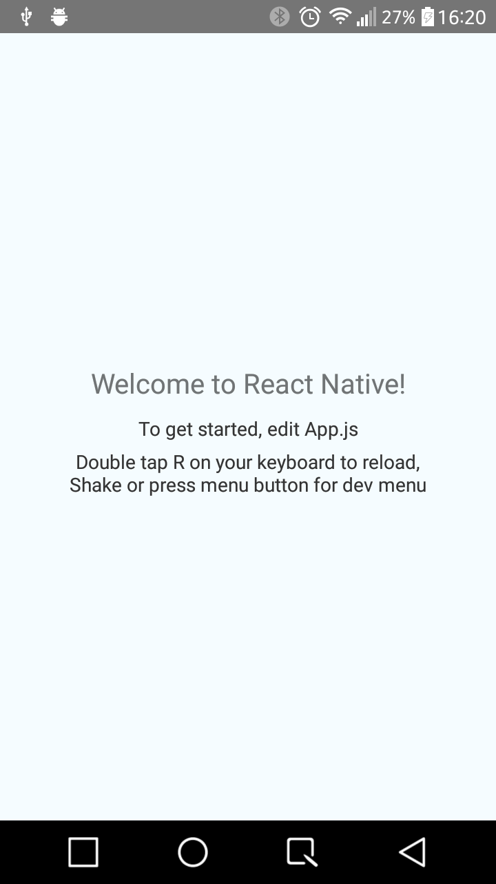
Testing the App
Simulator:
Open preferred simulator (Min android version 6.0.0)
Device:
Enable developer mode
Enable usb debugging
Notes:
React-nativen docseista esimerkki koodi

Slide 8
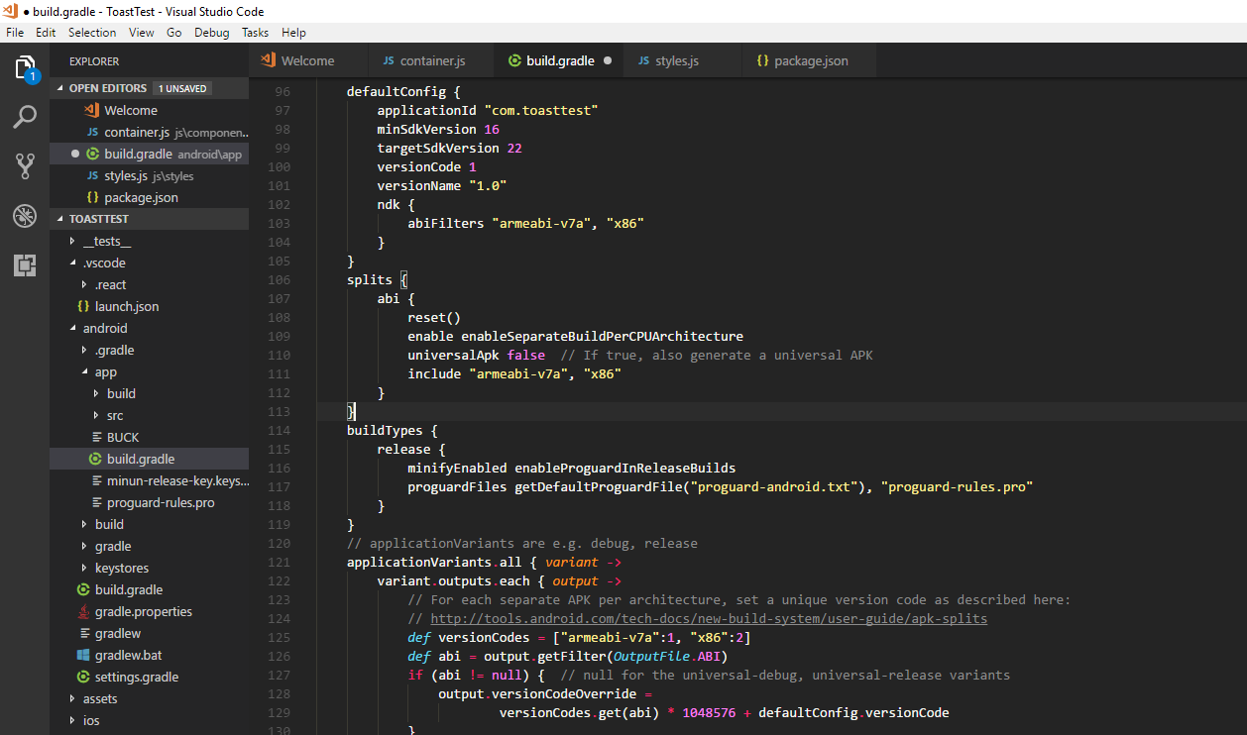
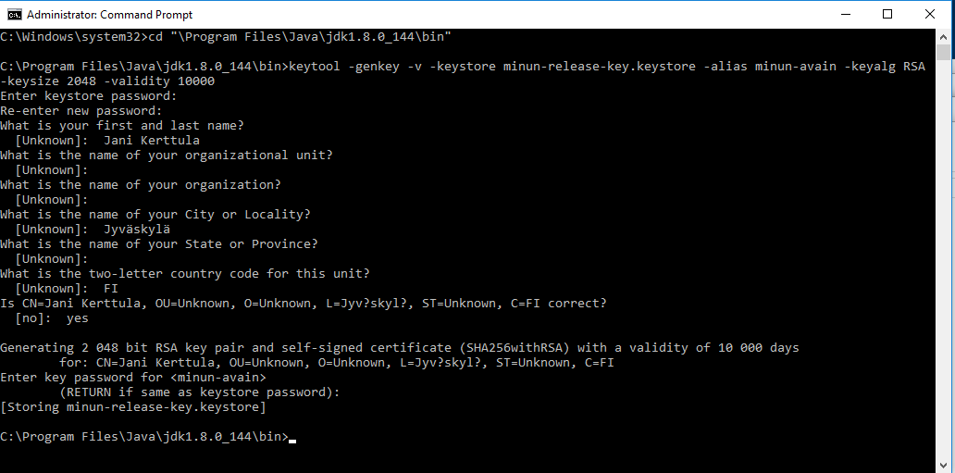
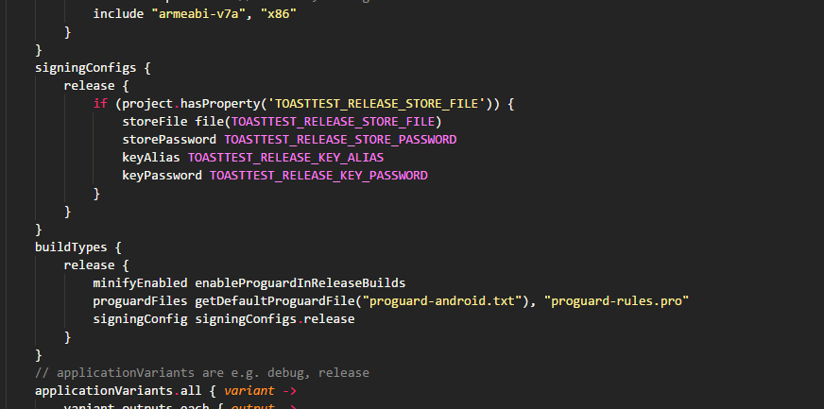
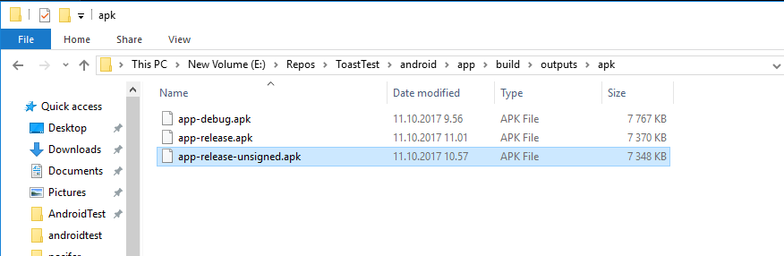
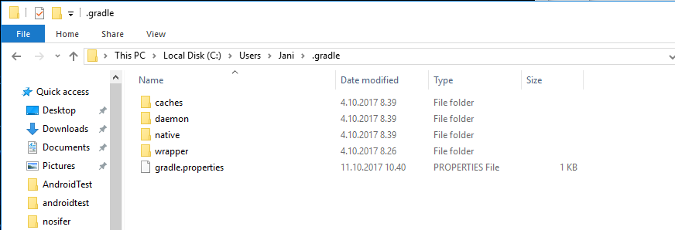
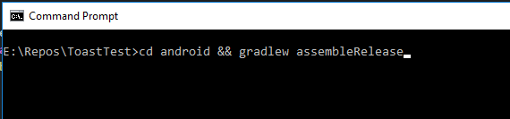
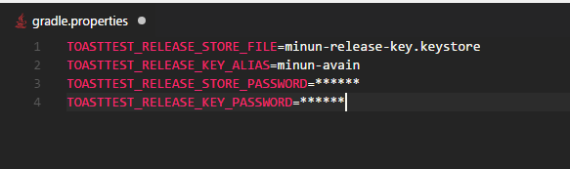
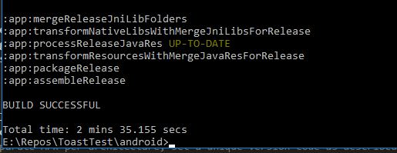
Generating Signed APK
Notes:
1 must be run from C:\Program Files\Java\jdkx.x.x_x\bin. Generate a signing key – valid for 10000 days – Keep keystore file private and dont commit to version control
2 Setting up gradle variables – Edit gradle.properties
3 Add signing config to gradle config, build.gradle 4 Generate the release APK $ cd android && ./gradlew assembleRelease
5 Test the release build of the app $ react-native run-android --variant=release

