Slide 1
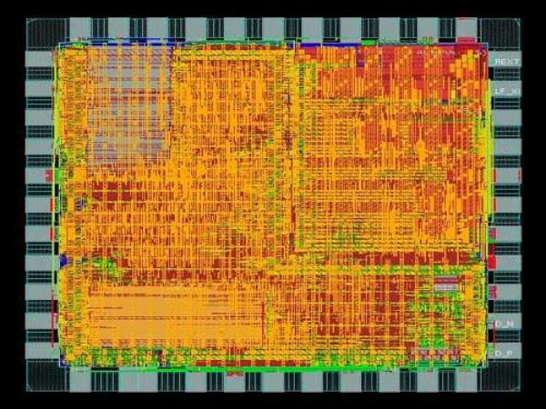
Proyecto de verificación
Avance 1: Testbench Basado en capas
uRISCV
Universidad de Costa Rica
EIE IE0621 Kenny Wu Wen C08592
Jorge Mora Soto B95222 Oscar Fallas Cordero B92861

Slide 2
Índice
01
05
09
DUV
RISCV vs uRISCV
Interfaces
reference_model.sv
02
06
10
Memory
driver.sv
stimulus.sv
scoreboard.sv
03
07
11
¿What we will verify?
Verification components
monitor.sv
Next steps
04
08
12
tb_top.sv
testcase.sv
environment.sv
Checkers
¿Questions?

Slide 3
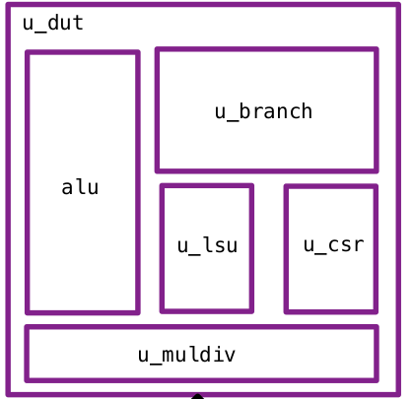
DUV
Starting bench
VCD info: dumpfile waveform.vcd opened for output.
Test:
1. Initialised data
2. Multiply
3. Divide
4. Shift left
5. Shift right
6. Shift right arithmetic
7. Signed comparision
8. Word access
9. Byte access
10. Comparision

Slide 4
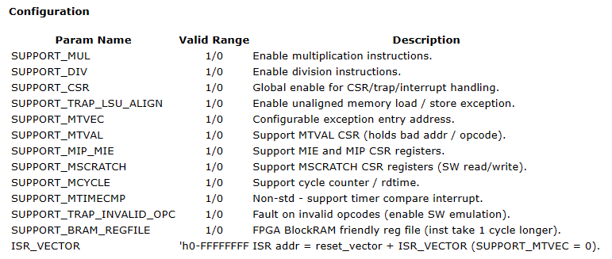
uRISCV?
uRISCV is a simple and small 32 bit RISCV CPU implementation
Supports Intenger (I), multiplication and division (M), and CSR instructions (Z) extensions (RV32IMZicsr)
Configurable support for exceptions, interrupts, timers, multiplication, division and error traps

Slide 5
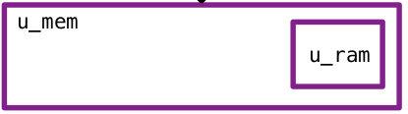
Memory
uRISCV is connected to a tcm_mem that has a tcm_mem_ram where the instructions are fetch
tcm_mem, has a task named write. The task is used to write to the ram
Note: This is not part of the DUT

Slide 6
¿What we will verify? ¿BlackBox-WhiteBox-GreyBox?

Slide 7
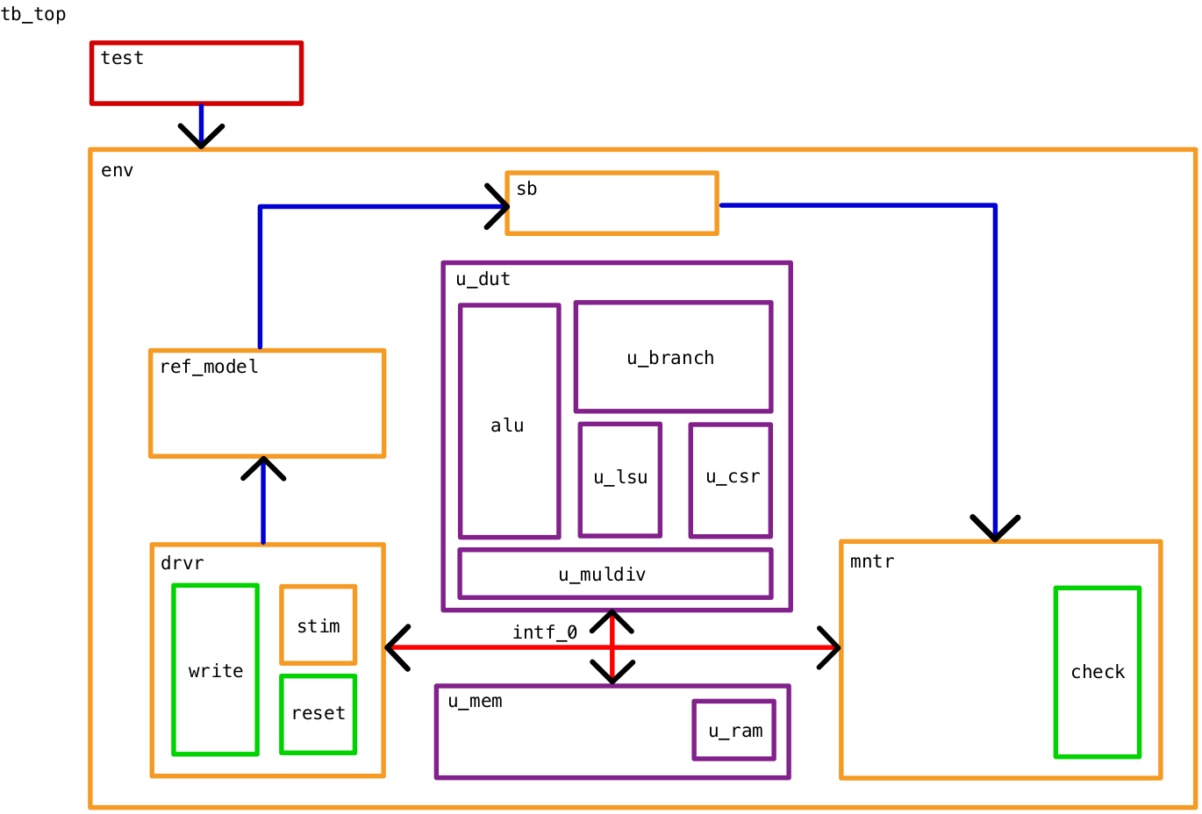
Basic verification components
testbench.sv
tb_top.v
interface_0.sv
testcase.sv
environment.sv
driver.sv
stimulus.sv
task reset
task write
reference_model.sv monitor.sv
task check
scoreboard.sv
01

Slide 8
tb_top.sv
Contains the instance of the uriscv, interface_1 and the tcm_ram.
The clk signal is declared
Dumpfile, dumpvars
Instance of testcase

Slide 9
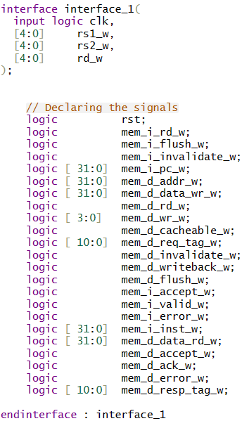
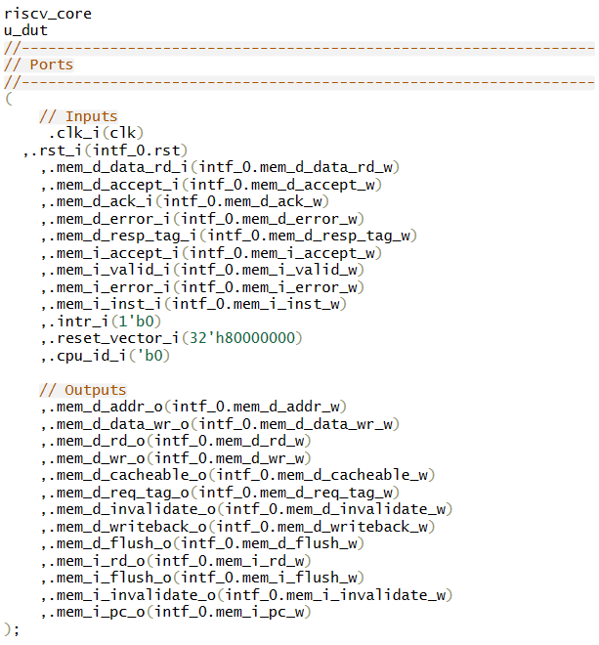
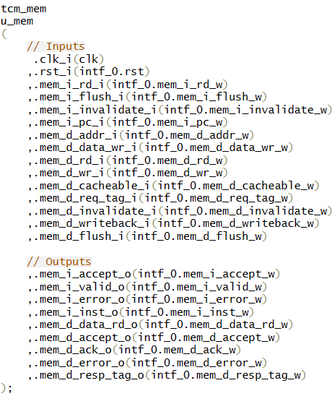
Intefaces
¿what about interface_1.sv?

Slide 10
driver.sv
write
stim
Load TCM men
Get stimulus
Load reference model
reset
Send reset signal thru interface

Slide 11
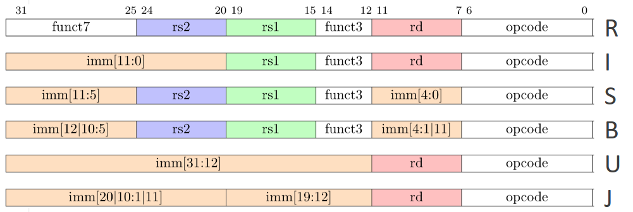
stimulus.sv

Slide 12
monitor.sv
Contains the checkers
Receives an interface and a scoreboard
Count the numbers of errors

Slide 13
Checkers.sv
This first version of the checker, compares the values inside the scoreboard with the values from the interface
Prints if the test pass or fail
Checks concurrently when detects a negedge of the mem_i_valid_w signal and rd_writeen_w
Can be classified as a checker base in micro-architecture rules

Slide 14
reference_model.sv
stim
Decode Ins
Classify
Function
Opcode
R
Add, Sub, And, Or, Xor
Func7 o Imm
I
Func3
S
Addi, Subi, Andi, Ori, lw
Rs1
B
Rs2
U
sw, sh, sb
Rd
J

Slide 15
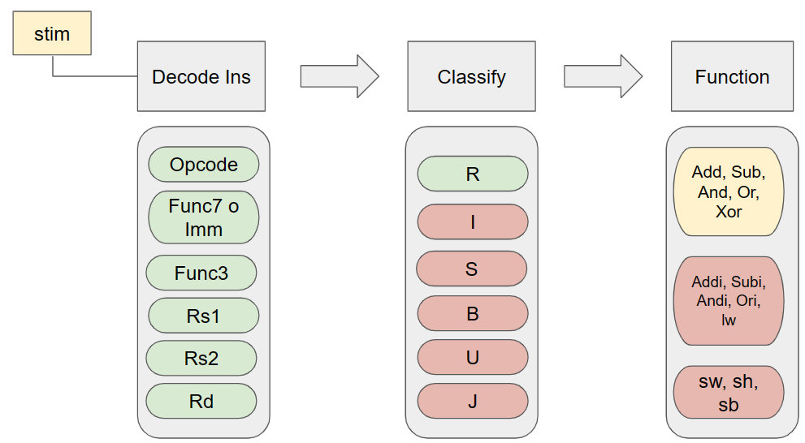
scoreboard.sv
ref_model.sv
Store ref_model results
scoreboar.sv

Slide 16
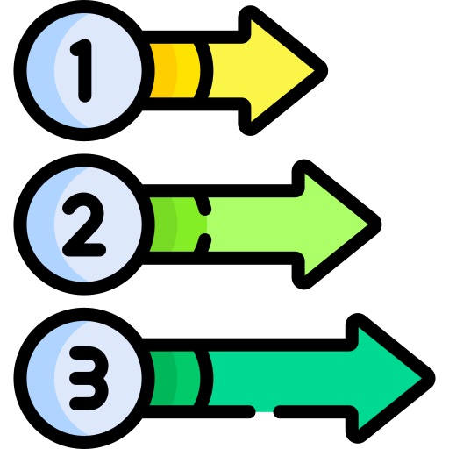
Next Steps

Slide 17

¿Questions?

Slide 18
¡Thank you!

