Slide 1
AI IN HEALTHCARE
Early Diabetes Prediction Using Machine Learning
A Medical Decision Support System
Jamshaid Amjad
AI in Healthcare — Capstone Project
May 2026
768
8
3
87.5%
Patients
Clinical Features
ML Models
Best ROC-AUC

Slide 2
Agenda
What this presentation covers — 15 slides
Problem & Clinical Motivation
Dataset & Exploratory Analysis
01
Why diabetes screening matters at scale
02
Pima Indians dataset, EDA, class imbalance
Slide 3
Slide 4–6
Preprocessing Pipeline
Feature Selection
03
6-step leakage-free data preparation
04
ANOVA + Random Forest combined ranking
Slide 7
Slide 8
Model Architectures
Training Strategy
05
Logistic Regression, Random Forest, MLP
06
Cross-validation, GridSearchCV, early stopping
Slide 9–11
Slide 12
Results & Evaluation
Conclusion & Future Work
07
Full metrics, ROC curves, model comparison
08
Key findings, limitations, clinical relevance
Slide 13–14
Slide 15
Jamshaid Amjad | AI in Healthcare — Capstone Project | May 2026 [2/15]

Slide 3
Problem & Clinical Motivation
Diabetes is a global epidemic — early detection saves lives
537M
783M
>90%
$966B
Adults with diabetes globally (2021)
Projected by 2045 (+46% increase)
Are Type 2 diabetes (preventable)
Annual global health expenditure on diabetes
The Clinical Challenge
How Machine Learning Can Help
▸ Type 2 diabetes progresses silently for years
▸ Predict risk from routine clinical blood measurements
▸ Often diagnosed after irreversible organ damage
▸ Automate flag of high-risk patients for confirmatory test
▸ Standard fasting glucose test is invasive & costly
▸ Provide probabilistic scores, not just binary outputs
▸ Primary care is overwhelmed — needs decision tools
▸ Interpretable models support clinical decision-making
▸ Timely screening reduces complications by up to 58%
▸ Cost-effective: uses data already collected at primary care
Jamshaid Amjad | AI in Healthcare — Capstone Project | May 2026 [3/15]

Slide 4
Dataset Overview
Pima Indians Diabetes Dataset — NIDDK / UCI Machine Learning Repository
Total patients
Clinical Features
768
Feature
Description
Unit / Type
Missing?
Glucose
Plasma glucose conc. (2hr OGTT)
mg/dL
Yes (4.9%)
Input features
BMI
Body Mass Index
kg/m²
Yes (1.4%)
8
BloodPressure
Diastolic blood pressure
mm Hg
Yes (4.6%)
Insulin
2-hour serum insulin
μU/mL
Yes (48.7%)
Positive cases (35%)
268
SkinThickness
Triceps skin-fold thickness
mm
Yes (29.6%)
DiabetesPedigreeFunction
Genetic diabetes risk score
0–2.42
No
Negative cases (65%)
Age
Age of patient
Years
No
500
Pregnancies
Number of pregnancies
Count
No
Outcome (TARGET)
Diabetes diagnosis
0 / 1
—
Jamshaid Amjad | AI in Healthcare — Capstone Project | May 2026 [4/15]

Slide 5
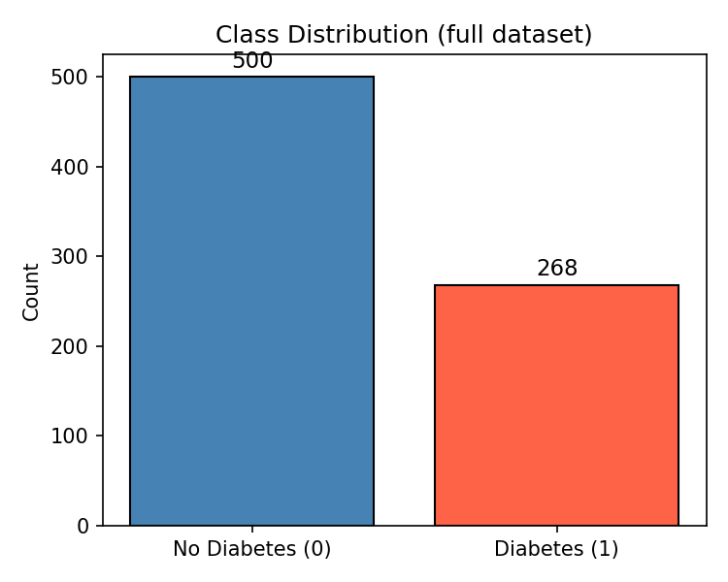
Exploratory Data Analysis — Class Distribution & Missing Values
Understanding imbalance and data quality before modelling
Class Distribution
Missing Data (Biological Zeros → NaN)
Insulin
48.7%
SkinThickness
29.6%
BloodPressure
4.6%
Glucose
4.9%
BMI
1.4%
Key EDA Insights
▸ 65% negative / 35% positive → class imbalance requires SMOTE
▸ Insulin has the most missing data (49%) — median imputation used
▸ Zeros in Glucose / BMI are biologically impossible → treated as NaN
▸ All features are continuous except Pregnancies & Outcome (discrete)
▸ No duplicate rows; dataset is complete after zero replacement
Jamshaid Amjad | AI in Healthcare — Capstone Project | May 2026 [5/15]

Slide 6
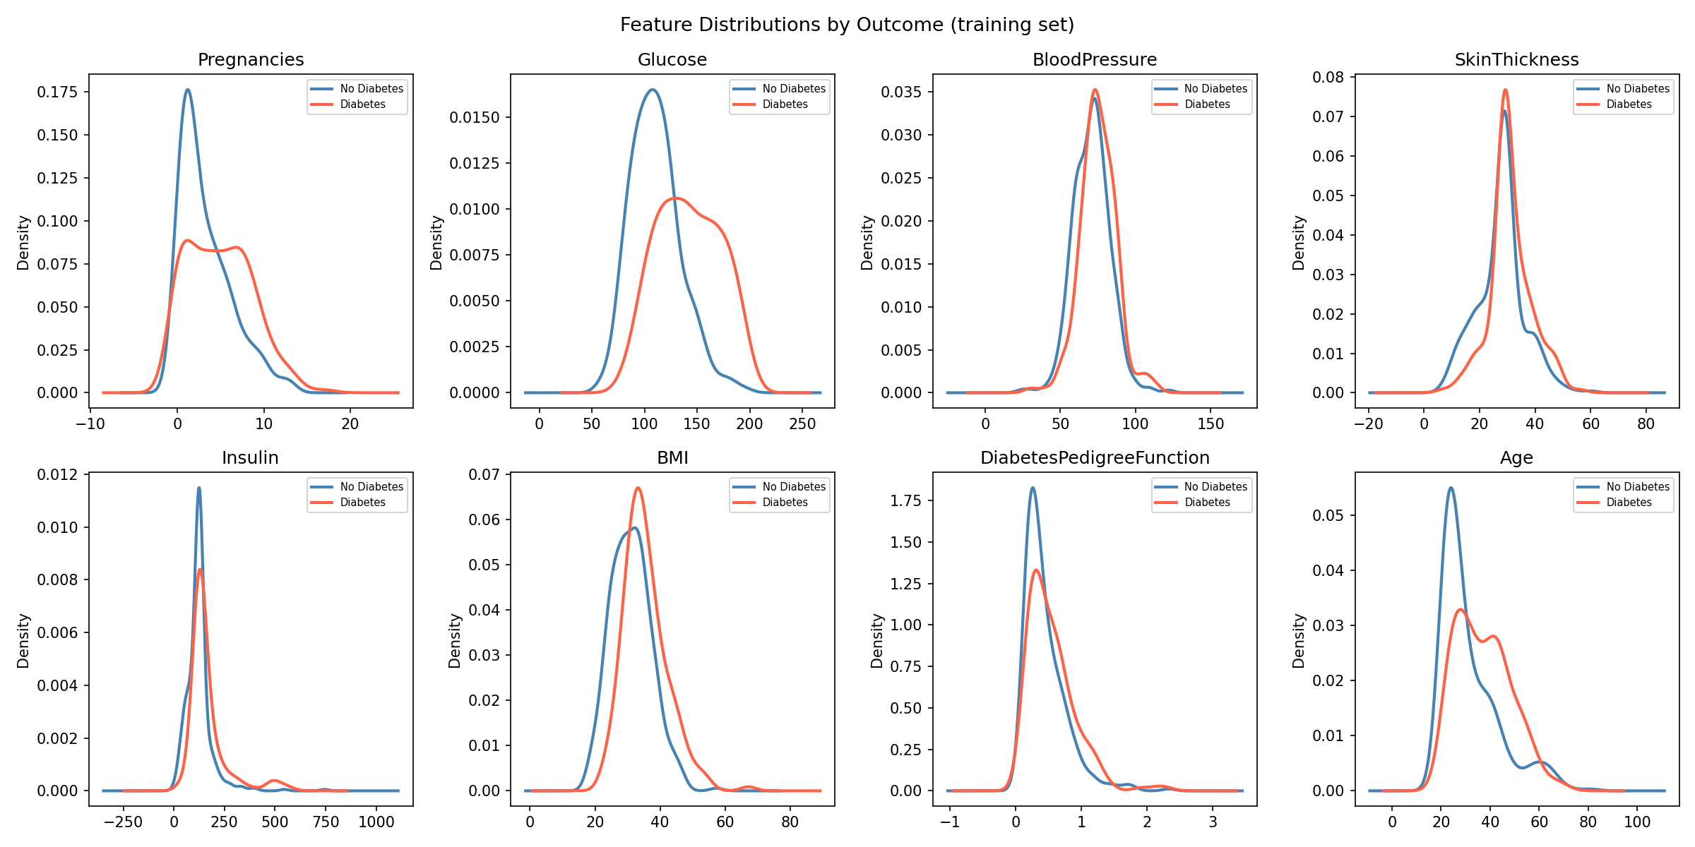
Exploratory Data Analysis — Feature Distributions & Correlations
Understanding which features separate diabetic from non-diabetic patients
Feature Distributions by Outcome (KDE)
Correlation with Outcome
Glucose
0.47
BMI
0.29
Age
0.24
Pregnancies
0.22
DiabetesPedigreeFunction
0.17
Insulin
0.13
SkinThickness
0.07
BloodPressure
0.07
Glucose is the strongest predictor (r=0.47), followed by BMI and Age.
Jamshaid Amjad | AI in Healthcare — Capstone Project | May 2026 [6/15]

Slide 7
Preprocessing Pipeline
Six leakage-free steps — all transformers fitted on training data only
01
Load & Clean
02
Stratified Split
03
Median Imputation
04
StandardScaler Normalisation
05
Feature Selection
06
SMOTE Oversampling
Replace biological zeros (Glucose, BMI, Insulin, BloodPressure, SkinThickness) with NaN
70% Train 15% Validation 15% Test Stratified by Outcome
SimpleImputer (median) Fit on train ONLY Applied to val + test No leakage
Mean=0, Std=1 Fit on train ONLY Applied to val + test Essential for LR & MLP
Top-5 by average of: • ANOVA F-test rank • Random Forest importance rank
Synthetic Minority Oversampling — train set ONLY Balances 65/35 → 50/50
▶
▶
▶
▶
▶
Why Leakage-Free Matters
✗ Fitting scaler on ALL data leaks test statistics into training
✓ All transformers fit on train set — same transform applied to val/test
✗ Imputing on ALL data uses future test values to fill training gaps
✓ Stratified split preserves class ratio in every split
✗ SMOTE applied to test set creates artificial, non-real samples
✓ This pipeline exactly mirrors real deployment conditions
Jamshaid Amjad | AI in Healthcare — Capstone Project | May 2026 [7/15]

Slide 8
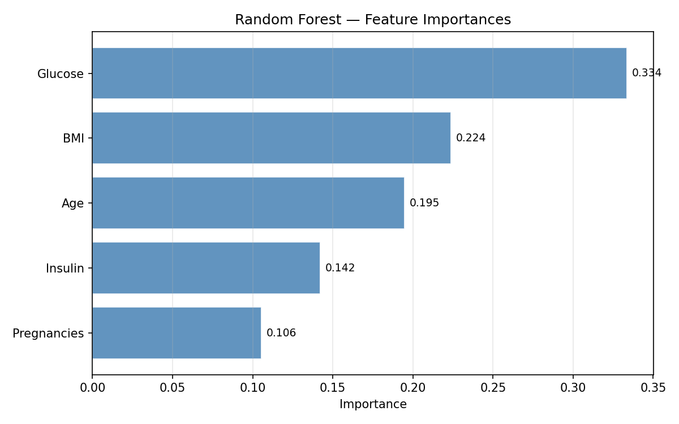
Feature Selection
Combining ANOVA F-test and Random Forest importance for robust top-5 selection
Selection Methodology
Feature Importances (Random Forest)
Step 1
ANOVA F-test
Compute F-statistic for each feature vs. Outcome. Rank 1–8 (1=highest).
Step 2
Random Forest Rank
Train RF on training data. Use feature_importances_ to rank 1–8.
Step 3
Average Rank
Average the two ranks per feature. Select the 5 features with lowest (best) average rank.
Step 4
Apply Selection
Use the same 5 feature indices on val + test sets. Never refit on test.
Selected Features: Glucose · BMI · Insulin · Age · Pregnancies
Jamshaid Amjad | AI in Healthcare — Capstone Project | May 2026 [8/15]

Slide 9
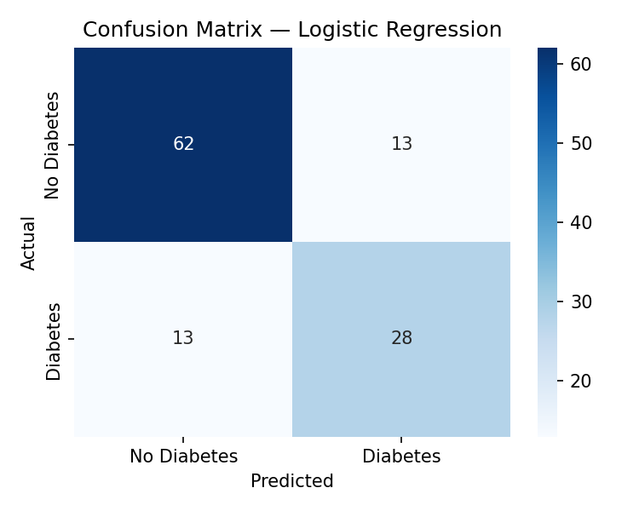
Model 1 — Logistic Regression
Interpretable linear baseline — essential reference point for clinical deployment
Model Description
Test-Set Performance (n=116)
▸ Linear model: log-odds = β₀ + β₁x₁ + … + β₅x₅
Accuracy
Precision
▸ Solver: L-BFGS (limited-memory quasi-Newton)
77.6%
68.3%
▸ Regularisation: L2 penalty (C=1.0 default)
▸ Max iterations: 1000 (ensures convergence)
Recall
F1 Score
68.3%
68.3%
▸ Threshold: 0.5 for binary prediction
ROC-AUC
Why Logistic Regression?
0.866
▸ Fully interpretable — coefficients show feature direction
5-Fold Cross-Validation F1
▸ Clinicians can understand and trust the prediction
0.718 ± 0.029
▸ Fast to train and deploy in resource-limited settings
▸ Calibrated probabilities useful for risk stratification
Confusion Matrix
▸ Strong baseline: if complex models barely beat it, use LR
Jamshaid Amjad | AI in Healthcare — Capstone Project | May 2026 [9/15]

Slide 10

Model 2 — Random Forest
Ensemble of decision trees with GridSearchCV hyperparameter optimisation
Model Description
Test-Set Performance (n=116)
▸ Ensemble of N independent decision trees (bagging)
Accuracy
Precision
▸ Each tree trained on bootstrap sample of training data
76.7%
69.4%
▸ Each split considers random subset of features (√5 ≈ 2)
▸ Final prediction: majority vote across all trees
Recall
F1 Score
61.0%
64.9%
▸ Naturally handles non-linear interactions between features
ROC-AUC
GridSearchCV Results (5-fold)
0.841
Parameter
Search Space
Best Value
5-Fold Cross-Validation F1
n_estimators
100, 300
100
0.801 ± 0.042
max_depth
None, 10, 20
10
min_samples_split
2, 5
2
Confusion Matrix
min_samples_leaf
1, 2
1
Jamshaid Amjad | AI in Healthcare — Capstone Project | May 2026 [10/15]

Slide 11
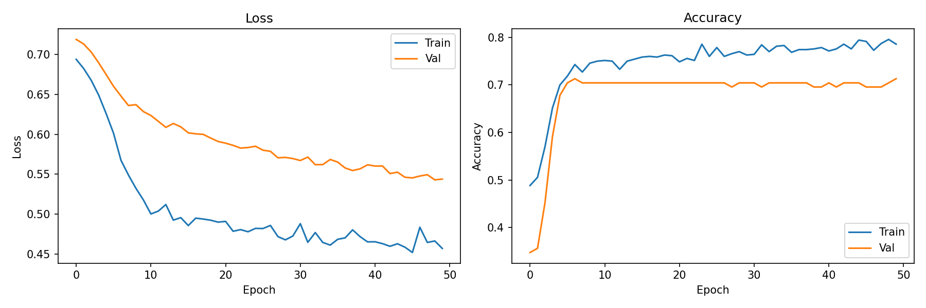
Model 3 — MLP Neural Network
Feed-forward network with early stopping and learning-rate scheduling
Network Architecture
Test-Set Performance (n=116)
Input Layer
5 neurons (selected features)
Accuracy
Precision
↓
76.7%
67.5%
Dense Layer 1
16 neurons + ReLU activation
↓
Recall
F1 Score
Dropout
rate = 0.2 (regularisation)
65.9%
66.7%
Dense Layer 2
↓
8 neurons + ReLU activation
↓
ROC-AUC
Output Layer
1 neuron + Sigmoid → P(diabetes)
0.875 ★
Loss function:
BCEWithLogitsLoss (numerically stable)
★ Highest ROC-AUC of all three models
Optimiser:
Adam (lr=0.001)
LR Scheduler:
ReduceLROnPlateau (factor=0.5, patience=5)
Training Curves
Epochs:
Up to 50 (early stopping at patience=10)
Batch size:
32
Jamshaid Amjad | AI in Healthcare — Capstone Project | May 2026 [11/15]

Slide 12
Training Strategy & Cross-Validation
Rigorous evaluation methodology to ensure reliable, unbiased results
Evaluation Strategy
▸ Held-out Test Set:
15% of data (n=116) — never seen during training or tuning
▸ Validation Set:
15% for early stopping & hyperparameter guidance (n=115)
▸ Train Set:
70% for fitting (n=538 raw, n=700 after SMOTE)
5-Fold Cross-Validation (LR & RF)
GridSearchCV — Random Forest
1. Combine train + validation set (n=653)
Search space:
24 combinations (2×3×2×2)
CV folds:
5-fold (same as CV above)
2. Split into 5 equal folds (~131 samples each)
Scoring:
F1 score
3. Train on 4 folds, evaluate on 1 fold — repeat 5×
Best CV F1:
0.8299
4. Report mean F1 ± standard deviation
Best params:
max_depth=10, n_estimators=100
SMOTE — Class Balancing
5. Best RF params from GridSearch applied to final model
▸ Training set: 65% negative / 35% positive (imbalanced)
▸ SMOTE generates synthetic minority (diabetic) samples
▸ After SMOTE: 350 positive / 350 negative — 50/50
▸ Applied to training set ONLY — val/test remain real data
Model
CV F1 Mean
Std Dev
Fold Scores
Logistic Regression
0.718
±0.029
[0.736, 0.685, 0.682, 0.748, 0.739]
Random Forest
0.801
±0.042
[0.756, 0.769, 0.840, 0.862, 0.778]
Jamshaid Amjad | AI in Healthcare — Capstone Project | May 2026 [12/15]

Slide 13
Performance Results — Test Set (n=116)
Held-out evaluation on 15% of data — never seen during training or hyperparameter selection
Complete Metrics — All Models vs. Majority Baseline
Model
Accuracy
Precision
Recall
F1 Score
ROC-AUC
Δ Base
Logistic Regression
0.776
0.683
0.683
0.683
0.866
+36.6%
Random Forest
0.767
0.694
0.610
0.649
0.841
+34.1%
MLP Neural Network
0.767
0.675
0.659
0.667
0.875
+37.5%
Majority Baseline
0.647
N/A
0.000
0.000
0.500
—
★ Green values = best in column | Δ Base = improvement over majority-class baseline AUC
Best Overall Accuracy
Best Precision
Best ROC-AUC
Best CV Stability
Logistic Regression 77.6%
Random Forest 69.4%
MLP Neural Net 0.875
Random Forest F1 0.801 ± 0.042
Jamshaid Amjad | AI in Healthcare — Capstone Project | May 2026 [13/15]

Slide 14
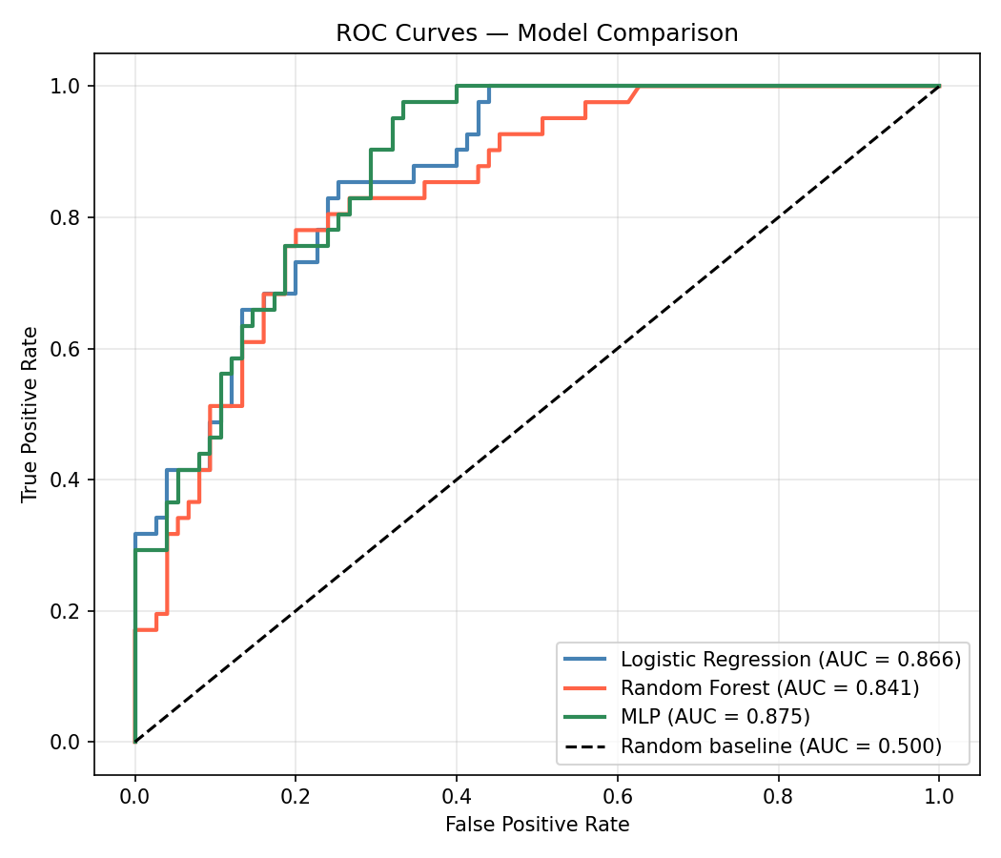
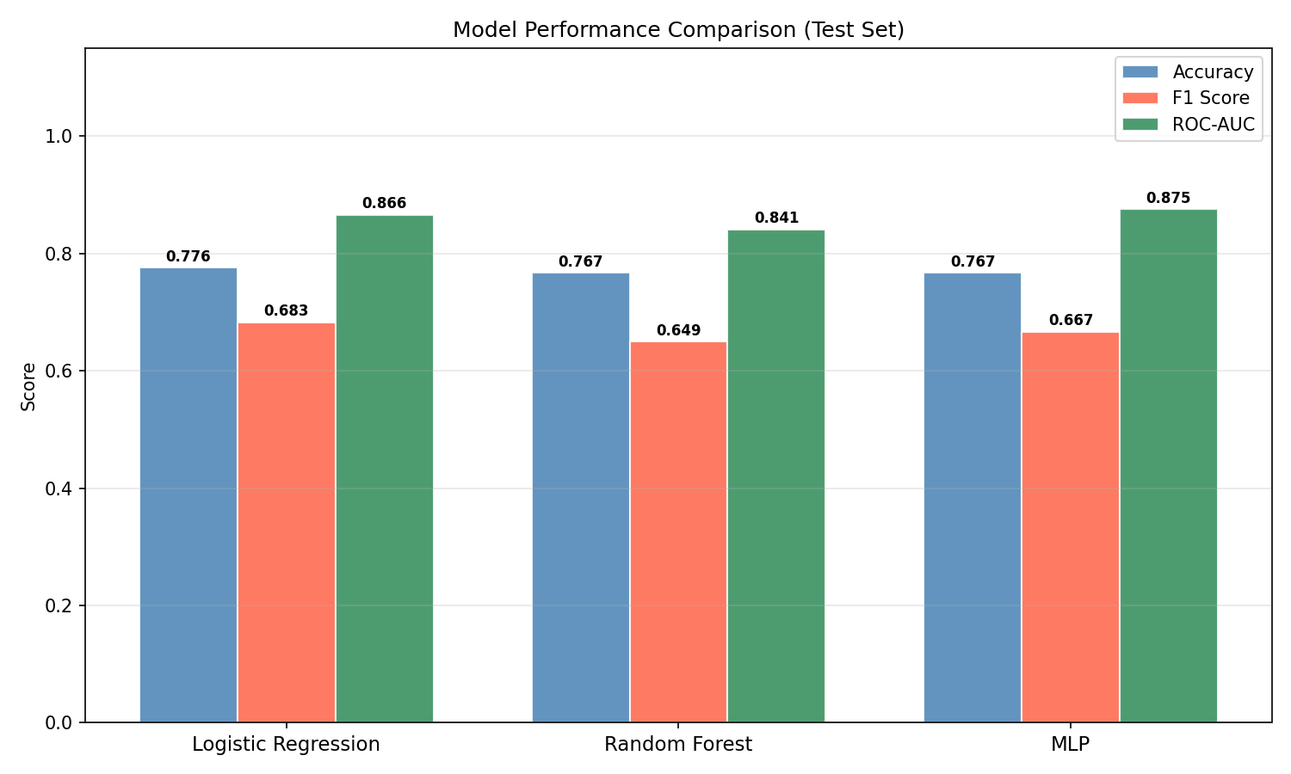
Model Comparison — ROC Curves & Performance Charts
Visual evaluation of discrimination ability and metric trade-offs
ROC Curves — All Models vs. Baseline
Accuracy / F1 / ROC-AUC by Model
Interpretation
▸ All models substantially outperform random (AUC=0.500)
▸ MLP leads on ROC-AUC — best probabilistic triage tool
▸ LR leads on F1 — best balanced classifier for deployment
▸ RF most stable across CV folds (std=0.042)
▸ Accuracy differences small (~1%) — ROC-AUC is the key metric
LR: AUC=0.866
RF: AUC=0.841
MLP: AUC=0.875
Jamshaid Amjad | AI in Healthcare — Capstone Project | May 2026 [14/15]

Slide 15
Conclusion & Future Work
Key findings, clinical implications, limitations, and next steps
Key Findings
Limitations
All models ROC-AUC > 0.84
⚠ Small dataset (n=768) — Pima women only, poor external validity
Routine clinical measurements are sufficient for meaningful diabetes screening
⚠ High missingness in Insulin (49%) limits feature reliability
MLP achieves best AUC (0.875)
Non-linear feature interactions add discriminative value over linear models
⚠ No prospective or multi-centre validation performed
Logistic Regression best F1 (0.683)
Interpretable linear model remains competitive and is preferred in clinical contexts
⚠ Temporal bias: dataset from 1988, population may have shifted
Glucose + BMI are top predictors
Future Work
Consistent across ANOVA, RF importance, and clinical literature
→ Validate on larger, diverse multi-ethnic cohorts
SMOTE + selection + tuning matter
Each preprocessing step contributed measurable improvement to final performance
→ Add HbA1c and fasting glucose as additional features
→ Implement calibration curves for probability reliability
→ Fairness audit across age, sex, and ethnic subgroups
Thank you | Questions?
→ Deploy as REST API with explainability (SHAP) layer
Code: github.com/JamshaidAmjad/AI-Diabetes-Prediction

