Slide 1


Master's Thesis Progress Report
Friday, July 10th
Focus:
Jamshed Karimnazarov

Slide 2

Table of contents
1. Component 1: Knowledge Base construction— Slide 3
2. Input data preparation— Slides 4
3. Hallucinations discovery LLM - 2a — Slide 5-6
4. My solution — Slide 7-10
6. Next steps— Slide 11
Total: 11 Slides

Slide 3
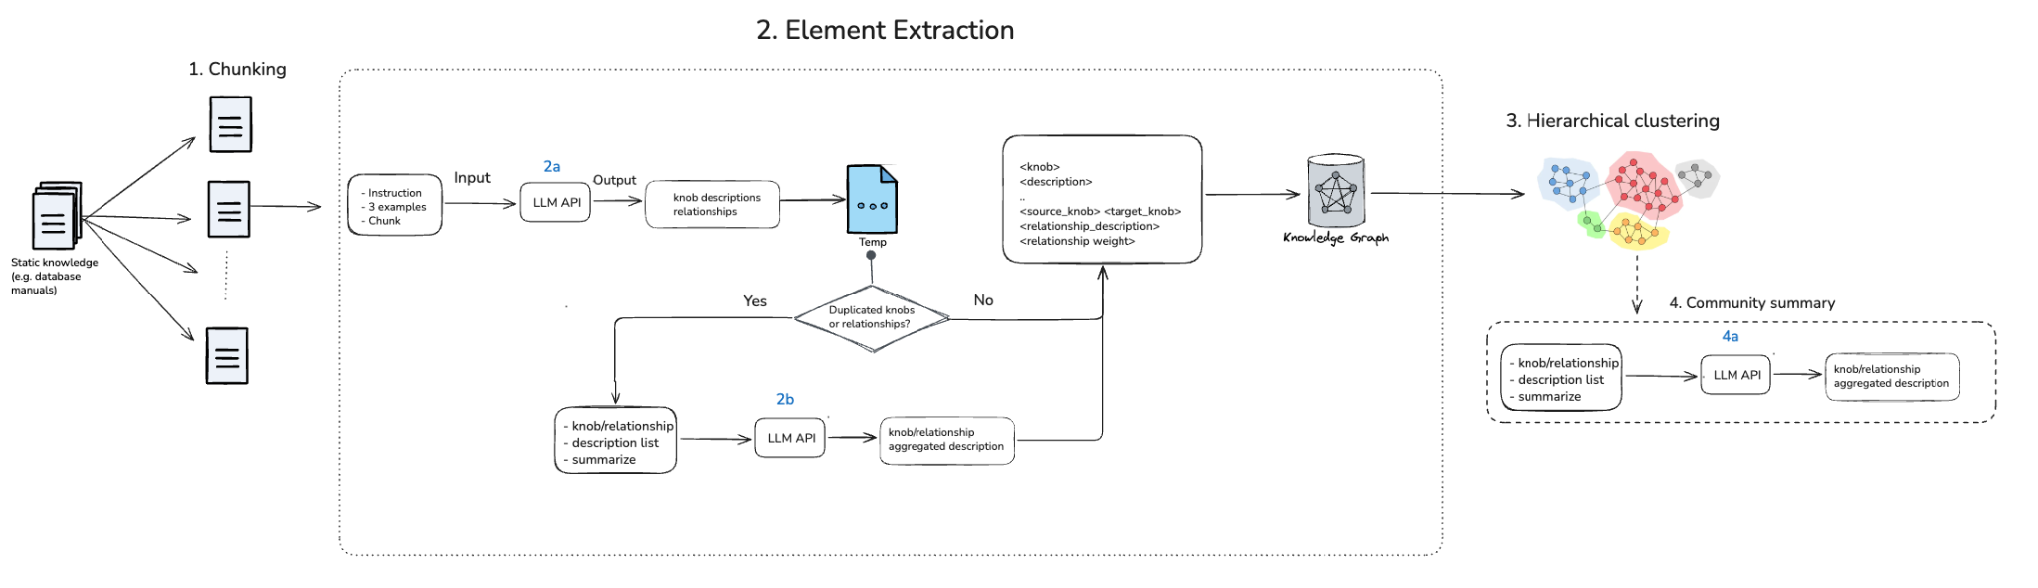
Component 1: Knowledge Base construction
Notes:
Decision, have to be yes or no. Is this condition true or not. If it’s not true, where I go.
Fixed the second LLM API.
Instead of having structured data, you can ingest in YAML format.
ToDo: - Take a section of the database manual maybe and only process that.
At the same time come up with a general framework for your prompt so it works for any DBMS, not just MySQL

Slide 4
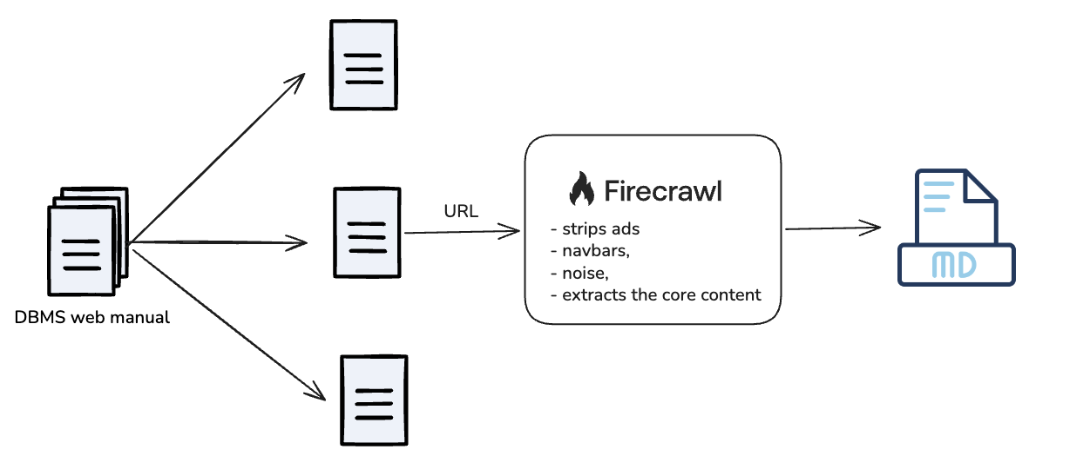
Input data preparation
DBMS manual:
PDF
RABBIT does not take input as PDF files
PDF to text conversion is challenging
Web
HTML tags noise
Utilize existing tools to extract core text
Select 3 pages:
InnoDB parameters
Internal Temporary Table
What the MySQL Upgrade Process Upgrades
Total: 184 knobs

Slide 5
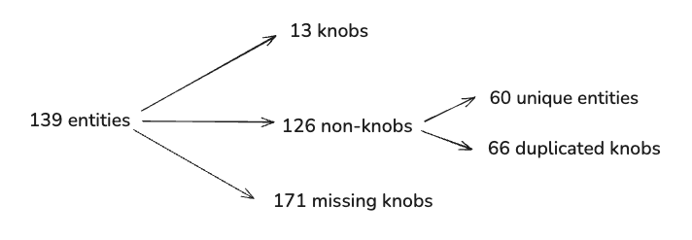
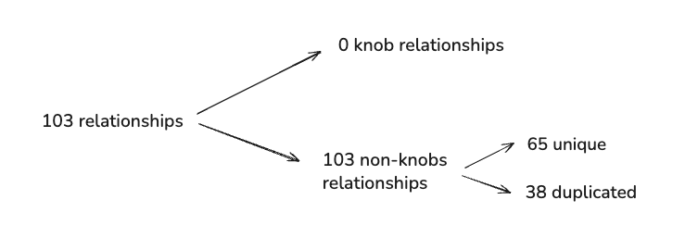
2. Element extraction - LLM 2a
Goal: Extract from chunks
All knobs + descriptions
All knob relationships + description
Hallucination type: Entity and relationship error

Slide 6
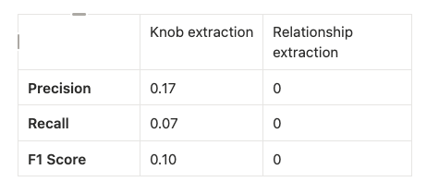
Precision and Recall

Slide 7
Solution
Focus on LLM-2a component where most of the hallucination happens
Cause of hallucination:
Default GraphRAG prompt
Default entity types

Slide 8
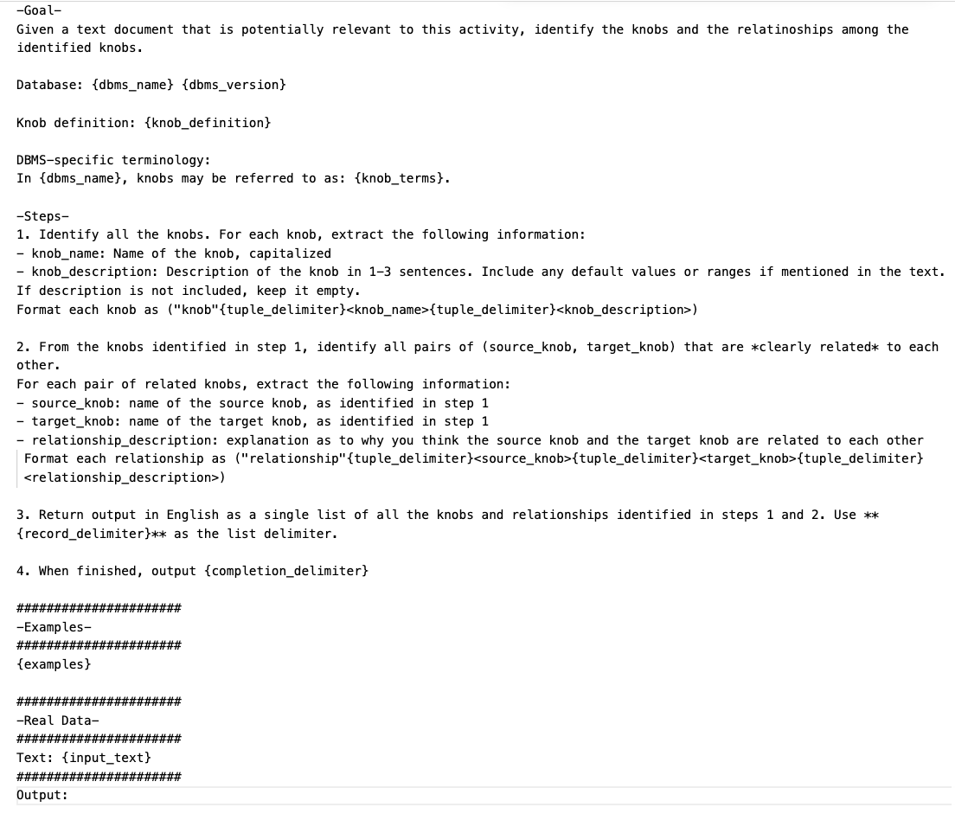
Prompt Template

Slide 9
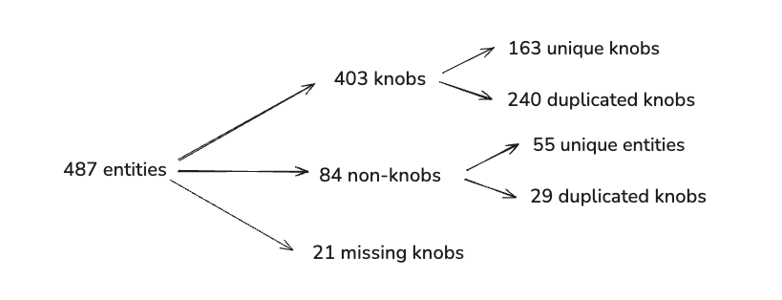
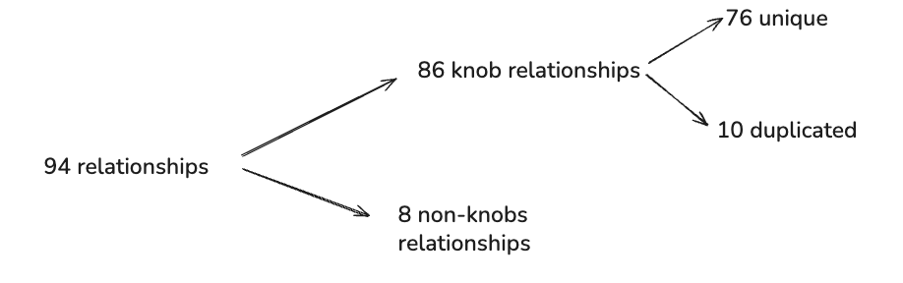
2. My solution: Element extraction - LLM 2a
Knobs
Relationships

Slide 10
My solution: Element extraction - LLM 2a
Knobs
Precision: 0.74 (0.17)
Recall: 0.88 (0.07)
F1-score: 0.80 (0.10)
Relationships
Precision: 0.9 (0.75)
Recall: NA (0.00)
F1-score: NA (0.00)
Notes:
What is the general approach to improve this. You need to give more specific information, what does that mean? You need to give a template, what the LLM should be tasked with. If I give more precise information, I may be able to improve the performance. This example, validates this hypothesis, but this is just an example. You need to come up with a general approach. You need to be able to test and validate your hypothesis.

Slide 11
Next steps
01 Count the number of relationships in the input file
02 Calculate Recall and F1 score for my solution
02 Come up with a solution to filter the input data
Notes:
Do not use structural and semantic hallucinations. Do not follow what you said a few weeks ago. What is structural for Gemini, is different for taxonomy.

Slide 12
Appendix

Slide 13
