Slide 1











Introducing DataSpeak: Transforming Data Access
DataSpeak lets users ask business questions and get instant answers — no SQL, no IT tickets. Empowers faster, data-driven decisions and removes delays for executives and analysts.
Amal Jose

Slide 2




The Data Bottleneck: Slow Access, Big Cost
Delayed analytics deprives teams of timely insights and drives measurable losses
Average wait for answers from IT/analytics: 3–5 days
Finance teams spend 40% of their time waiting — Sarah Chen, CFO
Estimated annual cost to mid-sized enterprises: $12.9M
73% of business decisions proceed without adequate data support
Outcome: delayed access undermines timely, actionable insights and competitive advantage

Slide 3






DataSpeak: From Tickets to Real-Time Answers
Traditional Data Requests
DataSpeak Real-Time Interaction
Average wait: 3–5 Days for answers
Vs
Answers in seconds with instant follow-ups
IT/Analytics tickets and back-and-forth clarifications
Replace 3–5 day waits with instant, exportable insights to speed decisions
Direct export, share, and schedule insights
High IT bottleneck; lowers agility
Limited ability for follow-up exploration
Empowers users; reduces IT load
Accelerates decision cycles and data literacy

Slide 4




Three Simple Steps to Data‑Driven Decisions
Ask in plain English, let AI interpret context, get instant tables, charts, and shareable insights
Ask
Understand
Deliver
Type questions in plain English using familiar business terms (no SQL, no IT tickets).
AI interprets intent in context and retrieves relevant data instantly.
Results in tables, charts, and insights; export or share. Example: top products in California last month returned in under five seconds.

Slide 5





Finance & Banking
Retail & E‑Commerce
Healthcare
Track patient wait times and throughput
Monitor quarterly revenue vs forecasts
Identify at-risk SKUs and reduce stockouts
Monitor clinical trial enrollments
Manage payment delays and optimize cash flow
Analyze seasonal sales trends and promotions
Tailored Solutions Built for Your Industry
Support industry-specific compliance and operational needs
Analyze expense variances for faster decisions
Optimize inventory and margin performance
Instant, compliance-ready metrics for Finance, Retail, and Healthcare — empower analysts and executives

Slide 6

Measurable Impact: Real Results from Customers
How DataSpeak frees IT, speeds decisions, and cuts costs through self-service analytics
85 %
40 %
IT relief from routine requests
Faster decision-making
Self-service analytics accelerates access to real-time data and reduces manual reporting
Frees 85% of IT teams to focus on strategic work
Enables 40% better decision speed via self-service access
Increased data literacy across the workforce drives proactive, strategic analysis
Shift focus from waiting for static reports to strategic actions
2.4m
Summary: measurable gains in efficiency, speed, and cost from enabling data democracy
Cost savings realized
$2.4 million saved by increasing data democracy

Slide 7








Enterprise-Grade Security and Compliance
Comprehensive controls and certifications to protect sensitive data in regulated environments
Role-based access control with strict row-level security to restrict data by user
SOC 2, HIPAA, GDPR, PCI-DSS supported for regulatory compliance
Deployments in on-premises or private cloud so data stays within customer environments
Encryption in transit & at rest plus PII masking for data protection
SSO / SAML integration and comprehensive audit trails for access and activity logging
Automated query guardrails to enforce safe analytics and compliance readiness

Slide 8
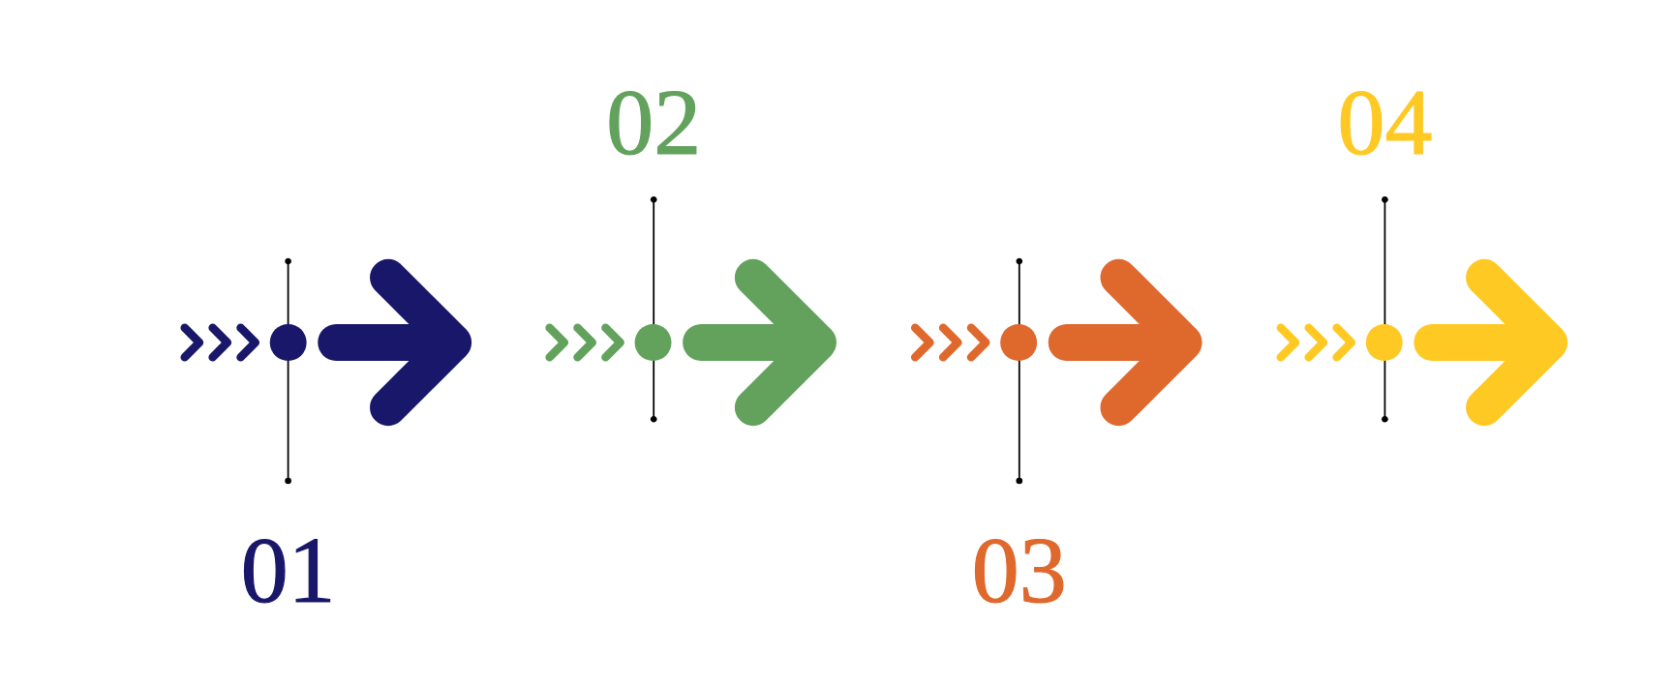
Fast Time-to-Value: Accelerated Deployment
Deploy DataSpeak in eight weeks with zero disruption and continuous learning
Discovery
Pilot
Analyze schemas and map use cases; define success criteria. Benefit: faster, targeted rollout.
Test with power users, refine prompts and UX; collect feedback. Benefit: rapid adoption and system learning.
Configuration
Go Live
Connect databases, set read-only access and access controls. Benefit: zero disruption to production.
Full rollout with training, dedicated team and 24/7 support. Benefit: sustained value delivery.

Slide 9


DataSpeak (Built for Enterprise)
Generic AI Tools (Adapted for Data)
Understands business-specific terms and learns user query patterns
Designed for general use; limited business terminology awareness
Why DataSpeak? Clear Competitive Advantage
Role- and row-level security; keeps data within organizational boundaries
Often lacks native role/row-level enforcement
Variable performance; not optimized for sub-second responses
Sub-second query response times with enterprise-grade SLAs
Secure, fast, business-aware data access built for enterprise scale
Standard support models; SLAs not always enterprise-grade
Dedicated enterprise support; trusted by Fortune 500 companies
Higher risk of data egress or boundary gaps in complex environments
Secure, compliant, and tailored for complex environments

Slide 10














Accelerate Decisions With immediate Data Insights — No SQL, No IT Tickets
Empower Teams — Reduce Wait From 3-5 Days To Near Real-time Access
Ready to Transform Your Data Access?
Proof Options: demo, pilot, Or 4-week Proof Of Value With Measurable Business Impact
Request a demo, start a pilot, or join a 4-week proof of value to see measurable impact
Contact: enterprise@dataspeak.ai To Request Engagement
Outcome: Ask Questions. Get Answers. Drive Decisions.

