Slide 1
Week 1 · Lecture 1
A systems approach to urban transport
LEC1 · Urban Transport Systems Planning and Design · TSTU · Prof. J. Sodikov

Slide 2
What you will be able to do after today
• Describe an urban transport system as networks, services, infrastructure and operations
• Tell the movement of vehicles apart from people's ability to reach destinations
• Define a transport problem, its system boundaries and the users it affects
• Start the course project on your own Tashkent corridor
2 / 26

Slide 3
How this course is built
• Technical backbone: methods for designing transport systems
• Policy backbone: urban transport planning and policy (justice, governance, decarbonisation)
• One city as the case: Tashkent, with research by TSTU students and staff
• One corridor per student or team, carried through all fifteen weeks
• Tools: QGIS and spreadsheets; every number traceable to a source
3 / 26

Slide 4
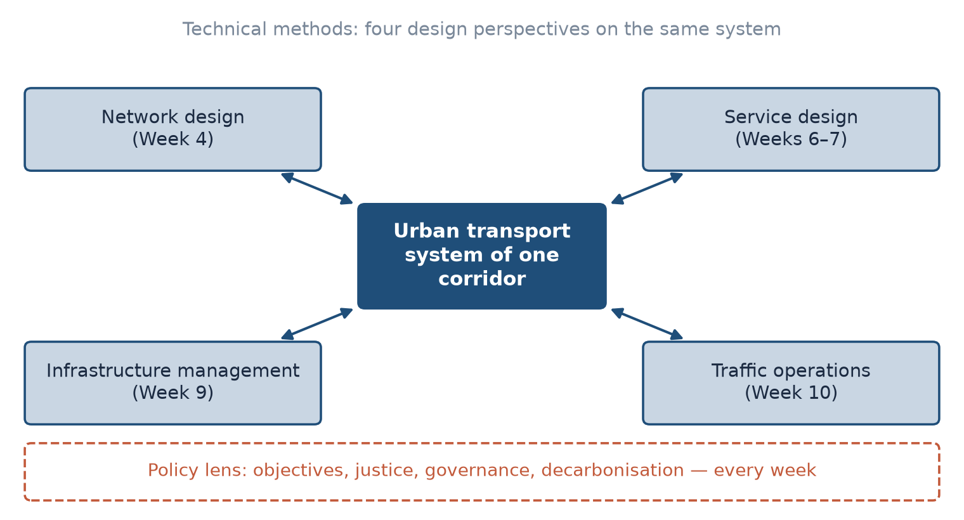
Four design perspectives, one policy lens
The technical methods look at the same system as a network, a set of services, physical assets and operations; the policy lens runs through every week.
4 / 26

Slide 5
What makes it a system?
• Elements: links, nodes, vehicles, services, users, operators, rules
• Interactions: a new bus lane changes car speeds, walking routes and shop deliveries
• Boundary: what you analyse in detail versus what you treat as given
• Feedback: faster roads change where people live and work over years
• Outcomes emerge from the whole, not from any single element
5 / 26

Slide 6
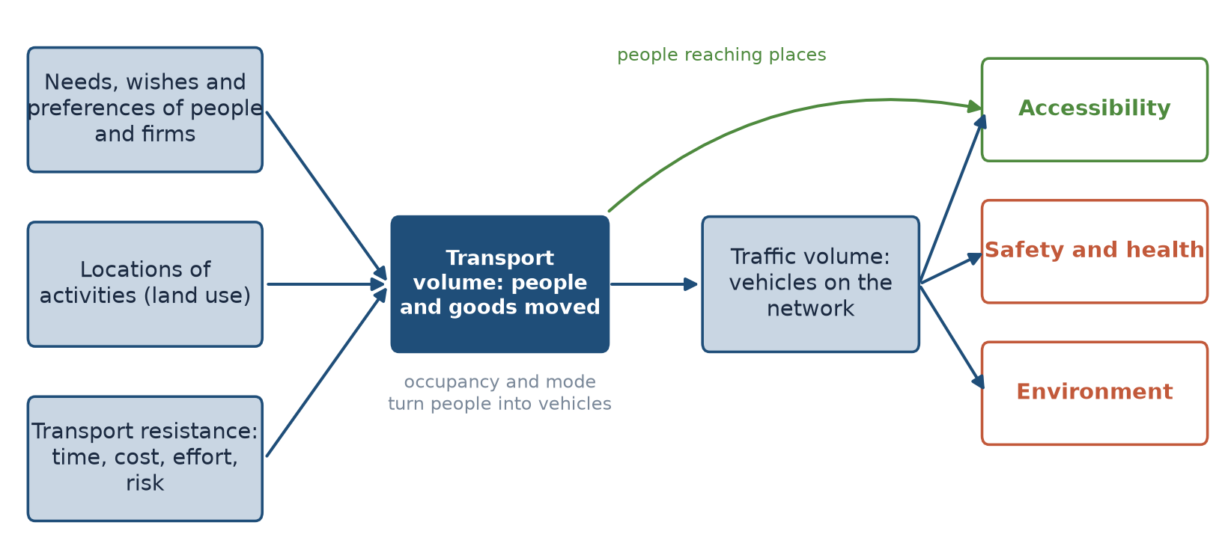
The transport system and its effects (after van Wee et al.)
Redrawn and simplified from the conceptual model in van Wee et al. (2023, ch. 2).
6 / 26

Slide 7
People moved are not vehicles moved
• Transport volume counts people and goods; traffic volume counts vehicles
• A full bus and a single-occupant car are each one vehicle in a traffic count
• Policies that maximise vehicle flow can reduce the number of people served
• Week 2 practical: compare vehicle flows with person flows on your corridor
7 / 26

Slide 8
Mobility versus accessibility
• Mobility: how far and how fast people can move
• Accessibility: how easily people can reach the activities they need
• Four components (Geurs & van Wee): land use, transport, time, the individual
• More mobility can mean less accessibility if activities spread out
• Plan for accessibility; treat speed as one means among several
8 / 26

Slide 9
Tashkent: moving vehicles or reaching places?
• Evidence from TSTU research by Ergashova, Normukhammadov and Pulatova
9 / 26

Slide 10
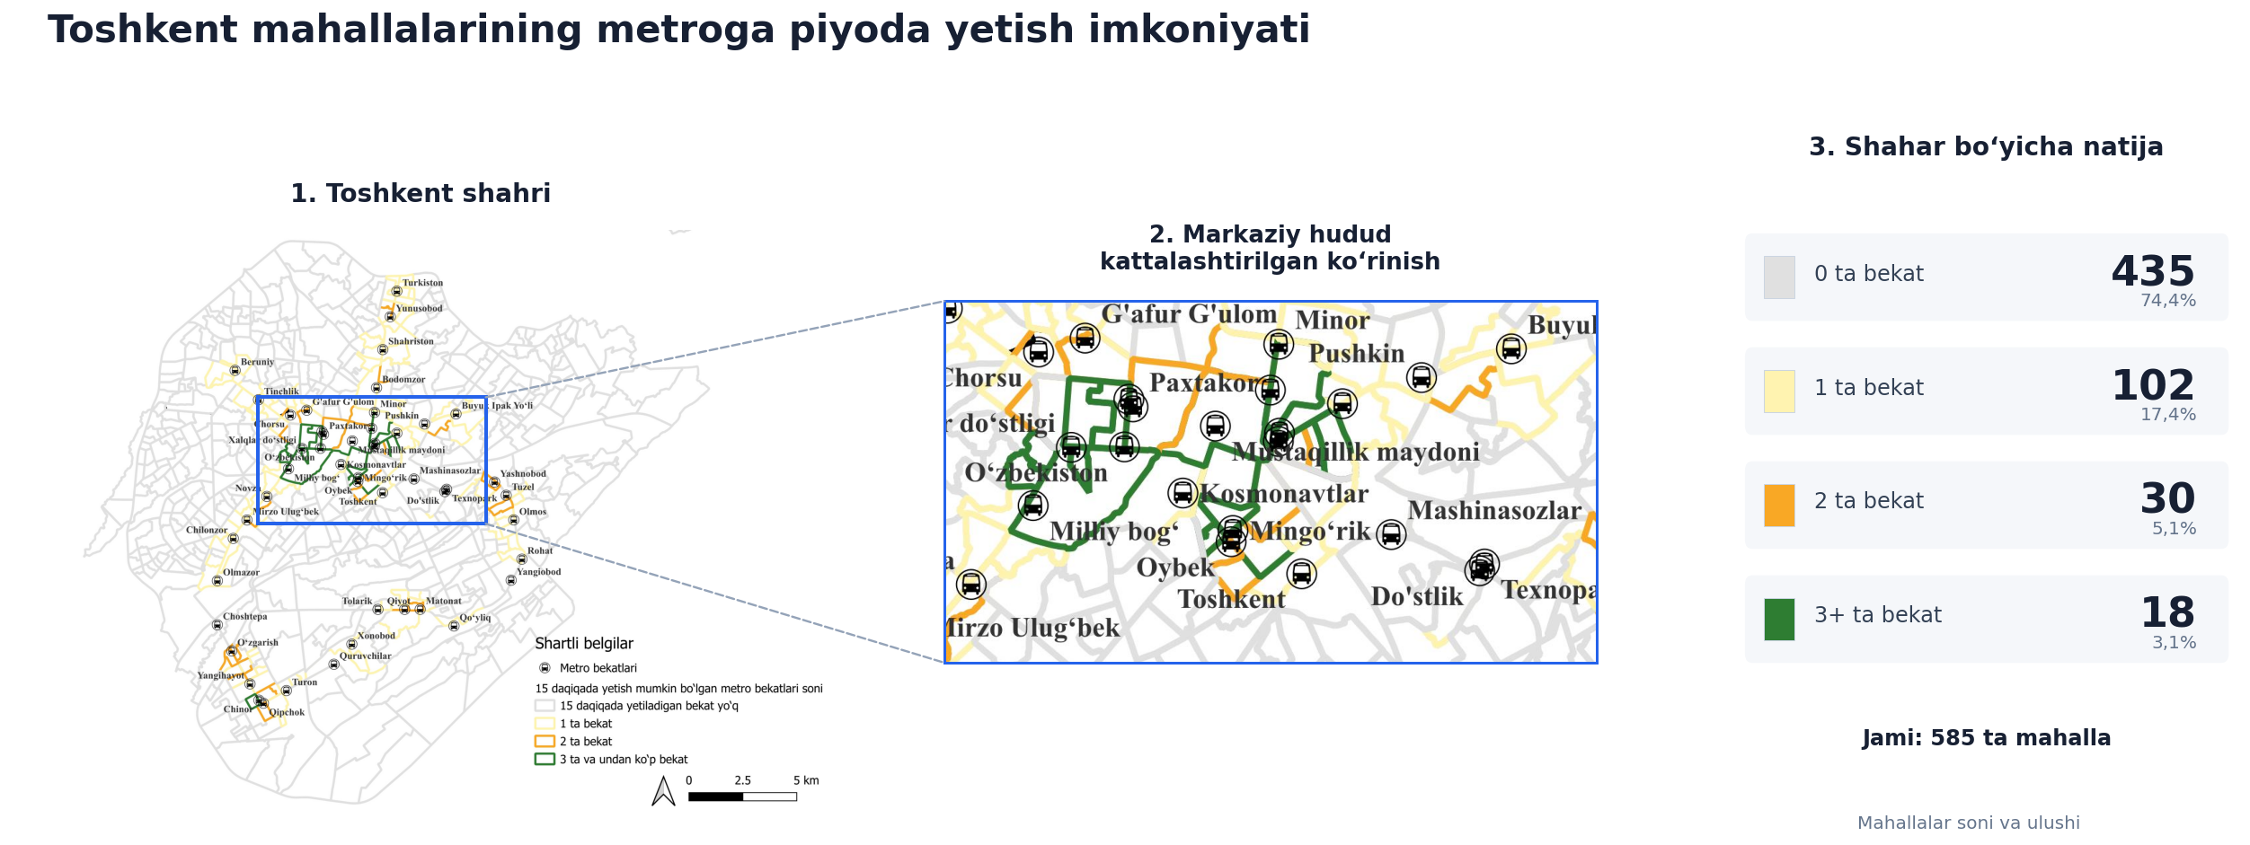
Walking to the metro: 585 mahallas
Ergashova (2026): 435 mahallas (74.4%) have no metro station within a 15-minute walk. Figure reproduced with permission (Uzbek labels).
10 / 26

Slide 11
Infrastructure built is not access delivered
• Tashkent has 49 metro stations (OSM), yet 74.4% of its 585 mahallas cannot reach one within a 15-minute walk
• 222.7 km of protected cycle paths connect only 4 of 4,095 district-scale origin–destination pairs
• Both are systems problems: the parts exist, the connections do not
• Indicators that count kilometres or stations miss this
11 / 26

Slide 12
Defining the problem
• Before alternatives: what is wrong, for whom, where and when?
12 / 26

Slide 13
Planning is a process, not a calculation
• A published course on urban transportation planning sets out 'The Planning Method' as a 19-step process
• The course keeps environment, economy and equity (the 'three E's') in view together
• SUMP Guidelines: start from problems and opportunities, not from a preferred project
• SUMP Guidelines: involve the people affected throughout and expect to iterate
• Our simplified cycle on the next slide is a synthesis of both, not the 19-step list
13 / 26

Slide 14
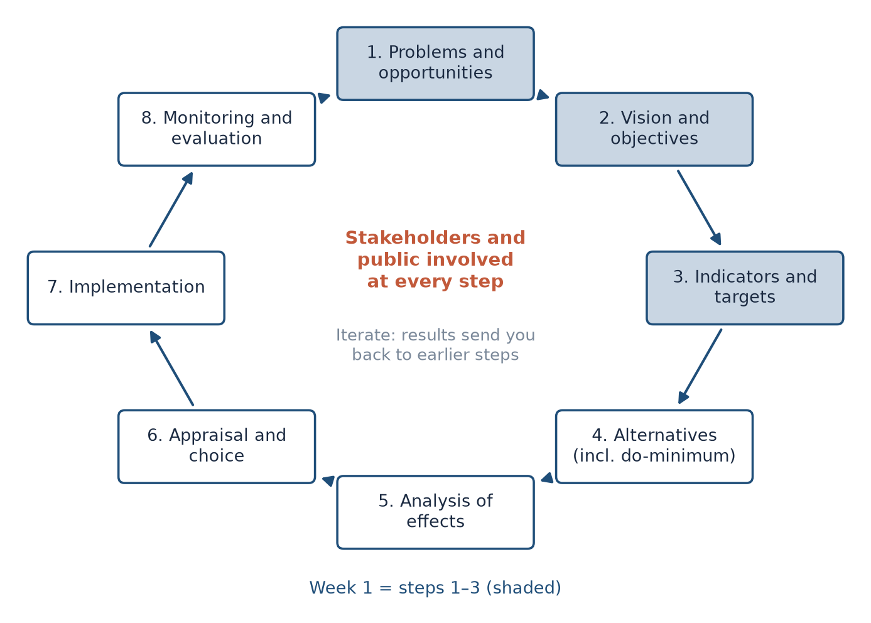
A planning cycle for this course
Synthesis of 'The Planning Method' and the SUMP Guidelines; Week 1 covers steps 1–3.
14 / 26

Slide 15
Symptoms, causes and disguised solutions
• Symptom: queues at a junction. Possible causes: signal timing, turning traffic, parked cars, land use
• 'We need a flyover' is a solution presented as a problem
• A problem statement names who is affected, where, when and how much
• Problem tree: one core problem, its causes below and its effects above
• Objectives come from reversing the tree: effects become goals, causes become levers
15 / 26

Slide 16
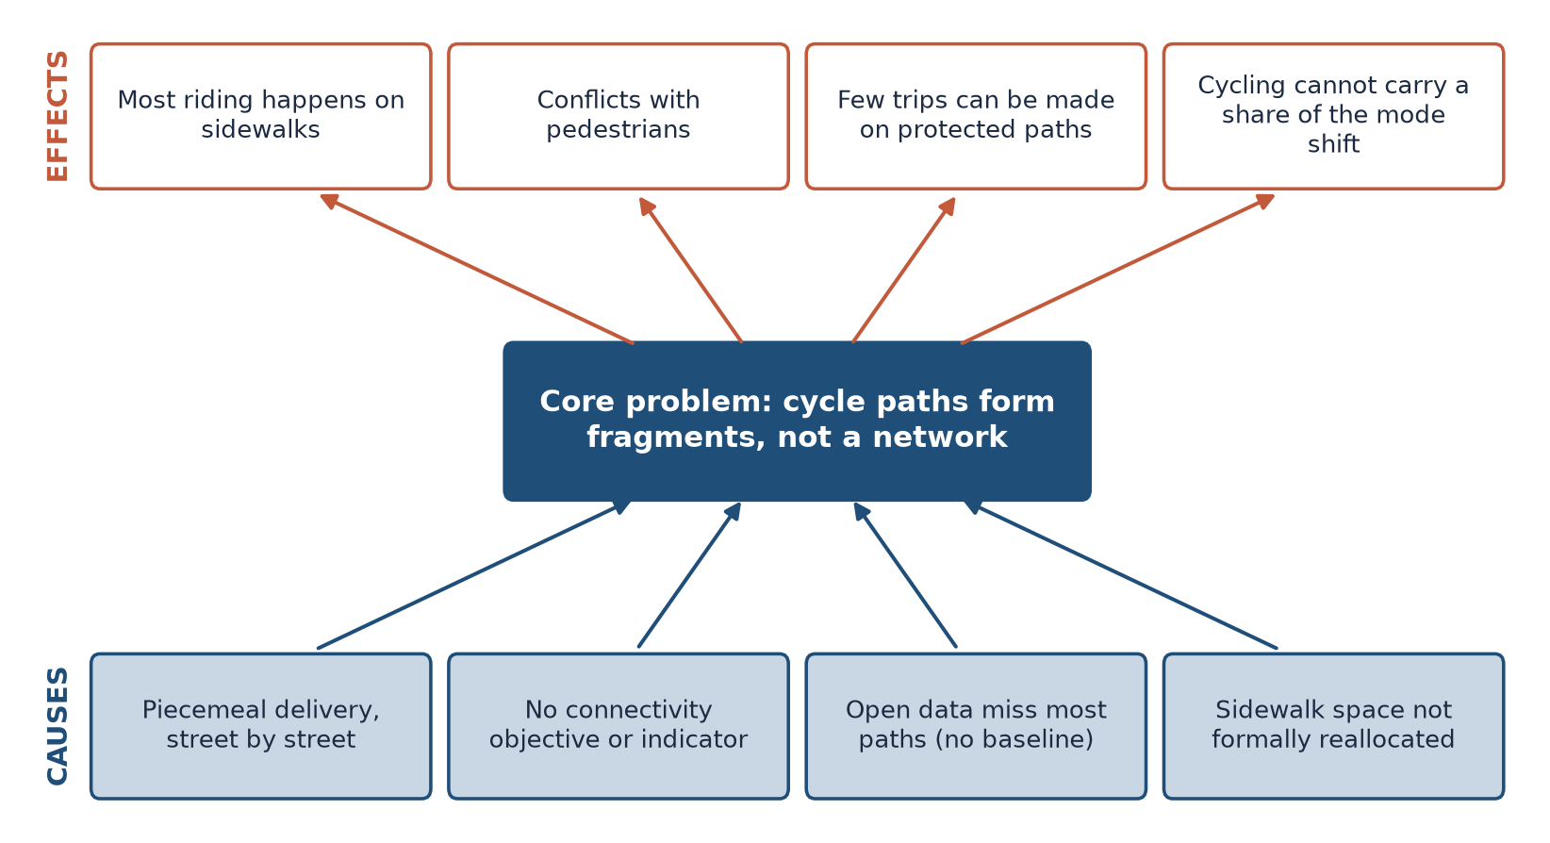
Problem tree: Tashkent's cycle network
Built from the problem statement in Normukhammadov (2026, ch. 1): composition, connectivity, strategy and data problems.
16 / 26

Slide 17
A well-framed problem: Normukhammadov (2026)
• Composition: 66.4% of riding took place on sidewalks
• Connectivity: protected paths form 149 disconnected fragments
• Strategy: which links to build first with a limited budget
• Data: OpenStreetMap shows 8.4 km of cycle track; the field audit found 238.7 km
• Each dimension has a measurable indicator and a research question
17 / 26

Slide 18
Drawing the system boundary
• Spatial: the corridor plus the area whose trips use it and where effects spill over
• Temporal: peak hour, whole day, season; one assessment year for all alternatives
• Modal: walking, cycling, public transport, car and freight together
• Institutional: which organisations decide, pay and operate
• Too narrow a boundary hides displaced problems, such as traffic moving to parallel streets
18 / 26

Slide 19
Users and their needs
• Residents, commuters, pupils, older people, people with disabilities, couriers, shopkeepers
• Needs differ: time, cost, safety, comfort, dignity, reliability
• Non-users are affected too: noise, air quality, severance
• Pulatova's survey: 73.1% report no infrastructure for people with disabilities
• 66.1% say pedestrian crossings are missing (sample size not reported)
19 / 26

Slide 20
Know your data before you define the problem
• Open data under-record what exists: 8.4 km of cycle track in OSM versus 238.7 km on the street
• 4.79% of mahallas have no footway recorded in OSM — not recorded is not absent
• Record source, date, coverage and limitations of every dataset (LAB1)
• A problem defined on a wrong baseline leads to the wrong solution
20 / 26

Slide 21
Where the city meets the region
• Entry corridors carry commuters, intercity buses and freight into local streets
• The M-41 corridor study used mixed methods to read traffic patterns and safety
• If your corridor touches the ring road or an entry road, include the external flows in the boundary
21 / 26

Slide 22
Discussion
For your corridor: what is the problem, for whom — and what would you see on the street if it were solved?
• Write one sentence. Then name one effect and one cause.
22 / 26

Slide 23
Key takeaways
• Plan for people reaching places; vehicles moved are only a means
• A problem statement names who, where, when and how much — without a solution
• Draw the boundary wide enough to catch displaced effects
• Check your data before you trust your problem
23 / 26

Slide 24
Before LEC2, P1 and LAB1
• Choose a candidate corridor and agree it with the instructor
• Read van Wee et al. (2023), chapters 1–2
• Install QGIS (current LTR) and open LAB01_base_map.gpkg
24 / 26

Slide 25
References
• TU Delft, Department of Transport & Planning. CIEM6250 Transport Systems Design — units B-1 Network Design, B-2 Service Design, B-3 Physical Infrastructure Management, B-4 Traffic Operations Management (Smart Public Transport Lab education page; MSc Civil Engineering TTE track). https://www.tudelft.nl/citg/over-faculteit/afdelingen/transport-planning/research/labs/smart-public-transport-lab/education
• MIT Department of Urban Studies and Planning. 11.540 Urban Transportation Planning and Policy (J. Aloisi). MIT Course Catalog, Course 11 subjects. https://catalog.mit.edu/subjects/11/
• van Wee, B., Annema, J. A., Banister, D., & Pudāne, B. (Eds.) (2023). The Transport System and Transport Policy: An Introduction (2nd ed.). Edward Elgar. https://rstrail.nl/the-transport-system-and-transport-policy-an-introduction/
• Salvucci, F. (2016). 1.252J/11.540J Urban Transportation Planning, Fall 2016. MIT OpenCourseWare. https://ocw.mit.edu/courses/1-252j-urban-transportation-planning-fall-2016/
• Geurs, K. T., & van Wee, B. (2004). Accessibility evaluation of land-use and transport strategies: review and research directions. Journal of Transport Geography, 12(2), 127–140. https://doi.org/10.1016/j.jtrangeo.2003.10.005 https://doi.org/10.1016/j.jtrangeo.2003.10.005
• Ergashova, M. Z. (2026). 15-minute walkability of Tashkent mahallas — dissertation defence presentation, 14 Oct 2026 (in Uzbek). Tashkent State Transport University.
• Normukhammadov, A. (2026). Pedalling Towards Sustainability: Developing an Integrated Bicycle Network for Enhanced Urban Mobility in Tashkent City (PhD thesis draft; supervisor J. I. Sodikov). Tashkent State Transport University.
• Pulatova, Z. S. (2024). Walkability assessment of Tashkent city districts (PhD dissertation, in Uzbek; supervisor J. I. Sodikov). Tashkent State Transport University.
• OpenStreetMap contributors (2026). Uzbekistan extract, Geofabrik GmbH (download.geofabrik.de). https://download.geofabrik.de/asia/uzbekistan.html
• Rupprecht Consult (Ed.) (2019). Guidelines for Developing and Implementing a Sustainable Urban Mobility Plan (2nd ed.). European Commission / Eltis. https://www.eltis.org/mobility-plans/sump-guidelines
• Sodikov, J. I., et al. (2026). Traffic pattern and safety evaluation on the M-41 corridor using mixed-methods analysis. AIP Conference Proceedings (2025 Int. Conf.).

Slide 26
© 2026 TSTU, J. Sodikov. CC BY-NC-SA 4.0. Adapts openly licensed material (CC BY-NC-SA 4.0) listed in the references.

