Slide 1
Week 1 · Lecture 2
Objectives of contemporary transport policy
LEC2 · Urban Transport Systems Planning and Design · TSTU · Prof. J. Sodikov

Slide 2
What you will be able to do after today
• Distinguish goals, objectives, targets and indicators
• Explain the five policy objectives and where they conflict
• Read a city's transport targets critically
• Define measurable outcome indicators for a Tashkent corridor
2 / 25

Slide 3
From problems to objectives
• Vision: the kind of city we want (qualitative)
• Objective: a direction of change (more, less, safer, fairer)
• Target: a value and a date for an indicator
• Indicator: what is measured, how, by whom, how often
• Measures (projects, policies) come after, and are judged against the objectives
3 / 25

Slide 4
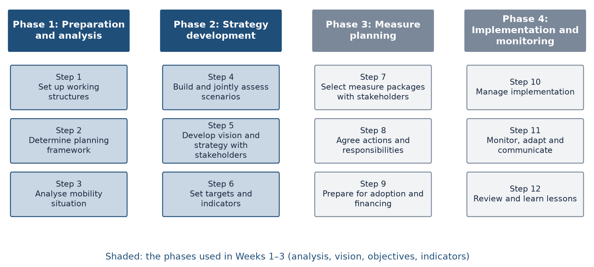
The SUMP cycle: where objectives sit
SUMP Guidelines (2019): 4 phases, 12 steps. Weeks 1–3 use Phases 1–2.
4 / 25

Slide 5
Five objectives of contemporary transport policy
• Mobility: ease and speed of movement
• Accessibility: reaching jobs, schools, services and each other
• Safety: fewer deaths and serious injuries, especially of vulnerable users
• Efficiency: resources (space, money, energy) per person served
• Environmental sustainability: emissions, air quality, noise, land
• Cutting across all five: who gains and who pays (equity)
5 / 25

Slide 6
Objectives, indicators and Tashkent data
Objective | Example indicator | Where Tashkent data come from
Mobility | Door-to-door travel time on the corridor | Field runs, GPS tracks (Week 2)
Accessibility | Residential land within a 15-minute walk of a metro station | OSM network + residential land (LAB3)
Safety | Recorded deaths and serious injuries per year | Police register (Week 2)
Efficiency | People moved per lane per hour | Classified and occupancy counts (P2)
Environment | Corridor CO2 and NOx per day | Activity × emission factors (LAB13)
6 / 25

Slide 7
Three E's: environment, economy, equity
• Urban transport decisions trade environment, economy and equity against each other
• No technical method removes the trade-off; it makes it visible
• Planning is also politics: who sets the objectives decides the answer
• Week 12 returns to institutions and participation
7 / 25

Slide 8
Goals conflict by design (Walker)
• Public transport is asked to maximise ridership and to cover everyone
• Ridership favours frequent service where demand is dense
• Coverage spreads service thinly so that no area is left out
• The same budget cannot do both — so decide the split explicitly
8 / 25

Slide 9
Where objectives collide
• Speed versus safety: faster arterials raise the stakes at every crossing
• Vehicle capacity versus bus priority: one lane, two uses
• Cycling versus walking: gap closure puts 94% of new cycle links on sidewalks
• Coverage versus frequency in public transport
• Short-term traffic relief versus long-term induced demand
9 / 25

Slide 10
Tashkent's objectives today
• What the city has said it wants — and what is missing
10 / 25

Slide 11
Tashkent context in numbers
• 3.04 million residents at the start of 2024
• 197 cars / 1,000 residents in 2023, the highest in the country
• Private vehicles in Uzbekistan growing by ≈7.5% a year
• 79% of trips by private car, by a 2022 presidential briefing
• Annual PM2.5 of 31.5 µg/m³ in 2024, more than six times the WHO guideline
11 / 25

Slide 12
The Tashkent transport concept, 2022–2025
Target for 2025 | Value | Type
Bus operating speed | +17% | Output
Bus service regularity | 95% | Output
Route headways | −35% | Output
Public transport share | 43% (2.7 million passengers a day) | Outcome
Cars in the city centre | −20% | Outcome
Junction vehicle capacity | +15% | Output
12 / 25

Slide 13
Reading the targets critically
• No target for walking, cycling or road deaths (Pulatova notes the missing pedestrian part)
• More junction capacity for cars can pull against fewer cars in the centre
• The public transport share target needs a measured baseline — the 79% car share is a briefing figure
• Most targets are outputs; few say who benefits
13 / 25

Slide 14
Kilometres announced or outcomes delivered?
• In 2020 the city announced 656 km of pedestrian and bicycle lanes
• A length target rewards building anywhere; a connectivity target rewards building where it joins
• By length 23.4% of the audited network is cycle path, by count 32.6% of segments
• The same infrastructure looks different depending on the indicator chosen
14 / 25

Slide 15
What makes a good indicator?
• Relevant: it moves when the objective is met, not just when money is spent
• Measurable with data you can actually collect, at a stated frequency
• Has a baseline, a target value and a target year
• Can be split by user group, area or time of day (equity)
• Has an owner: the organisation that measures and reports it
15 / 25

Slide 16
Inputs, outputs, outcomes
Level | Example on a bus corridor | Tells you
Input | Budget spent, kilometres of bus lane built | Effort
Output | Bus speed, headway, regularity | System performance
Outcome | Passengers carried, travel time door to door, deaths | Effect on people
Impact | Mode share, air quality, access to jobs | Long-term change
16 / 25

Slide 17
Indicators from Tashkent research you can reuse
• Pulatova: walk area within 1,200 m (15-min walk) on the network ÷ circle area
• Ergashova: metro stations reachable on foot from each mahalla; footway density
• Normukhammadov: fragments, largest connected length, origin–destination pairs reachable
• Sodikov et al.: recorded death among police-recorded casualties
• Each comes with a published method — cite it and reuse it
17 / 25

Slide 18
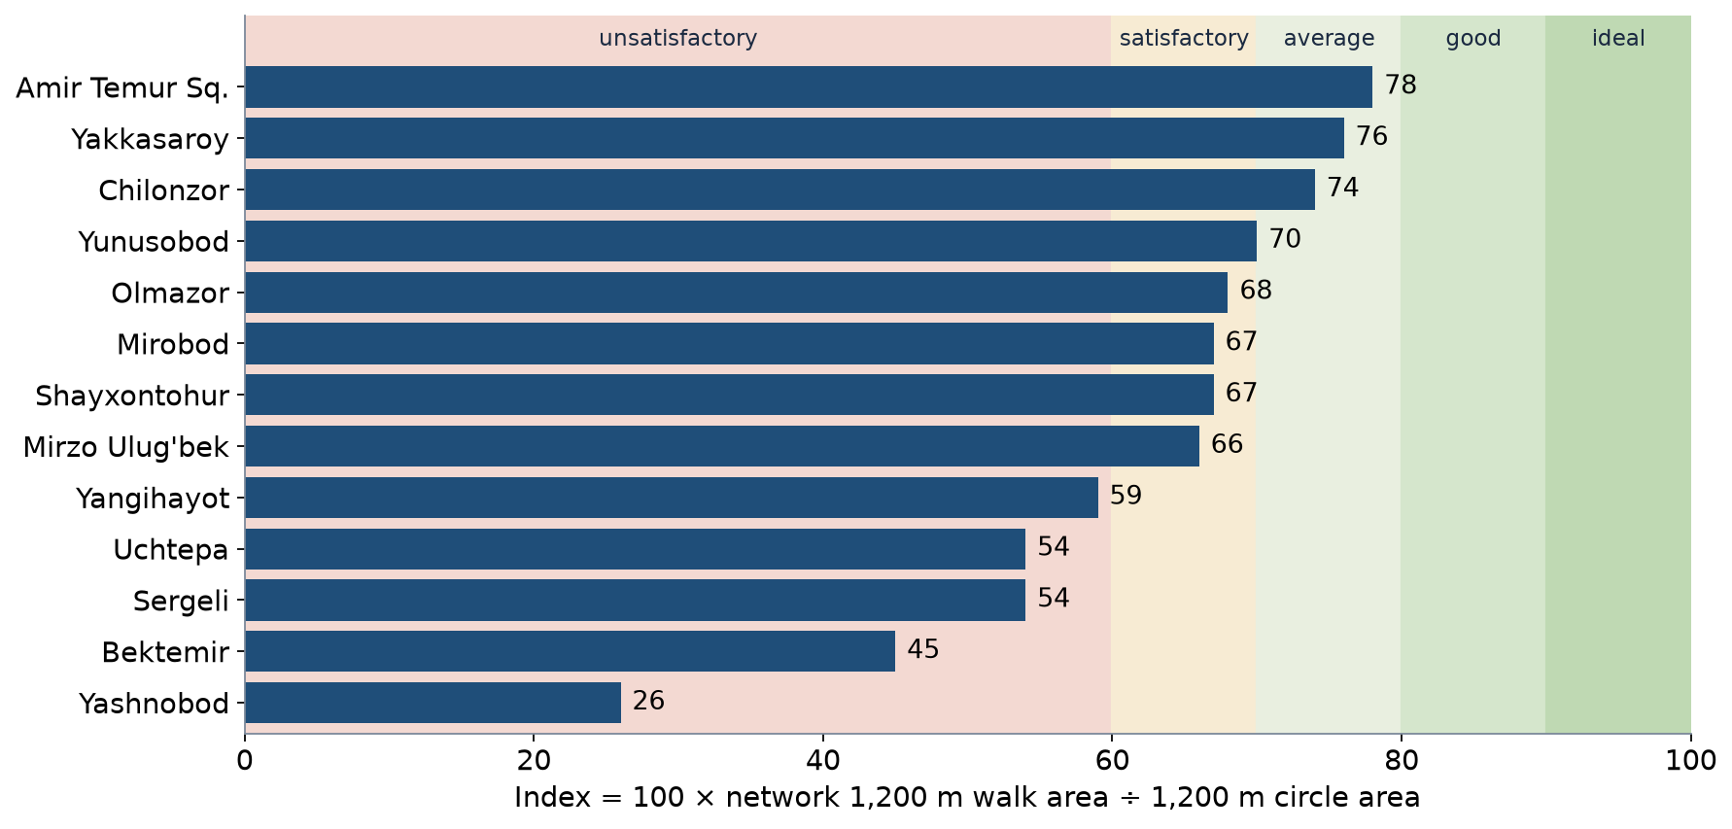
An indicator in use: Pulatova's walk index
No district centre reaches 'good' (80–89 = good). Values from Pulatova (2024), Appendix 9.
18 / 25

Slide 19
Worked example: indicators for an Abdulla Qodiriy corridor
• Problem: people on foot and bicycle cannot cross or ride safely along the street
• Objective 1: safer crossing — indicator: crossings per km with a signal or refuge
• Objective 2: access to the metro — indicator: residents within a 15-minute walk
• Objective 3: protected cycling — indicator: share of corridor length with a cycle path
• Objective 4: fair benefits — indicator: each of the above for older people and children
19 / 25

Slide 20
Common mistakes
• Only vehicle indicators (flow, speed) for a corridor used mostly by people on foot
• Indicators with no data source or no baseline
• Twenty indicators instead of five to seven that matter
• Counting the same benefit twice under two names
• No breakdown by who benefits
20 / 25

Slide 21
Discussion
The concept wants +15% junction capacity and a 43% public transport share. Can one corridor deliver both — and which would you drop?
• Argue from your corridor; name the indicator you would use to check.
21 / 25

Slide 22
Key takeaways
• Objectives first, measures second, and judge measures against objectives
• Policy objectives conflict; make the trade-off explicit
• Prefer outcome indicators with a baseline, a target, a method and an owner
• Tashkent's targets are mostly outputs and leave walking and safety out
22 / 25

Slide 23
Before P1
• Bring your corridor map and a list of the people who use it
• Read the SUMP Guidelines, Phases 1–2
• Read Walker (2008) on stating goals explicitly
23 / 25

Slide 24
References
• Rupprecht Consult (Ed.) (2019). Guidelines for Developing and Implementing a Sustainable Urban Mobility Plan (2nd ed.). European Commission / Eltis. https://www.eltis.org/mobility-plans/sump-guidelines
• MIT Department of Urban Studies and Planning. 11.540 Urban Transportation Planning and Policy (J. Aloisi). MIT Course Catalog, Course 11 subjects. https://catalog.mit.edu/subjects/11/
• van Wee, B., Annema, J. A., Banister, D., & Pudāne, B. (Eds.) (2023). The Transport System and Transport Policy: An Introduction (2nd ed.). Edward Elgar. https://rstrail.nl/the-transport-system-and-transport-policy-an-introduction/
• OpenStreetMap contributors (2026). Uzbekistan extract, Geofabrik GmbH (download.geofabrik.de). https://download.geofabrik.de/asia/uzbekistan.html
• Sodikov, J. I., et al. (under review). Odds of recorded death among police-recorded road-traffic casualties and register data quality in Tashkent, Uzbekistan. Traffic Injury Prevention (revision r4).
• Salvucci, F. (2016). 1.252J/11.540J Urban Transportation Planning, Fall 2016. MIT OpenCourseWare. https://ocw.mit.edu/courses/1-252j-urban-transportation-planning-fall-2016/
• Walker, J. (2008). Purpose-driven public transport: creating a clear conversation about public transport goals. Journal of Transport Geography, 16(6), 436–442. https://ses.library.usyd.edu.au/handle/2123/6057
• Normukhammadov, A. (2026). Pedalling Towards Sustainability: Developing an Integrated Bicycle Network for Enhanced Urban Mobility in Tashkent City (PhD thesis draft; supervisor J. I. Sodikov). Tashkent State Transport University.
• Pulatova, Z. S. (2024). Walkability assessment of Tashkent city districts (PhD dissertation, in Uzbek; supervisor J. I. Sodikov). Tashkent State Transport University.
• Ergashova, M. Z. (2026). 15-minute walkability of Tashkent mahallas — dissertation defence presentation, 14 Oct 2026 (in Uzbek). Tashkent State Transport University.

Slide 25
© 2026 TSTU, J. Sodikov. CC BY-NC-SA 4.0. Adapts openly licensed material (CC BY-NC-SA 4.0) listed in the references.

