Slide 1
Week 2 · Lecture 1
Transport data and data quality
LEC3 · Urban Transport Systems Planning and Design · TSTU · Prof. J. Sodikov

Slide 2
What you will be able to do after today
• Choose methods to observe vehicle, passenger, pedestrian and cycle flows
• Explain how origin–destination data are collected and inferred
• Plan sampling and observation periods, allowing for seasonality
• Judge how missing or wrong data change a decision
2 / 27

Slide 3
A data programme starts from the decision
• Which indicator, for which decision, at what precision?
• Which periods: peak hour, whole day, weekday, season?
• Which technique: manual, automatic, survey, passive data?
• What it costs, and who keeps the data afterwards
• Design the whole data programme before collecting anything
3 / 27

Slide 4
Data collection techniques
Technique | What it gives | Main limitation
Manual classified count | Vehicles by class, occupancy samples | Short periods; observer error
Point check at a stop | Bus load, headway, boardings | One location only
Ride check on board | Boardings and alightings by stop | Labour-intensive; small sample
Automatic counters, fare and location systems | Continuous counts, travel times, tap-ins | Not open in Tashkent; need validation
GPS or video survey | Speeds, paths, conditions | Processing effort; privacy
Interview survey | Trip purpose, origin, destination, attitudes | Sampling bias; recall
4 / 27

Slide 5
Traffic variables (Knoop)
• Flow q: vehicles passing a point per hour
• Density k: vehicles per kilometre at an instant
• Speed: time-mean (at a point) differs from space-mean (over a road section)
• q = k × space-mean speed links the three
• Local measurements (a counter) and instantaneous ones (an aerial photo) see different things
5 / 27

Slide 6
Counting people, not only vehicles
• Pedestrian and cycle counts at screenlines and crossings
• Occupancy samples by vehicle class turn vehicle flows into person flows
• Boardings and alightings at stops show who uses the corridor by bus
• Observe from safe positions; record no personal data (syllabus §6)
6 / 27

Slide 7
Origin–destination data
• Classic sources: household surveys, roadside interviews, plate matching
• Smart-card tap-ins give origins; the next tap-in suggests the destination
• Trip chaining and transfer inference rest on stated assumptions
• Validate inferred matrices against counts before using them
• Tashkent: no open OD matrix, GTFS feed or link counts were found
7 / 27

Slide 8
Sampling
• A count is a sample of days, hours and locations — state which
• Random sampling supports estimates of an average; purposive sampling does not
• Repeat counts on several days to see day-to-day variation
• Normukhammadov's survey touched 57% of segments, 29% of length — and avoided roads without facilities
• Coverage itself is a finding: what was not observed, and why?
8 / 27

Slide 9
Observation periods and seasonality
• Peak hour, inter-peak, evening and night carry different users
• Weekday versus weekend; school term versus holidays
• Tashkent heat: 15 days at or above 40 °C in 2025, peak 43.9 °C
• Mean daily maximum 38.7 °C in July, 13.9 °C in November — walking and cycling change with it
• A survey spanning July to November mixes seasons; report it
9 / 27

Slide 10
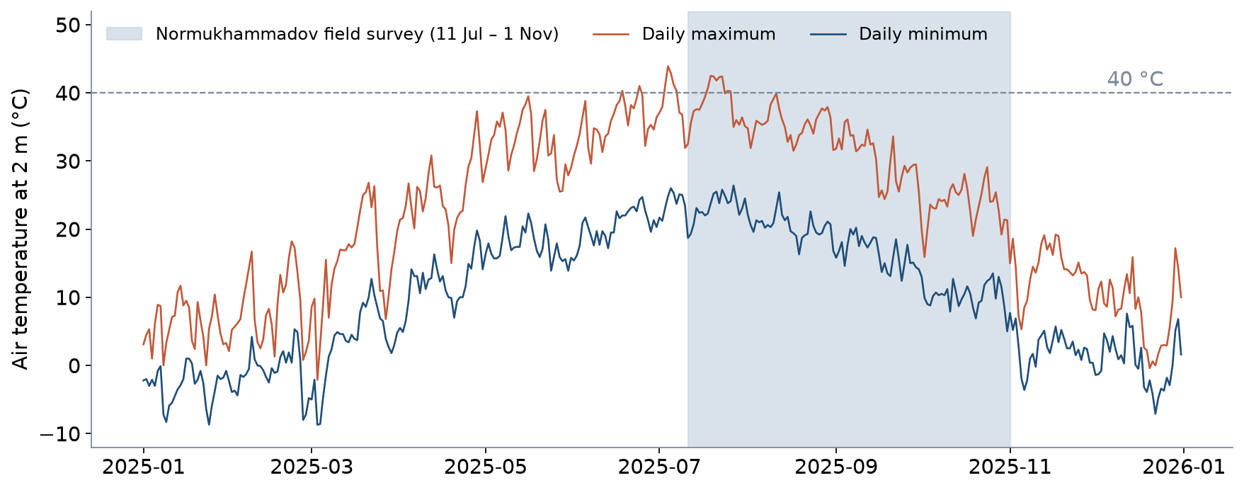
One year of Tashkent temperatures (2025)
Daily maximum and minimum, ERA5 reanalysis via Open-Meteo; shaded: Normukhammadov's field survey.
10 / 27

Slide 11
Missing data and decisions
• Missing completely at random: less precision, no bias
• Missing at random given what you know: correctable with care
• Informative missingness: the gap is related to the outcome — bias
• Gaps in time (a missing month) break seasonal and before–after comparisons
• Always report how much is missing and how you handled it
11 / 27

Slide 12
Tashkent case 1: auditing the police crash register
• Sodikov et al. (TIP, under review) — 2016 Tashkent register
12 / 27

Slide 13
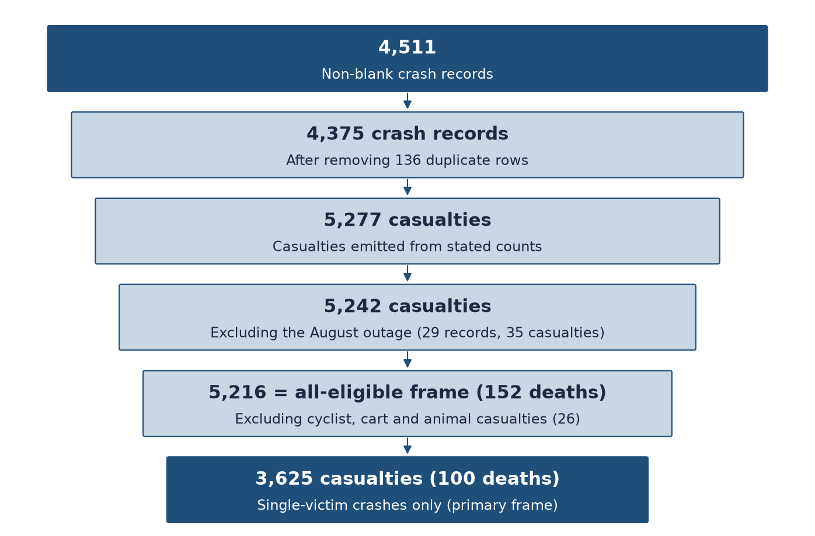
How raw data shrink to an analysis frame
Redrawn from Figure 1 of Sodikov et al. (under review). Every exclusion is counted and explained.
13 / 27

Slide 14
What the audit found
• 136 duplicate rows, some re-entered verbatim
• August held only 29 crash records — a four-week outage, excluded
• District recorded only January–April; crash type changed from text to unexplained codes in September
• Casualty counts agree with age fields for 96.9% of records
• No road-user role per casualty, no 30-day death window
14 / 27

Slide 15
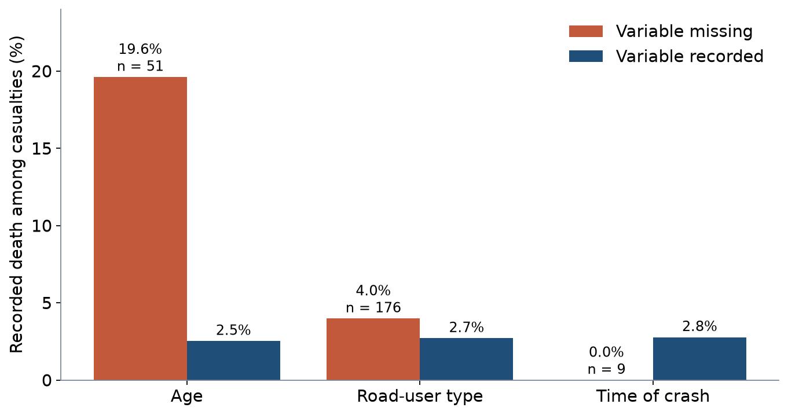
Informative missingness: missing age
Recorded death is 19.6% vs 2.5% when age is missing vs recorded: dropping incomplete rows would bias results.
15 / 27

Slide 16
Handling choices move the answer
• 176 (4.9%) casualties have no road-user type
• Pedestrian odds ratio: OR 2.60–3.89 depending on how unmapped codes are read
• OR 4.44 (complete cases) vs 3.89 (multiple imputation)
• Only 3,393 (93.6%) casualties are complete on all three predictors
• Report the range, not one convenient number
16 / 27

Slide 17
Tashkent case 2: cleaning a GPS field survey
• Normukhammadov (2026), panoramic camera and GPS rides, July–November 2025
17 / 27

Slide 18
Five real problems in one survey
• Whole clips copied into several folders — counted twice
• Cross-campaign contamination: 20 clips in both campaigns; 30–31% of Campaign II inertial rows removed
• Clip timers restarting at zero: sorting by them inflated distance ≈500×
• 253 rows, up to 112 m/s — impossible on a bicycle
• Folder names that gave the wrong route
18 / 27

Slide 19
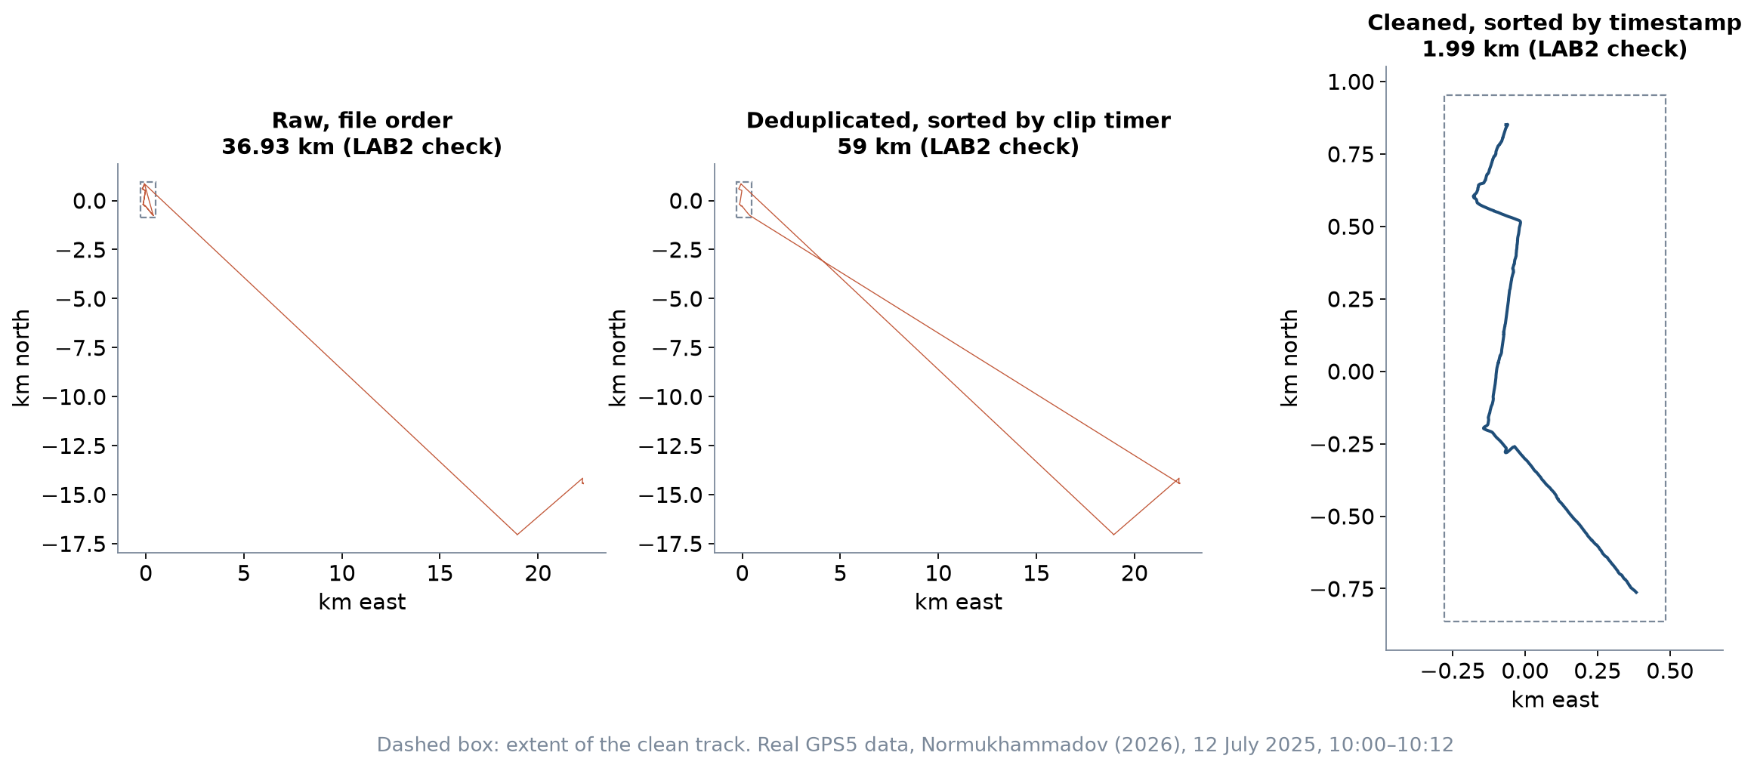
The same twelve minutes, sorted two ways
LAB2 sample: 1.99 km clean; 36.93 km in file order; 59.0 km sorted by clip timer. 6,273 raw rows, 3,123 duplicate rows.
19 / 27

Slide 20
Validation gates
• After each cleaning step, test a quantity you can predict independently
• Median step distance must match speed × time step: 0.25 m vs 0.26 m
• A discrepancy of two orders of magnitude signals a sorting or duplication error
• Write the gate down before you run the step
20 / 27

Slide 21
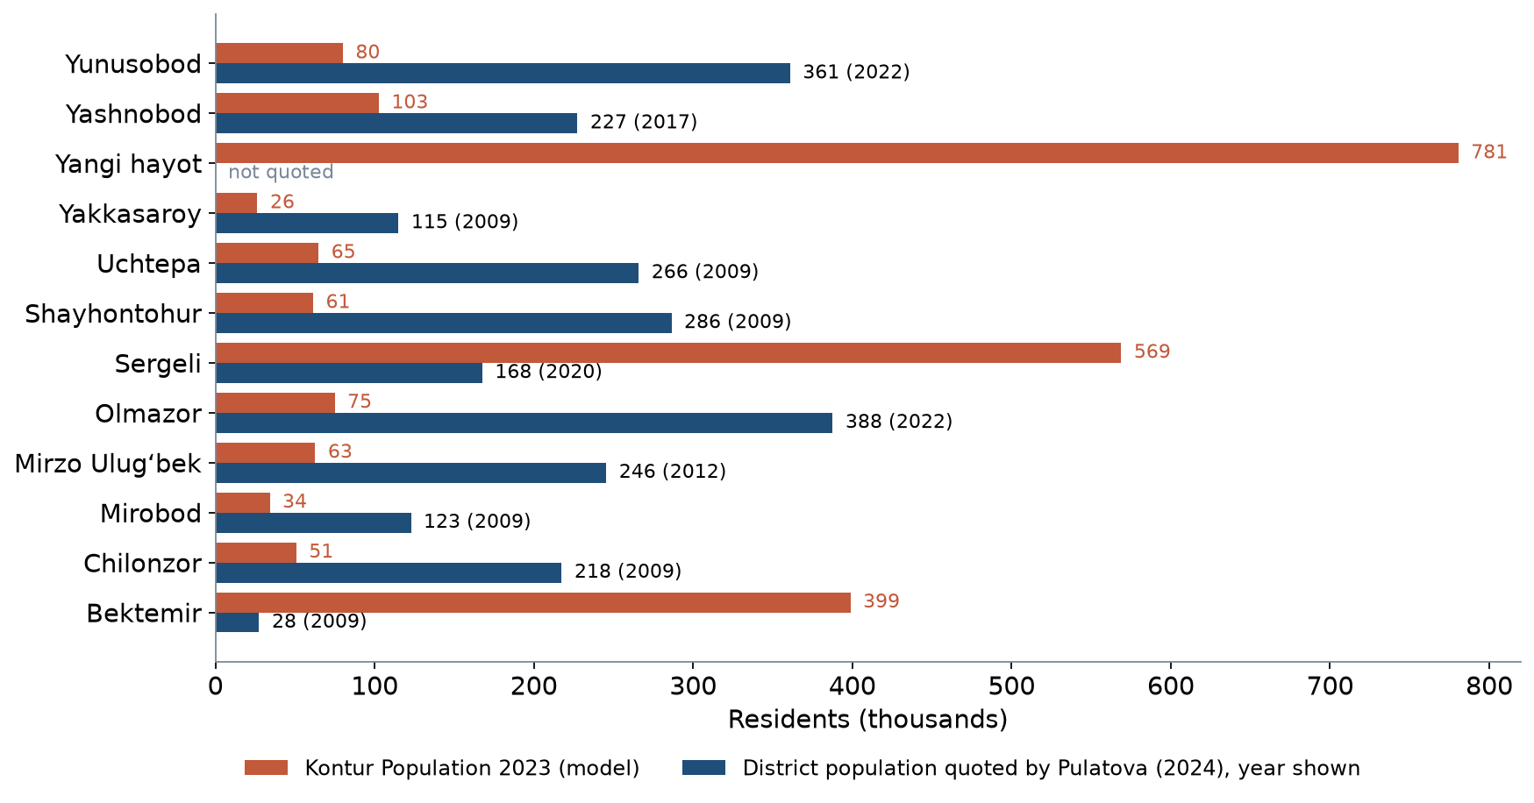
Open data can be badly wrong: population
Kontur (2023) gives Olmazor 74,918 residents; Pulatova quotes 387.7 thousand (2022). The model places the city's people in the south.
21 / 27

Slide 22
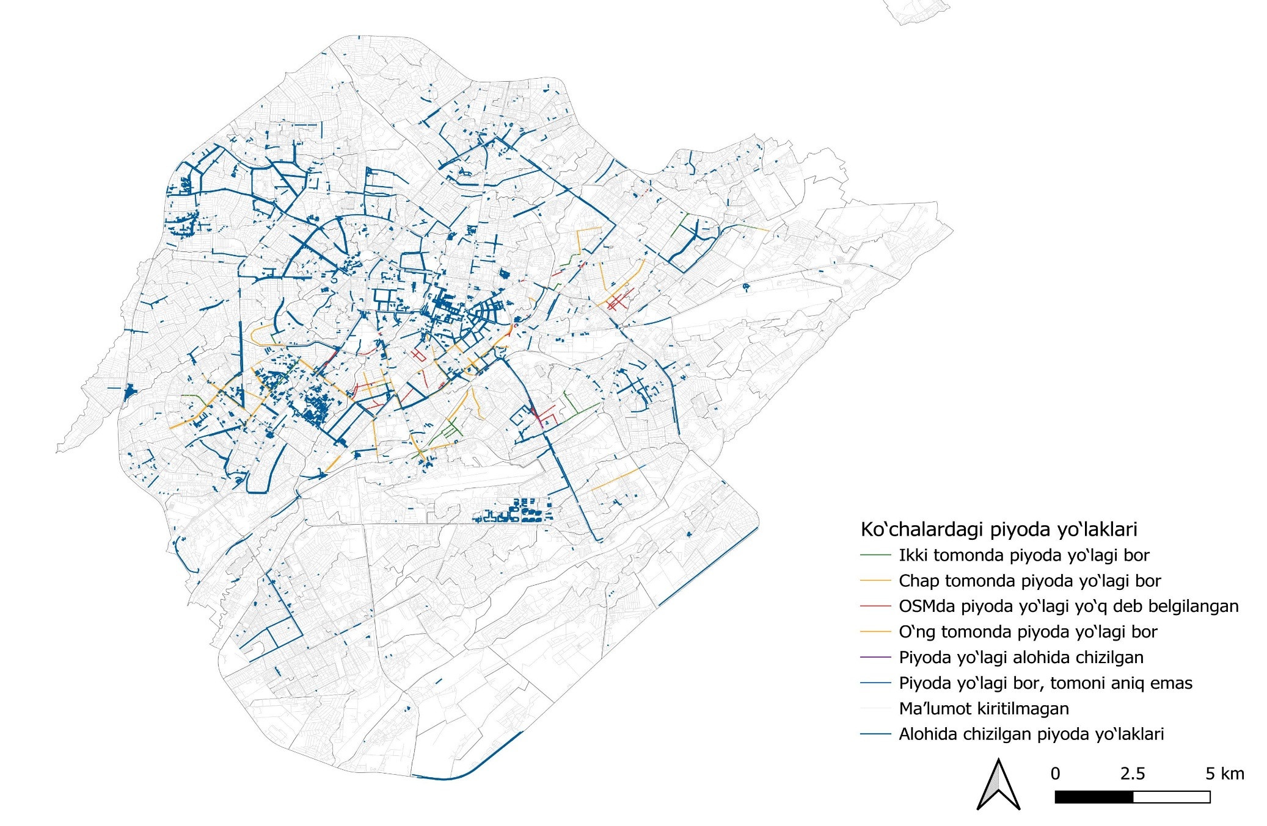
Not recorded is not absent: OSM sidewalk tags
Ergashova (2026): most streets carry no sidewalk information in OSM (grey); figure reproduced with permission (Uzbek legend).
22 / 27

Slide 23
Discussion
Which of your P1 indicators would be most damaged by missing data — and how would you notice?
• Name the indicator, the likely gap and the check you would run.
23 / 27

Slide 24
Key takeaways
• Design the data programme from the decision and the indicator
• State sample, periods and season; coverage gaps are findings
• Missing data can be informative; report how much and how handled
• Audit and validate before analysing — local surveys and open data alike
24 / 27

Slide 25
Before LAB2
• Open LAB02_gps_cleaning.xlsx and read the README sheet
• Read the required lecture notes on data collection
• Bring a laptop with Excel and QGIS
25 / 27

Slide 26
References
• Wilson, N., Sánchez-Martínez, G., & Nassir, N. (2017). 1.258J/11.541J Public Transportation Systems, Spring 2017. MIT OpenCourseWare. https://ocw.mit.edu/courses/1-258j-public-transportation-systems-spring-2017/
• Salvucci, F. (2016). 1.252J/11.540J Urban Transportation Planning, Fall 2016. MIT OpenCourseWare. https://ocw.mit.edu/courses/1-252j-urban-transportation-planning-fall-2016/
• Knoop, V. L. (2021). Traffic Flow Theory: An Introduction with Exercises (3rd ed.). TU Delft OPEN Publishing. https://books.open.tudelft.nl/home/catalog/book/203
• Zhao, J., Rahbee, A., & Wilson, N. H. M. (2007). Estimating a rail passenger trip origin-destination matrix using automatic data collection systems. Computer-Aided Civil and Infrastructure Engineering, 22(5), 376–387. https://doi.org/10.1111/j.1467-8667.2007.00494.x https://doi.org/10.1111/j.1467-8667.2007.00494.x
• TSTU course team (2026). Open data for Tashkent: inventory for the Excel/QGIS labs. Course research note, 22 October 2026 (Materials/_research/open_data_tashkent.md).
• Normukhammadov, A. (2026). Pedalling Towards Sustainability: Developing an Integrated Bicycle Network for Enhanced Urban Mobility in Tashkent City (PhD thesis draft; supervisor J. I. Sodikov). Tashkent State Transport University.
• Open-Meteo (2026). Historical Weather API (ERA5 reanalysis), Tashkent. https://open-meteo.com/en/docs/historical-weather-api
• Sodikov, J. I., et al. (under review). Odds of recorded death among police-recorded road-traffic casualties and register data quality in Tashkent, Uzbekistan. Traffic Injury Prevention (revision r4).
• Kontur (2023). Kontur Population: Uzbekistan, 400 m H3 hexagons. Humanitarian Data Exchange. https://data.humdata.org/dataset/kontur-population-uzbekistan
• Pulatova, Z. S. (2024). Walkability assessment of Tashkent city districts (PhD dissertation, in Uzbek; supervisor J. I. Sodikov). Tashkent State Transport University.
• Ergashova, M. Z. (2026). 15-minute walkability of Tashkent mahallas — dissertation defence presentation, 14 Oct 2026 (in Uzbek). Tashkent State Transport University.
• OpenStreetMap contributors (2026). Uzbekistan extract, Geofabrik GmbH (download.geofabrik.de). https://download.geofabrik.de/asia/uzbekistan.html

Slide 27
© 2026 TSTU, J. Sodikov. CC BY-NC-SA 4.0. Adapts openly licensed material (CC BY-NC-SA 4.0) listed in the references.

