Slide 1
Week 2 · Lecture 2
Baseline conditions and planning scenarios
LEC4 · Urban Transport Systems Planning and Design · TSTU · Prof. J. Sodikov

Slide 2
What you will be able to do after today
• Describe the existing conditions of a corridor with dated evidence
• Convert vehicle flows into person flows and explain the difference
• Separate observations, assumptions and forecasts in any report
• Define a future baseline for one assessment year
2 / 23

Slide 3
Two baselines
• Existing conditions: what is there now, measured and dated
• Future baseline (do-minimum): the corridor in the assessment year without your project
• Alternatives are compared with the future baseline, not with today
• All alternatives use the same assessment year (syllabus §5)
3 / 23

Slide 4
What goes into a corridor baseline
Component | Method | Week
Traffic composition and person flows | Classified and occupancy counts | 2
Journey times and speeds | Timed runs, GPS tracks | 2
Public transport supply | Routes, stops, observed headways | 2, 6
Street space by use | Measured cross-sections | 2, 7
Walking and cycling links | Network and audit | 3, 4, 8
Safety | Crash register, conflict observation | 2, 8
4 / 23

Slide 5
Traffic composition and person flows
• Count vehicles by class: car, taxi, minibus, bus, goods, motorcycle, bicycle
• Passenger car units express vehicle impact on capacity
• Occupancy turns vehicles into people: count it, do not assume it
• A corridor can be car-dominated in vehicles and bus-dominated in people
5 / 23

Slide 6
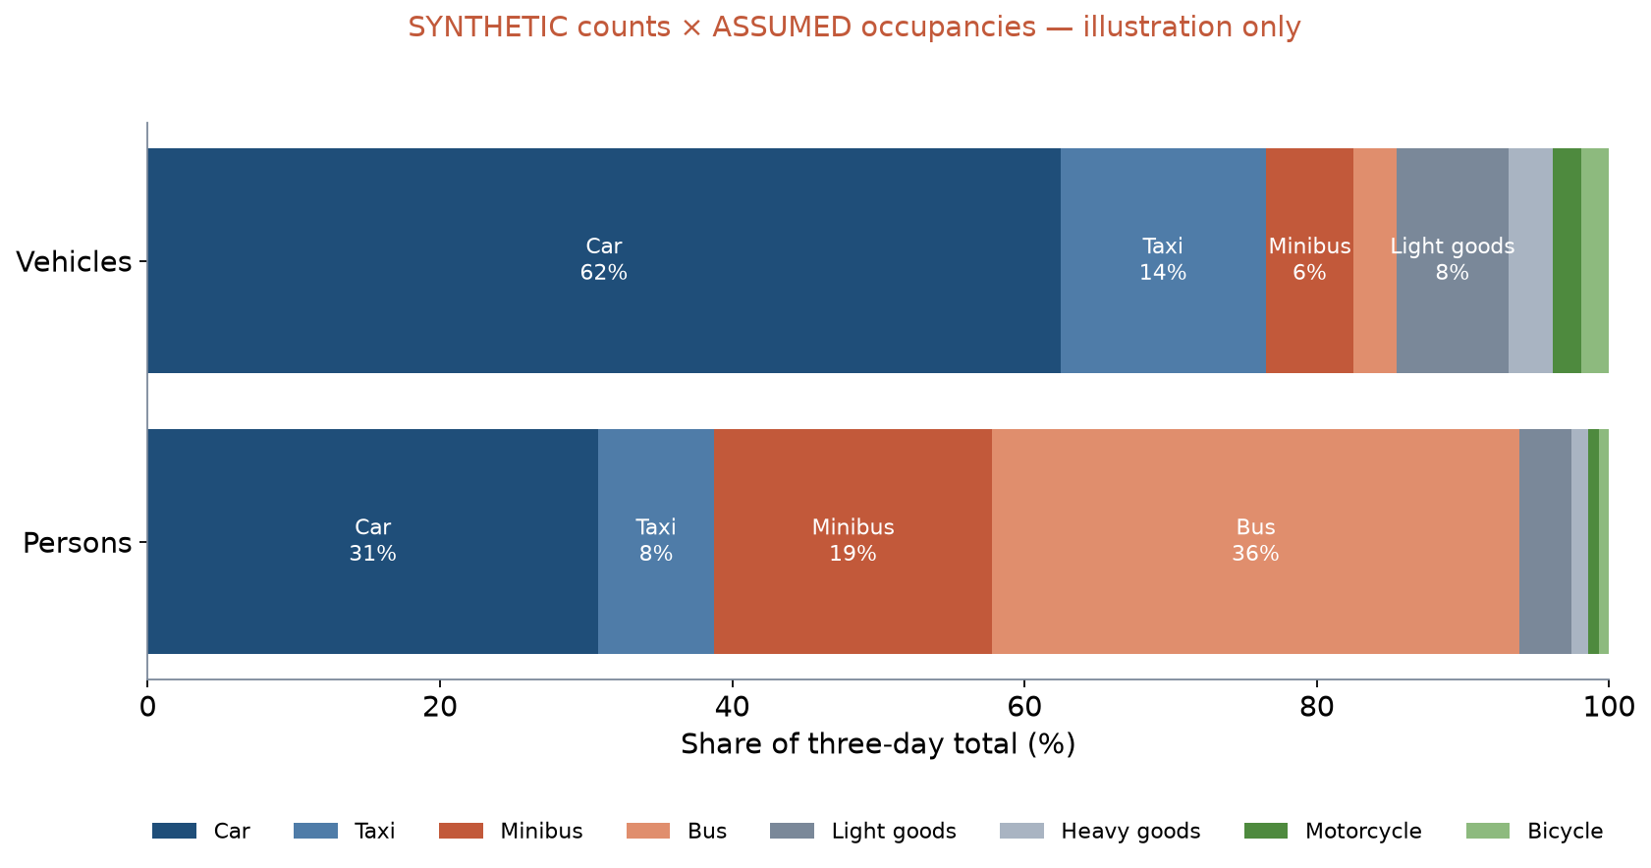
Vehicles or persons? (synthetic illustration)
SYNTHETIC LAB2 counts × ASSUMED occupancies: cars 62.4% of vehicles but 30.8% of persons; buses and minibuses 8.9% vs 55.1%.
6 / 23

Slide 7
Worked example: person flow
• Person flow = Σ (vehicles per hour × average occupancy) over classes
• 1,000 cars/h × 1.4 = 1,400 persons/h
• 30 buses/h × 35 = 1,050 persons/h
• Buses are 3% of these vehicles but 43% of these people
• One lane given to buses can carry more people than the car lane it replaces
7 / 23

Slide 8
Journey times and speeds
• Measure door to door, not only on the road section
• Report the spread (median and 90th percentile), not only the mean
• GPS tracks double as journey-time data once cleaned
• Normukhammadov: 11.5 vs 10.5 km/h mean riding speed on cycle paths vs sidewalks
8 / 23

Slide 9
Public transport supply
• OSM maps 2,019 bus stops and 125 bus route relations in the city
• No open timetable (GTFS) exists: observe headways on site
• The city concept targets 95% regularity and headways shortened by up to 35%
• A baseline needs measured headways to test such targets
9 / 23

Slide 10
Street space and walking infrastructure
• Measure the cross-section: carriageway, parking, footway, cycle path, trees
• Compare space allocated with people moved by each mode
• Footway density: 7.35 km/km² in Yakkasaroy vs 0.85 km/km² in Bektemir
• OSM footways under-record; check your corridor on foot
10 / 23

Slide 11
Safety baseline
• Pedestrian strikes are 57.4% of crash records in the 2016 register
• Recorded death: 3.46% vs 1.08% for pedestrian vs occupant casualties
• The register is a decade old and lacks locations: collect conflict observations on your corridor
• State the data year next to every safety number
11 / 23

Slide 12
Observations, assumptions and forecasts
• Label every number in your report as one of the three
12 / 23

Slide 13
Three kinds of number
Kind | Definition | Tashkent example
Observation | Measured, with method and date | 66.4% of riding on sidewalks (GPS survey 2025)
Assumption | Chosen value, not measured here | Occupancy of a car; a share of residents who change mode
Forecast | Modelled future value | Corridor traffic in the assessment year
13 / 23

Slide 14
Reading a claim: $19,007,010 per year
• Pulatova estimates the yearly saving if 173,580 people walk 1,200 m instead of driving
• Inputs: 10% of residents of seven districts (assumption), $0.30 per car-km (borrowed), every day of the year
• Not observed: trips per day, trip length in the formula, car occupancy, who would really switch
• Week 3 practical: check the arithmetic and the logic
14 / 23

Slide 15
Building the future baseline
• Start from measured existing conditions
• Add committed projects only (funded, approved), not wishes
• Apply stated trends: population, car ownership (private vehicles ≈7.5% a year nationally)
• Keep one assessment year for every alternative
• Record each trend's source and date
15 / 23

Slide 16
Scenarios are not forecasts
• A forecast claims what will happen; a scenario explores what could happen
• Use two or three scenarios (low, central, high growth) to bracket uncertainty
• Forecast-led planning builds for predicted traffic; objective-led planning tests options against goals
• SUMP step 4: build and jointly assess scenarios with stakeholders
16 / 23

Slide 17
A model to follow: measured baseline, scenario economics
• Normukhammadov measured the network (observation) before modelling it
• Benefits are scenarios: $0.9–6.75 M/yr for 5,000 to 30,000 daily users
• Each scenario states its inputs, so readers can disagree with them
17 / 23

Slide 18
Reporting uncertainty
• Give ranges where inputs are uncertain
• Show what changes the conclusion and what does not
• Pedestrian odds ratio OR 2.60–3.89 across handlings: the direction is robust, the size is not
• Date and source every number; keep the raw data
18 / 23

Slide 19
Discussion
Which number in your corridor baseline will be an assumption you cannot measure — and how will you show its effect?
• One number, one range, one sentence.
19 / 23

Slide 20
Key takeaways
• Baseline = measured existing conditions + a dated future do-minimum
• Count people as well as vehicles
• Label every number: observation, assumption or forecast
• Use scenarios to show uncertainty, not to hide it
20 / 23

Slide 21
Before P2
• Pick a counting position on your corridor that is safe to stand at
• Bring the P1 indicator table: the survey must serve it
• Read Knoop (2021) on traffic variables
21 / 23

Slide 22
References
• Rupprecht Consult (Ed.) (2019). Guidelines for Developing and Implementing a Sustainable Urban Mobility Plan (2nd ed.). European Commission / Eltis. https://www.eltis.org/mobility-plans/sump-guidelines
• Salvucci, F. (2016). 1.252J/11.540J Urban Transportation Planning, Fall 2016. MIT OpenCourseWare. https://ocw.mit.edu/courses/1-252j-urban-transportation-planning-fall-2016/
• Wilson, N., Sánchez-Martínez, G., & Nassir, N. (2017). 1.258J/11.541J Public Transportation Systems, Spring 2017. MIT OpenCourseWare. https://ocw.mit.edu/courses/1-258j-public-transportation-systems-spring-2017/
• Knoop, V. L. (2021). Traffic Flow Theory: An Introduction with Exercises (3rd ed.). TU Delft OPEN Publishing. https://books.open.tudelft.nl/home/catalog/book/203
• Synthetic teaching dataset generated for this course (method and random seed in each workbook's README sheet).
• Normukhammadov, A. (2026). Pedalling Towards Sustainability: Developing an Integrated Bicycle Network for Enhanced Urban Mobility in Tashkent City (PhD thesis draft; supervisor J. I. Sodikov). Tashkent State Transport University.
• OpenStreetMap contributors (2026). Uzbekistan extract, Geofabrik GmbH (download.geofabrik.de). https://download.geofabrik.de/asia/uzbekistan.html
• TSTU course team (2026). Open data for Tashkent: inventory for the Excel/QGIS labs. Course research note, 22 October 2026 (Materials/_research/open_data_tashkent.md).
• Pulatova, Z. S. (2024). Walkability assessment of Tashkent city districts (PhD dissertation, in Uzbek; supervisor J. I. Sodikov). Tashkent State Transport University.
• Ergashova, M. Z. (2026). 15-minute walkability of Tashkent mahallas — dissertation defence presentation, 14 Oct 2026 (in Uzbek). Tashkent State Transport University.
• Global Designing Cities Initiative & NACTO (2016). Global Street Design Guide. Island Press. https://globaldesigningcities.org/publication/global-street-design-guide/
• Sodikov, J. I., et al. (under review). Odds of recorded death among police-recorded road-traffic casualties and register data quality in Tashkent, Uzbekistan. Traffic Injury Prevention (revision r4).

Slide 23
© 2026 TSTU, J. Sodikov. CC BY-NC-SA 4.0. Adapts openly licensed material (CC BY-NC-SA 4.0) listed in the references.

