Slide 1
Week 3 · Lecture 1
Interactions between urban form and transport
LEC5 · Urban Transport Systems Planning and Design · TSTU · Prof. J. Sodikov

Slide 2
What you will be able to do after today
• Explain how land use and transport shape each other
• Use density, diversity, design and distance to read a station area
• Measure accessibility with network catchments rather than circles
• Judge how well Tashkent's metro stations connect to their neighbourhoods
2 / 25

Slide 3
The land use–transport feedback cycle
• Where activities are located creates the need to travel
• The transport system decides how easily those places can be reached
• Accessibility in turn shapes where homes, jobs and shops locate
• The cycle runs over years: a metro line or ring road reshapes a city slowly
• Plans that ignore one half of the cycle are surprised by the other
3 / 25

Slide 4
Functional zoning and its legacy
• Separating homes, industry and services lengthens everyday trips
• Soviet-era planning left Tashkent wide avenues and large residential blocks
• Wide cross-sections offer space for change; large blocks lengthen walks
• Mixed use brings daily needs within walking distance
4 / 25

Slide 5
Density and car dependence
• Cities with lower density show higher car use and longer distances driven
• Kenworthy and Laube compared cities worldwide on density, transport and costs
• Density alone is not enough: it must be near frequent public transport
• Correlation across cities is not proof of cause within one city
5 / 25

Slide 6
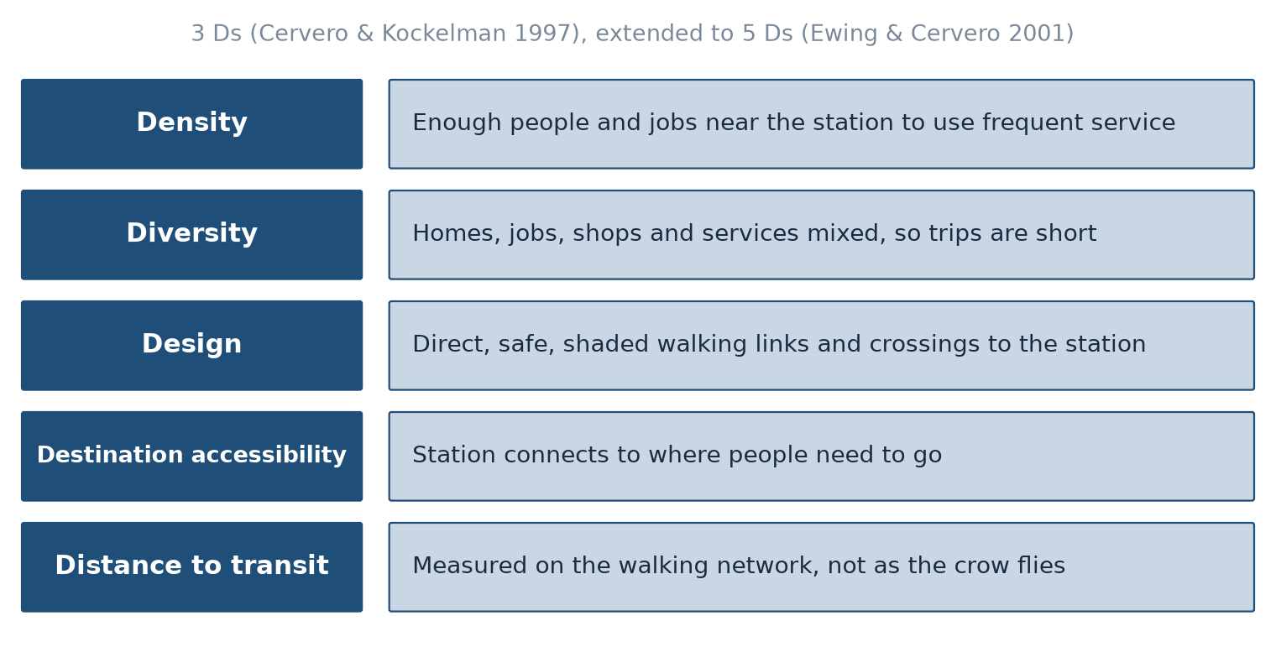
The Ds of the built environment
After Cervero and Kockelman (1997) and Ewing and Cervero (2001); redrawn.
6 / 25

Slide 7
What the evidence says
• Ewing and Cervero's meta-analysis: each built-environment variable has a small effect on travel
• Effects add up when density, mix, design and transit access come together
• Destination accessibility matters most for how far people drive
• Street design and connectivity matter most for walking
7 / 25

Slide 8
Measuring accessibility (Geurs & van Wee)
• Contour measure: opportunities reachable within a time or distance limit
• Gravity measure: opportunities weighted by how hard they are to reach
• Utility and person-based measures add preferences and time budgets
• Four components: land use, transport, time, the individual (Geurs & van Wee)
• LAB3 uses a contour measure on the walking network
8 / 25

Slide 9
Transit-oriented development
• Concentrate homes, jobs and services within walking distance of stations
• Mix uses so the station area is busy all day
• Give walking and cycling the shortest, safest routes to the platform
• Measure the walk on the network: barriers, missing crossings and closed blocks cut the catchment
9 / 25

Slide 10
Tashkent: how far can people walk to the metro?
• LAB3 results (OSM, October 2026) and the work of Pulatova and Ergashova
10 / 25

Slide 11
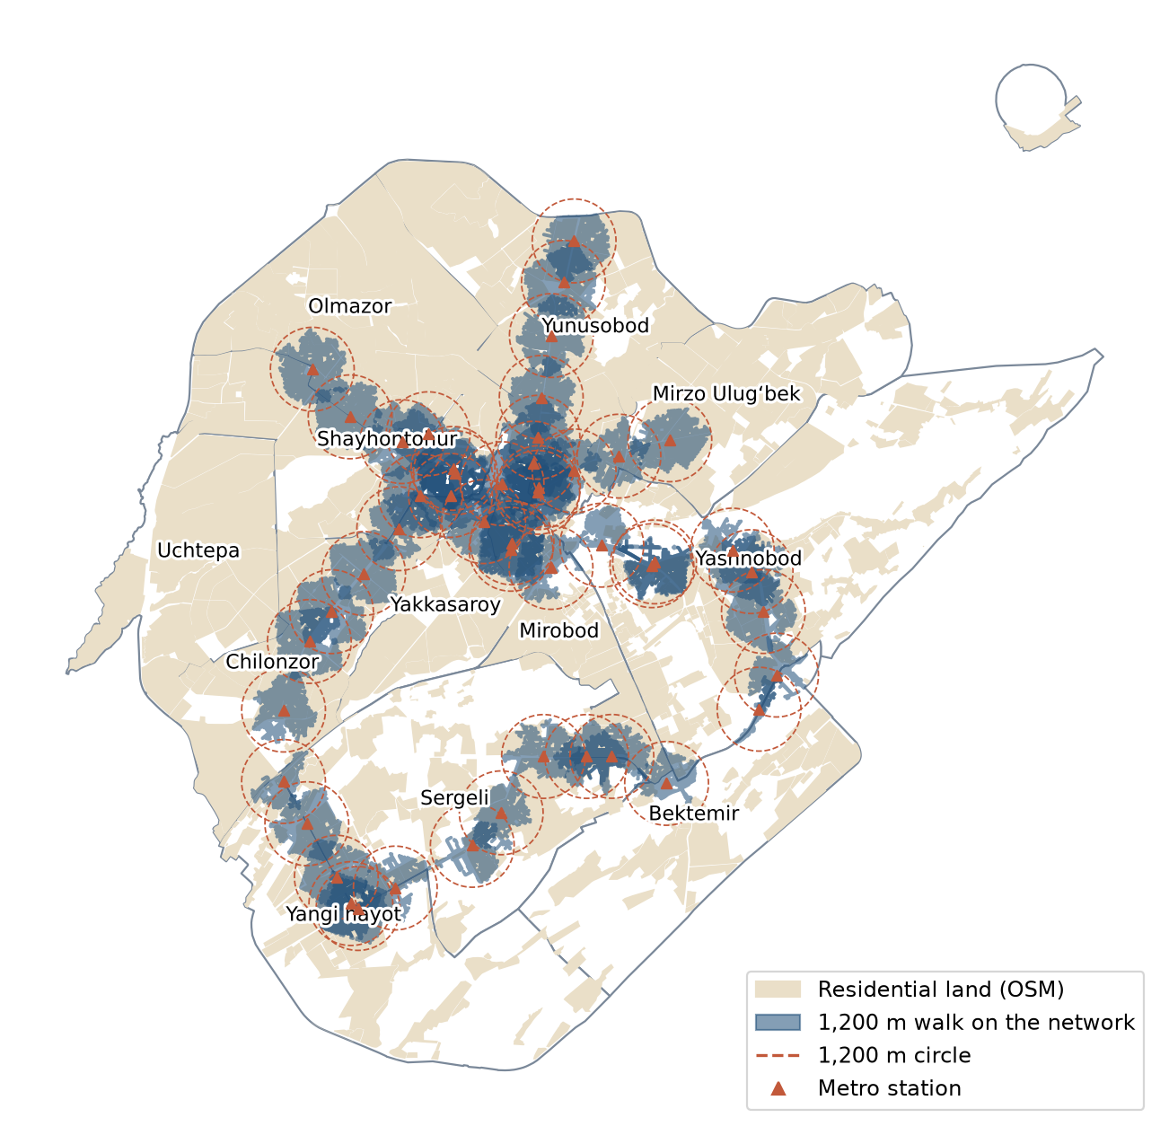
Walking reach of Tashkent's 49 metro stations
1,200 m walk on the street and footway network (shaded) versus 1,200 m circles (dashed); residential land from OSM.
11 / 25

Slide 12
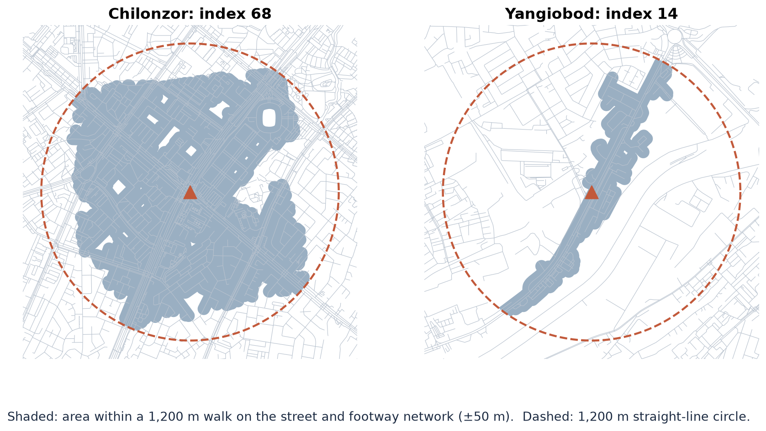
Circle versus network: two stations
Yangiobod (index 14.0, the lowest of all stations) beside rail land versus Chilonzor in a dense street grid: rail lines, canals and large blocks cut the walk.
12 / 25

Slide 13
What the network does to catchments
• Mean station index 56.7; no station reaches 'good' (80–89 = good)
• All stations together: 84.72 km² vs 131.65 km² within reach
• Residential land within reach: 23.8% vs 33.7% of the twelve districts
• Straight-line buffers overstate reachable residential land by about two fifths
13 / 25

Slide 14
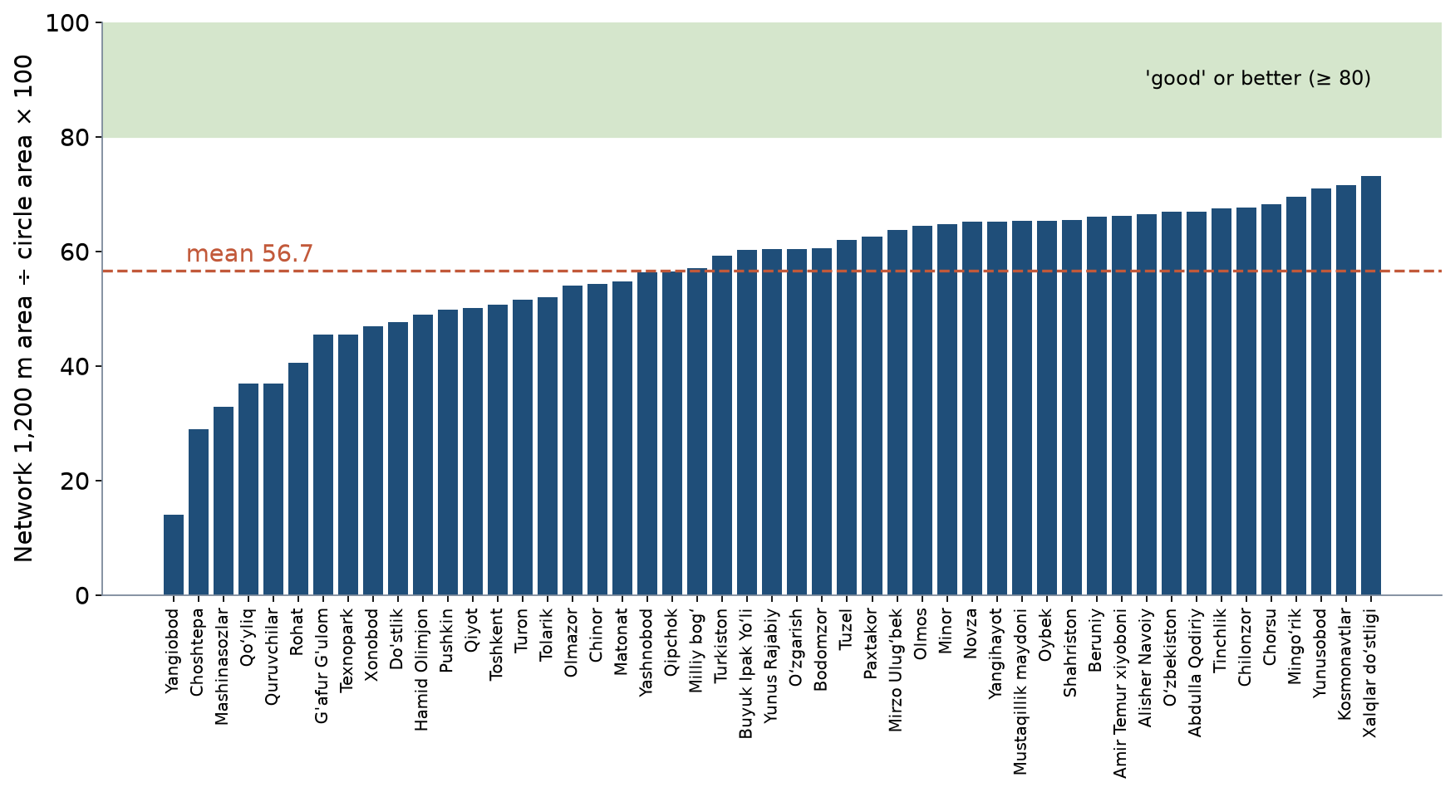
Every station, ranked
Pulatova-type index for each OSM metro station: network 1,200 m area as a percentage of the circle.
14 / 25

Slide 15
Stops and services: one corridor
• Norm: no more than 500 m walk to the nearest stop (600 m in low-density housing)
• Abdulla Qodiriy corridor: 49 bus stops reach on average 63.9 of the 500 m circle
• Its 16 schools reach 44.5 of their 800 m circle: large blocks and fences cut the walk
• Residential land within 500 m of a stop: 84.2% vs 94.2% in a straight line
• LAB3 repeats this for the stops and services on your own corridor
15 / 25

Slide 16
Replicating Pulatova (2024)
• Her index from district centres runs from 78 (Amir Temur Square) to 26 (Yashnobod)
• LAB3 repeats it on today's OSM: rank correlation 0.76 with her values
• Yakkasaroy differs most: 47.2 vs 76
• Different centroid, map date and area method change the level, less the ranking
• Lesson: report method choices next to any index value
16 / 25

Slide 17
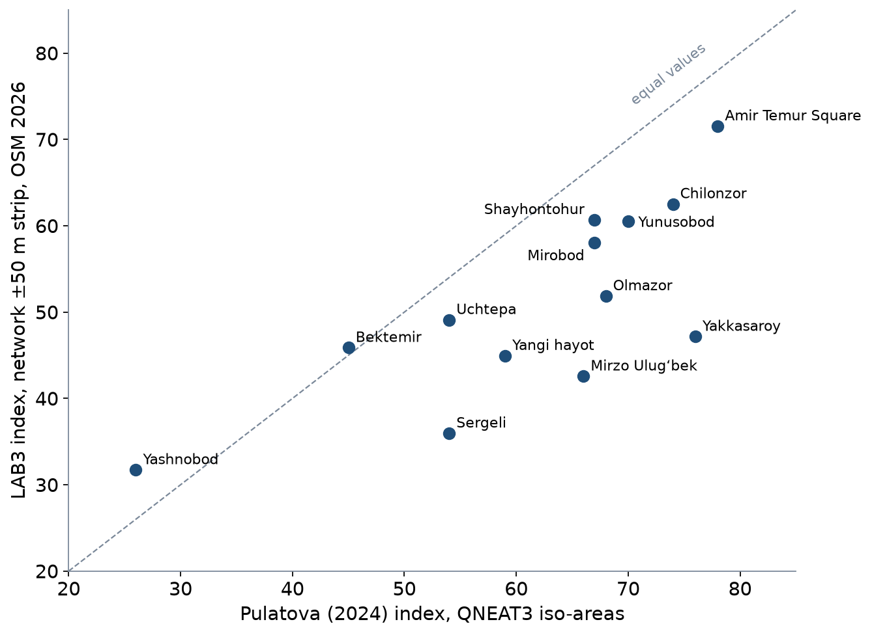
Same method, different data and tools
Each point is one of Pulatova's origins: her published index against the LAB3 recomputation.
17 / 25

Slide 18
The mahalla view: Ergashova (2026)
• 435 mahallas (74.4%) have no metro station within a 15-minute walk
• Shops and services cluster in the centre: 107 supermarkets, 520 restaurants and cafés mapped by Pulatova
• Different units (station, district, mahalla) give different pictures of the same city
18 / 25

Slide 19
Connecting stations to neighbourhoods
• Short, direct, shaded walking links and safe crossings at the station
• Feeder buses and cycling extend the catchment beyond walking distance
• Qwatt shared e-bikes (more than 1,300) are placed around metro stations and universities
• TSTU work integrates walking and cycling lanes with public transport and green zones
19 / 25

Slide 20
New Tashkent: a chance to plan land use and transport together
• Planned expansion of 25,000 hectares, up to 2.5 million people
• Masterplan organised around walkable, mixed-use districts
• Test question: will station catchments be designed and measured on the network?
20 / 25

Slide 21
Discussion
Pick the metro station nearest your corridor. What single change would add most walkable area within 1,200 m?
• Look at the LAB3 map: a bridge, a crossing, an opened block, a new footway?
21 / 25

Slide 22
Key takeaways
• Land use and transport shape each other over time
• Density, diversity, design and distance to transit work together
• Measure catchments on the network; circles overstate access
• Tashkent's stations reach on average just over half of their ideal walking area
22 / 25

Slide 23
Before LAB3
• Open LAB03_catchments.gpkg and check that the project CRS is EPSG:32642
• Read Geurs & van Wee (2004), sections 1–3
• Identify the metro stations, bus stops and one service type (schools, clinics) on your corridor
23 / 25

Slide 24
References
• Salvucci, F. (2016). 1.252J/11.540J Urban Transportation Planning, Fall 2016. MIT OpenCourseWare. https://ocw.mit.edu/courses/1-252j-urban-transportation-planning-fall-2016/
• TU Delft (2013). CIE4801 Transportation and Spatial Modelling. TU Delft OpenCourseWare. https://ocw.tudelft.nl/courses/transportation-and-spatial-modelling/
• van Wee, B., Annema, J. A., Banister, D., & Pudāne, B. (Eds.) (2023). The Transport System and Transport Policy: An Introduction (2nd ed.). Edward Elgar. https://rstrail.nl/the-transport-system-and-transport-policy-an-introduction/
• Normukhammadov, A. (2026). Pedalling Towards Sustainability: Developing an Integrated Bicycle Network for Enhanced Urban Mobility in Tashkent City (PhD thesis draft; supervisor J. I. Sodikov). Tashkent State Transport University.
• Kenworthy, J. R., & Laube, F. B. (1999). Patterns of automobile dependence in cities: an international overview of key physical and economic dimensions with some implications for urban policy. Transportation Research Part A, 33(7–8), 691–723. https://doi.org/10.1016/S0965-8564(99)00006-3 https://doi.org/10.1016/S0965-8564(99)00006-3
• Cervero, R., & Kockelman, K. (1997). Travel demand and the 3Ds: Density, diversity, and design. Transportation Research Part D, 2(3), 199–219. https://doi.org/10.1016/S1361-9209(97)00009-6 https://doi.org/10.1016/S1361-9209(97)00009-6
• Ewing, R., & Cervero, R. (2001). Travel and the built environment: a synthesis. Transportation Research Record, 1780, 87–114.
• Ewing, R., & Cervero, R. (2010). Travel and the built environment: A meta-analysis. Journal of the American Planning Association, 76(3), 265–294. https://doi.org/10.1080/01944361003766766 https://doi.org/10.1080/01944361003766766
• Geurs, K. T., & van Wee, B. (2004). Accessibility evaluation of land-use and transport strategies: review and research directions. Journal of Transport Geography, 12(2), 127–140. https://doi.org/10.1016/j.jtrangeo.2003.10.005 https://doi.org/10.1016/j.jtrangeo.2003.10.005
• OpenStreetMap contributors (2026). Uzbekistan extract, Geofabrik GmbH (download.geofabrik.de). https://download.geofabrik.de/asia/uzbekistan.html
• Pulatova, Z. S. (2024). Walkability assessment of Tashkent city districts (PhD dissertation, in Uzbek; supervisor J. I. Sodikov). Tashkent State Transport University.
• Ergashova, M. Z. (2026). 15-minute walkability of Tashkent mahallas — dissertation defence presentation, 14 Oct 2026 (in Uzbek). Tashkent State Transport University.
• Sodikov, J. I., et al. (2026). Sustainable urban transport: integrating pedestrian and bicycle lanes with the public transport system. AIP Conference Proceedings (2025 Int. Conf.).
• Sodikov, J. I., et al. (2026). Analysis of the '15-minute city' concept connected by pedestrian green zones: a theoretical review. Inzhener. https://engineer.tstu.uz

Slide 25
© 2026 TSTU, J. Sodikov. CC BY-NC-SA 4.0. Adapts openly licensed material (CC BY-NC-SA 4.0) listed in the references.

