Slide 1
Week 3 · Lecture 2
Transport justice and inclusion
LEC6 · Urban Transport Systems Planning and Design · TSTU · Prof. J. Sodikov

Slide 2
What you will be able to do after today
• Explain how benefits and costs of transport are distributed by income, age, gender and ability
• Use a principle of distributive justice to judge a project
• Assess travel-cost and time burdens and universal access
• Identify who benefits from your corridor project and who pays
2 / 23

Slide 3
Why justice is a transport question
• Transport decides who can reach jobs, schools and care
• It also decides who breathes the fumes, crosses the dangerous road and gives up space
• A published course on urban transportation planning and policy examines policymaking in relation to social and environmental justice
• A published course on transportation policy treats environmental justice and facility siting as core policy problems
3 / 23

Slide 4
Principles of distributive justice
• Utilitarian: maximise total benefit, whoever receives it
• Egalitarian: reduce differences between groups
• Sufficiency: everyone should reach a minimum level of accessibility
• Rawlsian: improve the position of the worst off first
• Capabilities: what people are actually able to do and be
4 / 23

Slide 5
Transport and social exclusion
• Transport disadvantage plus social disadvantage leads to exclusion
• Barriers: cost, distance, time, safety, information, physical access
• Exclusion is often invisible in average travel statistics
• Ask who does not travel, not only who does
5 / 23

Slide 6
Groups, burdens and the Tashkent evidence we have
Group | Typical burden | Tashkent evidence
Low income | Fares and travel time as a share of income | No open household data — collect
Children | Safe routes to school | Police register, ages recorded
Older people | Walking distance, crossings, injury severity | Police register (older age band)
Women | Trip chaining, personal security | Survey sample mostly male
People with disabilities | Steps, kerbs, missing ramps | Pulatova survey
Peripheral residents | Distance to stations and services | LAB3 catchments, Ergashova
6 / 23

Slide 7
Assessing cost and time burdens
• Cost burden = monthly travel spending ÷ monthly income
• Time burden = daily travel time to essential destinations
• Example: two fares a day × 22 working days, compared across income groups
• Report the distribution (lowest fifth vs highest fifth), not only the average
• Tashkent fares and incomes: collect current values with a dated source in P3
7 / 23

Slide 8
Universal access
• Design for the least able user: step-free, ramps, tactile paving, seating, shade
• Pulatova's survey: 73.1% say there is no infrastructure for people with disabilities
• 46.1% say footways have no shade
• 47.5% say footways are used for car parking
8 / 23

Slide 9
Environmental justice
• Who lives beside the busy road, the depot, the hot treeless street?
• Tashkent's annual PM2.5 reached 31.5 µg/m³ in 2024
• Tree canopy ranges from 0.06–37.23% between mahallas
• Heat and shade will be measured in Week 9
9 / 23

Slide 10
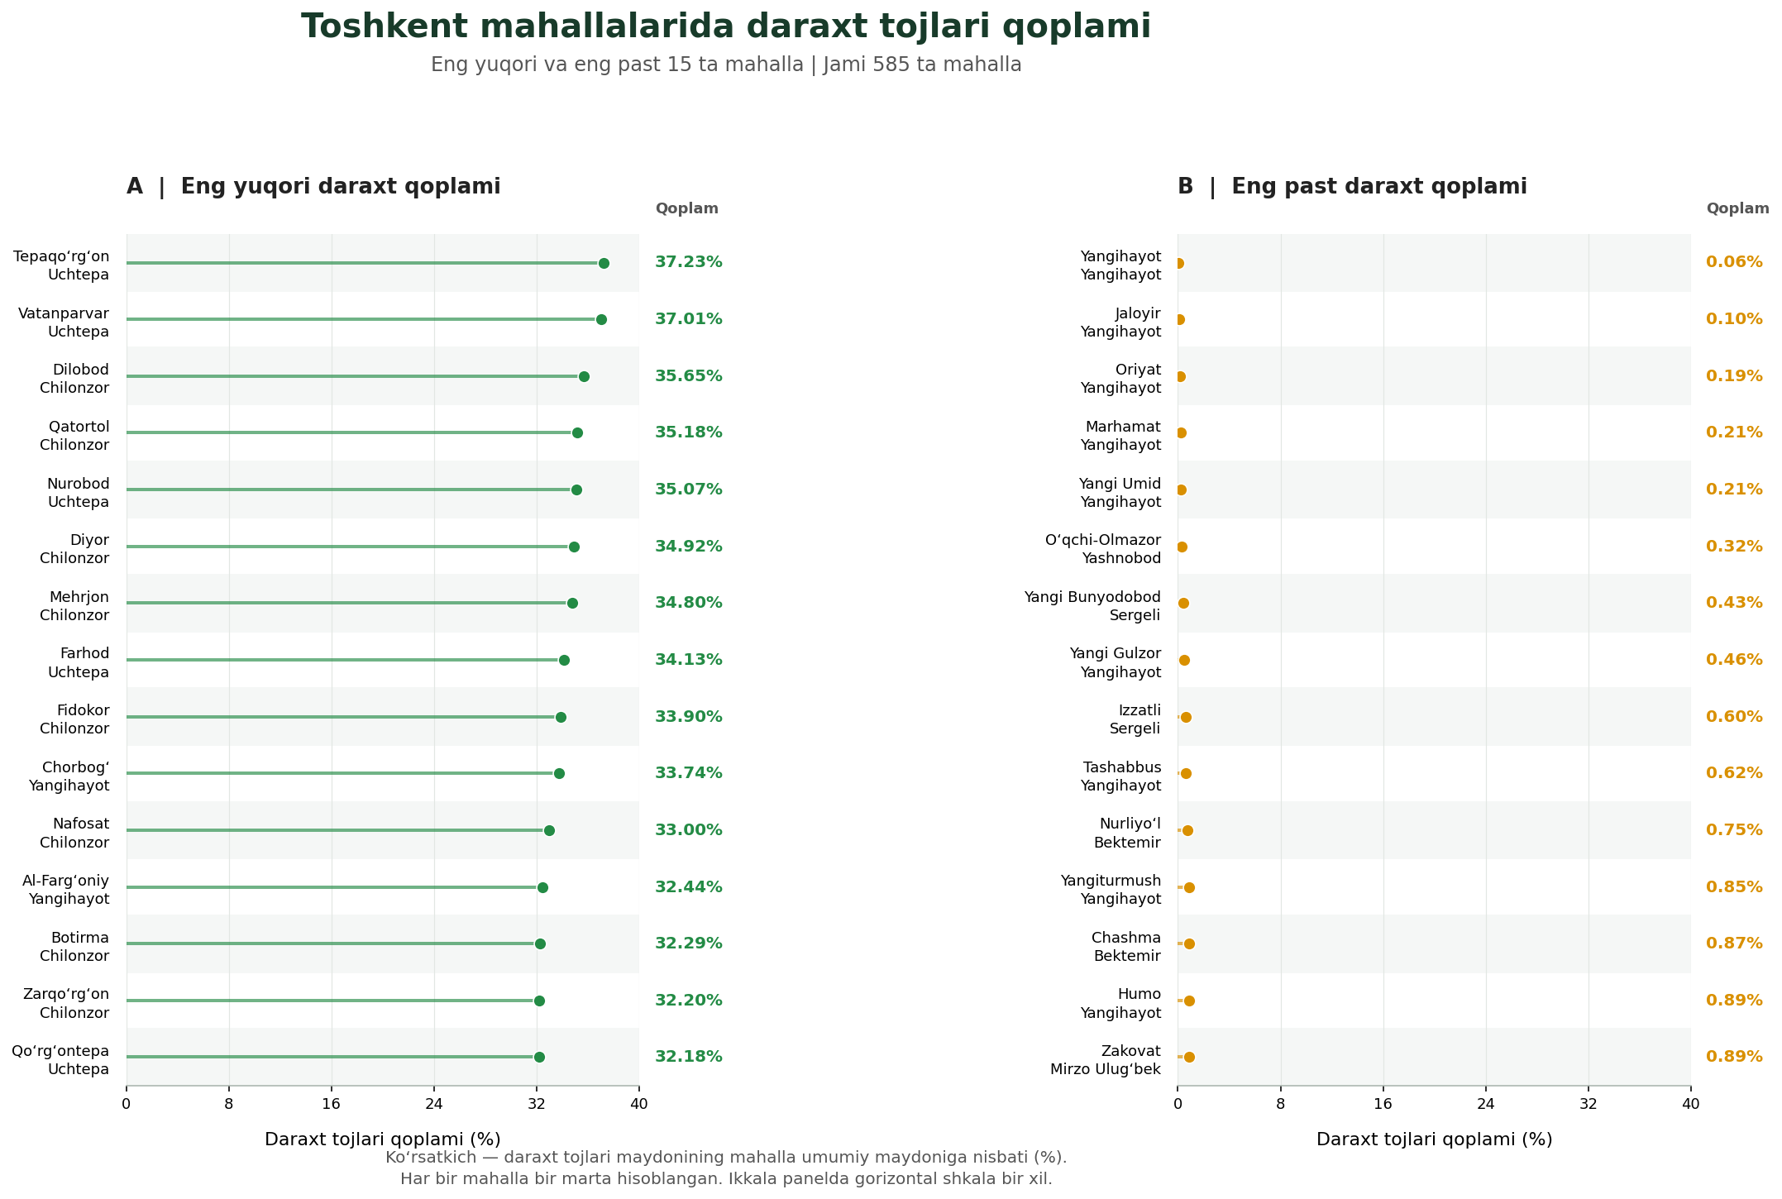
Shade is unequal: tree canopy by mahalla
Ergashova (2026): 9 of the 15 lowest-canopy mahallas are in Yangihayot. Reproduced with permission (Uzbek labels).
10 / 23

Slide 11
Who reaches the metro on foot?
• LAB3: residential land within a 1,200 m walk of a station, by district
11 / 23

Slide 12
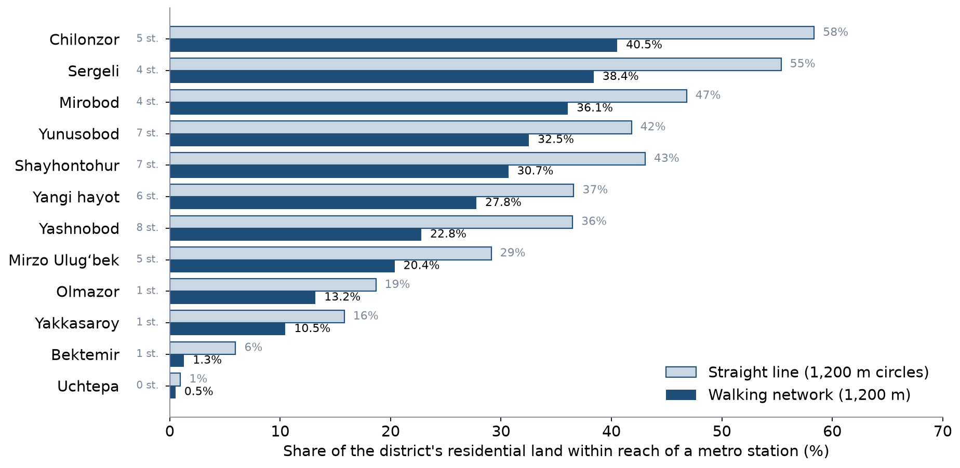
Walking access to the metro by district
Residential land within reach: 40.5% in Chilonzor, 0.5% in Uchtepa. Pale bars: straight-line circles.
12 / 23

Slide 13
Reading the access map
• City-wide, 23.8% vs 33.7% of residential land is within reach by network vs straight line
• Metro investment benefits those who live near stations; others depend on buses
• Uchtepa has no station: equity needs feeders, not only more metro
• Population layers could not be used: Kontur misplaces Tashkent's residents
13 / 23

Slide 14
Safety harm is unequal
• Pedestrian strikes: 57.4% of police crash records (2016)
• Age 60+ vs adults: OR 1.96 (1.09–3.52) for recorded death
• A 70-year-old in an overnight crash: 26.7% vs 8.6% recorded death as pedestrian vs occupant
• Those who drive least bear the most serious harm
14 / 23

Slide 15
Who pays for a cycle network?
• Closing Tashkent's cycle gaps puts 94% of new links on sidewalks
• 66.4% of riding already happens on sidewalks
• Cyclists gain; pedestrians may lose space unless footways are protected
• A just design states both, and mitigates the loss
15 / 23

Slide 16
Whose voice is in the data?
• Pulatova's survey: 72.2% of respondents male, sample size not reported
• Women, children and older people are under-represented in most counts and surveys
• Modelled population data can be wrong by a factor of several (Week 2)
• Missing groups in data become missing groups in decisions
16 / 23

Slide 17
Critical reading: checking a dissertation's numbers
• Uchtepa: 27,058 pixels give 60, not 54
• Yangihayot: 28,852 pixels give 2,885,200 m² (64), not 2,685,200 m² (59)
• Claimed saving of $19,007,010 per year from a formula with no distance term
• P3 asks you to recompute and to name the missing assumptions
17 / 23

Slide 18
Benefit–cost incidence: a template
Group | Benefits | Costs | Evidence and its gaps
Bus passengers | Faster, more reliable trips | Construction disruption | Counts, headways
Car drivers | — | Less road space, longer queues | Counts, journey times
Pedestrians | Safer crossings | Narrower footway if not protected | Audit, survey
Shopkeepers | More passing customers | Loss of kerbside parking | Interviews
Residents on the street | Less noise | Construction noise | Observation
18 / 23

Slide 19
Discussion
In your corridor project, who is the worst-off user — and what would a Rawlsian planner change first?
• Name the group, the evidence and the change.
19 / 23

Slide 20
Key takeaways
• Every transport project redistributes access, safety, space and pollution
• Choose and state a principle: sufficiency and worst-off-first are common choices
• Tashkent evidence is strongest on safety and walking access, weakest on income and gender
• Check the numbers — including those in respected sources
20 / 23

Slide 21
Stage 1 of the course project is due this week
• Problem, objectives and 5–7 indicators (P1)
• Baseline data, survey plan and data-quality log (P2, LAB2)
• Corridor map with dataset log (LAB1) and access catchments (LAB3)
• Who benefits and who pays (P3)
21 / 23

Slide 22
References
• MIT Department of Urban Studies and Planning. 11.540 Urban Transportation Planning and Policy (J. Aloisi). MIT Course Catalog, Course 11 subjects. https://catalog.mit.edu/subjects/11/
• Salvucci, F., & Coughlin, J. (2004). 1.253J/11.543J Transportation Policy and Environmental Limits, Spring 2004. MIT OpenCourseWare. https://ocw.mit.edu/courses/1-253j-transportation-policy-and-environmental-limits-spring-2004/
• Pereira, R. H. M., Schwanen, T., & Banister, D. (2017). Distributive justice and equity in transportation. Transport Reviews, 37(2), 170–191. https://doi.org/10.1080/01441647.2016.1257660 (open preprint: https://doi.org/10.31235/osf.io/9hhf7) https://doi.org/10.31235/osf.io/9hhf7
• Lucas, K. (2012). Transport and social exclusion: Where are we now? Transport Policy, 20, 105–113. https://doi.org/10.1016/j.tranpol.2012.01.013 https://doi.org/10.1016/j.tranpol.2012.01.013
• Sodikov, J. I., et al. (under review). Odds of recorded death among police-recorded road-traffic casualties and register data quality in Tashkent, Uzbekistan. Traffic Injury Prevention (revision r4).
• Pulatova, Z. S. (2024). Walkability assessment of Tashkent city districts (PhD dissertation, in Uzbek; supervisor J. I. Sodikov). Tashkent State Transport University.
• Ergashova, M. Z. (2026). 15-minute walkability of Tashkent mahallas — dissertation defence presentation, 14 Oct 2026 (in Uzbek). Tashkent State Transport University.
• TSTU course team (2026). Open data for Tashkent: inventory for the Excel/QGIS labs. Course research note, 22 October 2026 (Materials/_research/open_data_tashkent.md).
• Normukhammadov, A. (2026). Pedalling Towards Sustainability: Developing an Integrated Bicycle Network for Enhanced Urban Mobility in Tashkent City (PhD thesis draft; supervisor J. I. Sodikov). Tashkent State Transport University.
• OpenStreetMap contributors (2026). Uzbekistan extract, Geofabrik GmbH (download.geofabrik.de). https://download.geofabrik.de/asia/uzbekistan.html
• Kontur (2023). Kontur Population: Uzbekistan, 400 m H3 hexagons. Humanitarian Data Exchange. https://data.humdata.org/dataset/kontur-population-uzbekistan
• Salvucci, F. (2016). 1.252J/11.540J Urban Transportation Planning, Fall 2016. MIT OpenCourseWare. https://ocw.mit.edu/courses/1-252j-urban-transportation-planning-fall-2016/
• Rupprecht Consult (Ed.) (2019). Guidelines for Developing and Implementing a Sustainable Urban Mobility Plan (2nd ed.). European Commission / Eltis. https://www.eltis.org/mobility-plans/sump-guidelines

Slide 23
© 2026 TSTU, J. Sodikov. CC BY-NC-SA 4.0. Adapts openly licensed material (CC BY-NC-SA 4.0) listed in the references.

