Slide 1
Week 4 · Lecture 1
Street-network structure and hierarchy
LEC7 · Urban Transport Systems Planning and Design · TSTU · Prof. J. Sodikov

Slide 2
What you will be able to do after today
• Explain why urban networks are hierarchical and what each level is for
• Compare radial, ring–radial and grid network forms
• Measure a network by density, connectivity and directness
• Read Tashkent's network data critically before designing on it
2 / 23

Slide 3
Where this sits: the network-design perspective
• The course's technical methods take four perspectives: network design, service design, infrastructure management, traffic operations
• This week = network design: which links and nodes exist, and how they are ranked
• Weeks 6, 9 and 10 take the other three perspectives on the same city
• The design question: what network gives people access to destinations at acceptable speed and cost?
3 / 23

Slide 4
Why networks are hierarchical
• Trips differ in length — long trips need speed, short trips need direct access
• One network cannot do both: every access point slows through movement
• Hierarchy separates functions: few fast links, many slow access links
• Each level connects to the level above at a limited number of nodes
• Van Nes (2002): the design variables are network density and speed per level
4 / 23

Slide 5
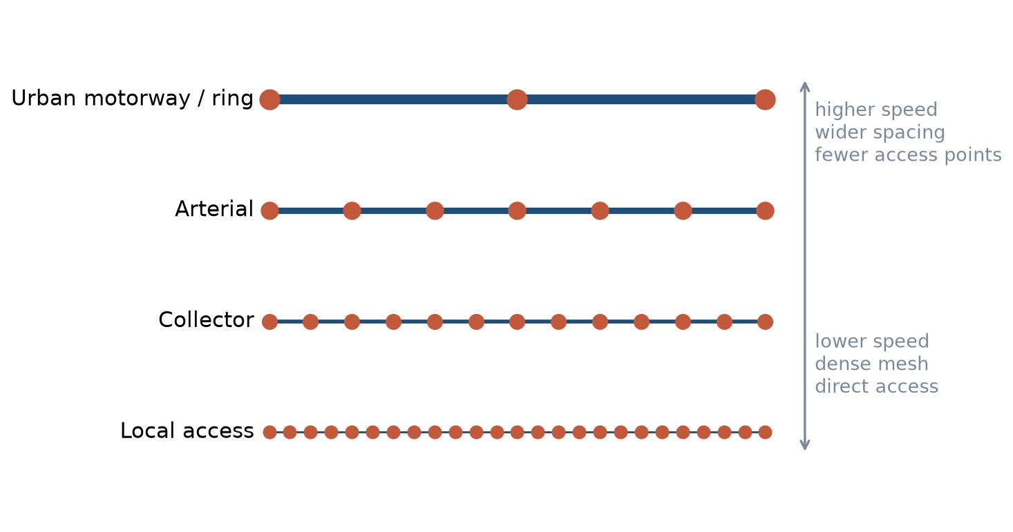
Hierarchy: speed versus access
Higher levels: faster, wider spacing, fewer access points. Lower levels: slower, denser, direct access.
5 / 23

Slide 6
Functional classes of urban streets
• Urban motorway / ring road: through movement, grade-separated access
• Arterial: city-wide movement, public transport corridors, controlled junctions
• Collector: links neighbourhoods to arterials, mixed movement and place
• Local street: access and place — walking, play, deliveries
• Movement and place are both functions; classify by both (GDCI)
• Functional class should drive design standards and maintenance priority
6 / 23

Slide 7
Worked example: link spacing and access distance
• Grid with link spacing s: average perpendicular walk to the nearest link ≈ s / 4
• s = 400 m → about 100 m of access walking
• s = 1,600 m → about 400 m of access walking
• Wider spacing: fewer junctions and higher speed, but longer access
• Optimum spacing depends on trip length and the value of access time
7 / 23

Slide 8
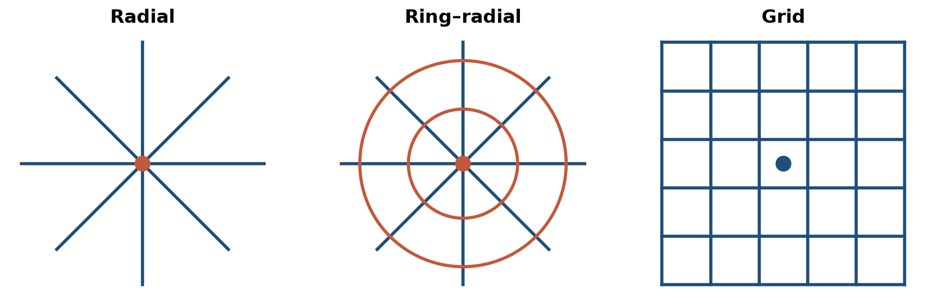
Network forms: radial, ring–radial, grid
Schematic forms; real cities combine them.
8 / 23

Slide 9
Network forms compared
Form | Strength | Weakness | Tashkent example
Radial | Strong access to the centre | Centre congests; poor cross-town links | Avenues converging on the centre
Ring–radial | Cross-town trips avoid the centre | Rings attract traffic; long detours | Inner ring road and the outer ring road
Grid | Many route options; legible; resilient | Needs frequent service everywhere | Chilonzor microdistrict grid
9 / 23

Slide 10
Measuring a network: three families
• Density: length of links per unit area (km/km²)
• Connectivity: intersections per km², links per node, share of dead ends
• Directness: circuity = network distance ÷ straight-line distance
• Each measure answers a different design question — report all three
• Measure per mode: the walking network differs from the car network
10 / 23

Slide 11
Circuity: how to read it
• Circuity = 1.0 means the route is as direct as a straight line
• Rivers, canals, rail lines and closed blocks push circuity up
• A circuity of 1.5 turns a 600 m walk into 900 m
• Pedestrians and cyclists feel circuity far more than drivers
• Always state the sample: which origin–destination pairs, how chosen
11 / 23

Slide 12
Tashkent: what the network data shows
• OpenStreetMap extract, October 2026, and the students' field audits
12 / 23

Slide 13
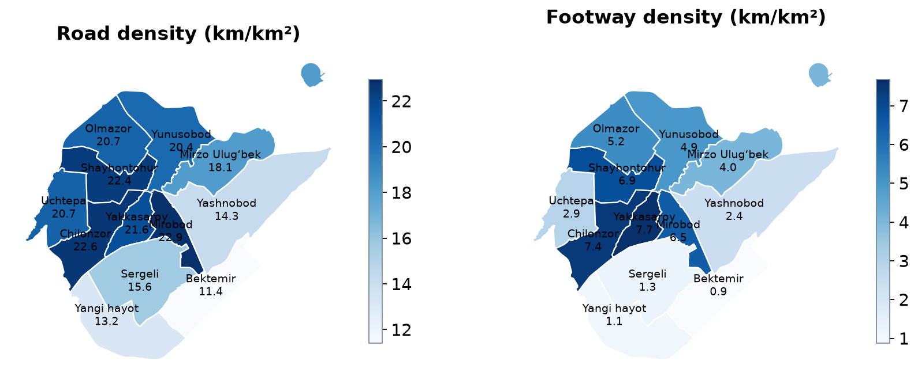
Road and footway density by district
All OSM road classes including service roads; footways = footway, path, pedestrian, steps.
13 / 23

Slide 14
Reading the density maps
• Study area (twelve districts): 437.7 km², 7,686.9 km of mapped road
• City road density 17.6 km/km²; Chilonzor 22.6 km/km²
• Footways: 7.7 km/km² in Yakkasaroy vs 0.87 km/km² in Bektemir
• Ergashova (2026) found 7.35 km/km² and 0.85 km/km² — same pattern, earlier extract
• Density is not quality: service roads inflate it, unmapped footways hide links
14 / 23

Slide 15
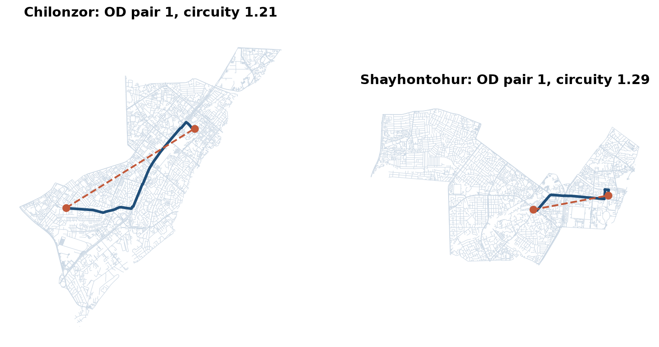
Circuity in practice: Chilonzor and Shayhontohur
Dashed = straight line; navy = shortest road path. LAB4 repeats this for ten pairs per district.
15 / 23

Slide 16
A surprising result
• Mean road circuity (ten random pairs): Chilonzor 1.37, Shayhontohur 1.32
• The planned microdistrict grid is not more direct: large blocks, few through streets
• The old city's dense lanes give short detours — but they are narrow and slow
• Small sample: LAB4 asks you to test how stable the difference is
16 / 23

Slide 17
From inventory to function: Tashkent's streets
• OSM tags (primary, secondary, residential) are not the national design categories
• A GIS inventory links each street to its class, condition and equipment
• Earlier TSTU work: GIS inventory of Tashkent's traffic signals
• Shortest-path tools in QGIS (Road Graph / Network Analysis) support route checks
• Your corridor: record both the OSM class and the official class
17 / 23

Slide 18
Connecting to the external road network
• Through traffic and freight should meet the city on the ring roads, not on local streets
• Entry corridors carry intercity, commuter and freight flows together
• The M-41 corridor study shows how mixed flows create safety problems at the edge
• Design question: where do external links enter the hierarchy, and at which level?
18 / 23

Slide 19
Discussion
Which district would you redesign first — and which measure (density, connectivity or directness) would justify it?
• Two minutes in pairs, then three answers to the class.
19 / 23

Slide 20
Key takeaways
• Hierarchy trades access against speed; design both ends deliberately
• Network form shapes which trips are easy and which are hard
• Report density, connectivity and directness — per mode, with the sample stated
• Tashkent's data is good enough to measure, but check what it leaves out
20 / 23

Slide 21
Before LAB4 and P4
• Open LAB04_network.gpkg in QGIS and check that the project CRS is EPSG:32642
• Read van Nes (2002) chapter 2 on network levels
• Bring a printout or screenshot of your project corridor and its surroundings
21 / 23

Slide 22
References
• TU Delft, Department of Transport & Planning. CIEM6250 Transport Systems Design — units B-1 Network Design, B-2 Service Design, B-3 Physical Infrastructure Management, B-4 Traffic Operations Management (Smart Public Transport Lab education page; MSc Civil Engineering TTE track). https://www.tudelft.nl/citg/over-faculteit/afdelingen/transport-planning/research/labs/smart-public-transport-lab/education
• van Nes, R. (2002). Design of Multimodal Transport Networks: A Hierarchical Approach (PhD thesis, TRAIL T2002/5). Delft University of Technology. https://research.tudelft.nl/en/publications/design-of-multimodal-transport-networks-a-hierarchical-approach
• Global Designing Cities Initiative & NACTO (2016). Global Street Design Guide. Island Press. https://globaldesigningcities.org/publication/global-street-design-guide/
• Sodikov, J. I. (2017). The role of highway functional classification in road asset management. Advances in Transportation Studies.
• Wilson, N., Sánchez-Martínez, G., & Nassir, N. (2017). 1.258J/11.541J Public Transportation Systems, Spring 2017. MIT OpenCourseWare. https://ocw.mit.edu/courses/1-258j-public-transportation-systems-spring-2017/
• OpenStreetMap contributors (2026). Uzbekistan extract, Geofabrik GmbH (download.geofabrik.de). https://download.geofabrik.de/asia/uzbekistan.html
• TU Delft (2013). CIE4801 Transportation and Spatial Modelling. TU Delft OpenCourseWare. https://ocw.tudelft.nl/courses/transportation-and-spatial-modelling/
• Ergashova, M. Z. (2026). 15-minute walkability of Tashkent mahallas — dissertation defence presentation, 14 Oct 2026 (in Uzbek). Tashkent State Transport University.
• Sodikov, J. I., et al. (2016). GIS inventory of traffic signals on Tashkent streets (in Russian). Transport Systems of Siberia.
• Sodikov, J. I. (2022). Determining the shortest path between two features with QGIS using the Road Graph module. Molodyi vchenyi.
• Sodikov, J. I., et al. (2026). Traffic pattern and safety evaluation on the M-41 corridor using mixed-methods analysis. AIP Conference Proceedings (2025 Int. Conf.).

Slide 23
© 2026 TSTU, J. Sodikov. CC BY-NC-SA 4.0. Adapts openly licensed material (CC BY-NC-SA 4.0) listed in the references.

