Slide 1
Week 4 · Lecture 2
Multimodal network alternatives
LEC8 · Urban Transport Systems Planning and Design · TSTU · Prof. J. Sodikov

Slide 2
What you will be able to do after today
• Treat walking, cycling, public transport, car and freight as layered networks
• Find nodes, missing links and barriers that break continuity
• Use connectivity, not kilometres, to prioritise new links
• Build a low-cost and a structural alternative under spatial constraints
2 / 23

Slide 3
One city, several networks
• Each mode has its own network and its own hierarchy
• Walking and cycling: dense, short links; continuity matters most
• Public transport: lines and stops on top of the street network
• Car and freight: the road hierarchy, with access restrictions
• Multimodal design = layers that work together at good transfer nodes
3 / 23

Slide 4
Design requirements for a network layer
• Coherence: every origin connects to every destination without breaks
• Directness: low detours compared with the alternative mode
• Safety: conflicts handled at the right level of the hierarchy
• Comfort and attractiveness: surface, shade, noise, social safety
• These requirements apply to every layer, weighted differently
4 / 23

Slide 5
Public transport network structure
• Radial networks: one-seat rides to the centre; poor cross-town service
• Grid networks: many destinations with one transfer; need high frequency
• Transfers are the price of a connected network — frequency makes them acceptable
• Ridership goals and coverage goals pull in different directions (Walker)
5 / 23

Slide 6
Nodes: where the networks meet
• Tashkent has 49 metro stations and 2,019 mapped bus stops (OSM)
• Yet 74.4% of the city's 585 mahallas have no metro station within a 15-minute walk
• A node is only as good as the walking and cycling links that reach it
• Design interchanges as part of the network, not as isolated buildings
6 / 23

Slide 7
Missing links and barriers
• Canals, rail lines, wide arterials and closed estates cut walking and cycling links
• A missing crossing can add hundreds of metres to a short trip
• Bo'zsuv canal: pedestrian safety and comfort along and across the canal
• Bo'rijar route: a canal-side corridor as a cycling opportunity
• Barriers are also opportunities: green corridors along water
7 / 23

Slide 8
Case: Tashkent's cycling network
• Normukhammadov (2026), PhD research supervised at TSTU — field audit, network analysis, gap closure
8 / 23

Slide 9
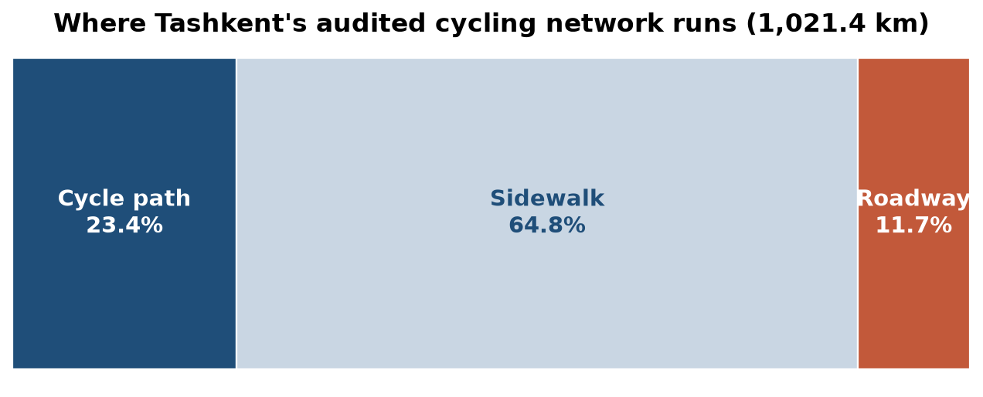
Where people actually cycle
Audited network 1,021.4 km: cycle path 23.4%, sidewalk 64.8%, roadway 11.7%.
9 / 23

Slide 10
Audit before you design
• 66.4% of riding exposure in the field survey was on sidewalks
• Field audit: 238.7 km of cycle path; OpenStreetMap shows only 108.9 km of cycleway
• Open data under-records active-travel infrastructure
• Lesson for your project: verify OSM in the field before drawing conclusions
10 / 23

Slide 11
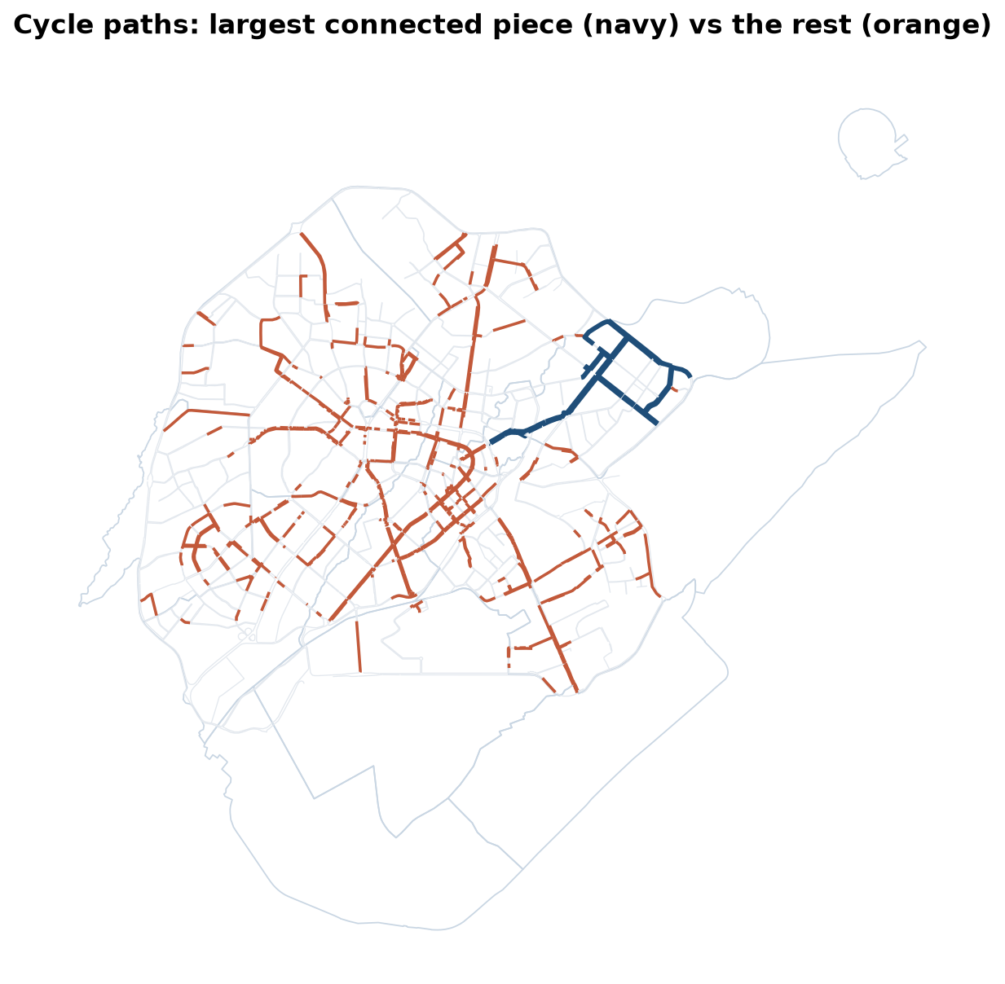
Fragmented, not missing
222.7 km of routable cycle path sits in 149 fragments; the largest is 31.1 km.
11 / 23

Slide 12
Why fragmentation matters
• Only 4 of 4,095 district-scale seed pairs are linked by protected paths
• A network's value grows with connections, not with kilometres
• A new metre is worth most when it joins two fragments
• Cyclists judge the weakest link on a route, not the average
12 / 23

Slide 13
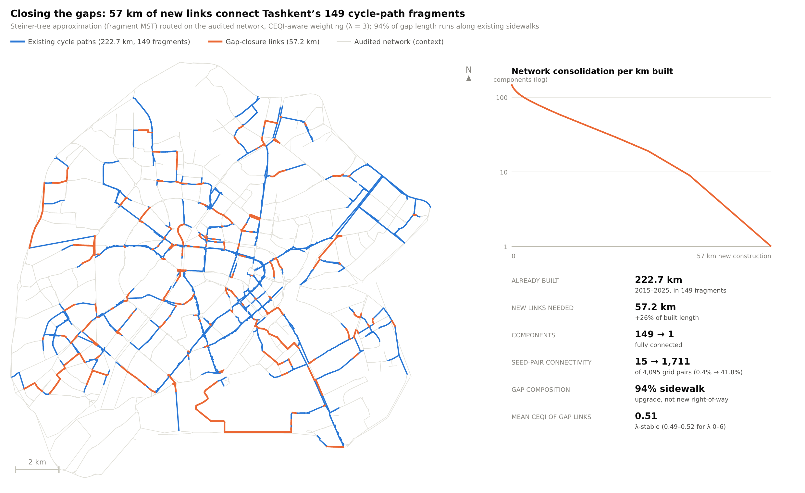
Closing the gaps
57.2 km of new links joins everything into one 279.9 km network — 94% by converting sidewalk.
13 / 23

Slide 14
Method: minimum gap closure
• Treat each fragment as a node; the cost of a link is the new length needed
• Find the cheapest path between every pair of fragments on the street network
• Join all fragments with a minimum spanning tree of those paths
• The answer is an upper bound: a better alignment can only reduce it
• Same logic works for footway gaps and missing crossings
14 / 23

Slide 15
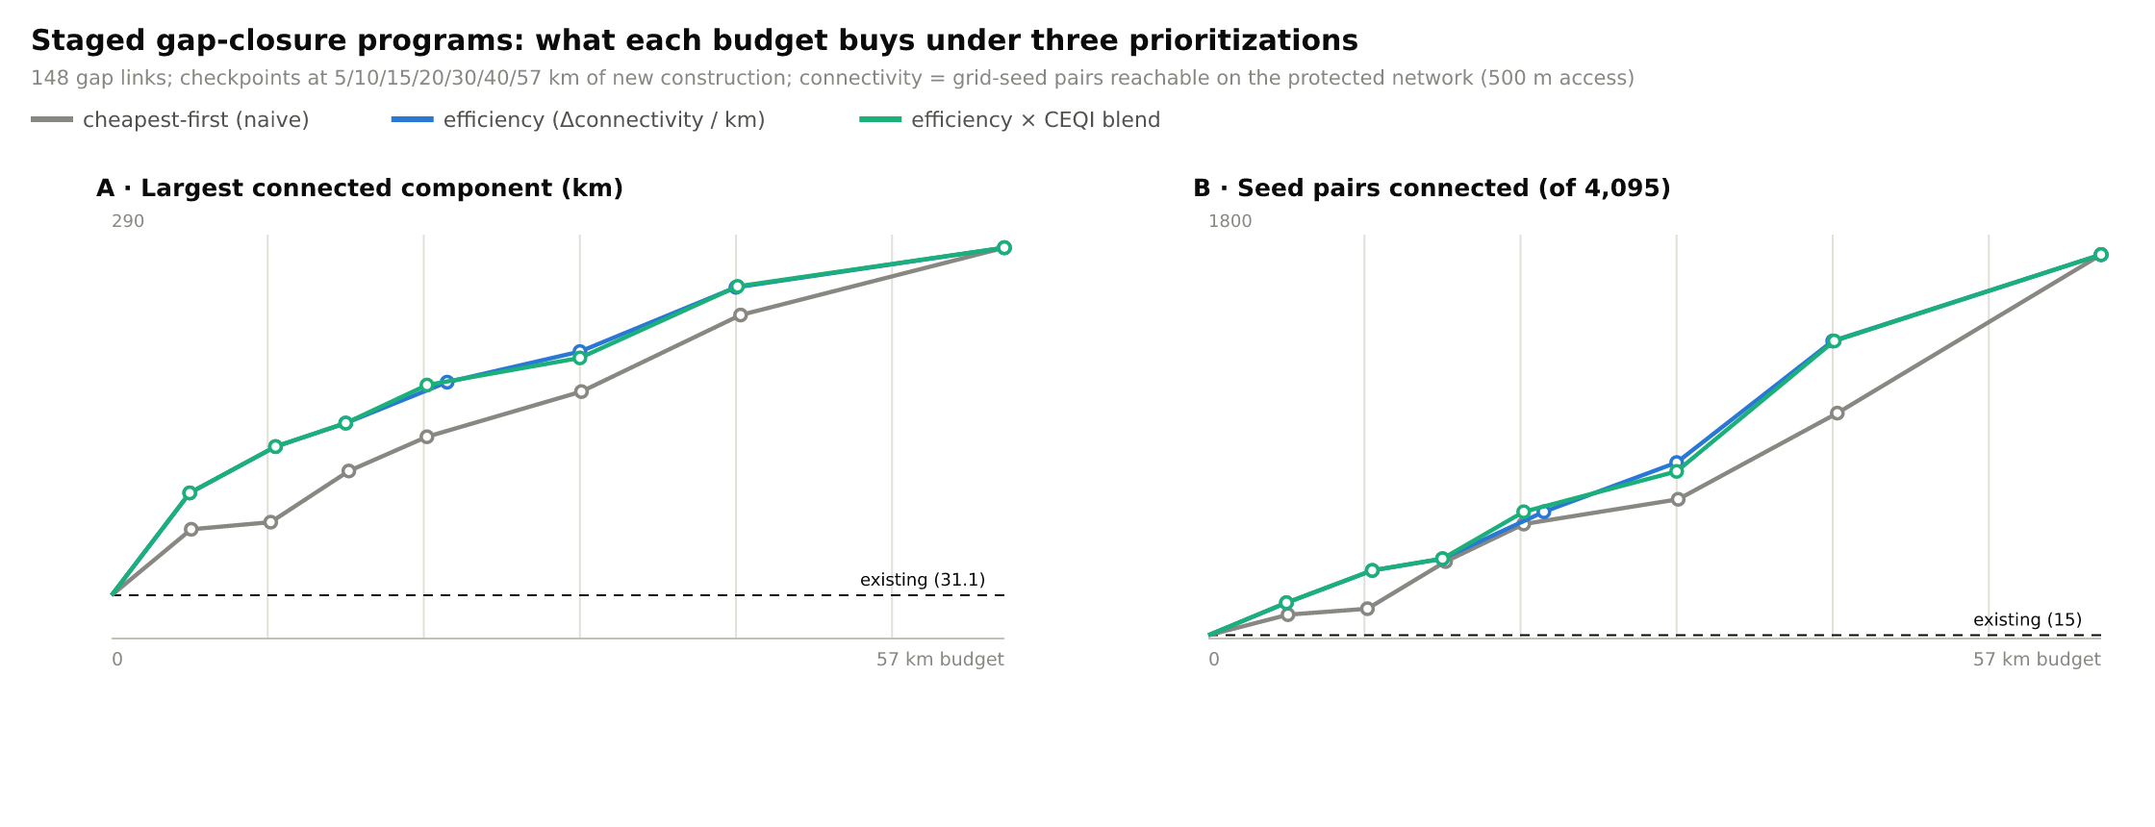
Phasing: build where it connects most
Phase 1: the largest connected network grows 31.1 → 137.8 km for $0.33–3.12 M.
15 / 23

Slide 16
Kilometres announced or connections delivered?
• The city announced 656 km of pedestrian and bicycle lanes in 2020
• A full planned network on the audited streets needs 363 km
• The full gap-closure programme costs $1.86–17.82 M
• Targets in kilometres reward length; targets in connections reward network value
16 / 23

Slide 17
Developing alternatives under spatial constraints
• Low-cost improvement: markings, crossings, kerb ramps, signal changes, sidewalk conversion
• Structural change: new links, canal bridges, road diet, dedicated bus lanes
• Keep the same study area and the same assessment year for both
• State the constraint each alternative removes: width, crossing, gradient, ownership
17 / 23

Slide 18
What changes in each alternative
Layer | Low-cost alternative | Structural alternative
Walking | Marked crossings, kerb ramps, shorter signal waits | New canal bridge, removal of barriers
Cycling | Protected lane on converted sidewalk | Continuous protected track on a spine
Public transport | Stop relocation and boarding platforms | Dedicated bus lane with junction priority
Car | Turn restrictions, speed management | Road diet: lanes reallocated
Freight | Loading time windows | Bypass routing via the ring road
18 / 23

Slide 19
Choosing between options: multi-criteria ranking
• Sodikov et al. combined a simulated cyclist survey with TOPSIS to rank network options in Tashkent
• Criteria such as safety, continuity, comfort and cost are weighted and compared
• Ranking makes trade-offs explicit — the weights must be justified
• Week 14 builds a full appraisal matrix with sensitivity tests
19 / 23

Slide 20
Discussion
With 10 km of construction for your corridor, which links would you build — and how would you show they matter?
• Answer with a connection argument, not a length argument.
20 / 23

Slide 21
Key takeaways
• Design networks as coupled layers joined at good nodes
• Continuity and missing links decide whether a network works
• Prioritise links by the connections they create
• Every alternative needs a stated constraint, cost range and beneficiaries
21 / 23

Slide 22
References
• TU Delft, Department of Transport & Planning. CIEM6250 Transport Systems Design — units B-1 Network Design, B-2 Service Design, B-3 Physical Infrastructure Management, B-4 Traffic Operations Management (Smart Public Transport Lab education page; MSc Civil Engineering TTE track). https://www.tudelft.nl/citg/over-faculteit/afdelingen/transport-planning/research/labs/smart-public-transport-lab/education
• van Nes, R. (2002). Design of Multimodal Transport Networks: A Hierarchical Approach (PhD thesis, TRAIL T2002/5). Delft University of Technology. https://research.tudelft.nl/en/publications/design-of-multimodal-transport-networks-a-hierarchical-approach
• Global Designing Cities Initiative & NACTO (2016). Global Street Design Guide. Island Press. https://globaldesigningcities.org/publication/global-street-design-guide/
• Wilson, N., Sánchez-Martínez, G., & Nassir, N. (2017). 1.258J/11.541J Public Transportation Systems, Spring 2017. MIT OpenCourseWare. https://ocw.mit.edu/courses/1-258j-public-transportation-systems-spring-2017/
• Walker, J. (2008). Purpose-driven public transport: creating a clear conversation about public transport goals. Journal of Transport Geography, 16(6), 436–442. https://ses.library.usyd.edu.au/handle/2123/6057
• OpenStreetMap contributors (2026). Uzbekistan extract, Geofabrik GmbH (download.geofabrik.de). https://download.geofabrik.de/asia/uzbekistan.html
• Ergashova, M. Z. (2026). 15-minute walkability of Tashkent mahallas — dissertation defence presentation, 14 Oct 2026 (in Uzbek). Tashkent State Transport University.
• Sodikov, J. I., et al. (2024). Navigating the urban terrain: enhancing pedestrian safety and comfort in Tashkent's Bo'zsuv canal area. Inzhener. https://engineer.tstu.uz
• Sodikov, J. I., et al. (2024). Cycling the Bo'rijar route: infrastructure innovation for Tashkent's sustainable transit. Inzhener. https://engineer.tstu.uz
• Normukhammadov, A. (2026). Pedalling Towards Sustainability: Developing an Integrated Bicycle Network for Enhanced Urban Mobility in Tashkent City (PhD thesis draft; supervisor J. I. Sodikov). Tashkent State Transport University.
• MIT Department of Urban Studies and Planning. 11.540 Urban Transportation Planning and Policy (J. Aloisi). MIT Course Catalog, Course 11 subjects. https://catalog.mit.edu/subjects/11/
• Sodikov, J. I., et al. (2026). Improving urban bicycle network planning: evidence from a survey and TOPSIS analysis in Tashkent. Inzhener. https://engineer.tstu.uz

Slide 23
© 2026 TSTU, J. Sodikov. CC BY-NC-SA 4.0. Adapts openly licensed material (CC BY-NC-SA 4.0) listed in the references.

