Slide 1
Week 5 · Lecture 1
Travel demand and mode choice
LEC9 · Urban Transport Systems Planning and Design · TSTU · Prof. J. Sodikov

Slide 2
What you will be able to do after today
• Explain the four steps of the classic travel-demand model and what each one assumes
• Describe mode choice as a trade-off of time, price and convenience (logit)
• Recognise the limits of simplified forecasts before you use one
• Read Tashkent's demand evidence critically and name the data that is missing
2 / 24

Slide 3
Why forecast at all?
• A forecast is a tool for comparing alternatives, not a prophecy
• Every alternative must be tested in the same assessment year (syllabus §5)
• Forecasts size infrastructure, services and budgets — errors are expensive
• One published course teaches the four-step model among its planning methods
• Another, on transportation modelling, builds it step by step with exercises
3 / 24

Slide 4
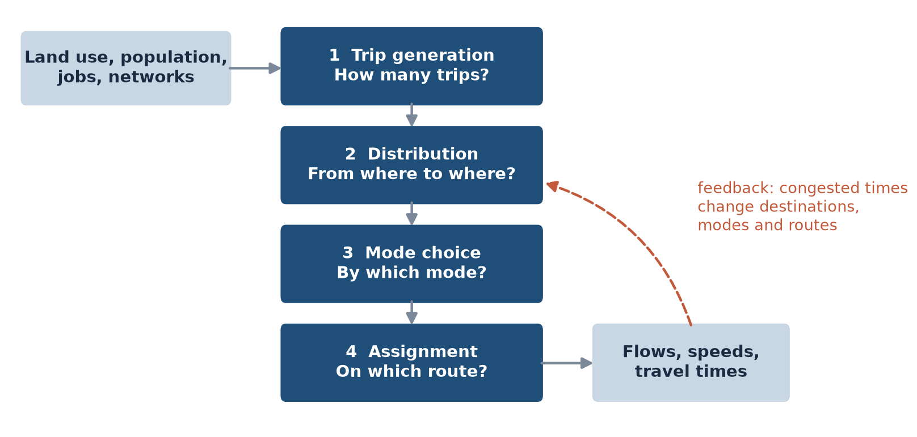
The four-step model
Generation → distribution → mode choice → assignment, with travel times fed back.
4 / 24

Slide 5
Step 1 — trip generation
• Productions: trips made by residents of a zone (households, cars, income)
• Attractions: trips drawn by a zone (jobs, schools, shops, floor space)
• Tools: trip rates per household or person, cross-classification, regression
• Inputs come from a household travel survey — which Tashkent does not publish
• Rates change with car ownership: motorisation feeds generation
5 / 24

Slide 6
Step 2 — distribution: the gravity model
• Trips from i to j grow with productions at i and attractions at j
• They fall with the cost of travel between them: f(c) = exp(−βc)
• Singly constrained: row totals match productions; doubly: columns match attractions too
• β is calibrated so the model reproduces the observed trip-length distribution
• Without observed trip lengths, β is an assumption — say so
6 / 24

Slide 7
Worked example: four zones (LAB5 Distribution sheet)
• Four synthetic zones with productions, an attractiveness index and distances
• At β = 0.15 per km the model gives a mean trip length of 4.22 km
• Raise β and trips stay closer to home; lower β and trips spread out
• The number only means something once compared with observed trip lengths
7 / 24

Slide 8
Step 3 — mode choice as utility
• Each traveller compares the utility of each mode: V = β·time + β·cost + β·comfort + constant
• Random-utility theory gives the logit model: P(m) = e^V(m) / Σ e^V(k)
• Out-of-vehicle time (walk, wait, transfer) is usually weighted more than in-vehicle time
• The mode constant captures what the variables miss: habit, image, reliability
• Coefficients are estimated from stated- or revealed-preference surveys
8 / 24

Slide 9
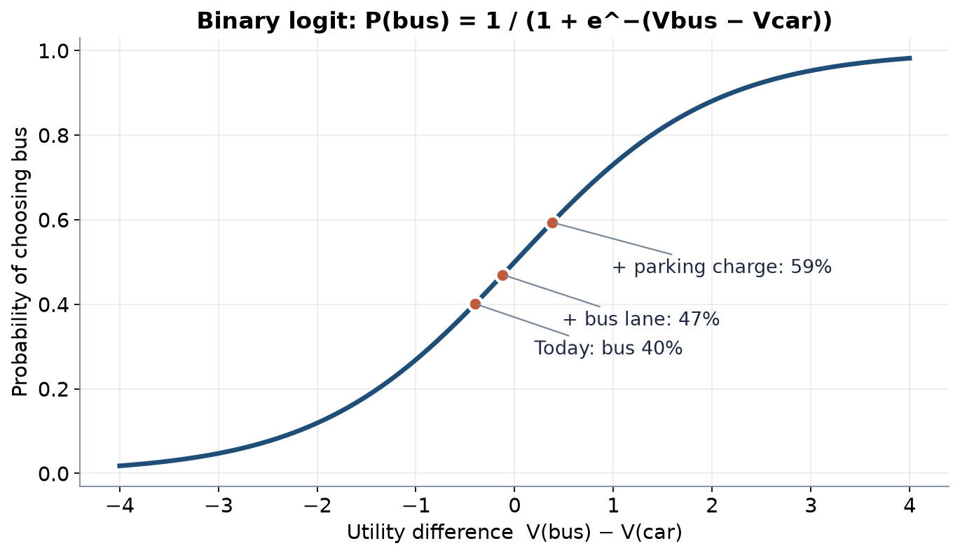
Worked example: what moves the bus share?
Illustrative coefficients. Bus lane cuts in-vehicle time 35 → 28 min; parking charge adds 5 to car cost.
9 / 24

Slide 10
Time, price and convenience
• Time: in-vehicle, walking, waiting, transferring — valued differently
• Price: fare, fuel, parking charge, tolls — and who pays them
• Convenience: reliability, crowding, comfort, safety, information
• Policy changes utilities; the model translates that into shares
• Measures that change several terms at once (bus priority + parking price) work best
10 / 24

Slide 11
Step 4 — assignment
• Trips are loaded onto routes in the network
• All-or-nothing: everyone takes the shortest path (fine for uncongested networks)
• User equilibrium (Wardrop): no traveller can save time by switching route
• Public-transport assignment adds waiting, transfers and line frequencies
• Congested times should feed back to steps 2 and 3
11 / 24

Slide 12
Limits of simplified forecasts
• Land use is held fixed — but new roads and lines move homes and jobs
• No feedback means no induced demand: capacity looks free
• Base-year calibration hides weak behavioural content
• Point forecasts hide uncertainty — report ranges and test assumptions
• Optimism bias: forecasts tend to favour the project being promoted
12 / 24

Slide 13
Tashkent: what we know about demand
• Motorisation, mode shares and targets — and the data that is missing
13 / 24

Slide 14
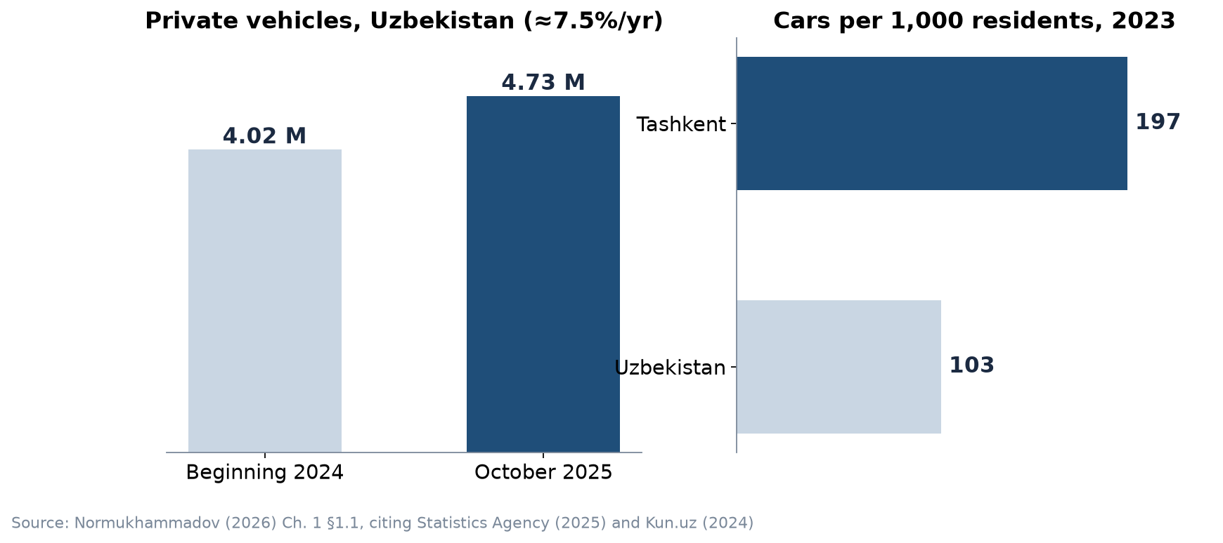
Motorisation is rising fast
National private fleet 4.02 million → 4.73 million in under two years; Tashkent 197 cars / 1,000 vs national 103 per 1,000.
14 / 24

Slide 15
Tashkent's demand in five numbers
• Population 3.04 million (beginning of 2024)
• 197 cars / 1,000 residents, almost twice the national 103 per 1,000
• National private fleet growing about 7.5% per year
• Cars carried 79% of trips and public transport 21% (2022 briefing)
• The same briefing set the task of doubling public-transport use
15 / 24

Slide 16
Read the 79 / 21 split critically
• 79% and 21% add up to the whole with no walking or cycling: motorised trips only
• Source is a policy briefing, not a published household travel survey
• No open origin–destination matrix, trip rates or mode shares by district exist
• ITF/OECD's Tashkent decarbonisation study holds a detailed published mode-share model
• Rule for your project: state where each demand number comes from and its year
16 / 24

Slide 17
Why do car owners switch — or not?
• Sodikov et al. (2026c) review the factors behind car owners' shift to public transport in Tashkent
• Read it with the utility frame: which factors are time, price or convenience?
• Which factors can a corridor project change, and which need city policy?
• Use it in P5 to justify the mode-share change in each alternative
17 / 24

Slide 18
Targets imply a demand forecast
• 2022–2025 concept: public-transport use to 43%, about 2.7 million passengers per day
• Implied total: 2.7 million ÷ 43% = 6.28 million trips per day
• LAB5 base year assumes 3.04 million residents × 2 trips = 6.08 million
• The assumed trip rate is consistent with the target (ratio 0.97) — a sanity check, not a validation
• A target is not a forecast: what measures would deliver it?
18 / 24

Slide 19
When there is no demand data: a thesis example
• Normukhammadov's network-growth model had no origin–destination data
• Latent demand was represented by a regular grid of seed points 1,707 m apart
• Benefit scenarios use 5,000 / 15,000 / 30,000 daily users — stated as assumptions
• The thesis says so in its limitations: honest, and a model for your report
19 / 24

Slide 20
Discussion
Which single survey would most improve demand forecasts for your corridor — and what would it cost to run?
• Think: counts, intercept interviews, GPS tracking, smart-card data.
20 / 24

Slide 21
Key takeaways
• The four-step model compares alternatives in one assessment year; it does not decide
• Mode choice responds to time, price and convenience — policy changes all three
• Simplified forecasts miss land-use change and induced demand
• Tashkent has headline numbers but no open travel survey: label every assumption
21 / 24

Slide 22
Before LAB5 and P5
• Open LAB05_demand_scenarios_synthetic.xlsx and read the README and Inputs sheets
• Read the required lecture notes on trip generation and distribution
• Bring your Stage 1 counts or the corridor flows from Week 2
22 / 24

Slide 23
References
• TU Delft (2013). CIE4801 Transportation and Spatial Modelling. TU Delft OpenCourseWare. https://ocw.tudelft.nl/courses/transportation-and-spatial-modelling/
• Ben-Akiva, M. (2008). 1.201J/11.545J Transportation Systems Analysis: Demand and Economics, Fall 2008. MIT OpenCourseWare. https://ocw.mit.edu/courses/1-201j-transportation-systems-analysis-demand-and-economics-fall-2008/
• Salvucci, F. (2016). 1.252J/11.540J Urban Transportation Planning, Fall 2016. MIT OpenCourseWare. https://ocw.mit.edu/courses/1-252j-urban-transportation-planning-fall-2016/
• Synthetic teaching dataset generated for this course (method and random seed in each workbook's README sheet).
• van Wee, B., Annema, J. A., Banister, D., & Pudāne, B. (Eds.) (2023). The Transport System and Transport Policy: An Introduction (2nd ed.). Edward Elgar. https://rstrail.nl/the-transport-system-and-transport-policy-an-introduction/
• Wilson, N., Sánchez-Martínez, G., & Nassir, N. (2017). 1.258J/11.541J Public Transportation Systems, Spring 2017. MIT OpenCourseWare. https://ocw.mit.edu/courses/1-258j-public-transportation-systems-spring-2017/
• Normukhammadov, A. (2026). Pedalling Towards Sustainability: Developing an Integrated Bicycle Network for Enhanced Urban Mobility in Tashkent City (PhD thesis draft; supervisor J. I. Sodikov). Tashkent State Transport University.
• International Transport Forum (2023). Decarbonising Pathways for Urban Mobility in Uzbekistan (Tashkent) — methodology report and scenario model. OECD/ITF. https://www.itf-oecd.org/decarbonising-pathways-urban-mobility-uzbekistan
• Sodikov, J. I., et al. (2026). A review of factors influencing car owners' shift to public transport in Tashkent. Inzhener. https://engineer.tstu.uz
• Pulatova, Z. S. (2024). Walkability assessment of Tashkent city districts (PhD dissertation, in Uzbek; supervisor J. I. Sodikov). Tashkent State Transport University.

Slide 24
© 2026 TSTU, J. Sodikov. CC BY-NC-SA 4.0. Adapts openly licensed material (CC BY-NC-SA 4.0) listed in the references.

