Slide 1
Week 5 · Lecture 2
Demand management and induced demand
LEC10 · Urban Transport Systems Planning and Design · TSTU · Prof. J. Sodikov

Slide 2
What you will be able to do after today
• Explain induced demand and summarise the evidence for it
• Choose demand-management measures — pricing, priority, walking and cycling
• Contrast forecast-led expansion with objective-led scenarios
• Test which assumptions drive a scenario result
2 / 24

Slide 3
Predict-and-provide versus decide-and-provide
• Predict-and-provide: forecast traffic, then build capacity to meet it
• Decide-and-provide: set objectives first, then shape demand to meet them
• SUMP guidelines put objectives and indicators before measures
• A published planning course uses the highway revolt in Boston to show the political limits of predict-and-provide
3 / 24

Slide 4
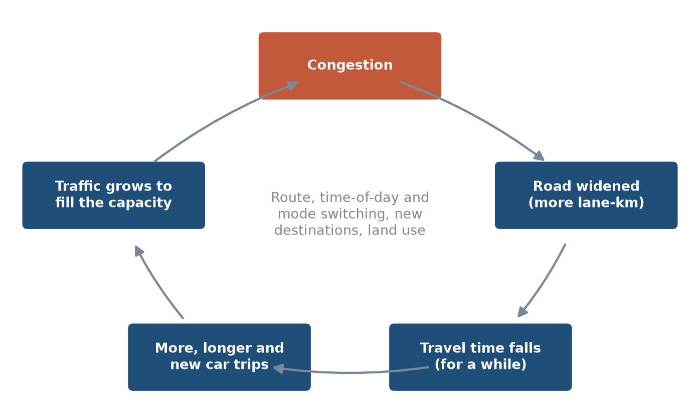
Induced demand: the feedback loop
Faster roads lower the cost of driving; people respond until congestion returns.
4 / 24

Slide 5
Where does the extra traffic come from?
• Route and time-of-day switching (short run)
• Mode switching from bus, walking and cycling to car
• Longer trips to more distant destinations
• New trips that were not made before
• Land use: homes and businesses move to newly accessible places (long run)
5 / 24

Slide 6
The evidence
• SACTRA (1994): monitoring of 151 trunk-road schemes — induced traffic is real and matters
• Duranton & Turner (2011): vehicle-km rise proportionately to lane-km in US cities
• Noland (2026): elasticities across thirty years of studies converge towards 1.0
• Bucsky & Juhász (2022): 55 years of Budapest bridges — less capacity, less traffic
6 / 24

Slide 7
Worked example: widening Tashkent's main roads (LAB5)
• Baseline 2035: 38.3 million veh-km/day of car travel (teaching assumptions)
• Add 10% more lane-km; induced-demand elasticity 1.0
• Result: about 3.8 million veh-km/day of extra traffic
• A fixed-demand forecast would have predicted zero extra traffic — and big time savings
7 / 24

Slide 8
Implication: capacity cannot cure congestion
• Duranton & Turner also found no effect of public-transport provision on vehicle-km
• So congestion relief needs price or space reallocation, not only alternatives
• Capacity can still be justified — for access, safety or freight — but not as a cure
• Appraisals that ignore induced demand overstate time savings
8 / 24

Slide 9
The demand-management toolbox
• Change time, price and convenience — together
9 / 24

Slide 10
Measures and the utility term they change
Measure | Changes | Typical Tashkent opportunity
Parking pricing and supply limits | Car cost, search time | Centre streets and footway parking
Bus lanes and junction priority | Bus in-vehicle time, reliability | Main radial corridors (Week 6)
Congestion or cordon charge | Car cost at peak | Long-term option; needs enforcement
Walking and cycling networks | Access time, safety, comfort | Gap closure and safe crossings (Weeks 4, 8)
Land use and parking standards | Trip lengths, destinations | New developments and New Tashkent
10 / 24

Slide 11
Parking: the strongest local lever
• Free parking at the destination makes driving cheap even when roads are full
• Price and supply of parking shape car ownership and use
• Pulatova's survey: 47.5% of pedestrians say footways are used for car parking
• Enforcing footway parking frees walking space and raises the cost of driving
11 / 24

Slide 12
Walking and cycling as demand measures
• Cycling benefits in the thesis rest on 5,000 / 15,000 / 30,000 daily users
• Central case: 15.0 M km cycled per year, worth about $2.7 M/yr
• Even the ambitious case is about 1% of residents — small against millions of car trips
• Value lies in short trips, metro access and network effects, not in city-wide totals
12 / 24

Slide 13
Objective-led scenarios for Tashkent
• Baseline and two alternatives in one assessment year: 2035
13 / 24

Slide 14
Three scenarios, one assessment year
• Baseline (trend): no new policy; car share grows with the fleet
• Alternative A (low-cost): bus lanes, junction priority, parking management
• Alternative B (structural): bus-network reform, priority corridors, cycling network, parking pricing
• Alternative B is set to the concept target: public transport 43%
• Same population, trip rate and trip length in all three — only policy differs
14 / 24

Slide 15
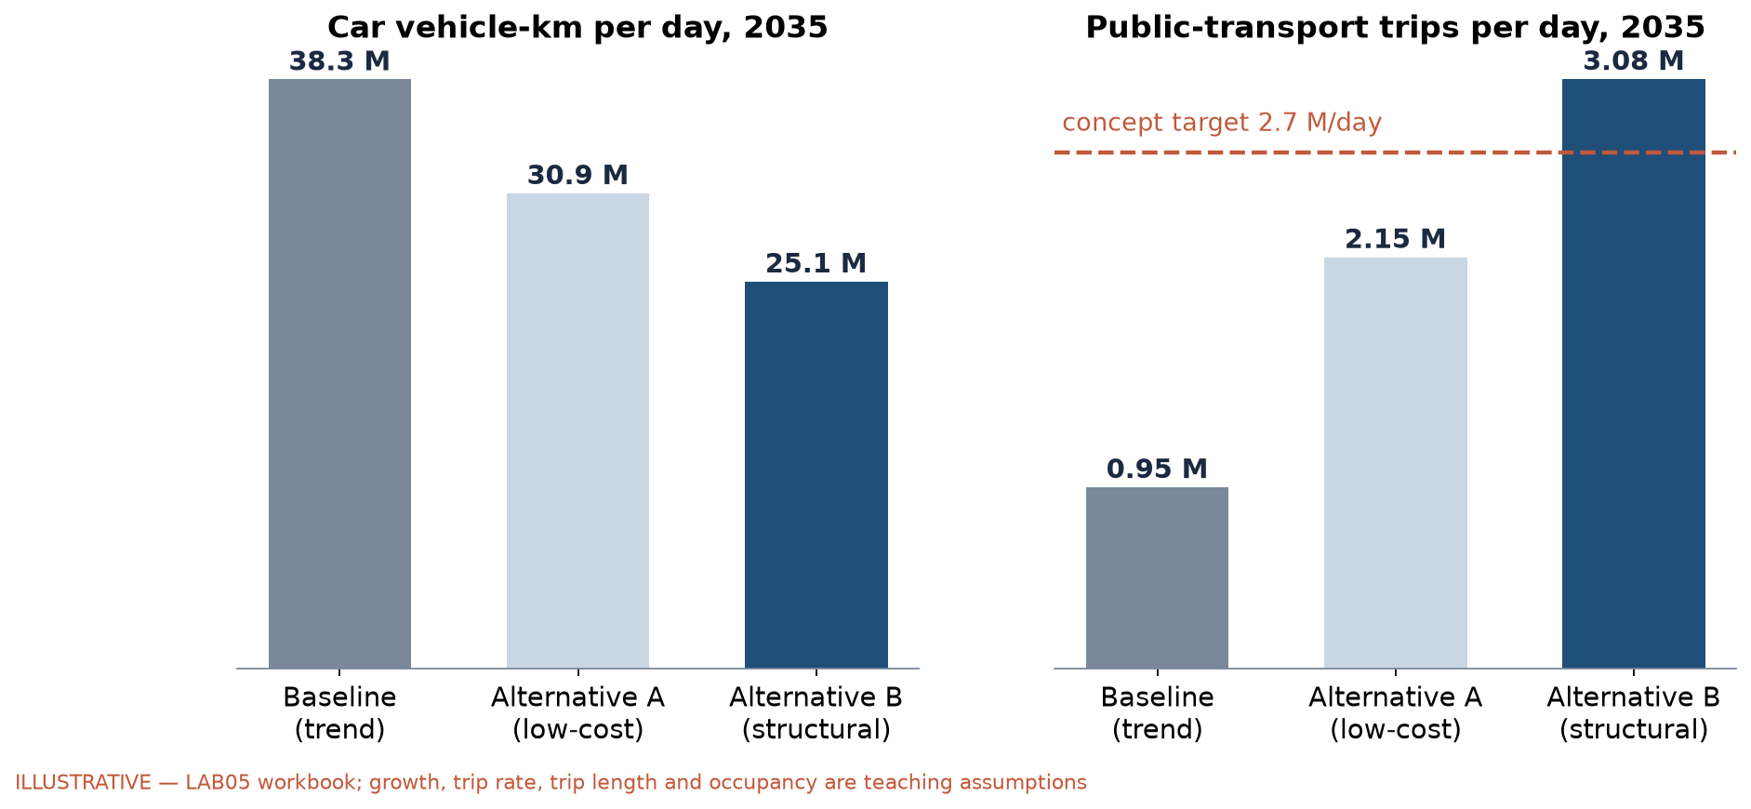
Scenario results (illustrative)
LAB5 workbook. Growth, trip rate, trip length and occupancy are teaching assumptions.
15 / 24

Slide 16
Reading the results
• Baseline: car share rises to 86.8% and car travel reaches 38.3 million veh-km/day
• Alternative A: 30.9 million veh-km/day
• Alternative B: 25.1 million (−34%) veh-km/day
• Alternative B carries 1.14 × the concept's daily public-transport target
• These are consequences of stated assumptions, not predictions
16 / 24

Slide 17
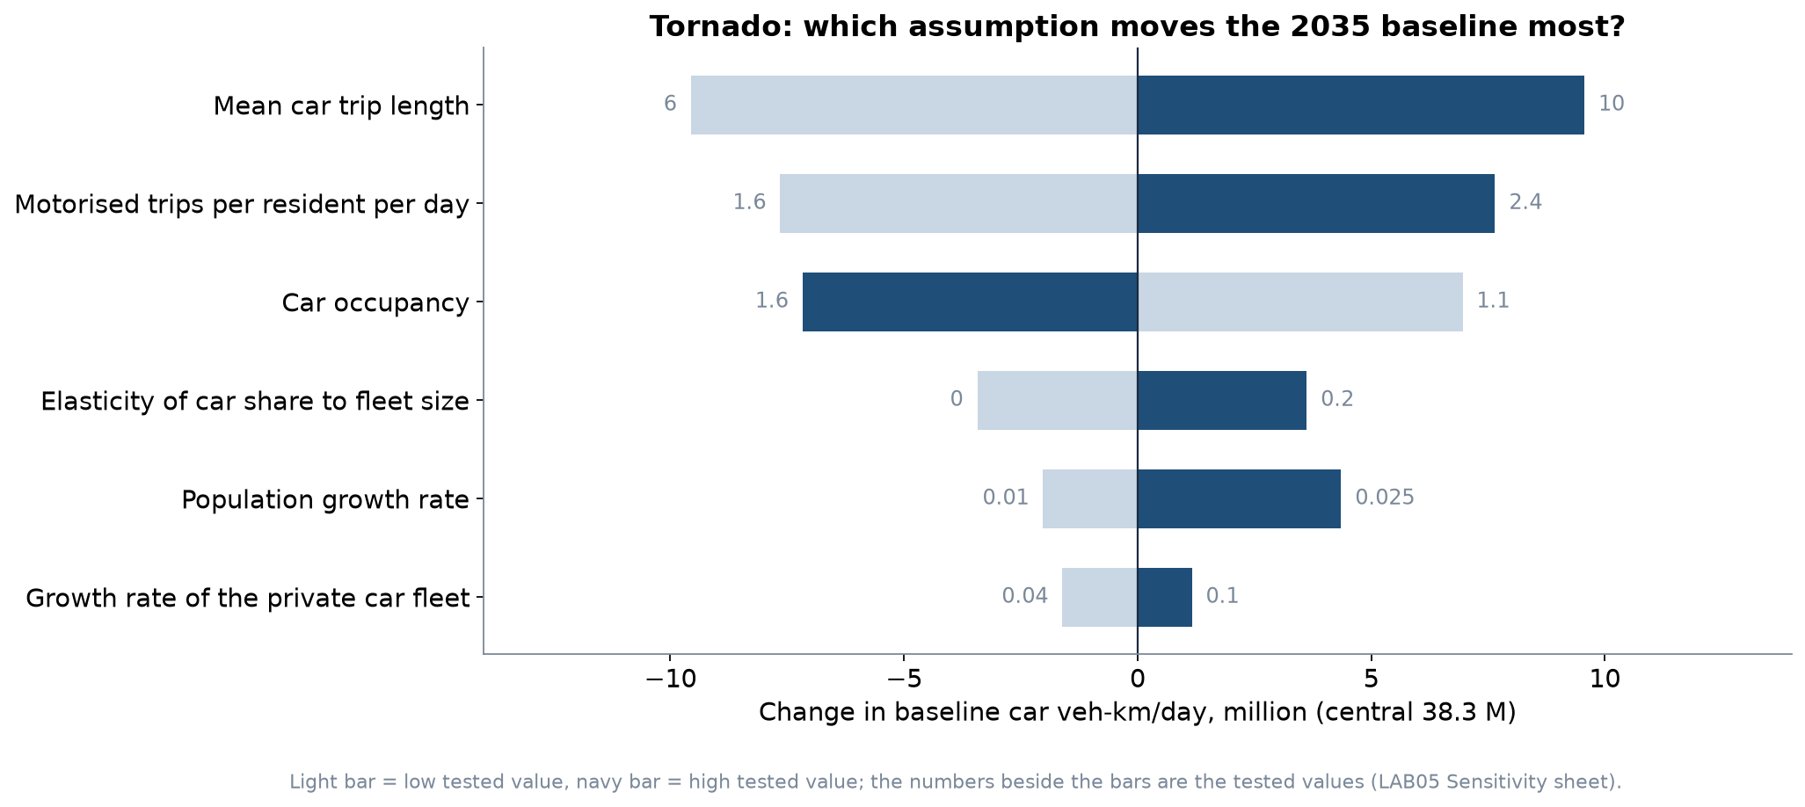
Which assumption matters most?
One-at-a-time sensitivity of the 2035 baseline (LAB5 Sensitivity sheet).
17 / 24

Slide 18
What the tornado tells you
• Mean car trip length swings the baseline by 19.1 million veh-km/day
• Trip length, trip rate and occupancy dominate — and none has an open Tashkent source
• Fleet growth, the one sourced rate, matters least
• Sensitivity analysis tells you which data to collect first
18 / 24

Slide 19
Critical reading: a local benefit claim
• Pulatova (2024): E = 365 × N × R = $19,007,010 per year
• N = 173,580, i.e. 10% of 1,735,800 residents walking instead of driving 1,200 m
• R = $0.30 per car-km, applied as one car-km per person per day
• Hidden assumptions: all switchers were drivers, every day of the year, one person per car
• Explicit assumptions in LAB5 give about $6.0 M per year (0.32 ×) — still worth having
19 / 24

Slide 20
Policy coherence check
• The same 2022–2025 concept targets public transport at 43%
• It also targets +15% junction capacity for cars
• Induced-demand evidence says added capacity fills with traffic
• Objective-led planning asks: which target does each measure serve?
20 / 24

Slide 21
Discussion
Your corridor is congested. Argue for one demand-management measure instead of widening — and name who loses.
• Use time, price or convenience in your argument.
21 / 24

Slide 22
Key takeaways
• Added road capacity induces traffic; the evidence points to elasticities near one
• Demand management works by changing time, price and convenience together
• Compare a baseline and alternatives in one assessment year, with every assumption labelled
• Sensitivity analysis shows which numbers need real data
22 / 24

Slide 23
References
• Salvucci, F. (2016). 1.252J/11.540J Urban Transportation Planning, Fall 2016. MIT OpenCourseWare. https://ocw.mit.edu/courses/1-252j-urban-transportation-planning-fall-2016/
• Ben-Akiva, M. (2008). 1.201J/11.545J Transportation Systems Analysis: Demand and Economics, Fall 2008. MIT OpenCourseWare. https://ocw.mit.edu/courses/1-201j-transportation-systems-analysis-demand-and-economics-fall-2008/
• Rupprecht Consult (Ed.) (2019). Guidelines for Developing and Implementing a Sustainable Urban Mobility Plan (2nd ed.). European Commission / Eltis. https://www.eltis.org/mobility-plans/sump-guidelines
• Duranton, G., & Turner, M. A. (2011). The fundamental law of road congestion: evidence from US cities. American Economic Review, 101(6), 2616–2652. https://doi.org/10.1257/aer.101.6.2616 https://doi.org/10.1257/aer.101.6.2616
• van Wee, B., Annema, J. A., Banister, D., & Pudāne, B. (Eds.) (2023). The Transport System and Transport Policy: An Introduction (2nd ed.). Edward Elgar. https://rstrail.nl/the-transport-system-and-transport-policy-an-introduction/
• SACTRA — Standing Advisory Committee on Trunk Road Assessment (1994). Trunk Roads and the Generation of Traffic. London: HMSO, Department of Transport. https://openalex.org/W564045229
• Noland, R. B. (2026). The empirical evidence for induced travel and implications for practice. Transportation Research Today, 100025. https://doi.org/10.1016/j.trt.2026.100025 https://doi.org/10.1016/j.trt.2026.100025
• Bucsky, P., & Juhász, M. (2022). Long-term evidence on induced traffic: a case study on the relationship between road traffic and capacity of Budapest bridges. Transportation Research Part A, 157, 244–257. https://doi.org/10.1016/j.tra.2022.01.018 https://doi.org/10.1016/j.tra.2022.01.018
• Synthetic teaching dataset generated for this course (method and random seed in each workbook's README sheet).
• Pulatova, Z. S. (2024). Walkability assessment of Tashkent city districts (PhD dissertation, in Uzbek; supervisor J. I. Sodikov). Tashkent State Transport University.
• Normukhammadov, A. (2026). Pedalling Towards Sustainability: Developing an Integrated Bicycle Network for Enhanced Urban Mobility in Tashkent City (PhD thesis draft; supervisor J. I. Sodikov). Tashkent State Transport University.

Slide 24
© 2026 TSTU, J. Sodikov. CC BY-NC-SA 4.0. Adapts openly licensed material (CC BY-NC-SA 4.0) listed in the references.

