Slide 1
Week 6 · Lecture 1
Route and service structures
LEC11 · Urban Transport Systems Planning and Design · TSTU · Prof. J. Sodikov

Slide 2
What you will be able to do after today
• Compare direct, grid and trunk-and-feeder service structures
• Explain the trade-off between coverage, frequency, vehicle capacity and resources
• Derive cycle time, frequency, headway and fleet for a single route
• Describe Tashkent's bus network from open data — and what the data cannot show
2 / 24

Slide 3
Where this sits: the service-design perspective
• Service design: lines, stops, frequencies and vehicles on top of the network
• Design variables: route structure, stop spacing, frequency, vehicle size, priority
• Passengers want short access, short waits, few transfers and fast reliable rides
• Operators want full vehicles and few vehicle-hours — the two pull apart
• A published course on public transportation systems gives the calculations; van Nes gives the network logic
3 / 24

Slide 4
The core trade-off: one budget, four wishes
• Coverage: a stop near everyone, including low-demand areas
• Frequency: short waits and easy transfers
• Vehicle capacity: enough places at the busiest point
• Resources: buses and drivers (vehicle-hours) are fixed in the short run
• More of one means less of another unless resources grow or speed rises
4 / 24

Slide 5
Ridership or coverage? Decide explicitly (Walker 2008)
• Ridership goal: concentrate service where many people will use it
• Coverage goal: provide some service everywhere, for access and fairness
• Both are legitimate — but a route cannot fully serve both
• Good practice: agree a budget split (for example a share for coverage) before designing
• Links to Week 3: coverage is a transport-justice decision
5 / 24

Slide 6
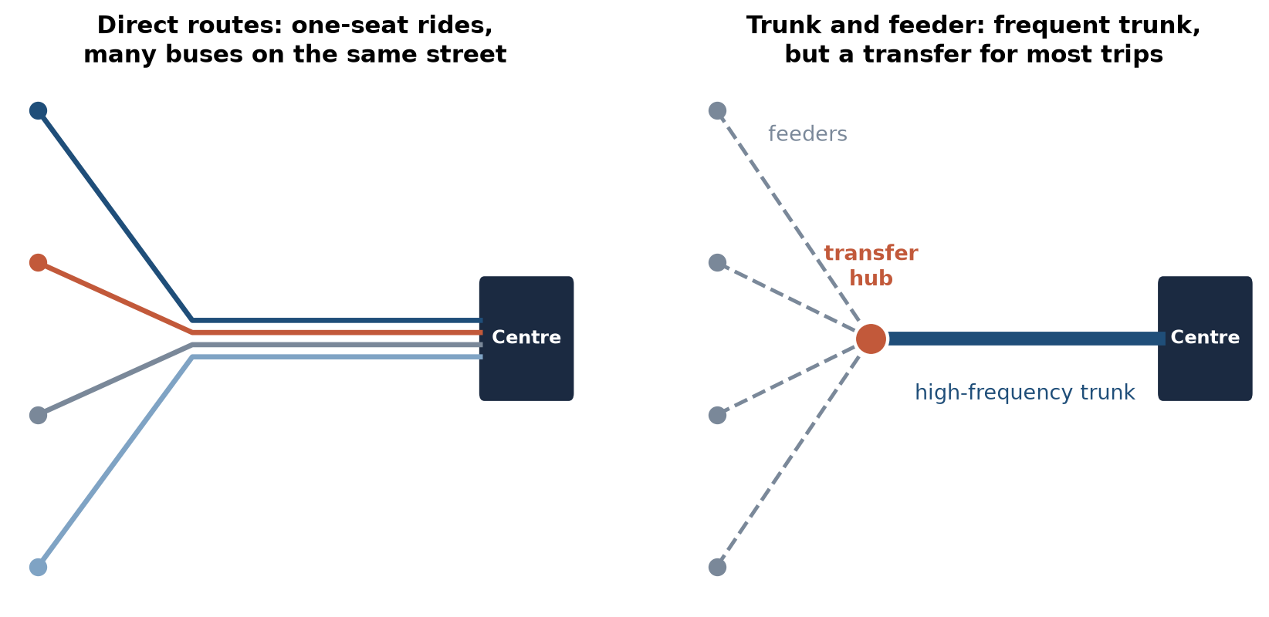
Two structures for the same city
Direct routes give one-seat rides but stack buses on the same streets; trunk-and-feeder concentrates frequency but adds a transfer.
6 / 24

Slide 7
Network structures
• Radial direct routes: good to the centre, poor across town
• Grid: any-to-any with one transfer; needs high frequency on every line
• Trunk-and-feeder: high-capacity trunk fed by local routes at hubs
• Timed transfers (pulse) work when frequencies are low
• Transfers are acceptable when waits are short, walks are short and fares are integrated
7 / 24

Slide 8
Single-route design
• Running time = route length ÷ running speed + stops × time lost per stop
• Cycle time C = 2 × running time + layover and recovery at both ends
• Fleet N = C ÷ h, rounded up; the operated headway is then C ÷ N
• Frequency = buses per hour = one hour ÷ headway; departures follow the timetable
• Speed and stop time are the levers: cut C and the same fleet runs more often
8 / 24

Slide 9
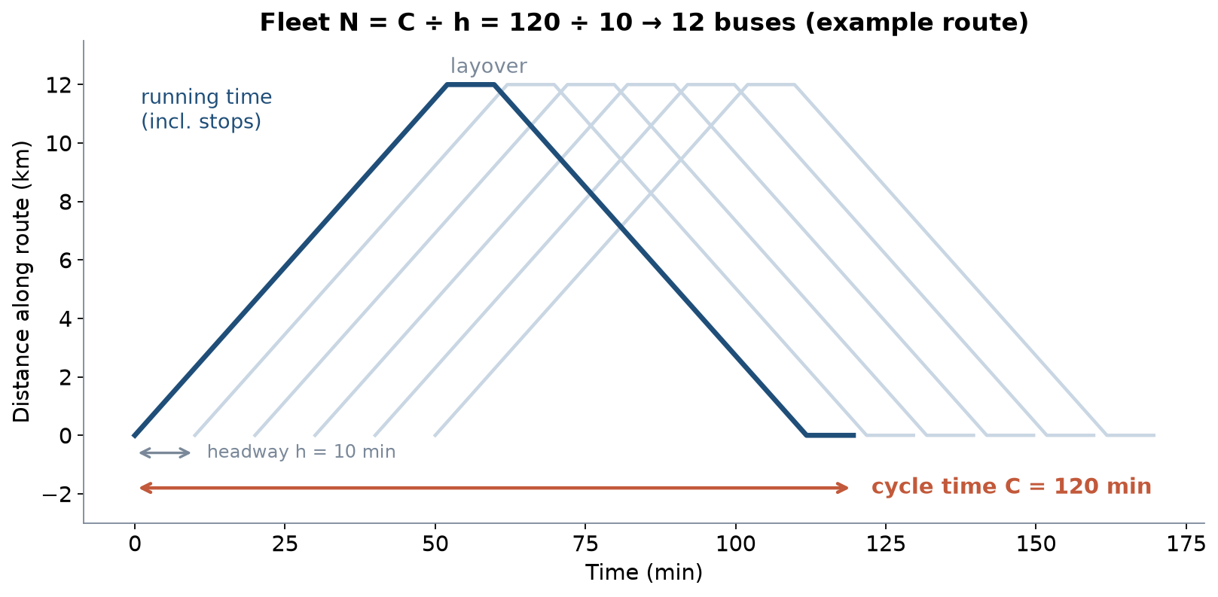
Cycle time and fleet on a time–distance diagram
Illustrative route: 12 km, 24 stops, 18 km/h, 30 s per stop, 15% layover.
9 / 24

Slide 10
Frequency from demand
• Maximum-load-point method: f = peak load ÷ (vehicle capacity × load factor)
• Load-profile method: use the whole profile to shorten or split the route
• Policy headway: a minimum frequency even where demand is low
• Choose the higher of the demand and policy frequencies
• Ride checks or counts at the busiest stop give the peak load
10 / 24

Slide 11
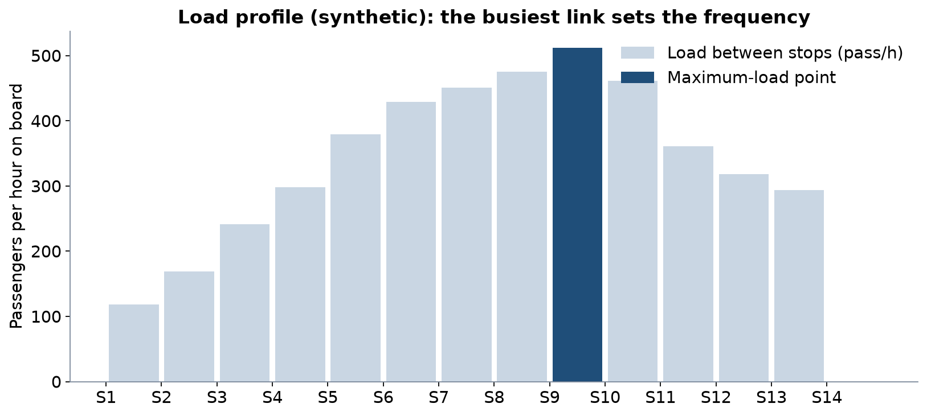
The busiest link sets the frequency
Synthetic load profile. Boardings minus alightings give the load on each link.
11 / 24

Slide 12
Worked example: route 8, Sergeli to Chilonzor (LAB6)
• Route 8: 17.84 km, 29 stops, 950 passengers/h (OSM length and stops; synthetic load)
• Running time 73.97 min one way; cycle 170.1 min including layover
• Required frequency 13.97 buses/h, so headway 4.29 min
• Fleet 40 buses; operated headway 4.25 min; expected wait 2.89 min
12 / 24

Slide 13
Tashkent's bus network in open data
• OpenStreetMap route relations, October 2026 extract — there is no open GTFS or ridership data
13 / 24

Slide 14
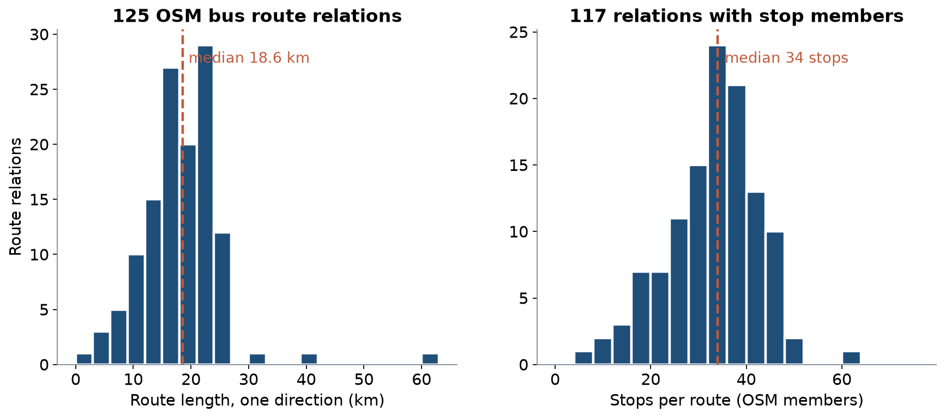
Route length and stops per route
125 relations; median 18.6 km one way and 34 stops.
14 / 24

Slide 15
What the open data shows — and what it does not
• 125 bus route relations carrying 67 route numbers
• 117 of 125 relations have their stops mapped in order
• 2,019 bus stops and 49 metro stations in the city
• No open GTFS timetable, ridership, load or speed data exists for Tashkent
• Route refs are inconsistent in places — check before you join tables
15 / 24

Slide 16
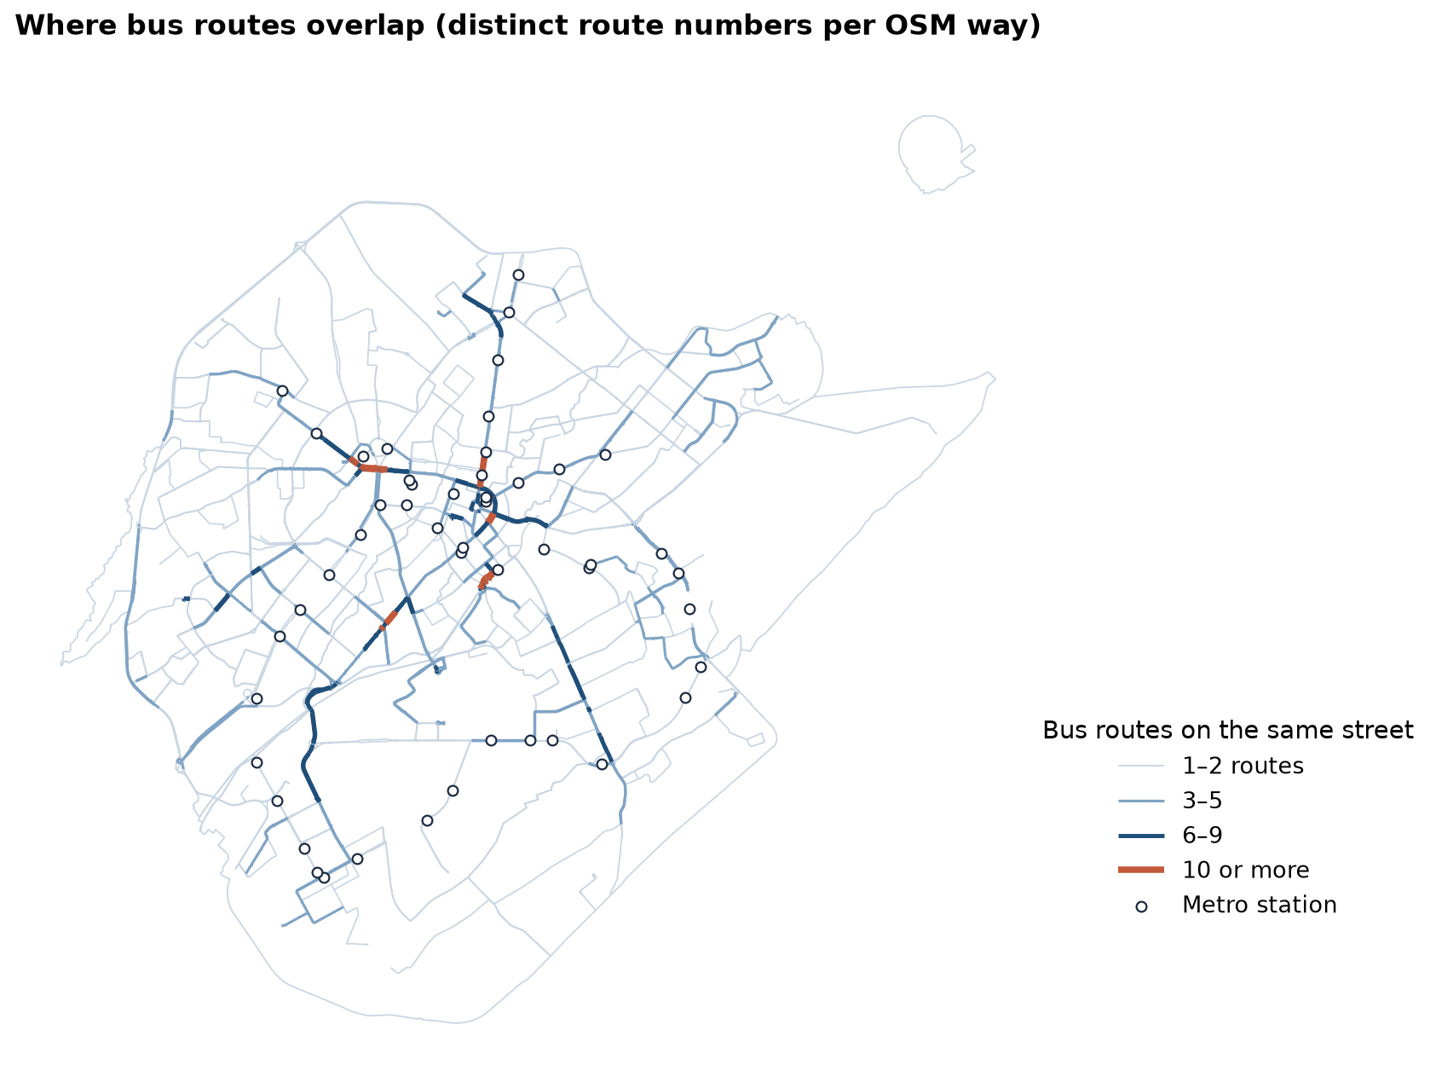
Where routes overlap
Distinct route numbers per OSM way. Orange = 10 or more routes on the same street.
16 / 24

Slide 17
Reading the overlap map
• Up to 18 route numbers share one street section
• 5.0 km of street carries 10 or more route numbers (a lower bound)
• Overlapping routes = high combined frequency, but uncoordinated headways
• Restructure: one frequent trunk on the shared section, feeders beyond
• Or keep direct routes and coordinate them with priority and a common timetable
17 / 24

Slide 18
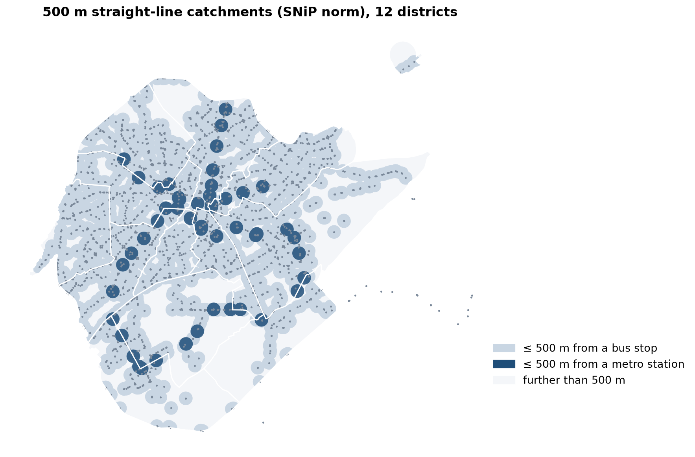
Who is within walking distance of a stop?
500 m straight-line catchments of OSM bus stops and metro stations, study districts.
18 / 24

Slide 19
Coverage: buses are the access layer
• 71.3% of the study area is within 500 m of a bus stop; only 7.9% of a metro station
• Ergashova: 74.4% of 585 mahallas have no metro station within a 15-minute walk
• So buses must feed the metro and cover the city, not compete with it
• Why area, not people? Kontur puts 76% of modelled residents in three outer districts — implausible
• Check gridded population against local statistics before using it
19 / 24

Slide 20
The city's own targets point to frequency and speed
• 2022–2025 concept: bus operating speed +17%
• Regularity of service up to 95%
• Route intervals: up to 35% shorter headways
• Public transport to 43% of trips
• All four depend on street priority — the subject of the next lecture
20 / 24

Slide 21
Discussion
On your corridor, would you keep the direct routes or create a trunk with feeders? What would passengers lose and gain?
• Answer with transfers, waiting time and walking distance.
21 / 24

Slide 22
Key takeaways
• Service design trades coverage, frequency and capacity within a fixed resource
• Fleet = cycle time ÷ headway: speed and stop time free up buses
• Frequency comes from the busiest link or from policy, whichever is higher
• Tashkent's routes overlap heavily and its open data has no timetables or loads
22 / 24

Slide 23
References
• TU Delft, Department of Transport & Planning. CIEM6250 Transport Systems Design — units B-1 Network Design, B-2 Service Design, B-3 Physical Infrastructure Management, B-4 Traffic Operations Management (Smart Public Transport Lab education page; MSc Civil Engineering TTE track). https://www.tudelft.nl/citg/over-faculteit/afdelingen/transport-planning/research/labs/smart-public-transport-lab/education
• Wilson, N., Sánchez-Martínez, G., & Nassir, N. (2017). 1.258J/11.541J Public Transportation Systems, Spring 2017. MIT OpenCourseWare. https://ocw.mit.edu/courses/1-258j-public-transportation-systems-spring-2017/
• van Nes, R. Designing public transport networks / Public transport service networks: design of urban and regional networks. TU Delft research portal. https://research.tudelft.nl/en/publications/designing-public-transport-networks/
• Walker, J. (2008). Purpose-driven public transport: creating a clear conversation about public transport goals. Journal of Transport Geography, 16(6), 436–442. https://ses.library.usyd.edu.au/handle/2123/6057
• MIT Department of Urban Studies and Planning. 11.540 Urban Transportation Planning and Policy (J. Aloisi). MIT Course Catalog, Course 11 subjects. https://catalog.mit.edu/subjects/11/
• Kittelson & Associates et al. (2013). Transit Capacity and Quality of Service Manual (3rd ed.), TCRP Report 165. Transportation Research Board. https://nap.nationalacademies.org/read/24766
• Synthetic teaching dataset generated for this course (method and random seed in each workbook's README sheet).
• OpenStreetMap contributors (2026). Uzbekistan extract, Geofabrik GmbH (download.geofabrik.de). https://download.geofabrik.de/asia/uzbekistan.html
• Pulatova, Z. S. (2024). Walkability assessment of Tashkent city districts (PhD dissertation, in Uzbek; supervisor J. I. Sodikov). Tashkent State Transport University.
• Ergashova, M. Z. (2026). 15-minute walkability of Tashkent mahallas — dissertation defence presentation, 14 Oct 2026 (in Uzbek). Tashkent State Transport University.
• Kontur (2023). Kontur Population: Uzbekistan, 400 m H3 hexagons. Humanitarian Data Exchange. https://data.humdata.org/dataset/kontur-population-uzbekistan

Slide 24
© 2026 TSTU, J. Sodikov. CC BY-NC-SA 4.0. Adapts openly licensed material (CC BY-NC-SA 4.0) listed in the references.

